Slide 1
State of Global Air – Data and Resources
Summer School on Air Quality and Pollution Prevention in Ghana
Kumasi, Ghana| October 23, 2023
Pallavi Pant, PhD
Health Effects Institute
ppant@healtheffects.org

Slide 2
Can you list five countries where we’ve seen progress on air quality in the last decade?

Slide 3
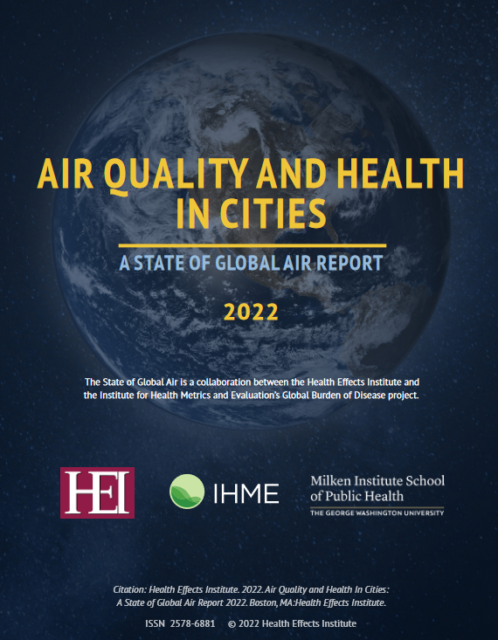
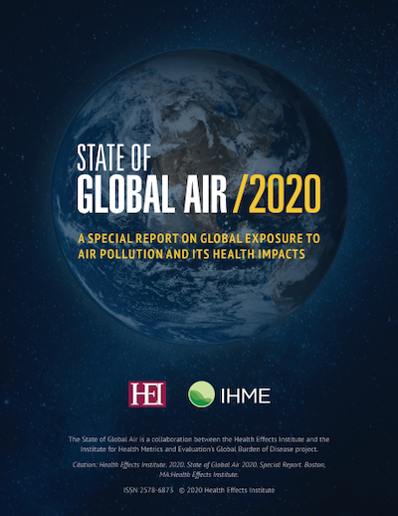



About the State of Global Air
Global assessment of air quality and health impacts
Report card on air pollution and health in more than 200 countries
A collaboration between the Health Effects Institute (HEI) and Institute for Health Metrics and Evaluation (IHME)
www.stateofglobalair.org

Slide 4
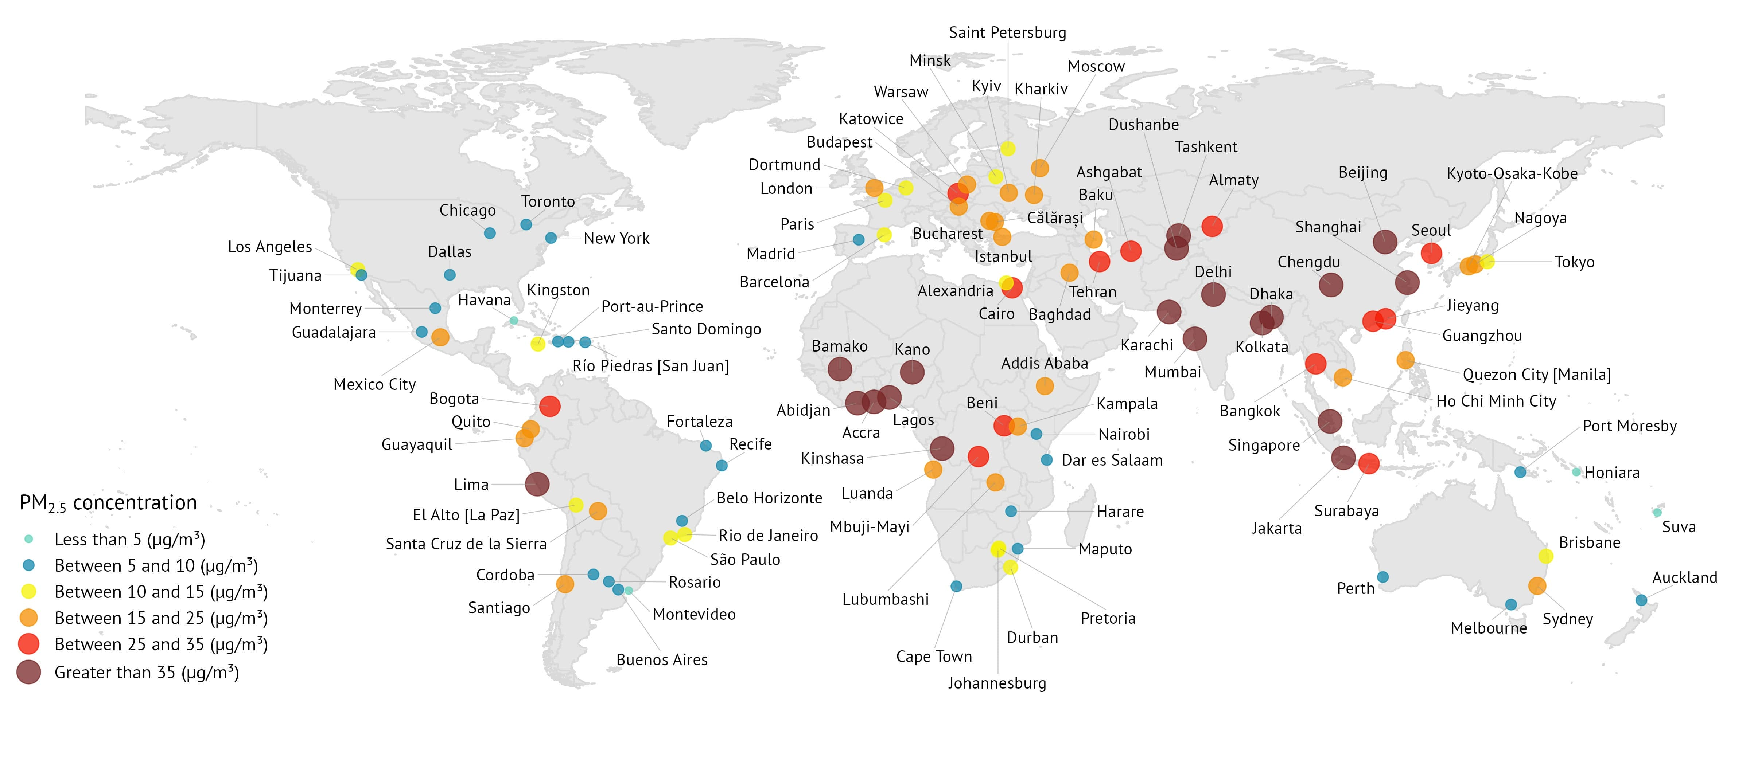
Pollution hotspots depend on the pollutant we’re looking at, and the geography.

Slide 5
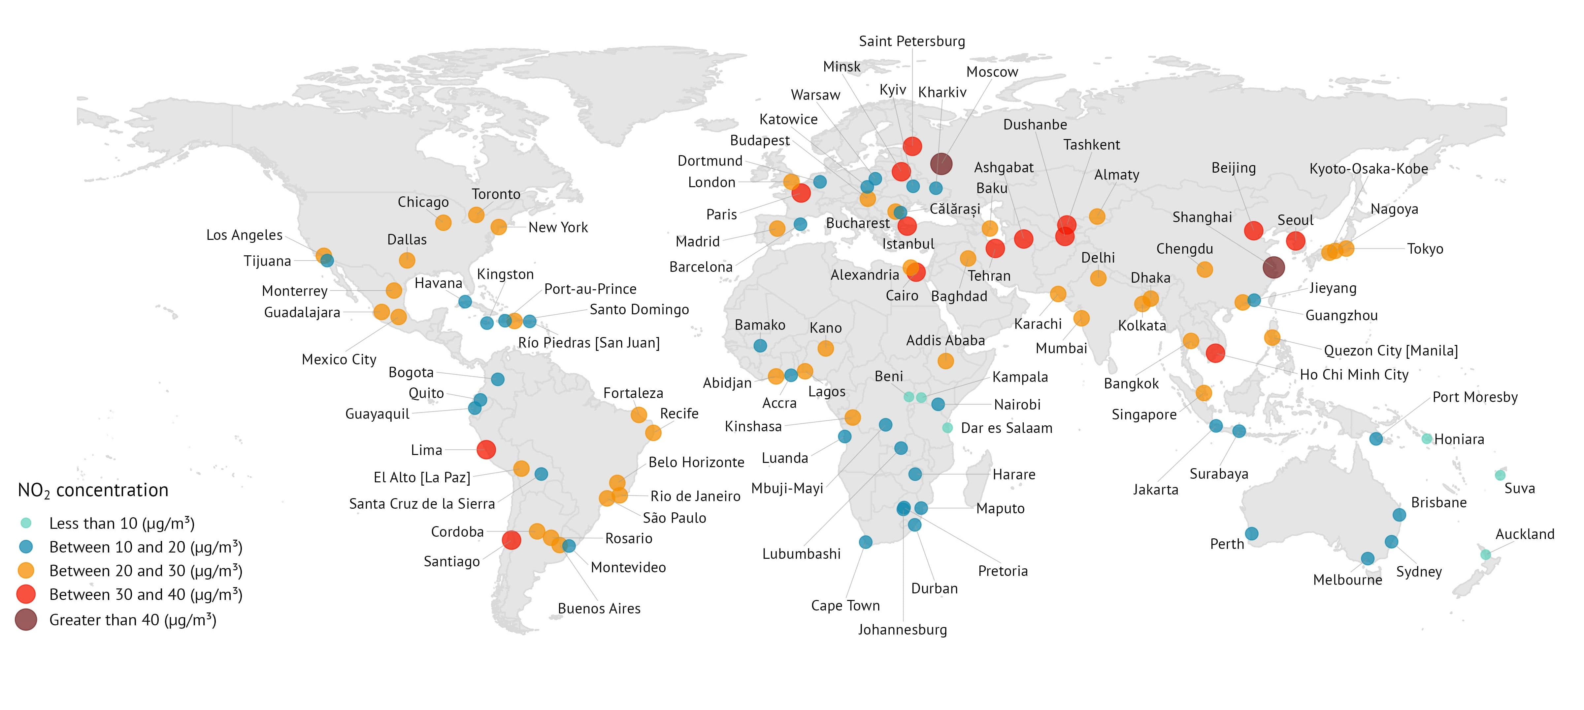
Pollution hotspots depend on the pollutant we’re looking at, and the geography.

Slide 6
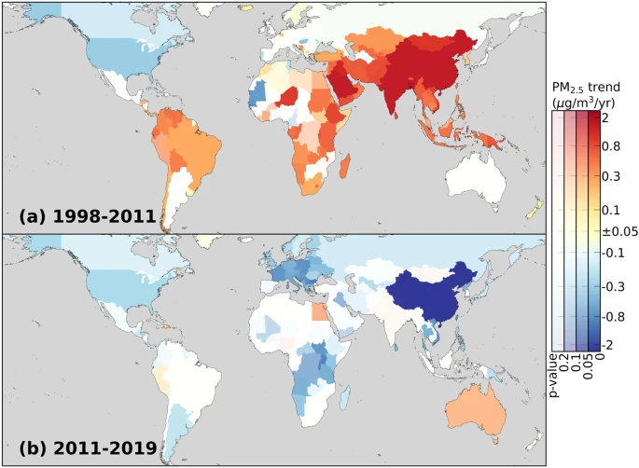
Levels of fine particulate matter are declining in some regions.
Li et al., 2023

Slide 7

Air pollution’s burden of disease is not borne equally across the world or across age groups.

Slide 8
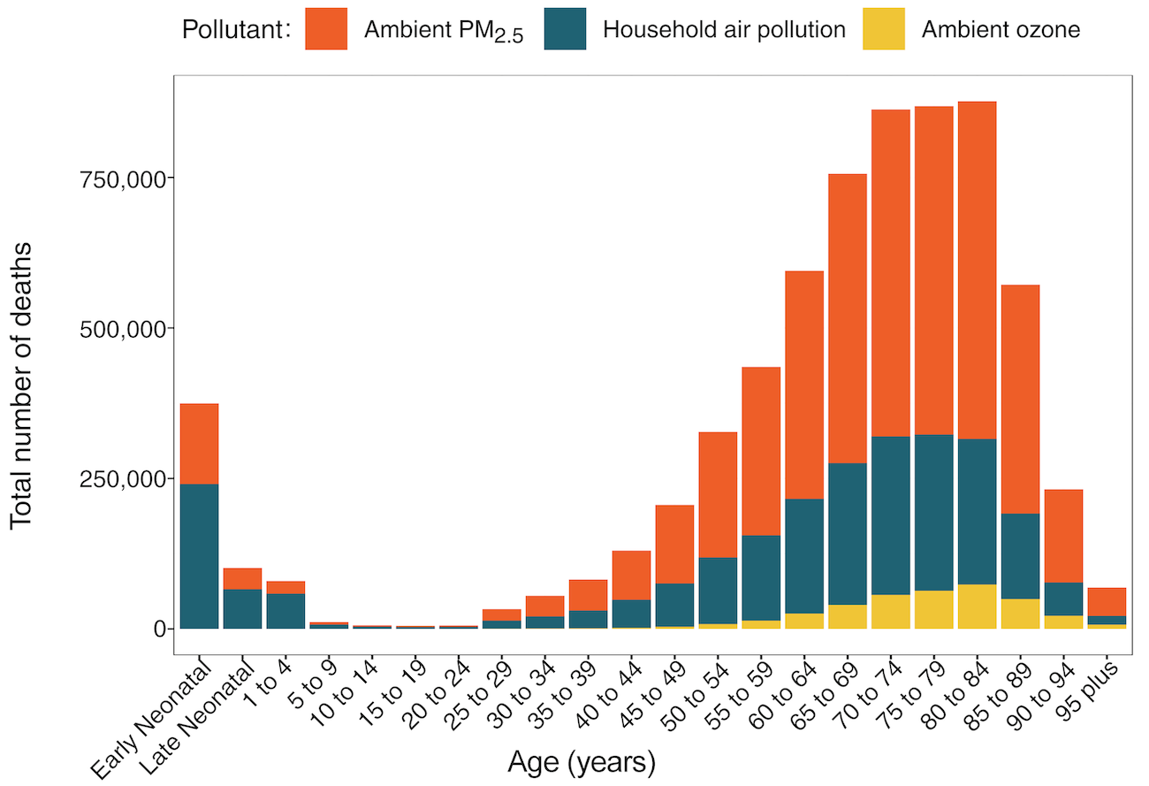
Children under 5 and older adults are particularly vulnerable
12% in adults over 70
14% of deaths in children under 5

Slide 9
Patterns of disease burden linked to air pollution vary across Africa
Ghana
Egypt

Slide 10
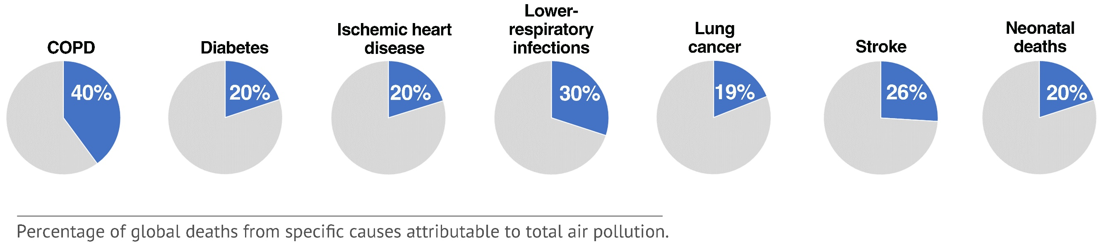
Non-communicable lung and heart diseases account for 80% of the total disease burden
https://www.stateofglobalair.org/data/#/health/bar

Slide 11
Unsafe water, sanitation and hygiene (WaSH) is responsible for more deaths in Africa than air pollution.
Is this true or false?

Slide 12
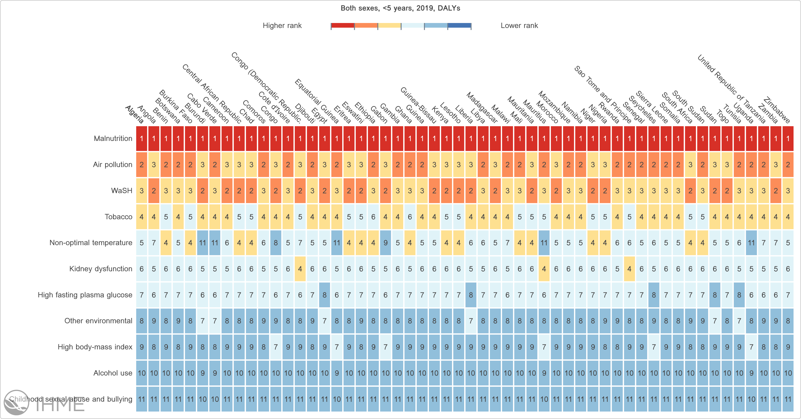
Contribution of air pollution to deaths in children under 5
Malnutriton
Air Pollution
WaSH
https://vizhub.healthdata.org/gbd-compare/#0

Slide 13



Health effects of exposure to air pollution in children
Exposure during pregnancy cause preterm birth, low birth weight etc.
Babies born too early or too small can get other diseases
Respiratory infections (e.g., pneumonia) among children, especially under 5
Poor lung function and lung growth
Impacts neurological development
Lifelong impacts on children's health due to exposures during childhood

Slide 14
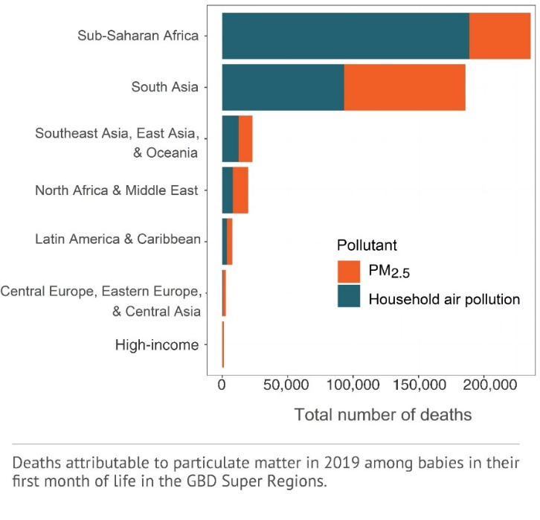

20% of newborn deaths were attributed to particulate air pollution.

Slide 15

Household air pollution remains an important driver for poor outdoor air quality.
Exposures to PM_{2.5} from household air pollution often exceed levels in outdoor air by orders of magnitude.
Household solid fuel use can contribute as much as 20-30% of ambient PM_{2.5} levels
increased risk of non-communicable diseases as well as death.
Exposure to air pollution in mothers can result in increased risk of their infants being born too small or too early.

Slide 16
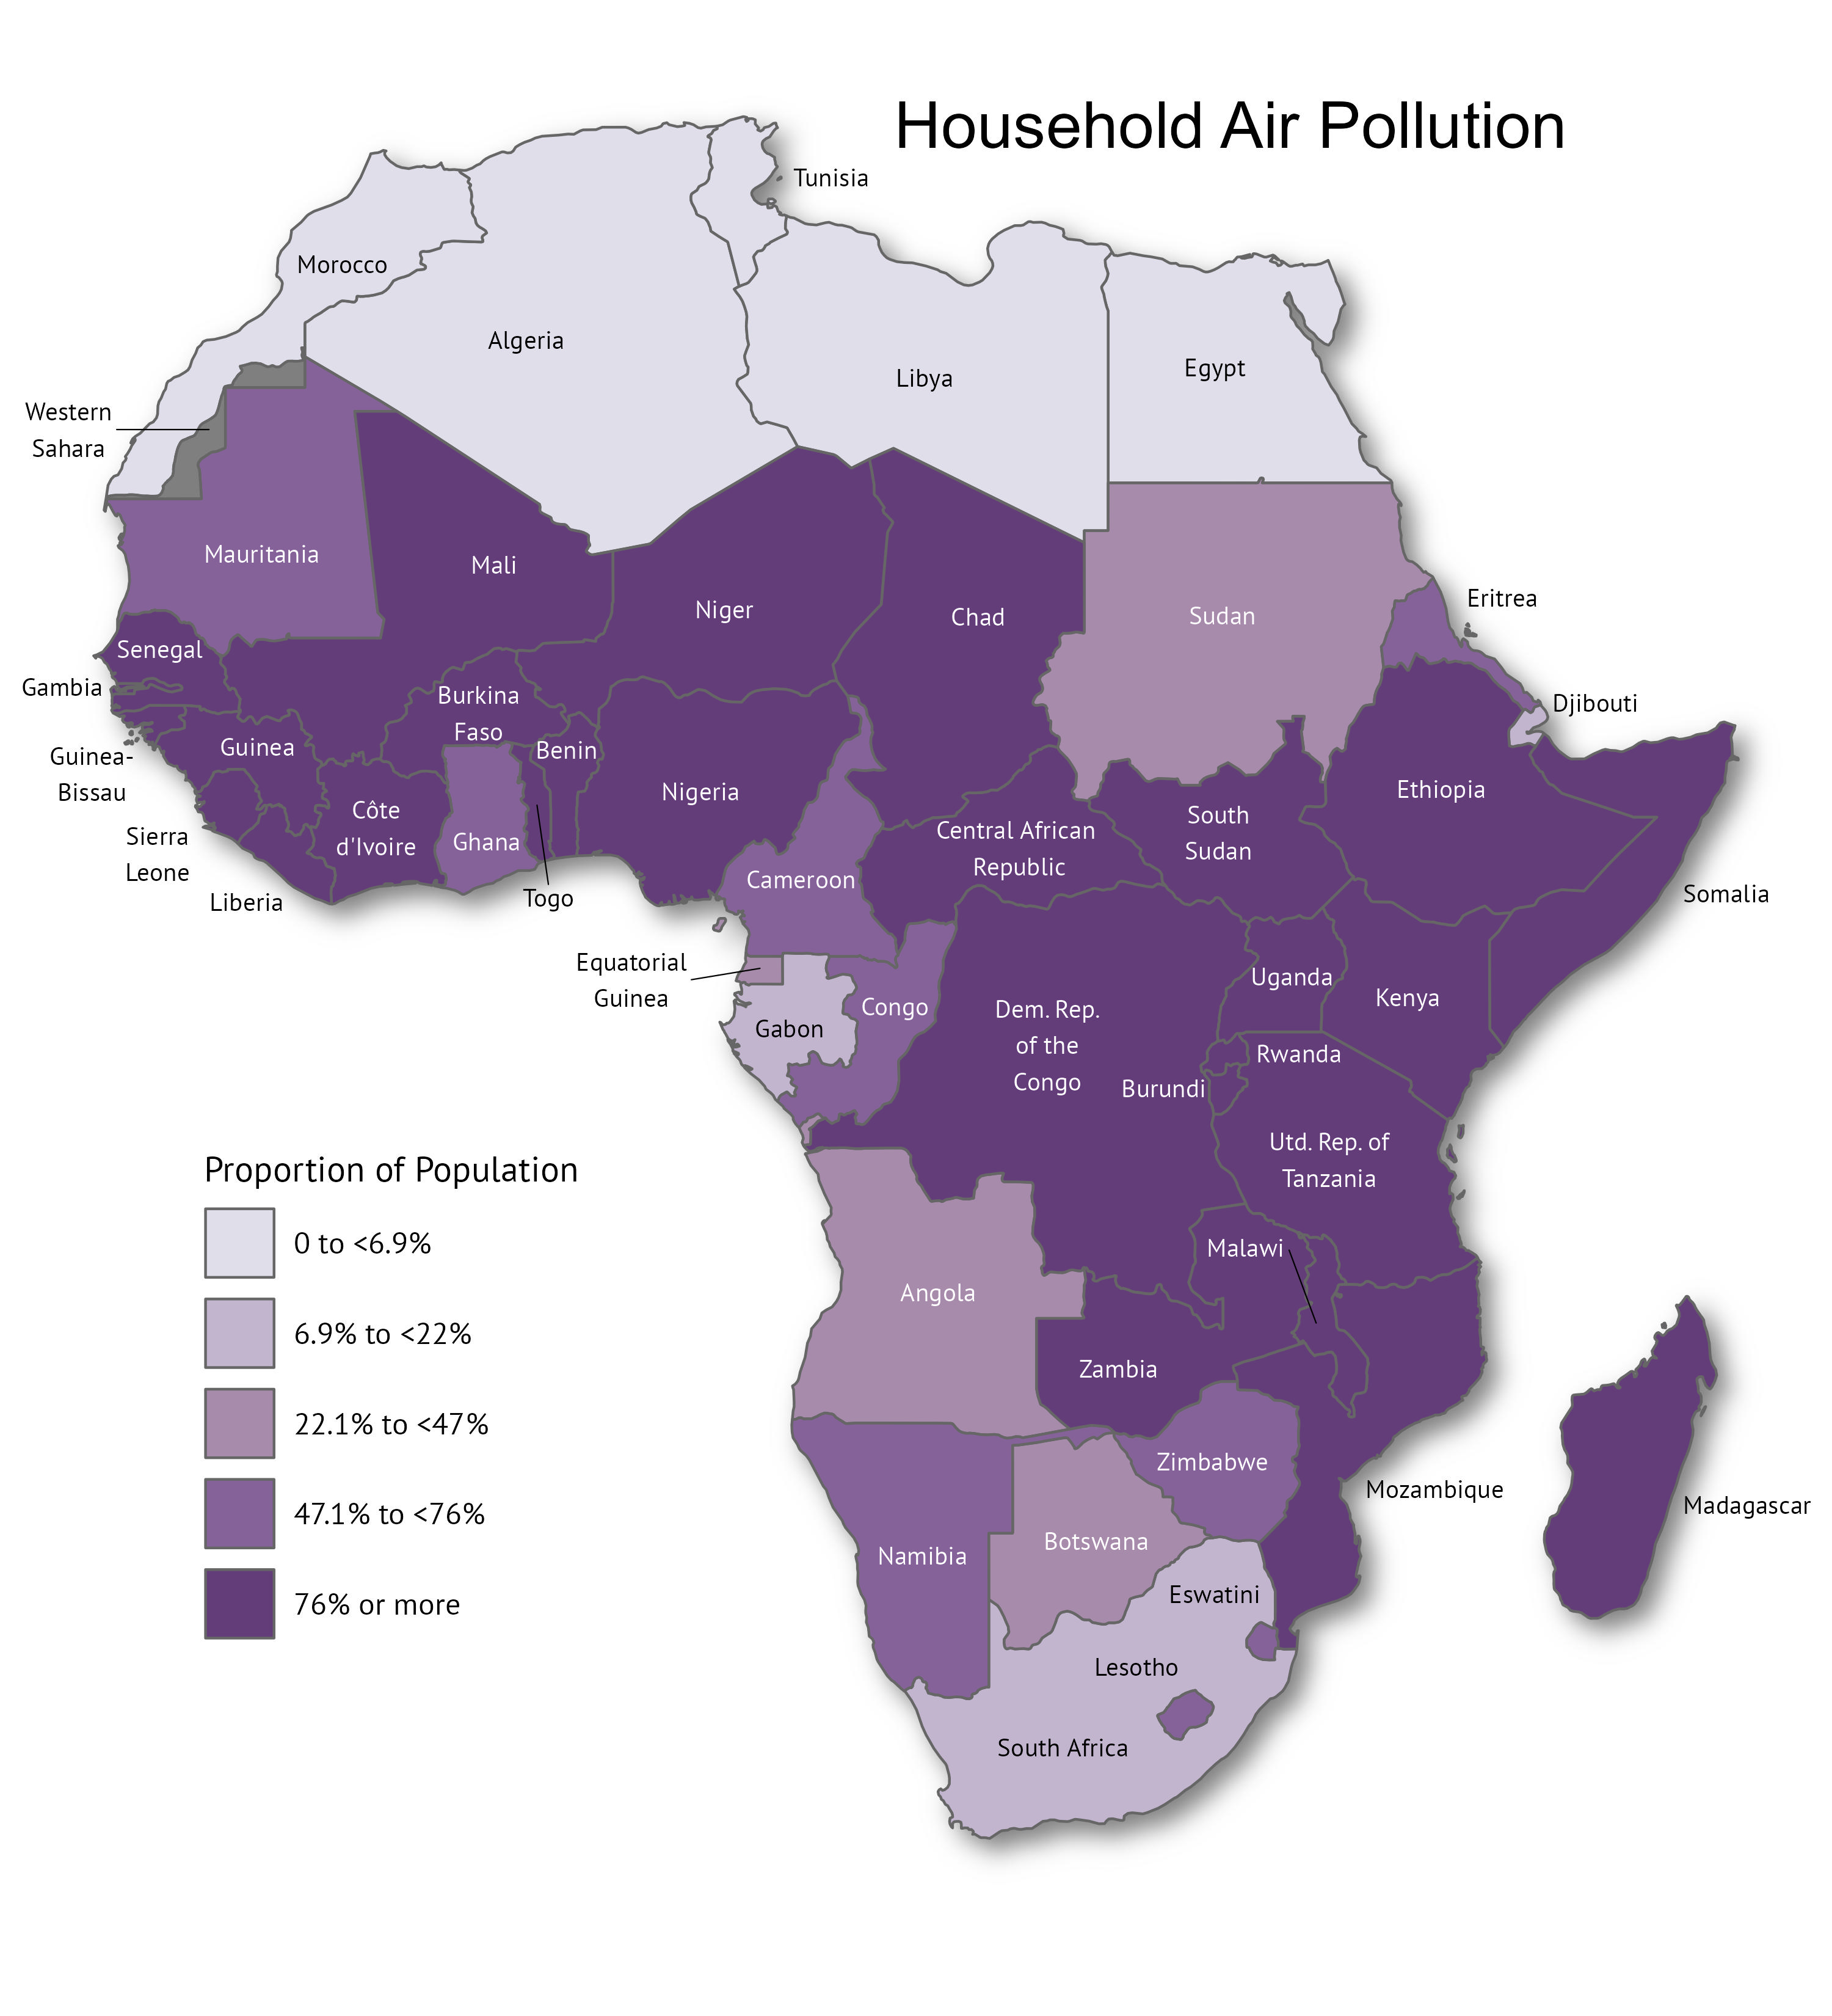
Trends in HAP Exposure in Africa
Percentage of population using solid fuels for cooking
Trends in death rates linked to HAP, 2010 – 2019
http://www.stateofglobalair.org/

Slide 17



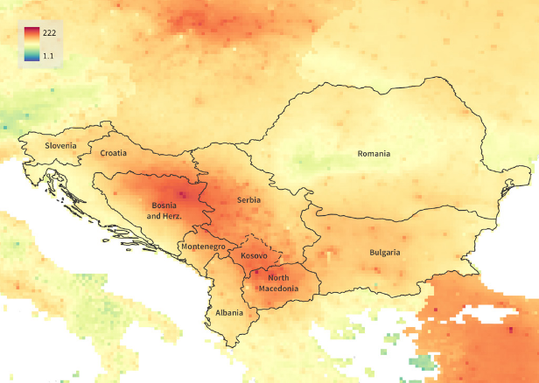

How are these estimates produced?
Satellite data
Concentration-response relationship
Chemical Transport Models
Ground monitoring data
Burden of Disease Linked to
Air Pollution
Baseline
disease
rates
Minimum risk exposure level
Epidemiology studies on health effects of air pollution
https://www.stateofglobalair.org/

Slide 18
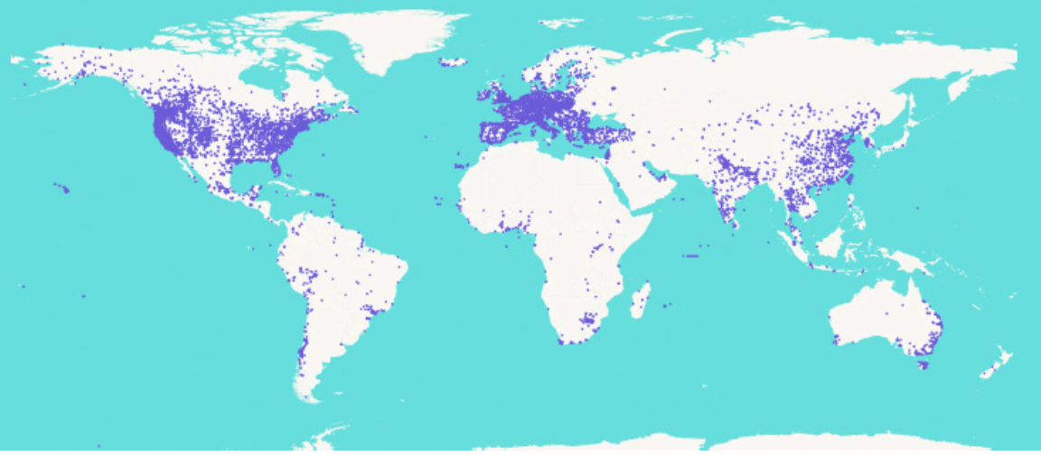
Producing the air quality estimates; gaps in data
Satellite data
Chemical Transport Models
Limited ground monitoring data from Africa >> higher uncertainties in exposure estimates
Ground monitoring data
Source: 2022 Open Air Quality Data: The Global Landscape, OpenAQ
Minimum risk exposure level
https://www.stateofglobalair.org/

Slide 19
Estimating health impacts; gaps
Concentration-response relationship
Limited studies on health effects of air pollution in high-pollution environments, no studies from Africa in the integrated concentration-response functions
Burden of Disease Linked to
Air Pollution
Baseline
disease
rates
Limited availability of baseline disease rates
Epidemiology studies on health effects of air pollution
https://www.stateofglobalair.org/

Slide 20


What drives health impacts of air pollution?
Also,
Availability of, and access to healthcare
Socio-economic development
Pollutant exposure
Demographic patterns, e.g., proportion of older vs younger people in the population

Slide 21
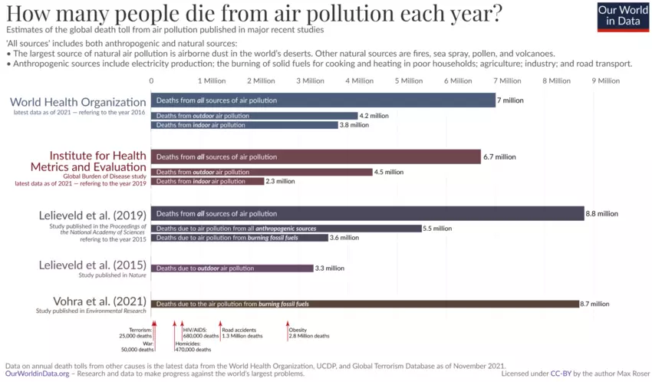
Estimates vary, but the overall message is the same.

Slide 22
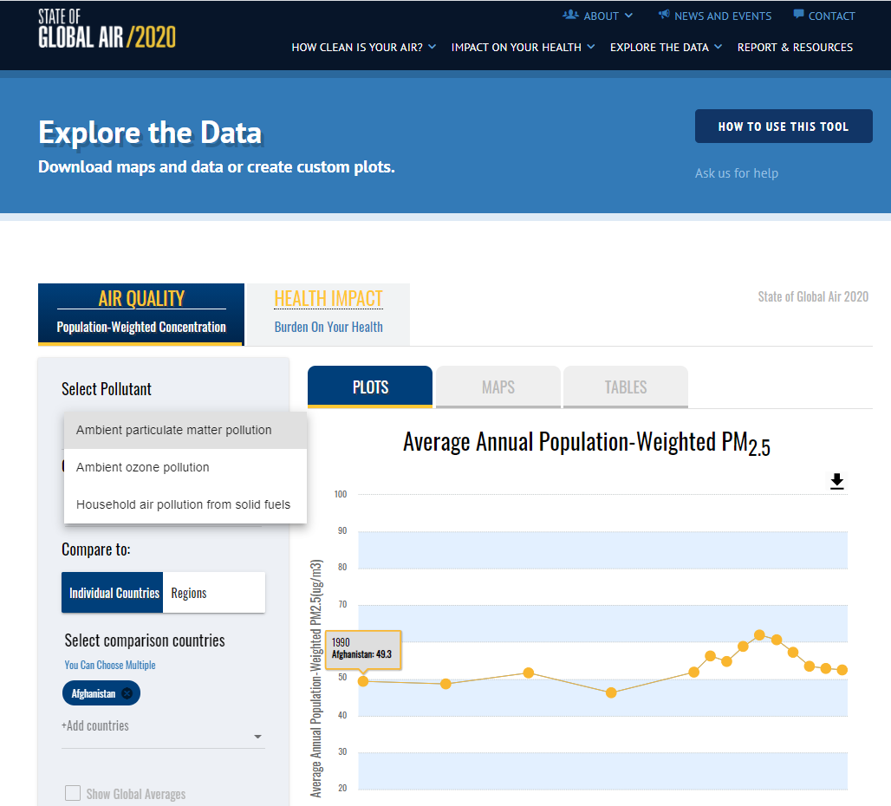
Data on the State of Global Air website
Exposure
  PM_{2.5}, Ozone, Household Air Pollution
Health impacts
  Mortality (deaths)
  Disability adjusted life years (DALYs) – healthy life years lost
  Age-standardized death and DALY rates
  Cause-specific % contributions (new)
Data for 1990 to 2019
Downloadable data & figures

Slide 23
Thank you!
Twitter
@HEISoGA | @HEIresearch
Email
ppant@healtheffects.org
Website
www.stateofglobalair.org | www.healtheffects.org

