Slide 1


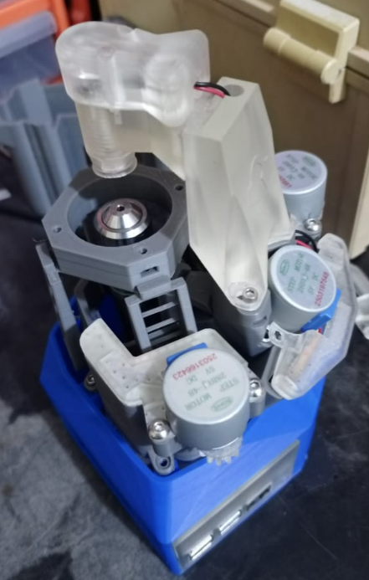
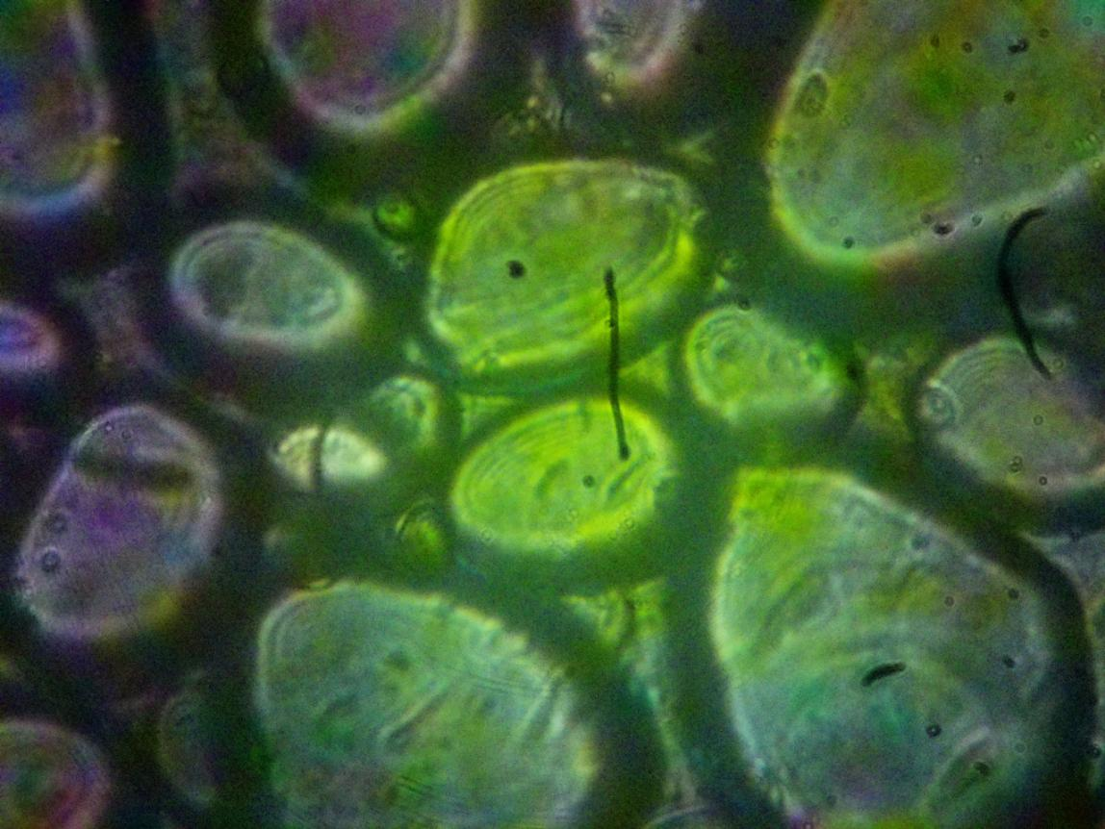
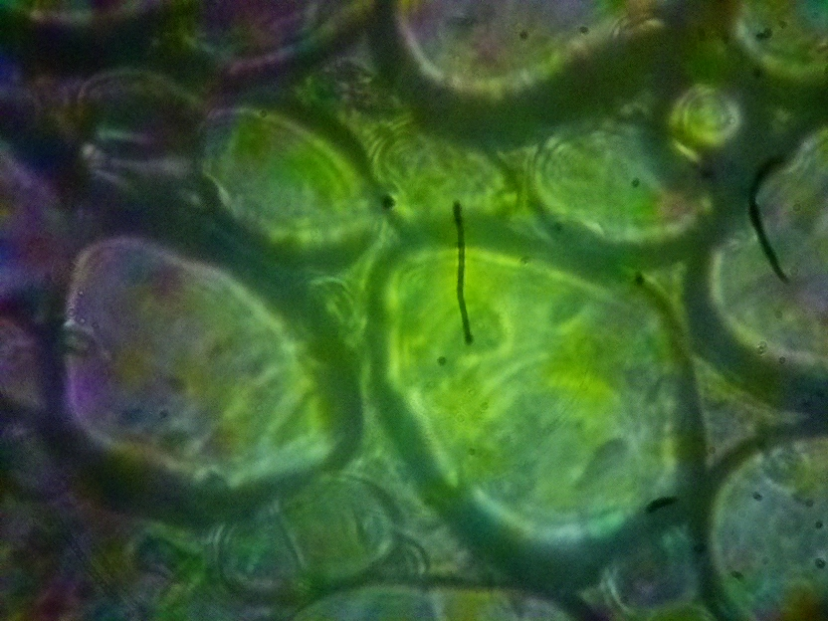
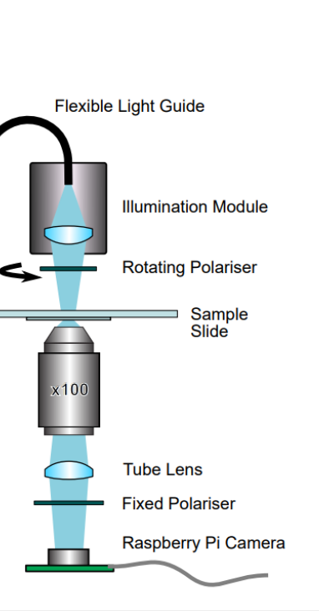
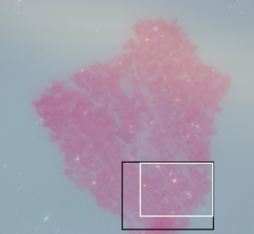
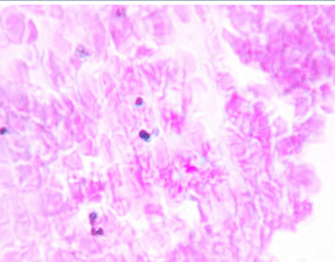
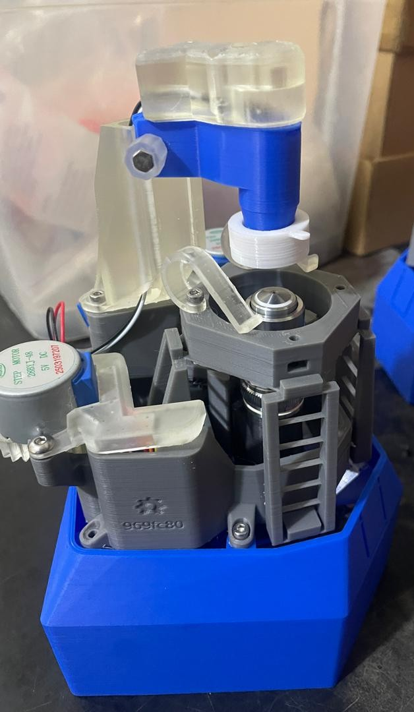
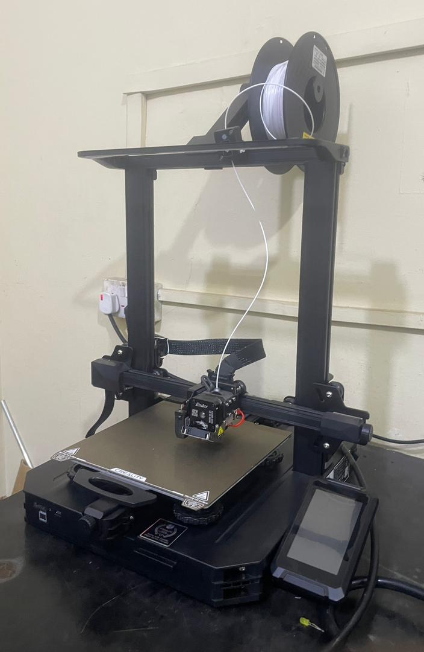
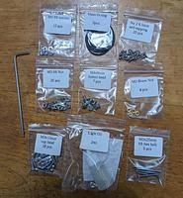
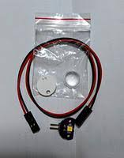
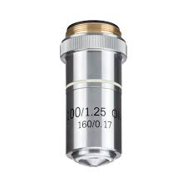
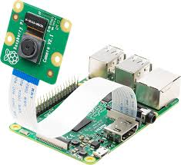
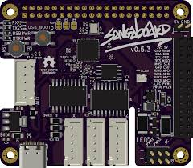

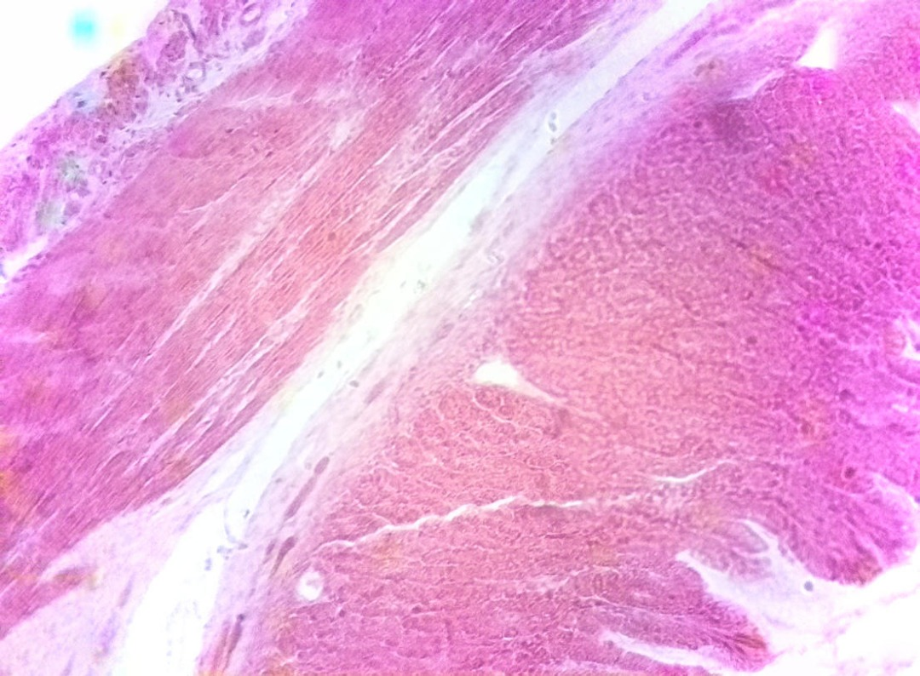




Open-Source Microscopy for Malaria Detection Using Polarised Light Imaging
Mutala Mohammed Illiasu ª, Akyana Britwum ª, Fraser Eadie ^{b}, M. K. E. Donkor ª, E. K. K. Abavare ª , Akhil Kallepalli ^{b} , Bayulu Yakubu ª, Ephriam Rogersª, Amedzo Johnª
ª Department of Physics, COS, KNUST, Kumasi.
^{b} Department of Physics, University of Strathclyde, Glasgow
ABSTRACT
Malaria continues to be a major health challenge in sub-Saharan Africa and other parts of the world. Early detection is one of the most effective strategies for reducing its impact, yet many diagnostic tools remain costly or inaccessible in resource-limited regions. The malaria parasite, Plasmodium spp., produces a crystalline by-product called hemozoin during hemoglobin digestion. Hemozoin is birefringent and detectable with cross-polarised light microscopy, making it a promising biomarker for affordable malaria diagnostics. In this project, we modified the open-source OpenFlexure microscope to create a Polarised Light Modular Microscope using 3D-printed components and simple polarising filters, making it low-cost and locally reproducible. To validate the design, we imaged potato starch granules, which displayed Maltese cross patterns under polarised light, confirming the system’s ability to detect crystalline features comparable to hemozoin. The microscope supports computational imaging to enhance birefringence signals and can be integrated with machine learning to automate detection and reduce observer bias. Affordable, modular, and locally fabricable, the system is now being prepared for pilot testing with malaria-infected blood samples in collaboration with medical professionals, with the goal of establishing it as a reliable diagnostic tool for healthcare delivery in low-resource areas like Ghana.
-
INTRODUCTION
Malaria remains one of the most serious public health problems, causing over 600,000 deaths worldwide each year (WHO, 2022). The disease is transmitted by Plasmodium parasites, which in their blood stage digest hemoglobin and produce a crystalline by-product known as hemozoin (Lawrence & Olson, 1996). Hemozoin is birefringent and can be detected using cross-polarised light microscopy, making it a natural marker for malaria infection. Conventional polarised light microscopes, however, are expensive and difficult to access in low-resource settings (Maude et al., 2009). The OpenFlexure microscope offers a low-cost, 3D-printed, and open-source alternative that can be adapted for polarised light imaging. By integrating simple polarising filters and computational image processing, this platform provides an affordable way to detect birefringence in biological samples. This work focuses on adapting the OpenFlexure system into a Polarised Light Modular Microscope as a pathway toward reliable, low-cost malaria diagnostics.
Fig. 2.2: OpenFlexure microscope
Fig. 5. Maltese cross patterns observed in potato starch granules under bright-field illumination, demonstrating the system’s ability to detect birefringent crystalline structures similar to hemozoin.
PROBLEM STATEMENT
Malaria remains a major health burden, claiming many lives each year, especially in sub-Saharan Africa. However, reliable detection is a challenge as most diagnostic microscopes are expensive and inaccessible, leaving communities without affordable tools to identify the disease early.
OBJECTIVES
Main
To design and adapt a low-cost, open-source polarised light microscope for the detection of malaria through the identification of birefringent hemozoin crystals.
Specific
To modify the OpenFlexure microscope with polarising filters.
To validate performance using potato starch birefringence.
To prepare for pilot testing with infected blood samples.
To explore machine learning for automated detection.
B
A
Fig. 3.1 : Polarised microscope System ( Eader et al. , 2023)
Fig. 6.c.(A) Bright-field image of cells in a blood smear. (B) Region of interest (ROI) highlighting selected cells (Eadie et al., 2023).
METHODOLOGY
CONCLUSION
Device and materials
This project successfully achieved its aim by designing and adapting a low-cost Polarised Light Modular Microscope based on the open-source OpenFlexure platform. Using 3D-printed components and polarising filters, the system demonstrated its ability to detect birefringent structures, validated through Maltese cross patterns in potato starch granules, which resemble hemozoin crystals found in malaria infection.
The microscope is affordable, modular, and locally fabricable, making it suitable for regions where access to advanced diagnostic tools is limited. In addition, its design supports computational imaging and future integration with machine learning to enhance detection accuracy and reduce observer bias. With upcoming pilot testing on malaria-infected blood samples in collaboration with medical experts, this system shows strong potential as a reliable diagnostic tool and an accessible resource for healthcare and research in resource-limited settings.
Fig. 1.2 Assembly kit
Fig. 1.3 Illumination kit
Fig. 3.2. Modified OpenFlexure Microscope for polarised light.
Fig. 1.1 3D printer
Fig. 1.4 Objectives Len
ACKNOWLEDGEMENT
RESULTS and DISCUSSION
We sincerely acknowledge SPIE for fostering opportunities in optics and photonics research, creating platforms for collaboration, and supporting innovation that has strengthened this project. We also thank the Kallepalli Lab (University of Glasgow) for their continuous guidance, technical advice, and support throughout this work
Fig. 1.7 Raspberry Pi and Pi Cam
Fig. 1.6 sangabord
Fig. 1.5 28byj-48 stepper motors
Method
Start
Test the Polarised Microscopy with Maltese ( Potato)
Print 3D Parts
Assemble Parts with Motors and Raspberry pi.
Install Software OpenFlexure OS
Text Basic Functionality
Modified Pol-ModMicro Parts
Fixed the Polarisers
Prepare Blood Sample
Image Acquisition
Image Processing and Analysis for Training a AI model
REFERENCES
1. Eadie, F., Gibbins, M. P., Gibson, G. M., Marti, M., & Kallepalli, A. (2023). Polarised light modular microscopy (Pol-ModMicro) for identifying hemozoin crystals in Plasmodium. arXiv preprint arXiv:2304.13739.
2. C. Lawrence and J. A. Olson, “Birefringent hemozoin identifies malaria,” Am. J. Clin. Pathol. 86, 360–363 (1996).
3. World Health Organisation (W.H.O.), “World Malaria Report 2022,” (2022).
4. R. J. Maude, W. Buapetch, and K. Silamut, “A simplified, low-cost method for polarized light microscopy,” Am. J.
Trop. Med. Hyg. 81, 782–783 (2009).
Fig. 2.1: Flowchart
Fig. 4. Stitched image of dog stomach tissue, showing the secretory structures.
MUTALA MOHAMMED ILLIASU

