Slide 1
EVALUATING THE EFFECTIVENESS OF CONSERVATION AGRICULTURE AS A CLIMATE CHANGE ADAPTATION STRATEGY FOR SMALLHOLDER FARMERS
IN THE
ATWIMA MPONUA DISTRICT, GHANA
Presented by
Owusu Abebrese
November, 2025

Slide 2
Presentation Outline
Main Sections of the Presentation
Introduction
Problem Statement
Aim and Objectives
Materials and Methods
Results and Discussion
Conclusion and Recommendation

Slide 3
Introduction - Background
1
2
Global Food Security Threat
Africa's Vulnerability
Climate change threatens global food security, especially for smallholder farmers, impacting yields and livelihoods (Chemura et al., 2020).
Sub-Saharan Africa, dependent on rain-fed agriculture, faces increased droughts and floods (Malhi et al., 2021; Tahiru, 2019).
3
4
Ghana's Agricultural Impact
Adaptation is Key
Ghana's agriculture is affected by changing rainfall, rising temperatures and droughts, impacting crop yield (Mohammed et al., 2022).
Swift adaptation measures are of the essence in mitigating climate change threat to economic development in the district (IPCC, 2014).
3

Slide 4
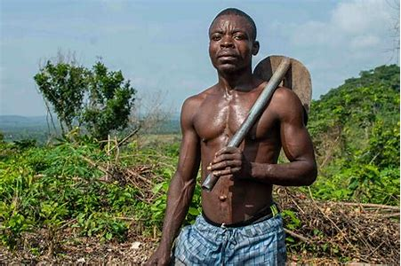
Introduction - Problem Statement
Climate change and variability make the agricultural sector a risky venture for smallholder farmers across the globe (Tessema & Simane, 2021).
Atwima Mponua is vulnerable to the threats of climate change, particularly due to its agrarian nature with a significant portion of its population engaged in farming and related activities.

Slide 5
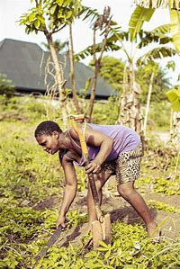
Introduction - Aim & Objectives
Aim
Evaluate the effectiveness of conservation agriculture as a climate change adaptation strategy for smallholder farmers in the Atwima Mponua District in the Ashanti Region of Ghana.

Slide 6
Introduction - Aim & Objectives Cont’d
Specific Objectives
1.
Identify the (CA) practices used by smallholder farmers in the study district to mitigate the adverse impacts of climate change
2.
Assess the effectiveness of the identified CA practices used by smallholder farmers in the study district.
3.
Assess the socioeconomic factors affecting the adoption of the CA practices.
4.
Determine the barriers militating against the adoption of the CA practices.

Slide 7
Materials and Methods
Study area
The Atwima Mponua District is located in the Ashanti Region of Ghana, approximately 45 kilometers northwest of Kumasi, the regional capital.
District’s vulnerability and reliance on smallholder farming as well as potential for CA adoption, an ideal location for the study
Figure 1: Map of Atwima Mponua

Slide 8
Materials and Methods – Cont’d
The study utilized;
pragmatic research philosophy
mixed-methods approach was employed
cross-sectional research design
4 communities selected for the study namely; Anyinamso No 2, Serebuoso, Kwankyeabo and Asamang KBK.
Three (3) primary data collection methods were used.

Slide 9
Materials and Methods – Cont’d
Questionnaire surveys (200 farmers)
FGDs provided deeper insights into community-level perceptions.
KII were conducted with individuals possessing expert knowledge on CA and climate change adaptation in the study area.

Slide 10
Materials and Methods – Data Analysis
Objective 1: Relative Importance Index, RII
(used to rank CA practices adopted by farmers)
Objective 2: Weighted Average Index and Hybrid Decision Support Tool (used to quantify farmers’ perceptions on the effectiveness of CA practices as well as Deterministic and probabilistic model approach)
Objective 3: Binary Logistic Regression, BLR
(analyze the influence of socioeconomic factors on farmer CA adoption)
Objective 4: Problem Confrontation Index, PCI
(used to determine the barriers militating against CA adoption)

Slide 11
Results and Discussion
Table 1: Adoption of Conservation Agriculture Practices by smallholder farmers in Atwima Mponua District
 | Gender
Survey questions | Male (n = 133) | Female (n = 67) | Total (n = 200) | X ² | p-value | RII | Rank
Which conservation agriculture (CA) practice do you use?
Agroforestry | 82 (61.7) | 40 (59.7) | 122 (61.0) | 0.071 | 0.789 | 0.805 | 1
Mulching | 73 (54.9) | 39 (58.2) | 112 (56.0) | 0.200 | 0.655 | 0.780 | 2
Minimum Tillage | 63 (47.4) | 42 (62.7) | 105 (52.5) | 4.192 | 0.041 | 0.763 | 3
Integrated Pest Management | 35 (25.6) | 22 (40.3) | 57 (30.5) | 0.929 | 0.335 | 0.643 | 4
Crop Rotation | 37 (27.8) | 17 (25.4) | 54 (27.0) | 0.135 | 0.713 | 0.635 | 5
Cover Cropping | 22 (16.5) | 13 (19.4) | 35 (17.5) | 0.253 | 0.615 | 0.588 | 6
Others | 13 (9.8) | 10 (14.9) | 23 (11.5) | 1.162 | 0.281 | 0.558 | 7
How long have you been using these (CA) practices?
Less than 1 year | 3 (2.3) | 1 (1.5) | 4 (2.0)
1 – 3 years | 8 (6.0) | 4 (6.0) | 12 (6.0) | 2.416 | 0.491
4 – 6 years | 17 (12.8) | 4 (6.0) | 21 (10.5)
More than 6 years | 105 (78.9) | 58 (86.6) | 163 (81.5)
What motivated you to adopt CA practices?
Economic Benefits | 123 (92.5) | 62 (92.5) | 185 (92.5) | 0.000 | 0.989 | 0.963 | 1
Training | 17 (12.8) | 7 (10.4) | 24 (12.0) | 0.230 | 0.632 | 0.560 | 2
Peer Influence | 15 (11.3) | 8 (11.9) | 23 (11.5) | 0.019 | 0.890 | 0.558 | 3
Environmental Concern | 13 (9.8) | 4 (6.0) | 17 (8.5) | 0.829 | 0.363 | 0.543 | 4
Others | 4 (3.0) | 4 (6.0) | 8 (4.0) | 1.018 | 0.313 | 0.520 | 5
Access to Resources | 5 (3.8) | 1 (1.5) | 6 (3.0) | 0.787 | 0.375 | 0.515 | 6
Government Support | 1 (0.8) | 1 (1.5) | 2 (1.0) | 0.247 | 0.619 | 0.505 | 7
Numbers in parentheses indicate percentages while numbers without parentheses indicate frequencies; X ² = Pearson Chi-square

Slide 12
Results and Discussion Cont’d
The predominance aligns with existing research that highlights them as cornerstones of CA in Sub-Saharan Africa (Komarek et al., 2021).
A significant gender - based difference (p = 0.041) was observed in the adoption of minimum tillage.
Figure 2: shows the adoption distribution of CA practices among farmers

Slide 13
Results and Discussion
Tabel 2: Effectiveness of CA practices of smallholder farmers in the Atwima Mponua District
 | Gender
Survey questions | Male (n = 133) | Female (n = 67) | Total (n = 200) | X ² | p-value | WAI | Rank
How effective are the CA practices in mitigating the adverse impacts of climate change in your farm?
Very Effective | 77 (57.9) | 48 (68.7) | 125 (61.5) |  |  | 3.13 | 1
Effective | 44 (33.1) | 11 (16.4) | 55 (27.5) | 9.289 | 0.054 | 1.10 | 2
Neutral | 10 (7.5) | 7 (10.4) | 17 (8.5) |  |  | 0.26 | 3
Ineffective | 2 (1.5) | 0 (0.0) | 2 (1.0) |  |  | 0.02 | 4
Very Ineffective | 0 (0.0) | 1 (1.5) | 1 (0.5) |  |  | 0.01 | 5
Have CA practices helped improve your crop yields?
Yes | 126 (94.7) | 61 (91.0) | 187 (93.5) | 1.038 | 0.595
No | 5 (3.8) | 4 (6.0) | 9 (4.5)
Not sure | 2 (1.5) | 2 (3.0) | 4 (2.0)
Have CA practices helped improve your soil health?
Yes | 118 (88.7) | 54 (80.6) | 172 (86.0) | 2.939 | 0.230
No | 11 (8.3) | 8 (11.9) | 19 (9.5)
Not sure | 4 (3.0) | 5 (7.5) | 9 (4.5)
Have CA practices helped reduce the impact of climate-related hazards on your farm?
Yes | 88 (61.2) | 41 (61.2) | 129 (64.5) | 0.831 | 0.660
No | 11 (8.3) | 8 (11.9) | 19 (9.5)
Not sure | 34 (11.3) | 18 (26.9) | 52 (26.0)
Numbers in parentheses indicate percentages while numbers without parentheses indicate frequencies; X ² = Pearson Chi-square

Slide 14
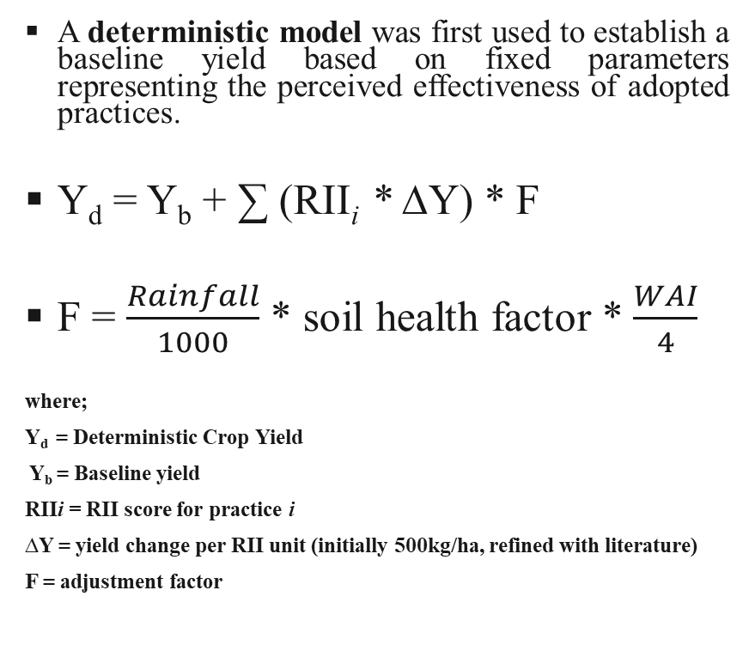
Results and Discussion – Cont’d
Hybrid Decision Support Tool
A deterministic model was first used to establish a baseline yield based on fixed parameters representing the perceived effectiveness of adopted practices.
Y_{d} = Y_{b} + ∑ (RII_{i} * ∆Y) * F
F = $\frac{Rainfall}{1000}$ * soil health factor * $\frac{WAI}{4}$
where;
Y_{d} = Deterministic Crop Yield
Y_{b} = Baseline yield
RIIi = RII score for practice i
∆Y = yield change per RII unit (initially 500kg/ha, refined with literature)
F = adjustment factor
A probabilistic variability was introduced into the yield prediction. The simulation considered various uncertainty factors.
Y_{p} = Y_{b} + ∑ (RII_{i} * ∆Y) * F * G * C
where;
G = gender impact
C = combined climate and financial factor
Y_{p} = Probabilistic Crop Yield

Slide 15
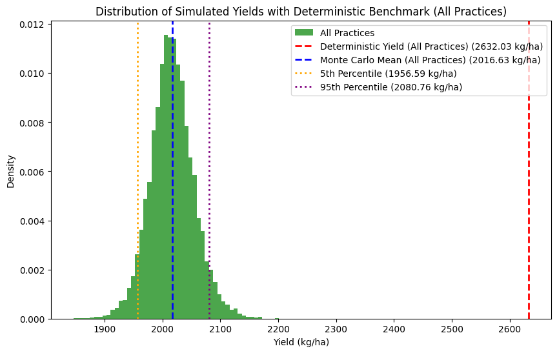
Results and Discussion – Cont’d
The APSIM model predicts a yield of 2632.03 kg/ha, representing a theoretical maximum yield under idealized conditions with the given parameters and adopted practices.
The Monte Carlo Simulator simulated yield is 2017.22 kg/ha, which is notably lower than the deterministic yield
Suggests the combined effects of the probabilistic factors significantly reduce the expected yield compared to the deterministic scenario.
Figure 3: illustrates a visual display of a hybrid model on the distribution of simulated yields

Slide 16
Results and Discussion – Cont’d
Table 3: Socioeconomic factors influencing the Conservation agricultural adoption practices of the respondents.
Socio-demographic Characteristics |  |  | Coefficient (β)
 | CAP1 | CAP2 | CAP3 | CAP4 | CAP5 | CAP6 | CAP7
Gender | 1.868** | 1.050 | 0.945 | 0.896 | 1.036 | 0.702 | 0.650
Age | 0.800 | 1.299 | 0.992 | 1.092 | 0.737 | 1.030 | 0.803
Household Size | 1.112 | 0.834 | 0.736 | 1.038 | 1.522** | 1.272 | 0.955
Education Level | 0.797 | 0.949 | 1.519 | 1.195 | 0.607** | 0.879 | 1.021
Primary Occupation | 0.583** | 0.760 | 0.698 | 1.154 | 0.764 | 0.571** | 0.492**
Year of Farming Experience | 1.193** | 1.292 | 1.444 | 1.017 | 0.762 | 1.149 | 1.527
Nagelkerke R² values | 0.165 | 0.158 | 0.222 | 0.064 | 0.158 | 0.189 | 0.156
NB: Asterisk (**) means significant at 95% confidence interval; Numbers with/without asterisk = Beta Coefficients.
CAP1 = Minimum Tillage (Ragasa, 2012), (Kassie et al., 2015) & (Andersson & D’Souza, 2014)
CAP2 = Crop Rotation
CAP3 = Cover Cropping
CAP4 = Mulching
CAP5 = Agroforestry (Sileshi et al., 2007)
CAP6 = Integrated Pest Management
CAP7 = Other Practices

Slide 17
Results and Discussion
Table 4: Barriers militating against the adoption of CA practices in the Atwima Mponua District
 | Gender
Survey Questions | Male (n = 133) | Female (n = 67) | Total (n = 200) | X ² | p-value | RII | WAI | PCI | Rank
What barriers have you encountered in adopting CA practices?
Financial constraints | 93 (63.3) | 50 (74.6) | 143 (71.5) | 0.483 | 0.487 |  |  | 286 | 1
Lack of government support | 57 (42.9) | 33 (49.3) | 90 (45.0) | 0.737 | 0.391 |  |  | 180 | 2
Limited access to resource | 59 (44.4) | 24 (35.8) | 83 (41.5) | 1.338 | 0.247 |  |  | 166 | 3
Others | 31 (23.3) | 16 (23.9) | 47 (23.5) | 0.008 | 0.928 |  |  | 94 | 4
Lack of knowledge | 15 (11.3) | 19 (28.4) | 34 (17.0) | 9.212 | 0.002 |  |  | 68 | 5
Resistance to change | 1 (0.8) | 2 (3.0) | 3 (1.5) | 1.504 | 0.220 |  |  | 6 | 6
How significant are these barriers in preventing the adoption of CA practice?
Very significant | 103 (77.4) | 58 (86.6) | 161 (80.5) |  |  |  | 4.03 |  | 1
Significant | 28 (21.1) | 9 (13.4) | 37 (18.5) | 2.897 | 0.413 |  | 0.74 |  | 2
Neutral | 1 (0.8) | 0 (0.0) | 1 (0.5) |  |  |  | 0.02 |  | 3
Insignificant | 1 (0.8) | 0 (0.0) | 1 (0.5) |  |  |  | 0.01 |  | 4
Very insignificant | 0 (0.0) | 0 (0.0) | 0 (0.0) |  |  |  | 0.00 |  | 5
What support or resources would help you to implement?
Financial resources | 97 (72.9) | 52 (77.6) | 149 (74.5) | 0.514 | 0.474 | 0.87 |  |  | 1
Access to resource | 62 (46.6) | 33 (49.3) | 95 (47.5) | 0.124 | 0.724 | 0.74 |  |  | 2
Government support | 57 (42.9) | 32 (47.8) | 89 (44.5) | 0.434 | 0.510 | 0.72 |  |  | 3
Training programs | 35 (26.3) | 21 (31.3) | 56 (28.0) | 0.559 | 0.455 | 0.64 |  |  | 4
Others | 18 (13.5) | 15 (22.4) | 33 (16.5) | 2.535 | 0.111 | 0.58 |  |  | 5
Government policies | 18 (13.5) | 9 (13.4) | 27 (13.5) | 0.000 | 0.984 | 0.57 |  |  | 6
Numbers in parentheses indicate percentages while numbers without parentheses indicate frequencies; X ² = Pearson Chi-square

Slide 18
Conclusion and Recommendations
Conclusion
Recommendations
CA practices contributed to improved crop yields, better soil health, and enhanced resilience to climate-related shocks.
Agroforestry emerged as the most valued and effective.
Adoption was constrained by some factors.
Expand extension services to promote CA practices.
Enhance Government and institutional support.
Establish women-led farmer groups and youth engagement initiatives to ensure equitable access to resources and decision-making.

Slide 19
References
Ambler, K., Gargano, N., & Murphy, M. (2020). Conservation Agriculture Evaluation Project in Northern Ghana : a formative evaluation using a framed field experiment Formative evaluation report Accepted by 3ie : July 2020. July.
Awazi, N. P., Tchamba, M. N., Temgoua, F. L., & Marie-Louise, T.-A. (2021). Farmers’ Adaptive Capacity to Climate Change in Africa: Small-Scale Farmers in Cameroon. African Handbook of Climate Change Adaptation: With 610 Figures and 361 Tables, 1–2838. https://doi.org/10.1007/978-3-030-45106-6
Doss, C. R. (2018). Women and agricultural productivity: Reframing the Issues. Development Policy Review, 36(1), 35–50. https://doi.org/10.1111/dpr.12243
FAO Report. (2011). Chapter 5. Ethiopia. Chapter 5(November), 19.
Mohammed, D., Timothy, E., Abaka, S. S., & Arubi, A. A. (2022). Analysis of climate change vulnerability and adaptation towards increase resilience among farmers in Borno State, Nigeria. African Journal of Agricultural Research, 18(2), 80–88. https://doi.org/10.5897/ajar2021.15765
Pretty, J. (2011). Interdisciplinary progress in approaches to address social-ecological and ecocultural systems. Environmental Conservation, 38(2), 127–139.
Quisumbing, A. R., Meinzen-Dick, R., Raney, T. L., Croppenstedt, A., Behrman, J. A., & Peterman, A. (2014). Gender in agriculture: Closing the knowledge gap. Gender in Agriculture: Closing the Knowledge Gap, 1–444. https://doi.org/10.1007/978-94-017-8616-4
Ragasa, C. (2012). Gender and Institutional Dimensions of Agricultural Technology Adoption: A Review of Literature and Synthesis of 35 Case Studies. AgEcon Search, 56. https://doi.org/10.22004/ag.econ.126747
Ragasa, C., Ulimwengu, J., Randriamamonjy, J., & Badibanga, T. (2016). Factors Affecting Performance of Agricultural Extension: Evidence from Democratic Republic of Congo. Journal of Agricultural Education and Extension, 22(2), 113–143. https://doi.org/10.1080/1389224X.2015.1026363

Slide 20
THANK YOU

