Slide 1

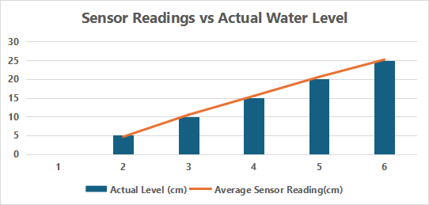


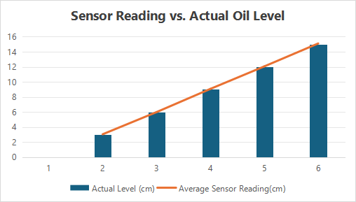
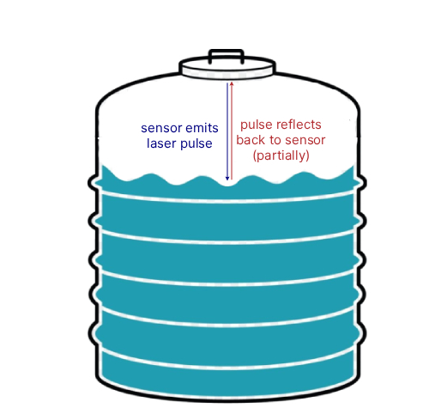
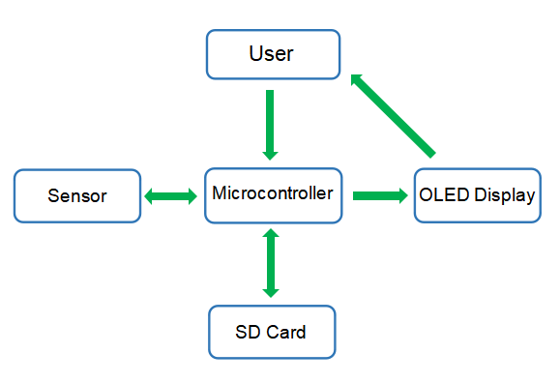
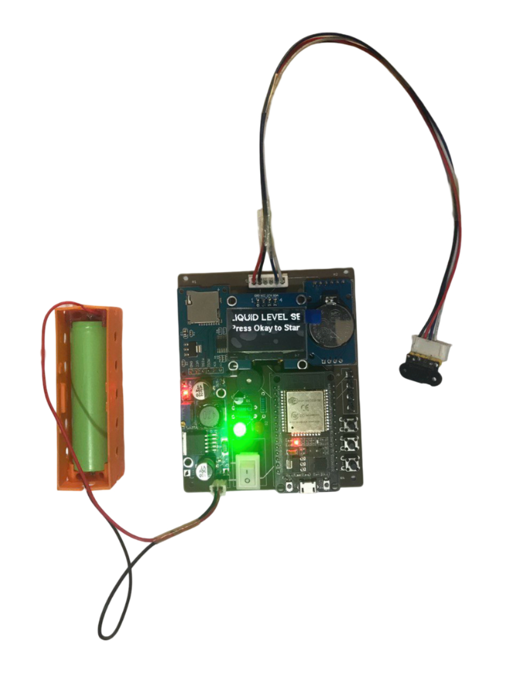
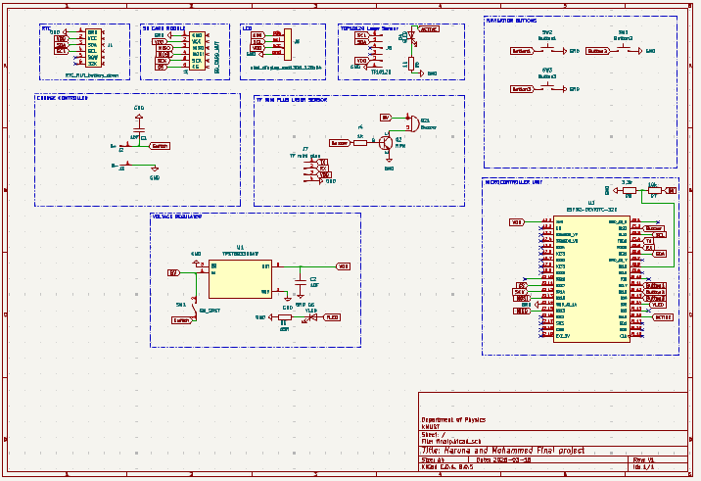
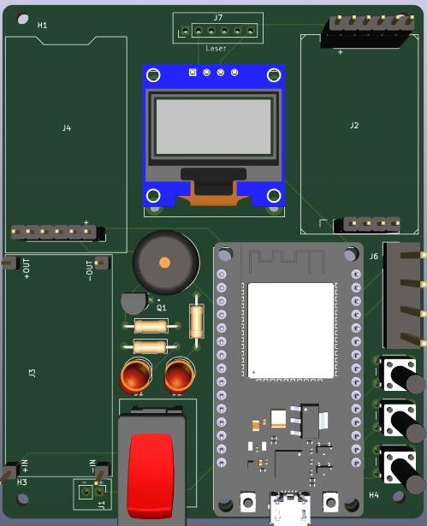

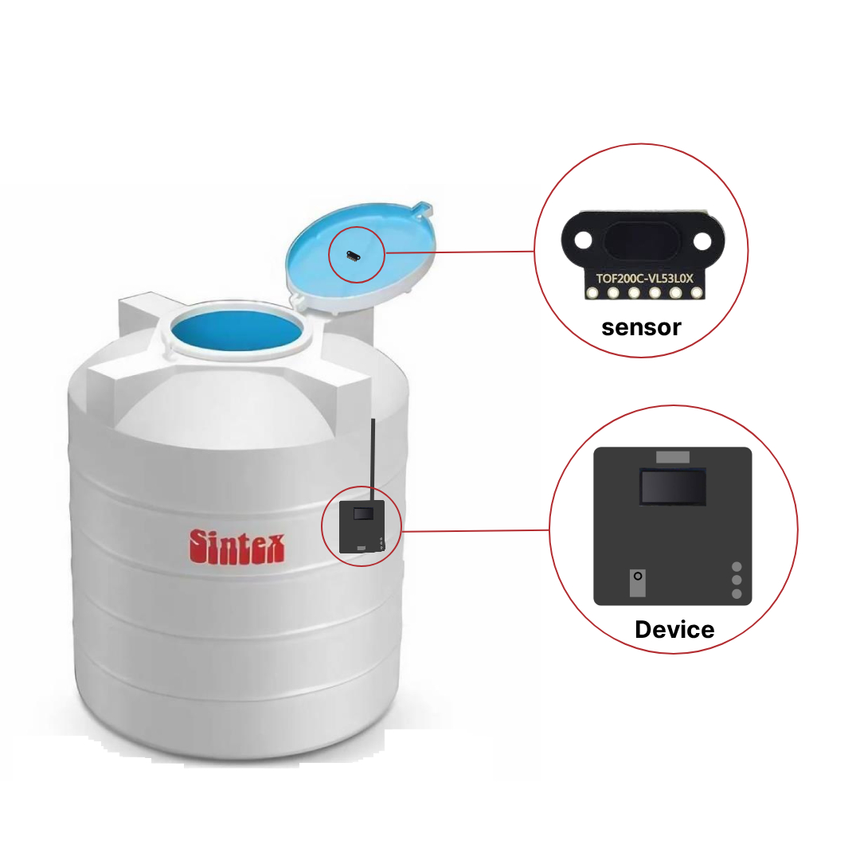



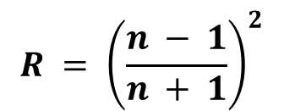

DEVELOPMENT OF A LIQUID-LEVEL SENSING SYSTEM BASED ON LASER LIGHT REFLECTION
Haruna S., John A., Yakubu B., Illias M., Britwum A., Donkor M. K. E., Nkrumah I.
Department of Physics, Kwame Nkrumah University of Science and Technology, Kumasi, Ghana.
ABSTRACT
In critical industries such as water treatment centers, pharmaceuticals and chemical industries, a mistake in the measurement of liquid level can result in overflow, leakage, or pump failures. These can lead to explosions, contaminations, and costly downtime. Also, in many households, the absence of an accurate liquid level monitoring system in water tanks often leads to water overflow and wastage creating a need for a more reliable sensing solution. However, current sensing methods still suffer from limited accuracy, sensitivity to environmental factors, and restricted applicability to liquid types and container geometries, highlighting the demand for more robust, versatile, and cost-effective solutions. This project introduced the development of a laser based non-contact and continuous liquid level sensing system. A photodetector and a 940nm laser diode are integrated into a single unit and mounted at the top of the liquid container. The time taken by the emitted laser pulse to travel from the sensor unit to the liquid surface and get reflected to the detector is used in the time-of-flight equation to calculate for the liquid level in the container. The developed device is experimented with frytol oil and clean water to evaluate its accuracy. A mean percentage error of 0.58% and 3.83% was obtained for the frytol oil and clean water respectively. The achieved results indicate the systems accuracy for liquid level measurement, demonstrating higher accuracy for liquids of relatively higher refractive index.
ABSTRACT
INTRODUCTION
THEORY
Liquid level sensing is very essential in domestic and industrial applications ensuring high-quality production and improving daily life. A variety of techniques have been used for this purpose, including float-type, ultrasonic, capacitive, and pressure-based sensors. They are classified into contact vs. non-contact and point vs. continuous (Mohindru, 2023). Point level sensors provide binary information while continuous level sensors provide real-time quantitative readings of liquid. However, each of these methods has limitations in terms of Accuracy, complexity, liquid type and container geometries(Suemori et al., 2023). This research focuses on developing a non-contact, continuous liquid-level sensing system that is based on laser light reflection.
The following equations, eqn(1) and eqn(3) were used to calculate for the ideal wavelength of laser light used and the reflectivity of the liquid surface.
Beer-Lambert Law:
I = I_{o}e^{-αd}
(1)
α$= \frac{4πk}{λ}$
(2)
Fresnel Equation:
$$R = {\left(\frac{n − 1}{n + 1}\right)}^{2}$$
(3)
PROBLEM STATEMENT
The distance between the sensor and the surface of the liquid is calculated from:
Fig. 5.2: Graph showing the correlation of the sensor height readings with the actual height of clean liquid water
Existing liquid level sensors are limited to specific container geometries and liquid types.
Also, most liquid level sensors are complex, expensive and sensitivity to environmental factors such as wind and temperature fluctuations.
(4)
Then, the height of the liquid is calculated using eqn(5):
OBJECTIVES
(5)
Main
Design and develop a simple, cost-effective and versatile liquid-level sensing system based on laser light reflection, capable of accurately and reliably measuring liquid levels in various containers and compatible to different liquids and environments .
Specific
Investigate the physics of laser light reflection in liquid environments.
Design and prototype a liquid-level sensing system based on laser reflection.
Optimize the system for accurate and reliable measurements.
D
H_{T}
H_{L}
Fig. 5.3: Graph showing the correlation of the sensor height readings with the actual height of cooking oil
METHODOLOGY
Fig. 4.1: Illustration of the working of the sensor
Major Components
ESp32 Microcontroller
ToF200C VL53LOX sensor
OLED Display Module
RTC
Tools/Softwares
KiCAD
Arduino IDE
Fusion 360
RESULTS
SYSTEM SIGNIFICANCE
Developed device is not limited to specific container geometry and liquid type.
It is portable and can easily be used as a tool in households to measure liquid level.
Laser based method is highly accurate and less affected by environmental conditions.
Continuous and non-contact method used hence reduces the risk of contamination during measurement
Power
Supply
OLED Display
SD
Card
RTC
CONCLUSION
Fig. 3.1: Block Diagram of the system
Laser
Sensor
The system exhibits relatively high accuracy for oil compared to liquids of lower refractive index (clean water). The study concludes that the laser-based ToF method is an effective, non-contact solution for determining the level of liquid with relatively high refractive index, suitable for containers of any geometry and industrial applications where contamination avoidance is critical.
Microcontroller
ACKNOWLEDGEMENT
Fig. 5.1: Diagram illustrating the circuit board of the liquid level sensing system
Special thanks to our supervisors, Dr. Michael Kweku Edem Donkor, Dr. Akyana Britwum, Dr. Isaac Nkrumah, and our mentors, Mr. Awutu Victor, Mr. Nutifafa Yao, Mr. Mutala Iliasu and Mr. Ephraim Rodgers for their support and guidance throughout this project. We also extend our thanks to our parents, who have been the fundamental support on this journey.
The developed laser-based liquid level sensing system was tested with water and frytol oil to evaluate its accuracy and reliability. The graphs in fig 5.2 and fig 5.3 show a comparison between the sensor readings of the liquid’s height and that of the actual liquid level(height) for clean liquid water and frytol oil respectively. For the liquid water, the system showed a mean percentage error of 3.83%, and the frytol oil level measurements exhibited consistently high accuracy, with average errors below 1% at each test interval, averaging 0.58% across all levels. The comparative analysis reveals that the system performs better in oil due to its high refractive index and stable reflective surface, while minor deviations in water were likely caused by surface disturbances. Overall, the findings confirm that the sensor provides a versatile, non-contact, and reliable solution for liquid level monitoring, suitable for both industrial and domestic applications.
Fig. 3.2: Schematic of the sensing system
designed on KiCAD
Fig. 3.3: 3D Model of PCB
REFERENCES
Patel, D., Sharma, P., & Kumar, V. (2020). Introduction to sensor technology. 10.1088/978-0-7503-2707-7ch1
Lunadei, L., Diezma, B., & Ruiz-Altisent, M. (2009). Monitoring agricultural and food processes with sensors: A review. Food Control, 20(9), 873–882.
Javaid, M., Haleem, A., Rab, S., Singh, R. P., & Suman, R. (2021). Sensors for daily life: A review. Sensors International, 2.
Suemori, K., Komatsu, Y., & Nobeshima, T. (2023). Flange-type liquid-level sensor based on laser light reflection. Sensors International, 4, 100230.
Fig. 3.4: 3D casing of the PCB
Fig. 3.5: Implementation of the system
Suale Haruna
Illias Mohammed
Yakubu Bayula

