Slide 1

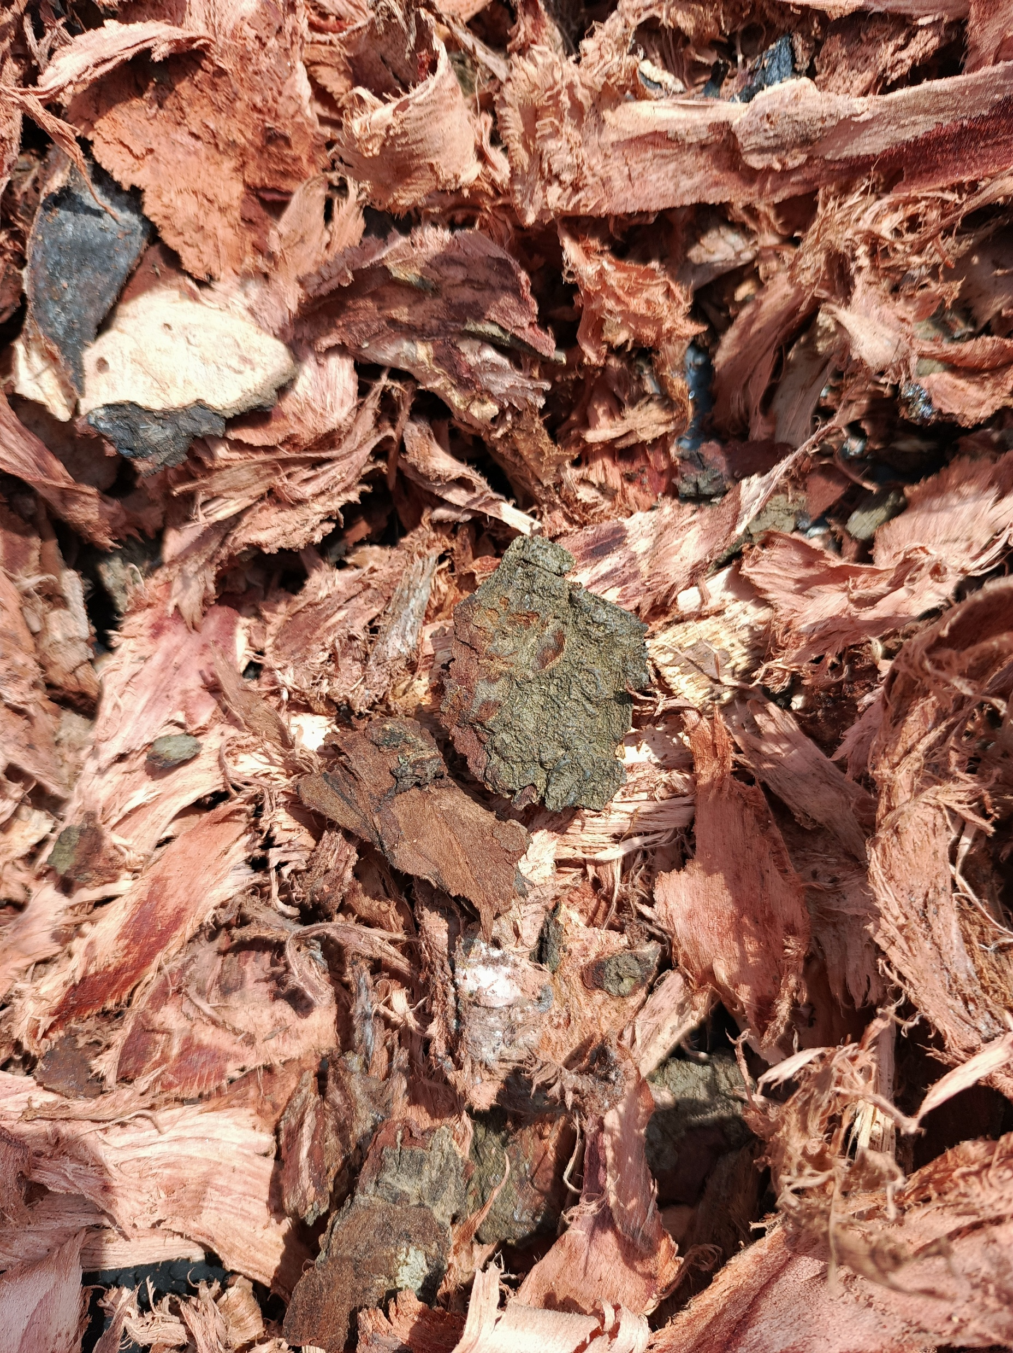
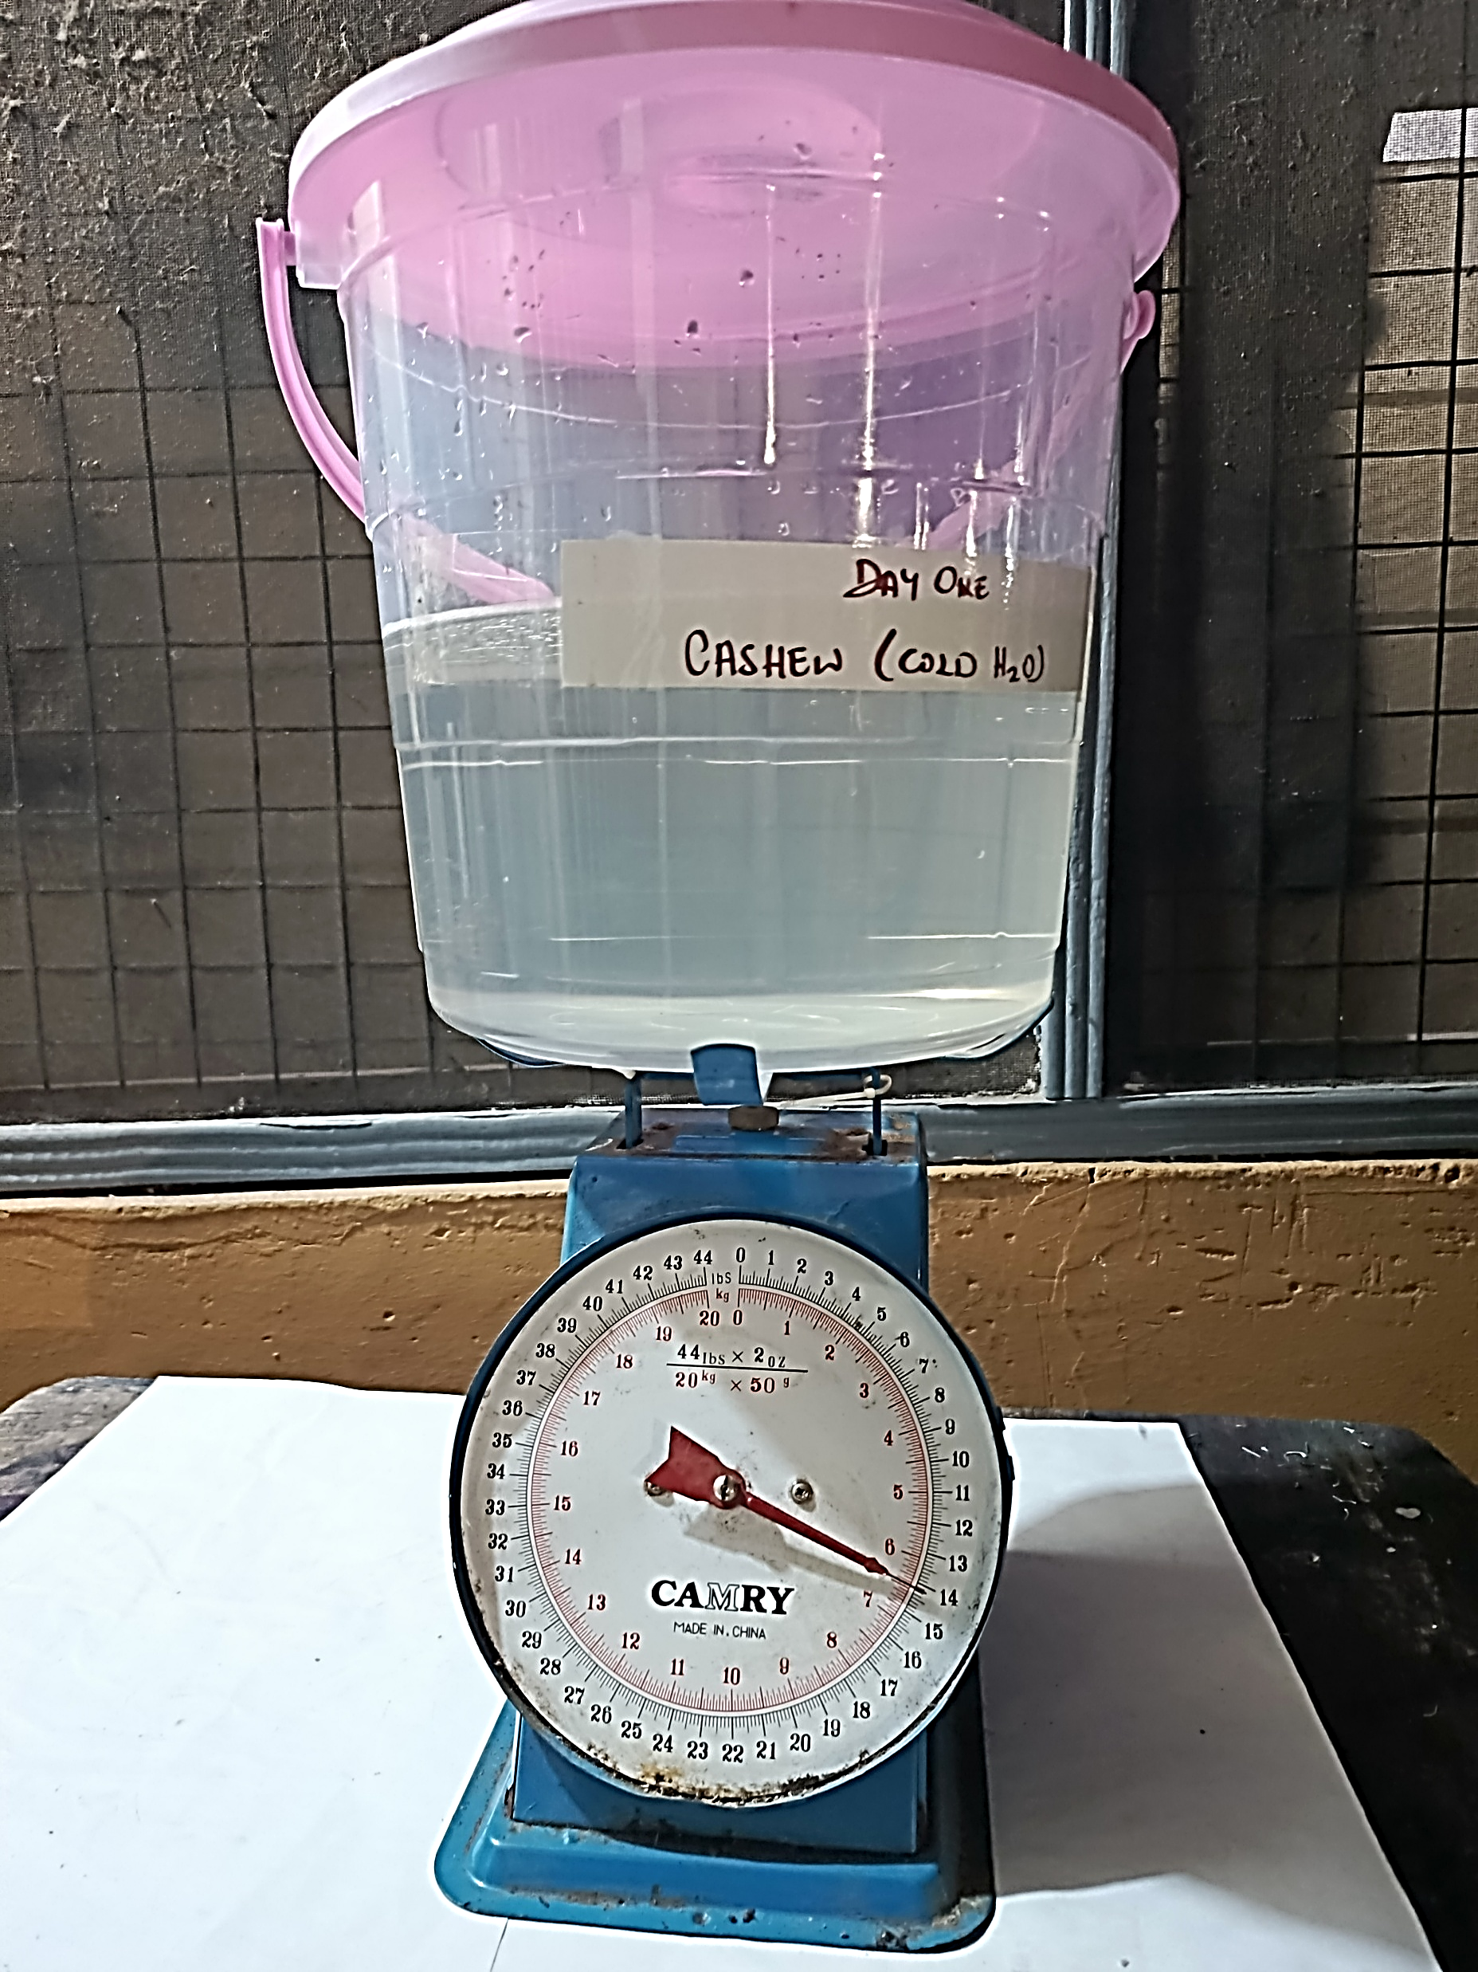
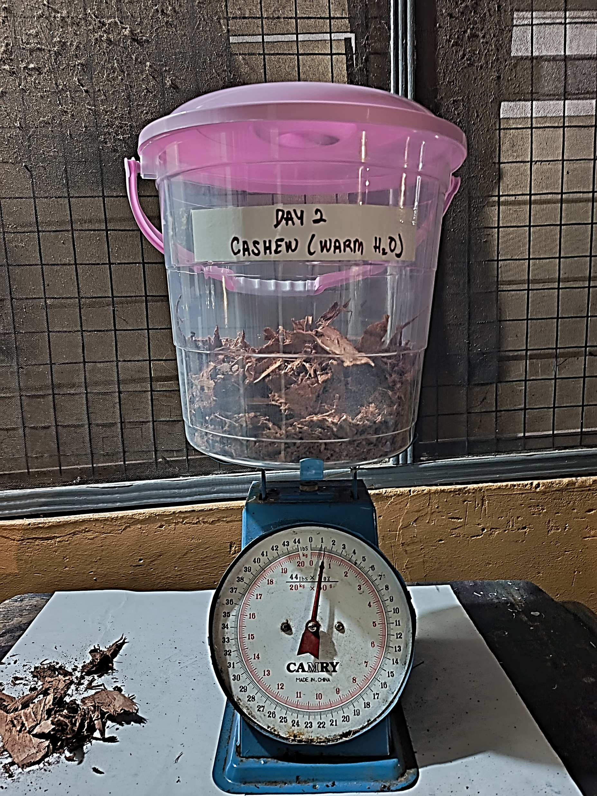
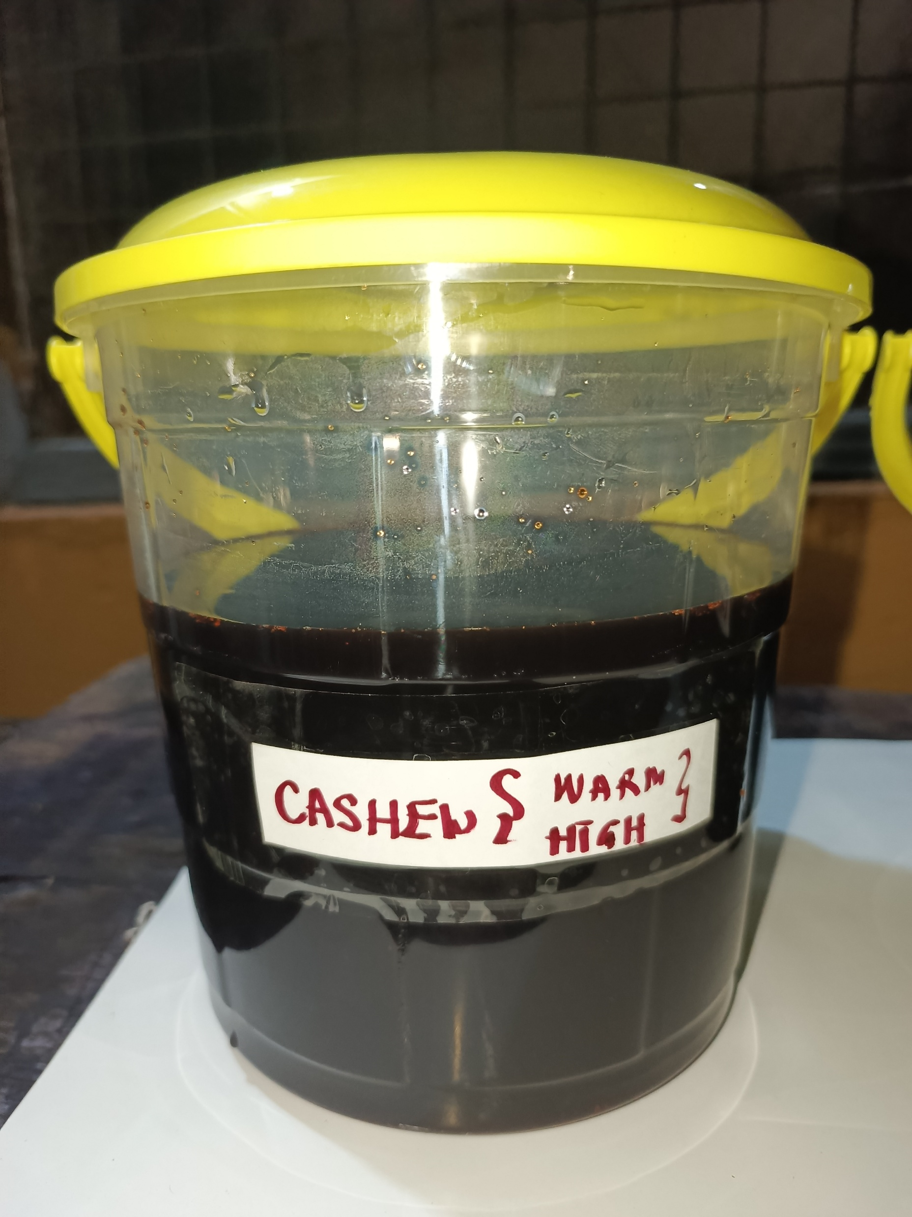
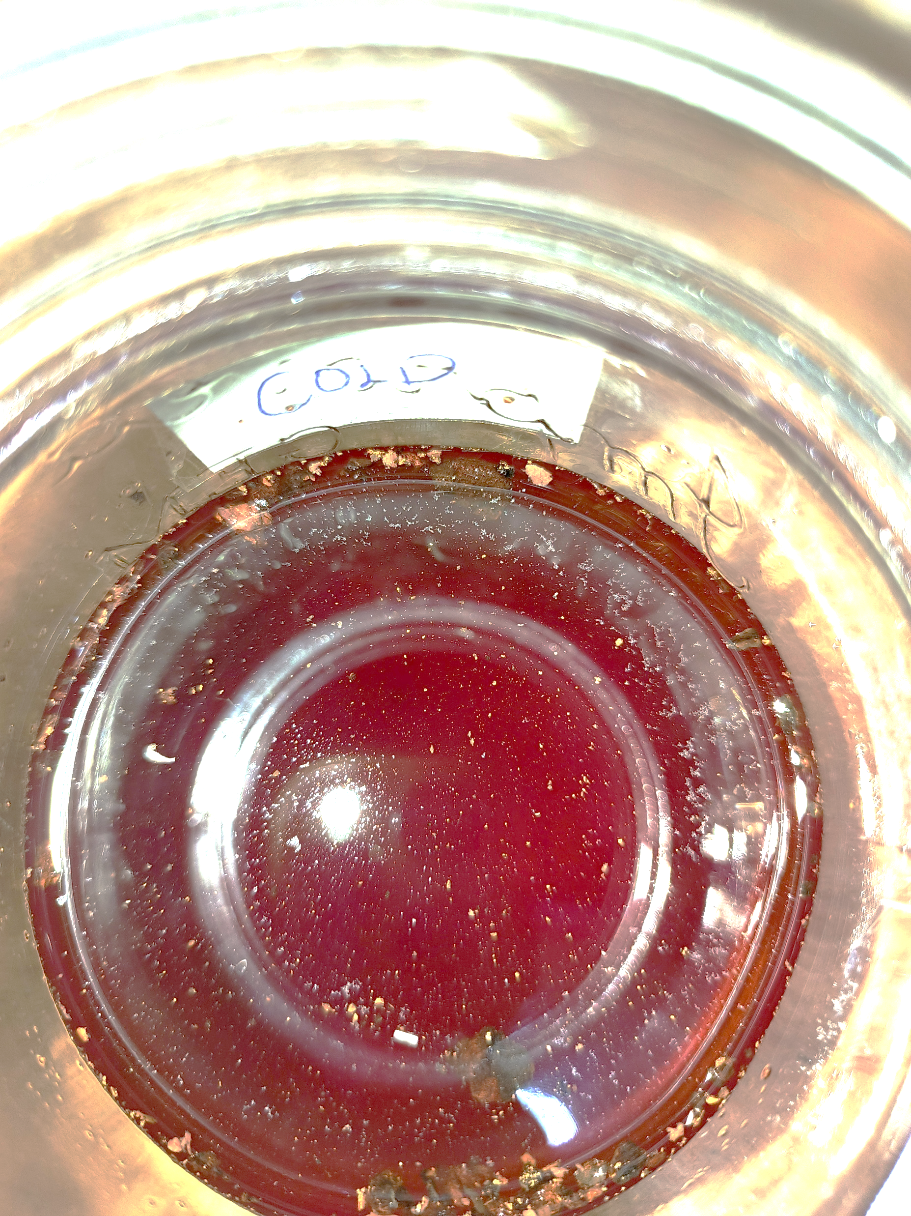
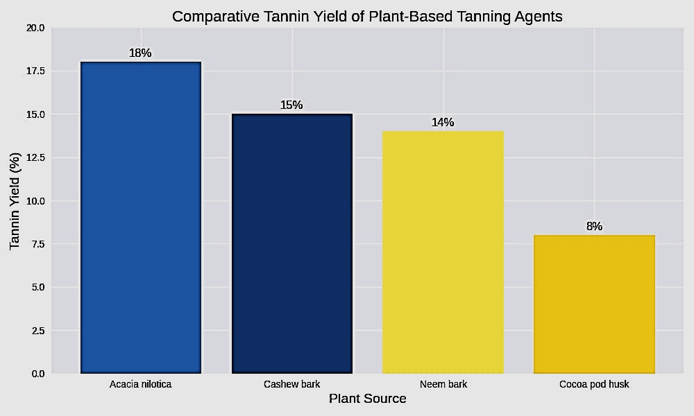
EXPLORATION OF PLANT-BASED TANNING AGENTS FOR LOCAL TANNERIES
IN GHANA
Ebenezer Fosu Boamah¹; John Osei Bobie Boahin, PhD² ; Kwabena Asubonteng, PhD³ ; Abdul-Latif Amadu, PhD⁴;
¹KNUST, ²KNUST, ³KNUST, ⁴KNUST,
ABSTRACT
INTRODUCTION
RESEARCH DESIGN AND METHODOLOGY
MAJOR FINDINGS
ABSTRACT
Leather manufacturing is one of the earliest material transformation technologies, converting raw hides into durable, dimensionally stable products (Wemegah, 2014). Today, chrome tanning dominates global leather production, accounting for 85–90% due to its efficiency and cost-effectiveness (Haroun, 2022; Hassan et al., 2023). However, chromium salts pose environmental and health risks, including toxic effluents and potential formation of carcinogenic chromium (VI) compounds (Khan, Khan, & Khan, 2023; Mwangi, Silayo, & Chaula, 2024).
Vegetable tanning is widely recognized as a sustainable alternative because plant-based tannins are biodegradable and eco-friendly (Das et al., 2022; Mwangi et al., 2024). In Ghana, traditional vegetable tanning relies almost exclusively on Acacia nilotica (Bagaruwa), creating vulnerabilities such as seasonal shortages and high transport costs from Sahelian regions (Wemegah, 2014; Appiah-Brempong et al., 2020).
This study explore cashew bark (Anacardium occidentale), neem bark (Azadirachta indica), and cocoa pod husk (Theobroma cacao) as locally available, sustainable tanning agents to reduce dependence on Acacia nilotica, enhance production consistency, and support eco-friendly leather manufacturing aligned with SDG 12 (Araújo et al., 2022; Mensah et al., 2011; Haroun, 2022).
Research Method : Qualitative
Research Design: Exploratory and Descriptive
Sampling Technique: Purposive
Target Population: All plants in Ghana
Accessible Population: Cashew Bark, Neem Bark, and Cocoa pod husk
Data Collection Instruments: Observation and Interview
Source of Data:
Primary Source: Local Tanners and Leather Lecturers
Secondary Sources: Books, Articles, Journals, and Internet
Sustainability Impact:
Cashew bark, Neem bark, and Cocoa pod husk provide year-round availability, accessibility and affordability, reducing reliance on seasonal Acacia nilotica and lowering costs.
Global Alignment:
Results align with the various empirical studies, confirming cashew bark, neem bark, and cocoa pod husk as viable plant-based tanning agents alternatives to chrome tanning.
Industry Implication:
Adoption of these alternatives plants-based supports SDG 12, promotes the utilization of local resources, and enhances the competitiveness of Ghana’s leather industry.
Ghana’s leather tanning industry depends heavily on Acacia nilotica (Bagaruwa) for tannins, creating sustainability challenges due to seasonal shortages, geographical constraints, and high transportation costs from Sahelian regions.
This study investigates locally available plant-based alternatives thus cashew bark (Anacardium occidentale), neem bark (Azadirachta indica), and cocoa pod husk (Theobroma cacao), as cost-effective, eco-friendly tanning agents.
These materials, abundant across Ghana’s ecological zones, were analyzed for tannin content and tested for tanning efficiency
Results show cashew and neem bark provide substantial tannin yields, while cocoa husk demonstrates potential when combined with cashew and neem bark. All three produced durable, eco-friendly leather comparable to Acacia nilotica, offering year-round availability and reduced costs. This research promotes sustainability, supports local artisans, and aligns with SDG 12: Responsible Consumption and Production.
Acknowledgements
Kwame Nkrumah University of Science and Technology (KNUST)
Local tannery artisans in Ashanti, Bono, and Northern Ghana
EXTRACTION PROCESS
CONCLUSION
Cashew bark, neem bark, and cocoa pod husk are viable for tanning, locally available alternatives to Acacia nilotica for leather tanning in Ghana. They deliver durable, eco-friendly leather comparable to conventional methods while reducing costs and reliance on seasonal imports.
Adoption of these plant-based agents enhances sustainability, supports local artisans, and aligns with SDG 12: Responsible Consumption and Production.
This research provides a foundation for policy development, industrial innovation, and future studies on sustainable tanning practices.
Pate 1: drying of plant materials
Pate 2: Measuring of Water for extracting.
Pate 3: Measuring of plant materials
Pate 4: Tannins Extract using Aqueous
RESULTS
REFERENCES
Das, R.K. et al. (2022) 'Extraction of a novel tanning agent from indigenous plant bark and its application in leather processing,' Journal of Leather Science and Engineering, 4(1). https://doi.org/10.1186/s42825-022-00092-5.
Haroun, M. (2022) 'Assessment of tannins extracts of Acacia nilotica ssp Adansonii pods and Azadirachta indica bark on leather processing,' World Journal of Advanced Research and Reviews, 16(3), pp. 187–192. https://doi.org/10.30574/wjarr.2022.16.3.1218.
Mwangi, S.Z., Silayo, V.C. and Chaula, D.N. (2024) 'Optimization of Tannin’s Extraction from Cashew (Anacardium occidentale L.) Nut Testa for Use in Leather Tanning,' Asian Journal of Applied Chemistry Research, 15(2), pp. 7–16. https://doi.org/10.9734/ajacr/2024/v15i2283.
Wemegah, R. (2014) 'Vegetable tanning in Bolgatanga: challenges and the way forward,' VNU Journal of Science: Natural Sciences and Technology (Vietnam National University), 16, pp. 27–37. http://iiste.org/Journals/index.php/ADS/article/view/10289.
OBJECTIVES
To investigate the tannin content and tanning efficiency of cashew bark (Anacardium occidentale), neem bark (Azadirachta indica), and cocoa pod husk (Theobroma cacao).
To compare the performance of these plant-based alternatives with Acacia nilotica in producing durable, eco-friendly leather.
Figure 1. The table presents identified plant species in Ghana that present tanning potentials with specific properties.
CONTACT
EBENEZER FOSU BOAMAH
Kwame Nkrumah University Science and Technology, Kumasi.
Email: efboamah@knust.edu.gh
Phone: +233(0)542166545
Figure 2. Comparative Tannin Yield of Plant-Based Tanning Agent.

