Slide 1
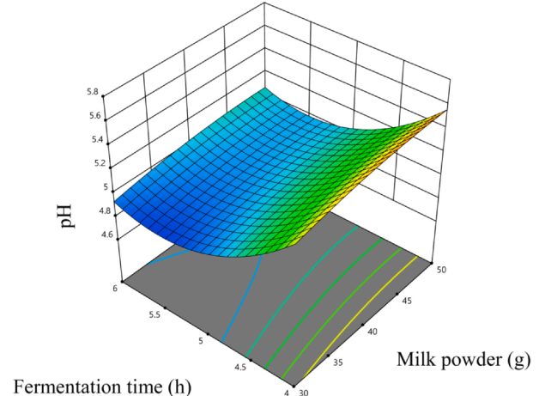
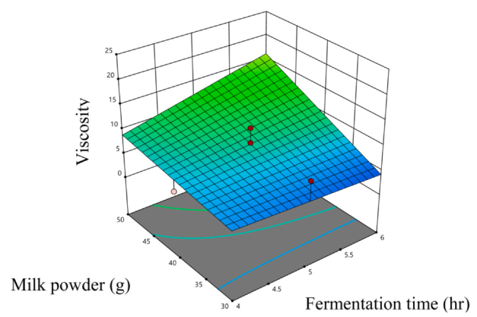
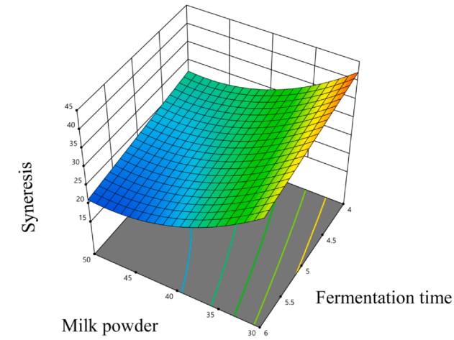
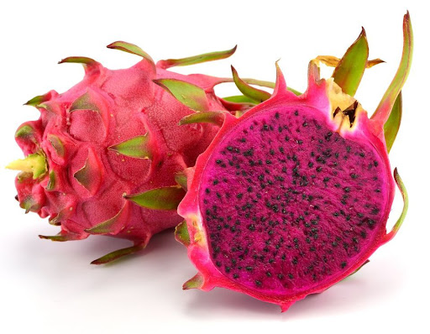
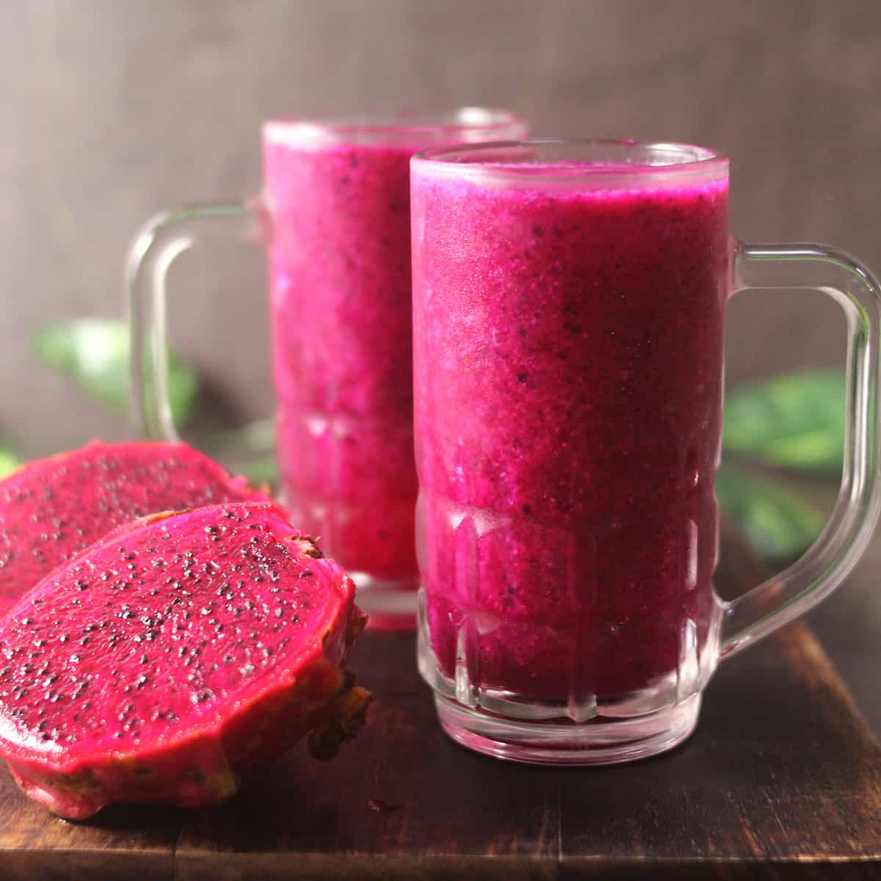
Optimized fermentation conditions for dragon fruit yogurt
Shadrach Yankey,¹; Eric Owusu Mensah¹ ; Gloria M. Ankar-Brewoo¹ ; William Otto Ellis ¹
¹Department of Food Science and Technology, Kwame Nkrumah University of Science and Technology
College of Science
INTRODUCTION
RESULTS AND DISCUSSION
Yogurt, a nutrient-dense product from milk fermented by lactic acid bacteria, comes in plain (dairy-only) or flavored varieties. Flavored yogurts, often containing fruit, sugar, or sweeteners, are popular for their enhanced appeal. Fruit yogurt is more popular among flavored yogurts with consumers, and the addition of fruit to yogurt improves the flavor, making the yogurt product more appealing to consumers.
Dragon fruit (Pitaya/Pitahaya), a tropical plant found in regions like Ghana, is incorporated into yogurt to improve its nutritional and physiological qualities. However, knowledge on optimizing dragon fruit yogurt production is limited. This study adopted a central composite design to determine the optimal processing parameters
Table 1. Values of coded levels used for dragon fruit yogurt.
pH
After 6 hours of fermentation, pH dropped from 6.5 at the beginning of the fermentation to 4.6, a change vital for forming the yogurt's gel structure. Milk powder had a significant positive effect on pH (tending to raise it), whereas increased fermentation time significantly lowered it (Fig. 1). Dragon fruit and corn starch did not significantly affect this pH decrease.
Viscosity
Yogurt products had a viscosity range of 2 cP to 23 cP. Higher total solids in the yogurt base led to increased viscosity. Milk powder significantly and positively impacted viscosity, as did the interaction between milk powder and fermentation time (Fig. 2). Dragon fruit puree and corn starch, however, had no significant effect on viscosity.
Syneresis
Syneresis (liquid separation) in the yogurt samples ranged from 18.75% to 45.00%. Higher milk powder content led to less syneresis. Milk powder and fermentation time showed a significant negative correlation with syneresis (Fig. 3), meaning they helped reduce it. Dragon fruit puree and corn starch had no significant impact.
Titratable acidity
Titratable acidity (TTA) in the yogurt samples ranged from 0.77 to 1.42%. Higher milk powder content led to higher TTA. Milk powder showed a significant positive correlation with TTA, meaning milk powder helps increase the TTA. Dragon fruit puree, corn starch, and fermentation time had no significant impact on TTA.
Levels | Dragon fruit (g) | Corn starch (g) | Milk powder (g) | Fermentation time (hr)
-1 | 22.15 | 3 | 30 | 4
0 | 44.3 | 5 | 40 | 5
1 | 66.45 | 7 | 50 | 6
RESEARCH DESIGN AND METHODOLOGY
Experimental design
A two-level factorial design with central points (2 k +2k+n c​ ), which gave us 29 total treatment runs. The coded values for these levels are in Table 1.
Preparation of dragon fruit yogurt
First, milk powder was dissolved in 300 mL of distilled water, followed by the addition of corn starch. Next, dragon fruit puree, which had been pasteurized at 60°C for 5 minutes, was incorporated. The entire mixture was then pasteurized at 80°C for 10 minutes using a constant water volume of 400 mL.
After pasteurization, the yogurt base was cooled to 43°C and inoculated with a starter culture. The mixture was then incubated at 43°C for the specified treatment time. Finally, the pH was recorded, and the set yogurt was gently stirred before being stored at 4 °C in a refrigerator.
Physicochemical Analysis of Yogurt
pH The pH for each treatment was measured using a standardized hand-held pH meter.
Syneresis analysis
Syneresis was measured using the centrifuged method at 2250 rpm/ min for 10 min
Viscosity
A rotational viscometer was used to measure the viscosity of the yogurt samples.
Figure 1. Response surface plot showing the effect of fermentation time and milk powder on the pH
CONCLUSION
The optimal formulation for dragon fruit yogurt, derived from surface response models, included 31.42 g of dragon fruit puree, 7.0 g of corn starch, 49.02 g of milk powder, and a 6.0-hour fermentation time. This precise combination yielded a product with a pH of 4.77±0.12, a viscosity of 30.33±9.29 cP, syneresis of 25.24±5.36% and titratable acidity of 1.05 ± 0.03%.
Figure 2. Response surface plot showing the effect of fermentation time and milk powder on viscosity
REFERENCES
Amirdivani, S., & Baba, A. S. (2011). Changes in yogurt fermentation characteristics, and antioxidant potential and in vitro inhibition of angiotensin-1 converting enzyme upon the inclusion of peppermint, dill and basil. LWT - Food Science and Technology, 44(6), 1458–1464.
Jayasinghe, Oshadi, Fernando, Sumali, & Jayamanne, Vijith (2015). Production of a novel fruit-yogurt using dragon fruit (Hylocereus undatus). European Scientific Journal, 11(3), 208–215.
Figure 3. Response surface plot showing the effect of fermentation time and milk powder on syneresis

