Slide 1
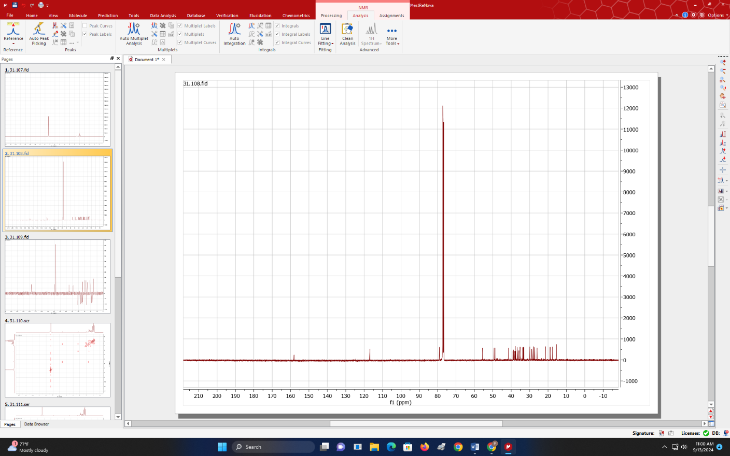
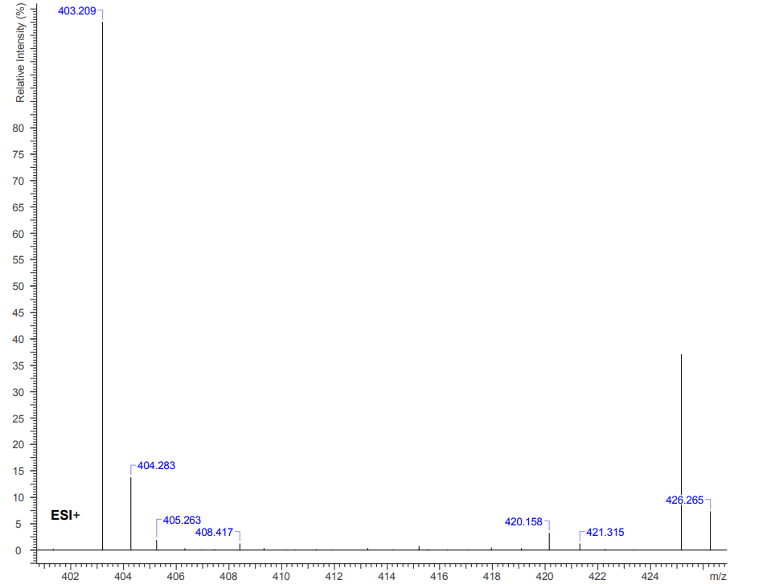
BIOACTIVITY ASSESSMENT, ISOLATION AND CHARACTERIZATION OF THE METHANOLIC EXTRACT OF THE STEM BARK OF ANINGERIA ROBUSTA
Anthony Appiah-Yeboah^{1*} , Joseph Kwasi Adu ^{1*},Isaac Ayensu ¹
Department of Pharmaceutical Chemistry , Faculty of Pharmacy and Pharmaceutical Sciences, Kwame Nkrumah University of Science and Technology
Email : anthonyappiahyeboah@gmail.com
INTRODUCTION
RESULTS
Medicinal treatments have a storied history tied to natural products discovery and development (Holford et al., 2016)
Natural products from plants and animals have long been used in traditional medicine and are now key sources of chemical diversity for pharmaceutical drug discovery (Holford et al., 2016)
Natural products have long played a vital role in traditional medicine and remain key sources of chemical diversity for drug discovery (Holford et al., 2016). Their importance was highlighted by the 2015 Nobel Prize in Physiology or Medicine for the discoveries of Avermectin and Artemisinin (Holford et al., 2016). Aningeria robusta (Asanfena), a Ghanaian Aningre wood species, has been reported to have pharmaceutical applications (Konai et al., 2015) and is traditionally used to treat malaria, ear infections, and pain. This study investigates the biological activity of Aningeria robusta (AR) and the isolation and characterization of a compound from its stem bark extract.
Table 2: Result of Antioxidant and total Phenolic content assays
sample | TAC(mgAAE/g) | TPC(mgGAE/g) | IC50DPPH (mg/l) | IC50H₂O₂ (mg/l)
AR | 213.95± 0.39 | 117.59± 0.09 | 140.00±0.02 | 276.06± 0.32
Standards | N/A | N/A | 2.093 ± 0.01 | 38.30 ± 0.01
Table 3:Anti-microbial assay
Test organism | AR | Cipro | Fluconazole
P.aeruginosa | 6.25 | 0.39 | -
S. aureus | 3.125 | 0.39 | -
B.subtilis | 0.78 | 0.39 | -
E.coli | 3.125 | 0.78 | -
C. albicans | - | - | 0.39
AIM
To scientifically investigate the anti-inflammatory, antioxidant and anti-microbial properties of Aningeria robusta and to isolate and characterize compounds from the stem bark extract of Aningeria robusta
C-Ciprofloxacin, F-Fluconazole, Concentrations(mg/ml)
Broth microdilution assay
Figure 3.Structure of AR-D1,3β-Taraxerol (3-Methyl-27-nor-13α-olean-14-en-3β-ol)
OBJECTIVES
Table 4 : ED₅₀ Values for Extract and Controls
CONCLUSION
1.To determine the types of phytochemicals in Aningeria robusta
2.To test for the anti-inflammatory , antioxidant anti-microbial properties of Aningeria robusta
3.To Isolate and characterize compound/(s) from the stem bark of Aningeria robusta
Sample | ED₅₀ (mg/kg)
AR | 281.4
Dexamethasone | 5.26
Diclofenac | 55.3
The stem back of Aningeria Robusta contains phytochemicals such as glycosides, tannins, phenols, and terpenoids.
The extract shows broad-spectrum antimicrobial activity, although less effective than standard antibiotics and also antioxidant activity with phenolic compounds playing a key role.
3β-Taraxerol, a pentacyclic triterpenoid, was successfully isolated and characterized, known for its antioxidant, antimicrobial ,anti-inflammatory, and potential anti-cancer effects.
Further research is recommended to isolate and characterize bioactive compounds, explore mechanistic pathways, and conduct toxicity studies
MATERIALS AND METHODS
Sample collection and identification
Drying and pulverization
Extraction and Concentration
Phytochemical screening
Bioassays: Antioxidant, anti-microbial and Anti-inflammatory assays
Isolation
TLC analysis, column chromatography,
Characterization:
NMR,IR,MS
RESULTS
REFERENCES
Table 1: Phytochemical screening
Figure 1.Proton NMR of AR-D1(3β-Taraxerol)
1.Konai, N., Pizzi, A., Raidandi, D., Lagel, M. C., Hostis, C. L., Saidou, C., Hamido, A., Abdalla, S., Bahabri, F., & Ganash, A. (2015). Aningre ( Aningeria spp .) tannin extract characterization and performance as an adhesive resin. Industrial Crops & Products, 77, 225–231. https://doi.org/10.1016/j.indcrop.2015.08.053
2.Mensah, J. K., Jibria, Y., & Ibrahim, A. (2019). PHYTOCHEMICAL SYNERGY OF STROPHANTHUS HISPIDUS AND AFRAMOMUM MELEGUETA (Issue May).
3. Jato, J. (2015). Anti-inflammatory, Antimicrobial and Antioxidant Properties of Margaritaria nobilis, Stylochiton lancifolius, Drypeters Principum, Crescentia cujete and Albizia glaberrima.
Test | AR
Glycosides | +
Alkaloids | -
Saponins | +
Tannins | +
Flavanols | +
Flavonoids | +
Phenols | +
Terpenoids | +
coumarins | -
Key, + = present,- = Absence
Figure 2.Mass spectrum of isolate AR-D1(3β-Taraxerol)

