Slide 1


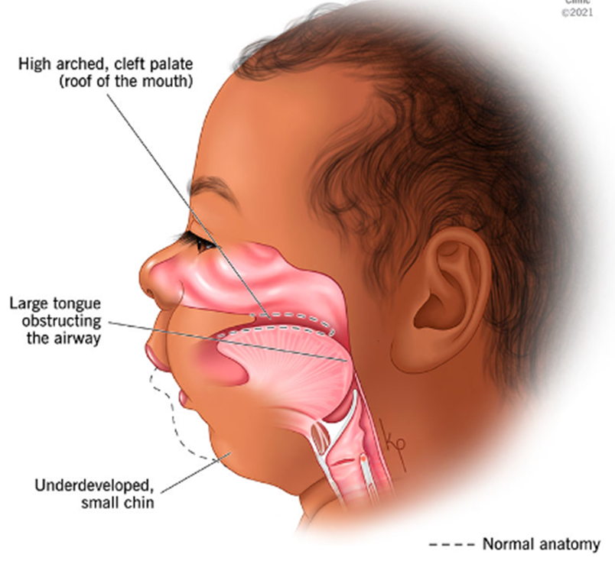
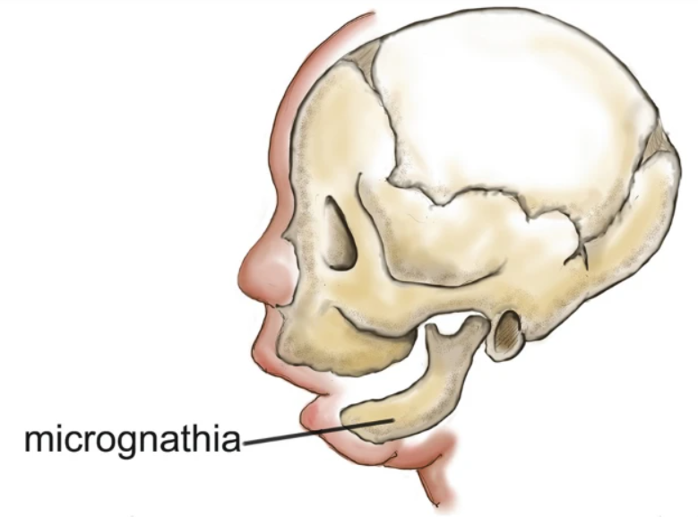
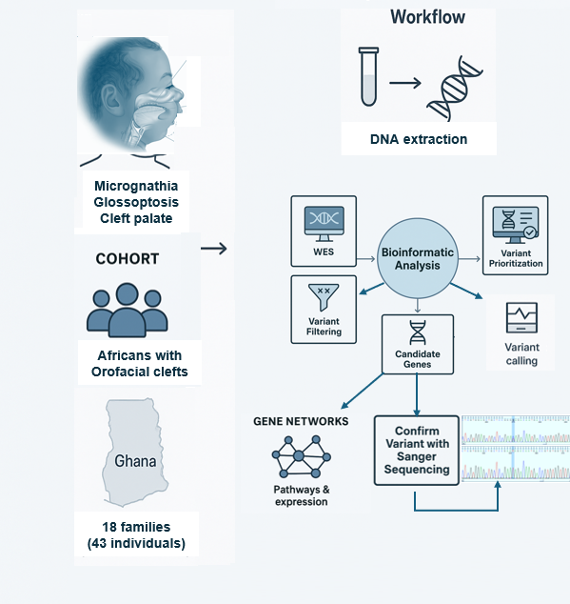
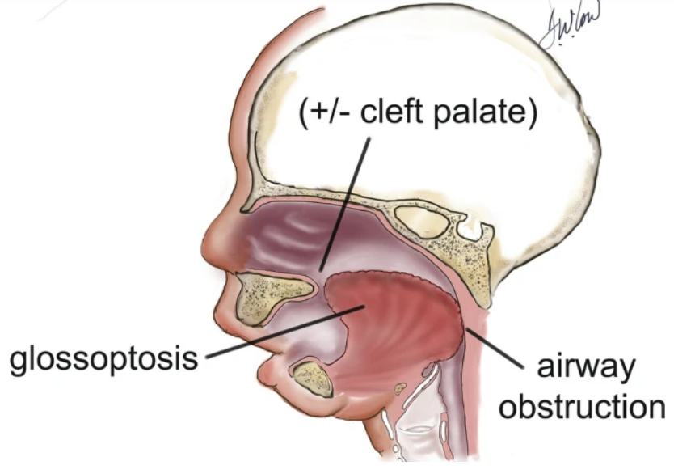


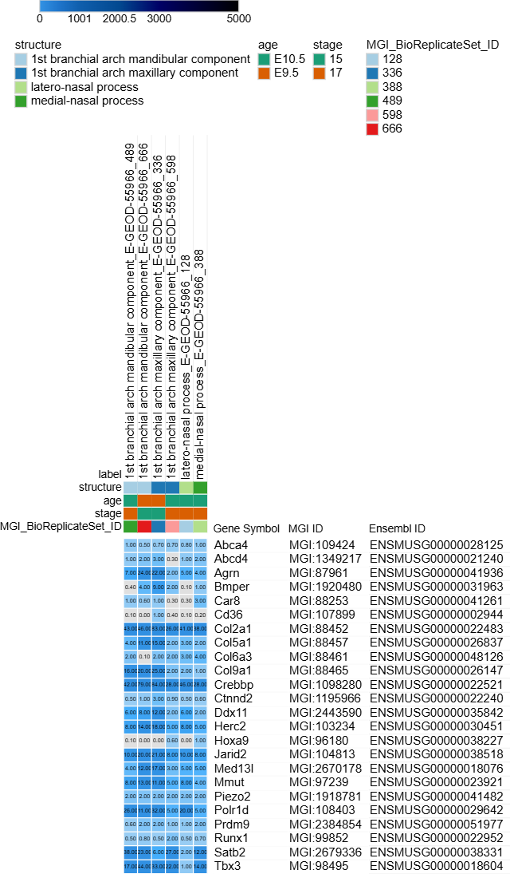
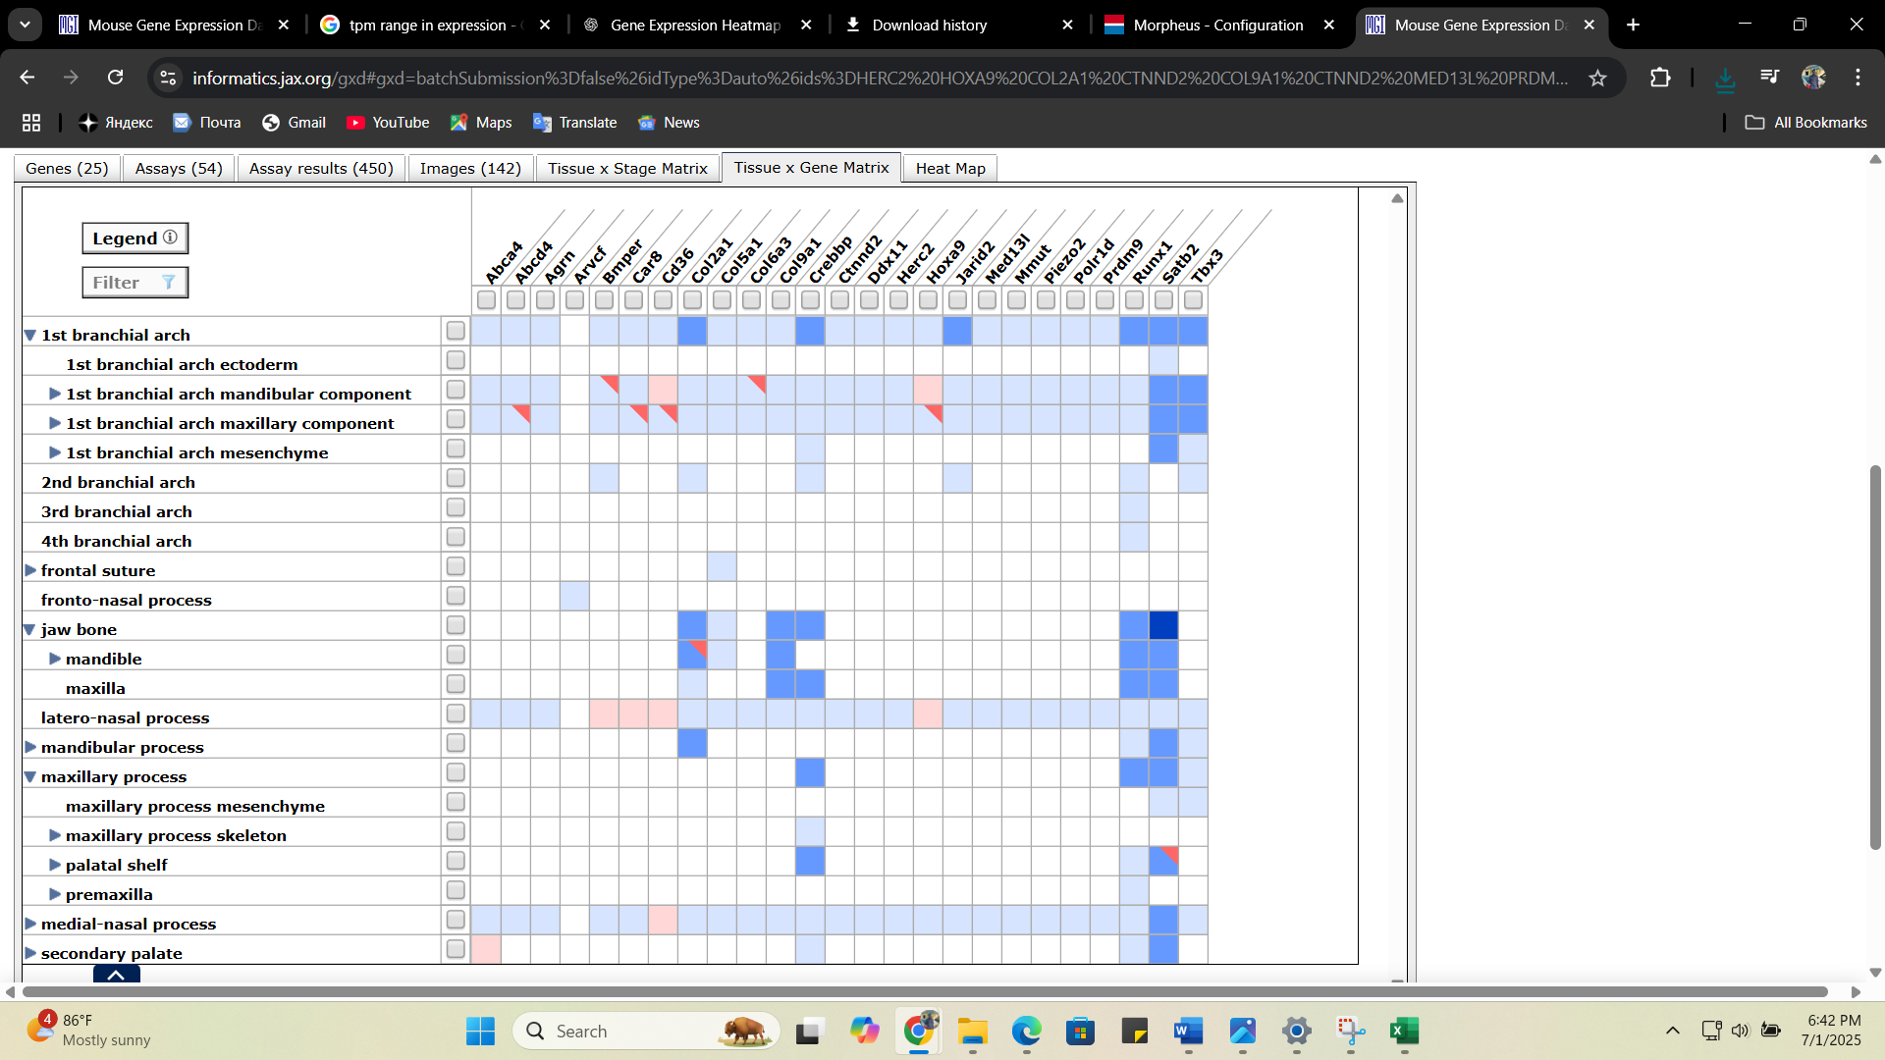
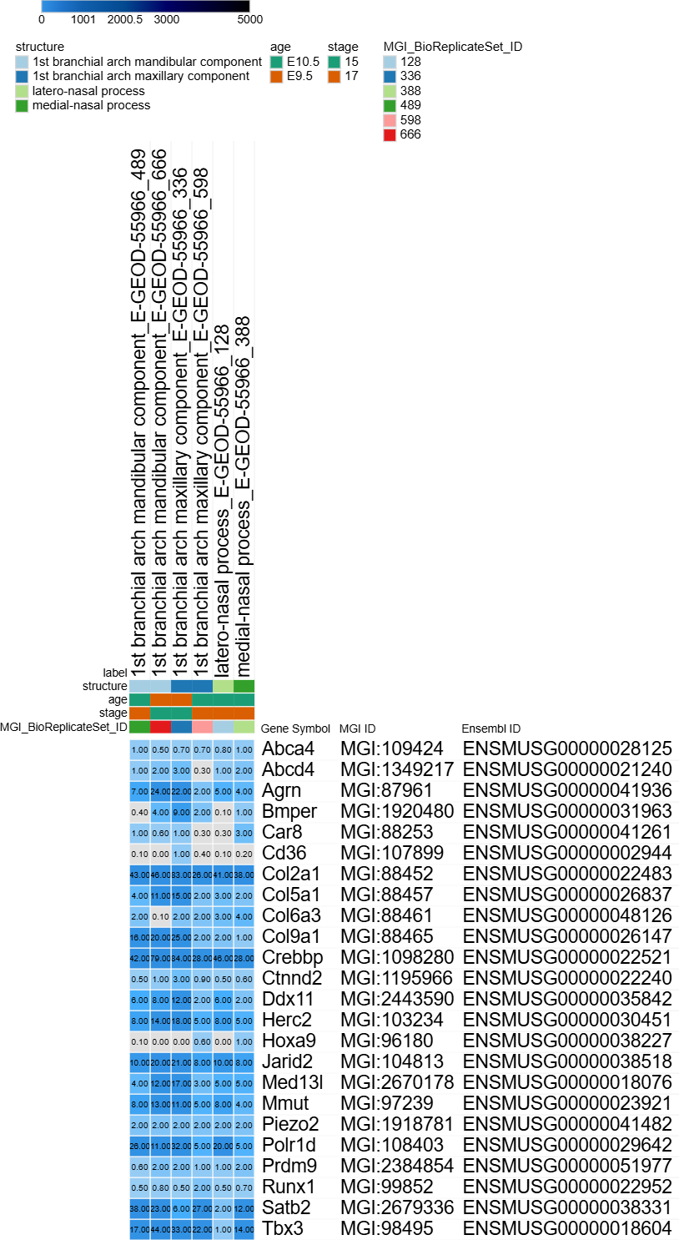
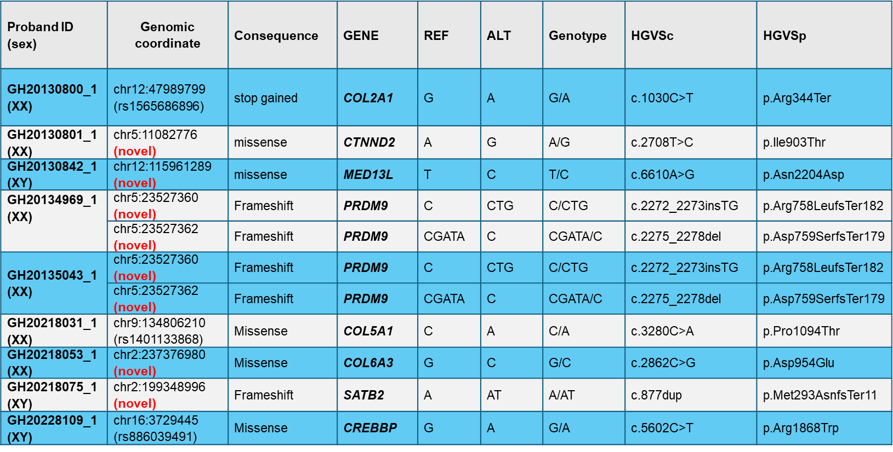



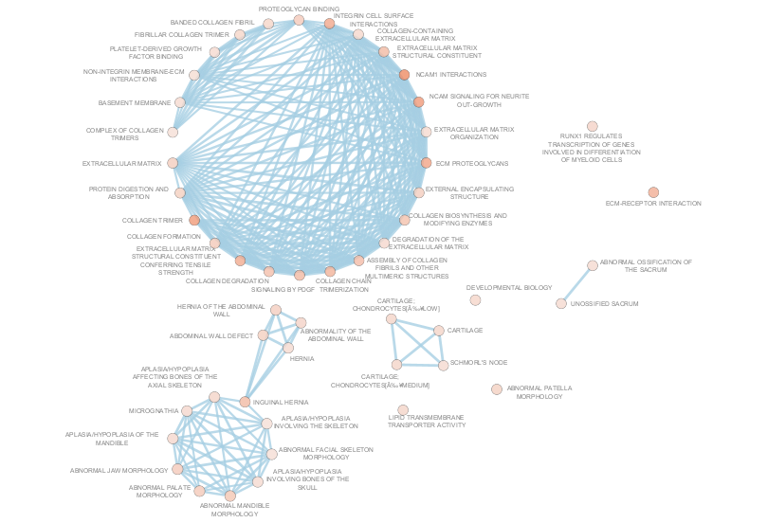
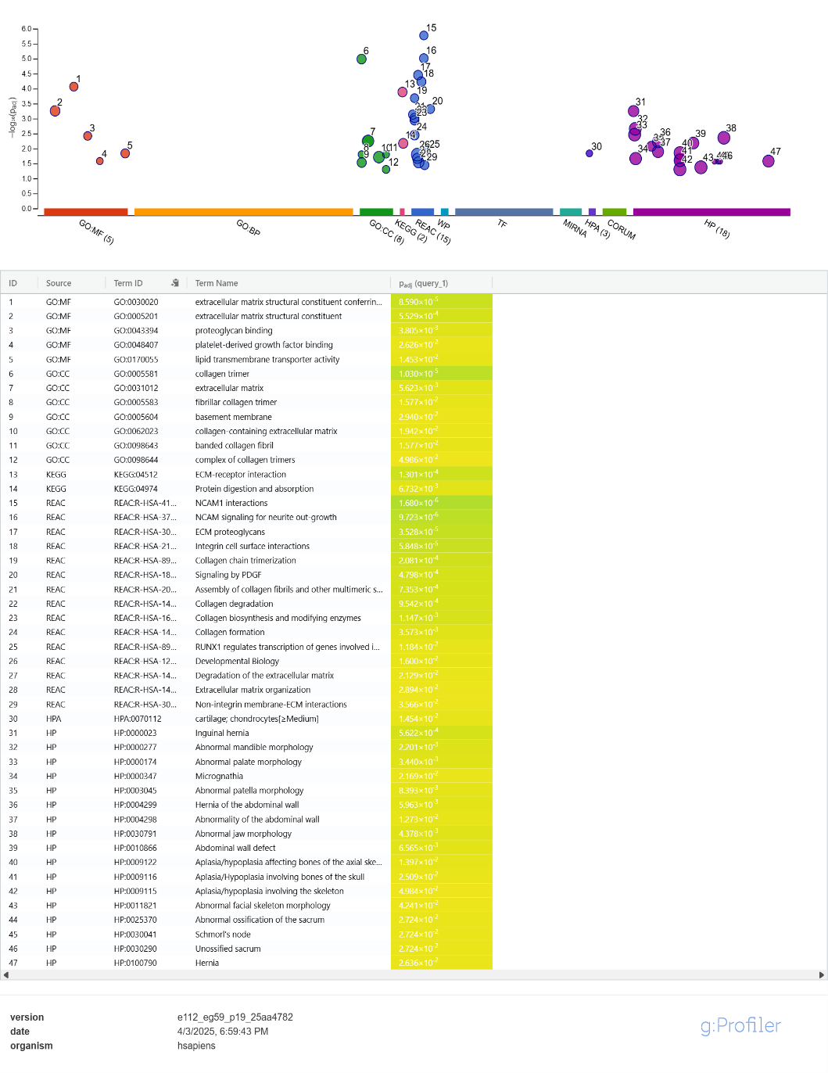
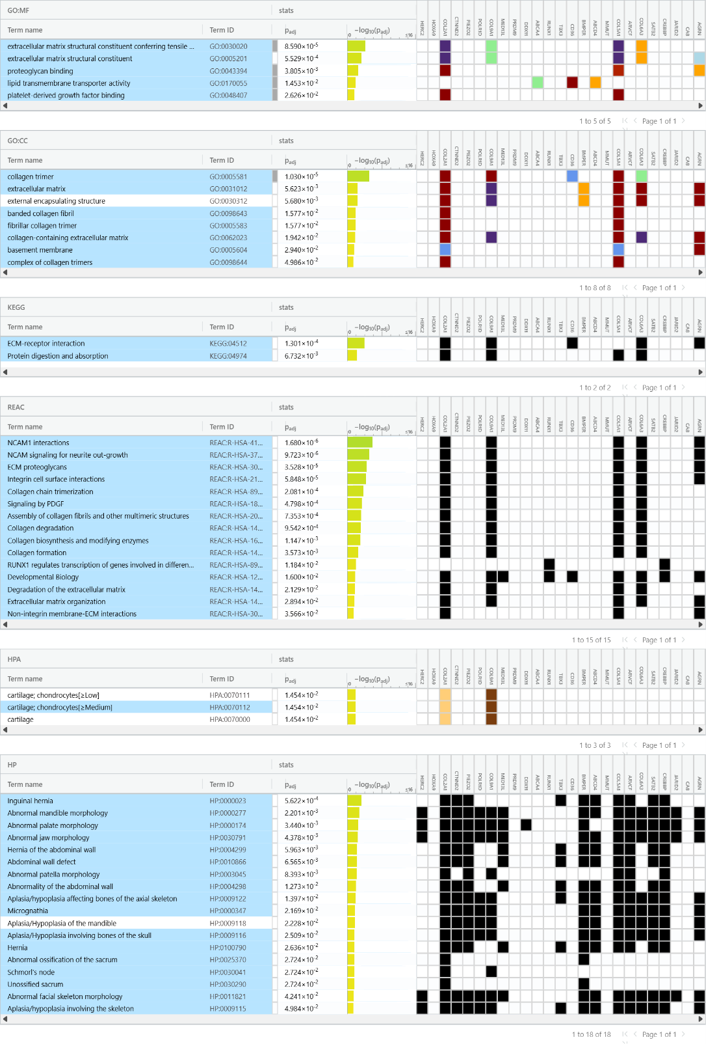
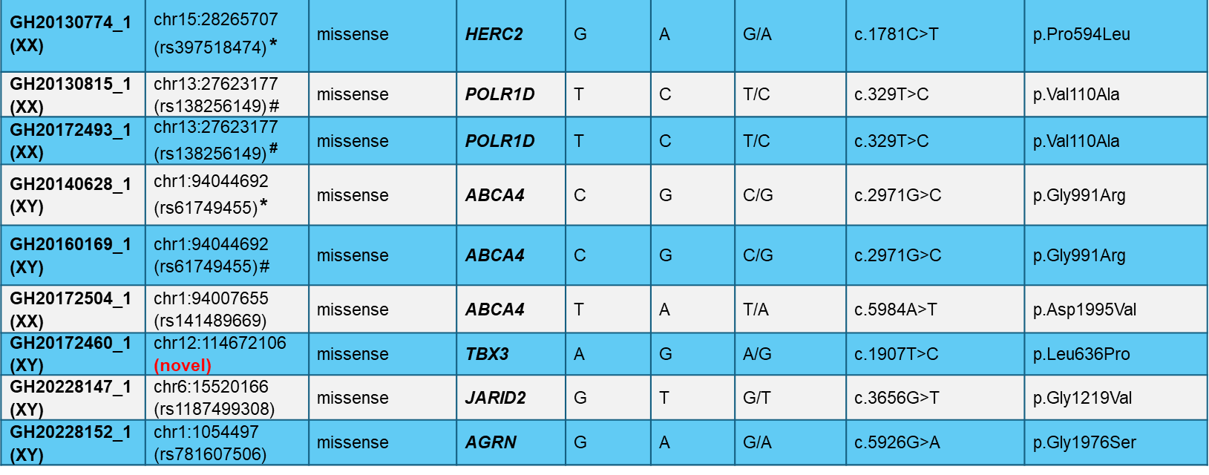

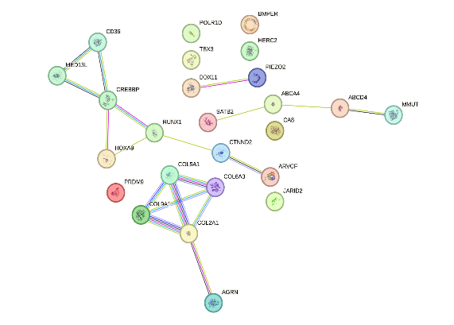

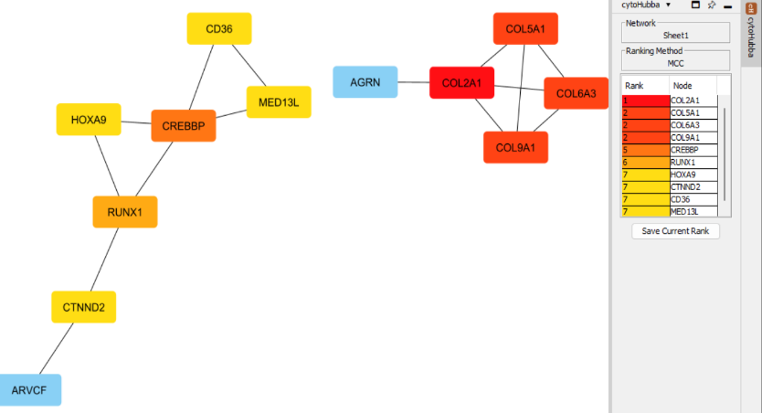
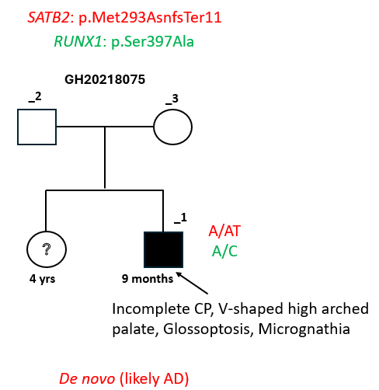
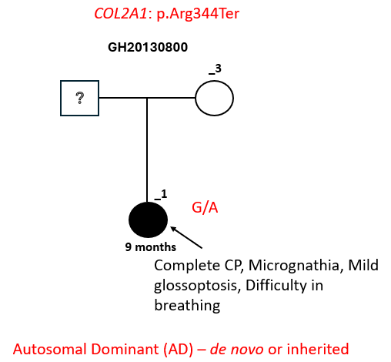
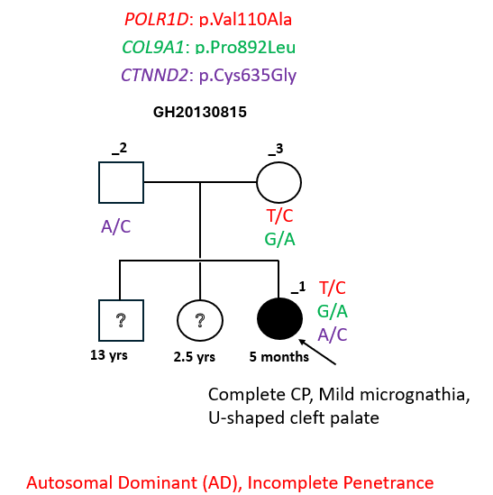
Genomic Architecture of Pierre Robin Sequence in Africans with Orofacial Clefts
CONTACT: Dr. Lord Jephthah Joojo Gowans ljjgowans@knust.edu.gh
Christian Opoku Asamoah¹, Gideon Okyere Mensah¹, Bruce Tsri¹, Edna Tackie¹, Abass Shaibu Danbaki¹, Elvis Poku-Adusei¹, Hafsa Akeyaa¹, Samuel Quaynor¹, Jonathan Kalami¹, Solomon Obiri-Yeboah^{2,3}, Tamara D. Busch^{4,5}, Emmanuel Temitope Aladenika^{4,5}, Hayan Raffi^{4,5}, Miskiyat Sanni^{4,5}, Daniel K. Sabbah^{2,3}, Gyikua Plange-Rhule^{2,6}, Alexander A. Oti³, Peter A. Mossey⁷, Adebowale A. Adeyemo⁸, Jeffery C. Murray⁹, Azeez Butali^{4,5}, Peter Donkor^{2,3,10}, Lord Jephthah Joojo Gowans^{1,2,3}
¹Department of Biochemistry and Biotechnology, Kwame Nkrumah University of Science and Technology (KNUST), Kumasi, Ghana ²National Cleft Care Center, Komfo Anokye Teaching Hospital, Kumasi, Ghana ³School of Dentistry, Kwame Nkrumah University of Science and Technology (KNUST), Kumasi, Ghana ⁴Department of Oral Pathology, Radiology and Medicine, University of Iowa, Iowa City, IA, USA ⁵Iowa Institute of Oral Health Research, University of Iowa, Iowa City, IA, USA ⁶Department of Child Health, Kwame Nkrumah University of Science and Technology (KNUST), Kumasi, Ghana ⁷Department of Orthodontics, University of Dundee, Dundee, UK ⁸National Human Genomic Research Institute, National Institutes of Health, Bethesda, MD, USA ⁹Department of Pediatrics, University of Iowa, Iowa City, IA, USA ¹⁰Department of Surgery, Kwame Nkrumah University of Science and Technology (KNUST), Kumasi, Ghana
Introduction
Objectives
Pierre Robin Sequence (PRS) is a clinically important subgroup of OFCs and one of the most common syndromes in individuals with CL/P.
It is characterized by a triad of micrognathia, glossoptosis and airway obstruction (and often cleft palate).
To detect and characterise rare genetic variants linked to PRS in Ghanaian cohort by using WES
To identify the various syndromes underlying PRS through clinical assessment & WES data set
To identify enriched pathways, hub genes and spatiotemporal expression patterns in PRS
Materials and Methods
Study design
Family-based cross-sectional study involving 18 Ghanaian families (case-parent trios or dyads)
Sample Collection
Written Consent; Ethical consideration, Questionnaire
Saliva samples were collected for DNA extraction
Whole Exome Sequencing
Whole exome sequencing (WES) was performed at 100X on DNA samples using the Illumina HiSeq platform.
Variant Calling and annotation
Pathway enrichment and interactome analysis with g:profiler STRING Cytoscape
Gene expression profiling with MGI GXD
Enrichment analysis
Variant Prioritization
Sentieon v202112.01 used to align read and call variants
Variants were annotated using Ensembl VEP
WES variant filtering process was based on ACMG guidelines
Rare and potentially pathogenic variants were identified
There remains a substantial gap in understanding the genetic and genomic foundations of PRS, particularly within African populations, including Ghana.
Results and Discussion
A. Identification of rare and potentially pathogenic variant
C. Gene Expression Profiles in Craniofacial Tissues
Genes include;
HERC2, COL5A1, COL6A3, COL2A1, CTNND2, POLR1D, MED13L, PRDM9, ABC4, TBX3, SATB2, CREBBP, JARID2, AGRN
PIEZO2, DDX11, RUNX1, CD36, BMPER, ABCD4, ARVCF, MMUT, CA8
Table 1: Rare and Potentially pathogenic variants observed in 18 Ghanaian PRS families
Figure 2: Expression Profiles of Candidate Genes in Craniofacial Tissues During Early Mouse Embryogenesis
D. Pathway enrichment and interactome analysis
Figure 3: Pathway enrichment and interactome analysis
NB: All these are canonical transcripts. All variants have MAF of less than 1%. * allele is also present in father # allele is also present in mother
Conclusions & Recommendations
B. Segregation analysis
This study provides valuable insights into the genetic and genomic basis of PRS in a Ghanaian cohort and aid in genetic testing and counselling
The aetiology of PRS often involves various syndromes; among these are Stickler syndrome (Collagen genes), Rubinstein-Taybi Syndrome (CREBBP) and other syndromes (POLR1D, TBX3, PRDM9)
Functional studies are needed to confirm the significance of the identified genetic variants in the Ghanaian population and beyond.
References
Bütow, K.-W., Hoogendijk, C. F., & Zwahlen, R. A. (2009). Pierre Robin sequence: Appearances and 25 years of experience with an innovative treatment protocol. Journal of Pediatric Surgery, 44(11), 2112–2118. Gowans, L. J. J., Adeyemo, W. L., Eshete, M., Mossey, P. A., Busch, T., Aregbesola, B., Donkor, P., Arthur, F. K. N., Bello, S. A., Martinez, A., Li, M., Augustine-Akpan, E. A., Deressa, W., Twumasi, P., Olutayo, J., Deribew, M., Agbenorku, P., Oti, A. A., Braimah, R., … Butali, A. (2016). Association Studies and Direct DNA Sequencing Implicate Genetic Susceptibility Loci in the Etiology of Nonsyndromic Orofacial Clefts in Sub-Saharan African Populations. Journal of Dental Research, 95(11), 1245–1. Jakobsen, L. P., Ullmann, R., Christensen, S. B., Jensen, K. E., Mølsted, K., Henriksen, K. F., Hansen, C., Knudsen, M. A., Larsen, L. A., Tommerup, N., & Tümer, Z. (2007). Pierre Robin sequence may be caused by dysregulation of SOX9 and KCNJ2. Journal of Medical Genetics, 44(6), 381–386.
Figure 1: Pedigrees of some selected families
Acknowledgement
We sincerely thank the study Participants, all the member of the cleft-craniofacial team at the National Cleft Care Center (NCCC), Komfo Anokye Teaching Hospital (KATH)
Funding: IADR/Smile Train Cleft Research Award, 2023, and K43DE029427 by NIDCR/FIC/NIH, USA (LJJG)

