Slide 1
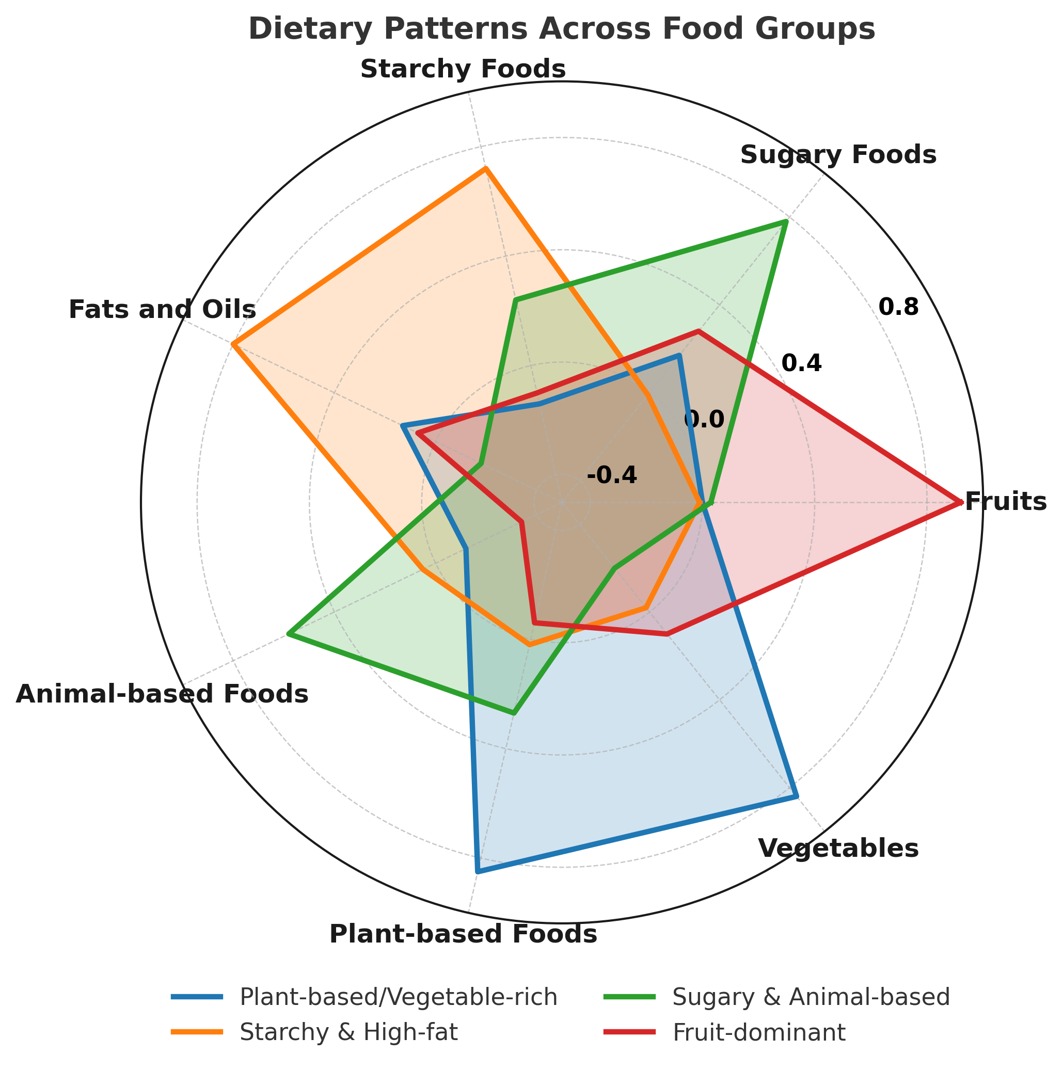
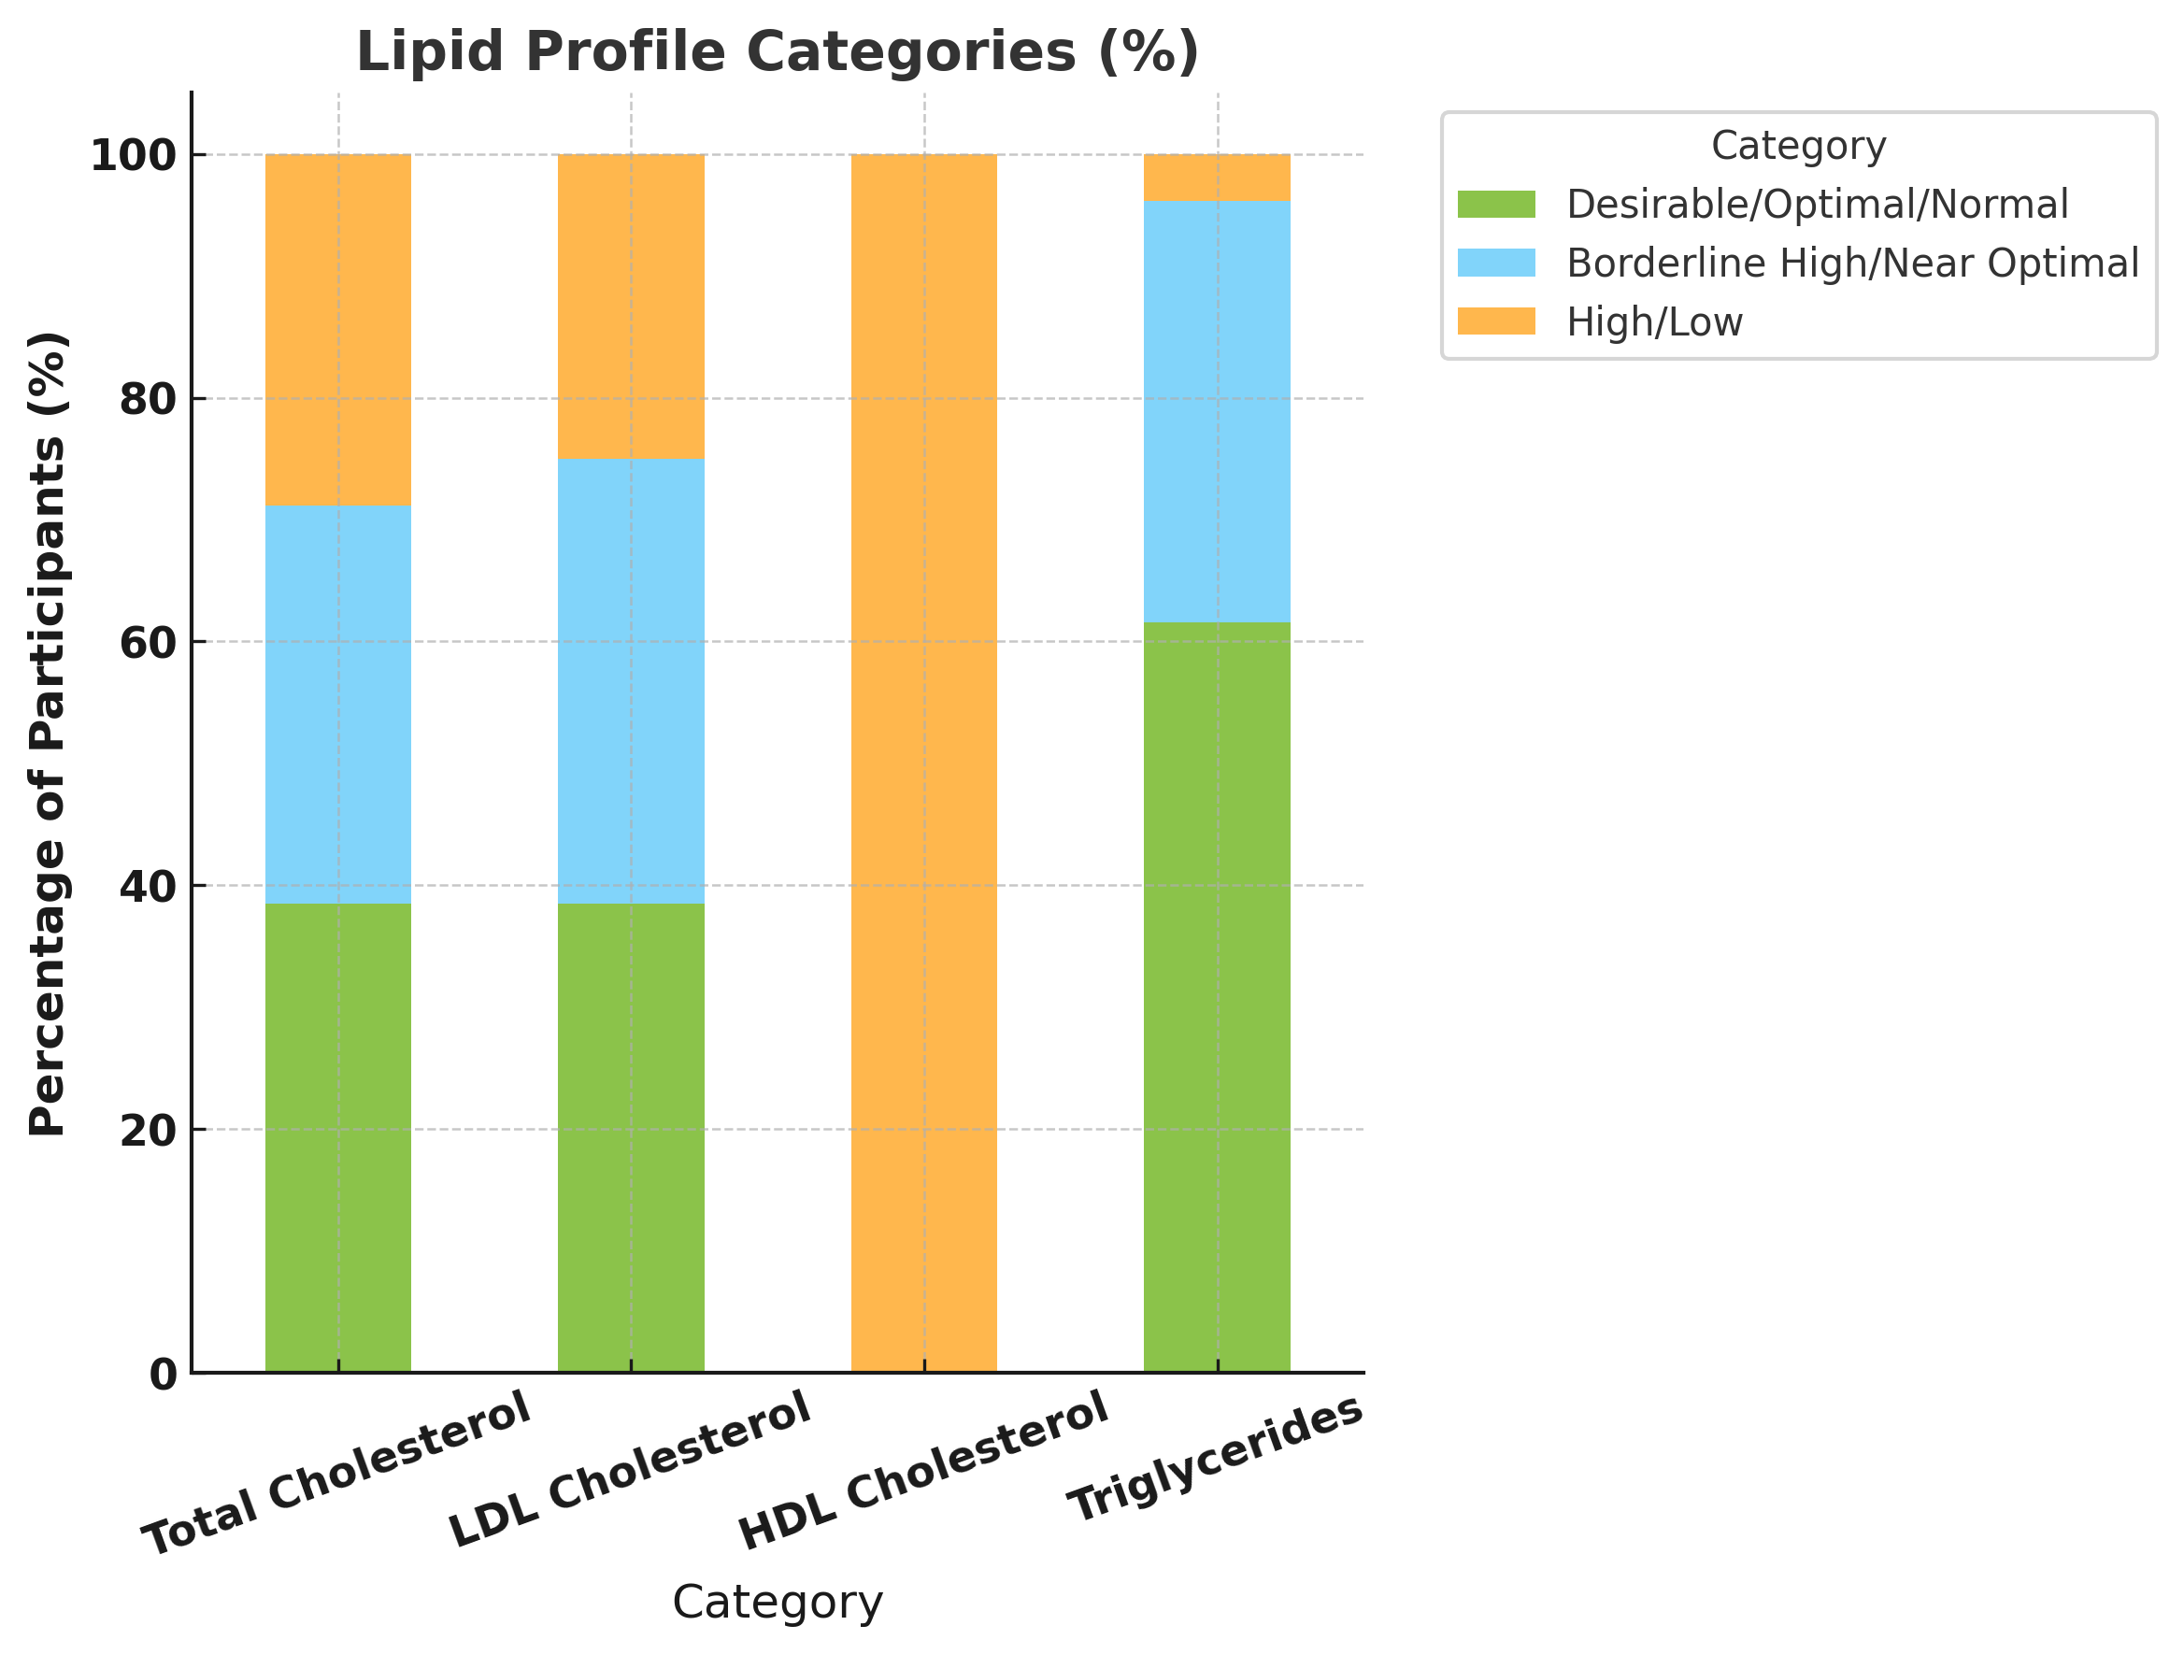
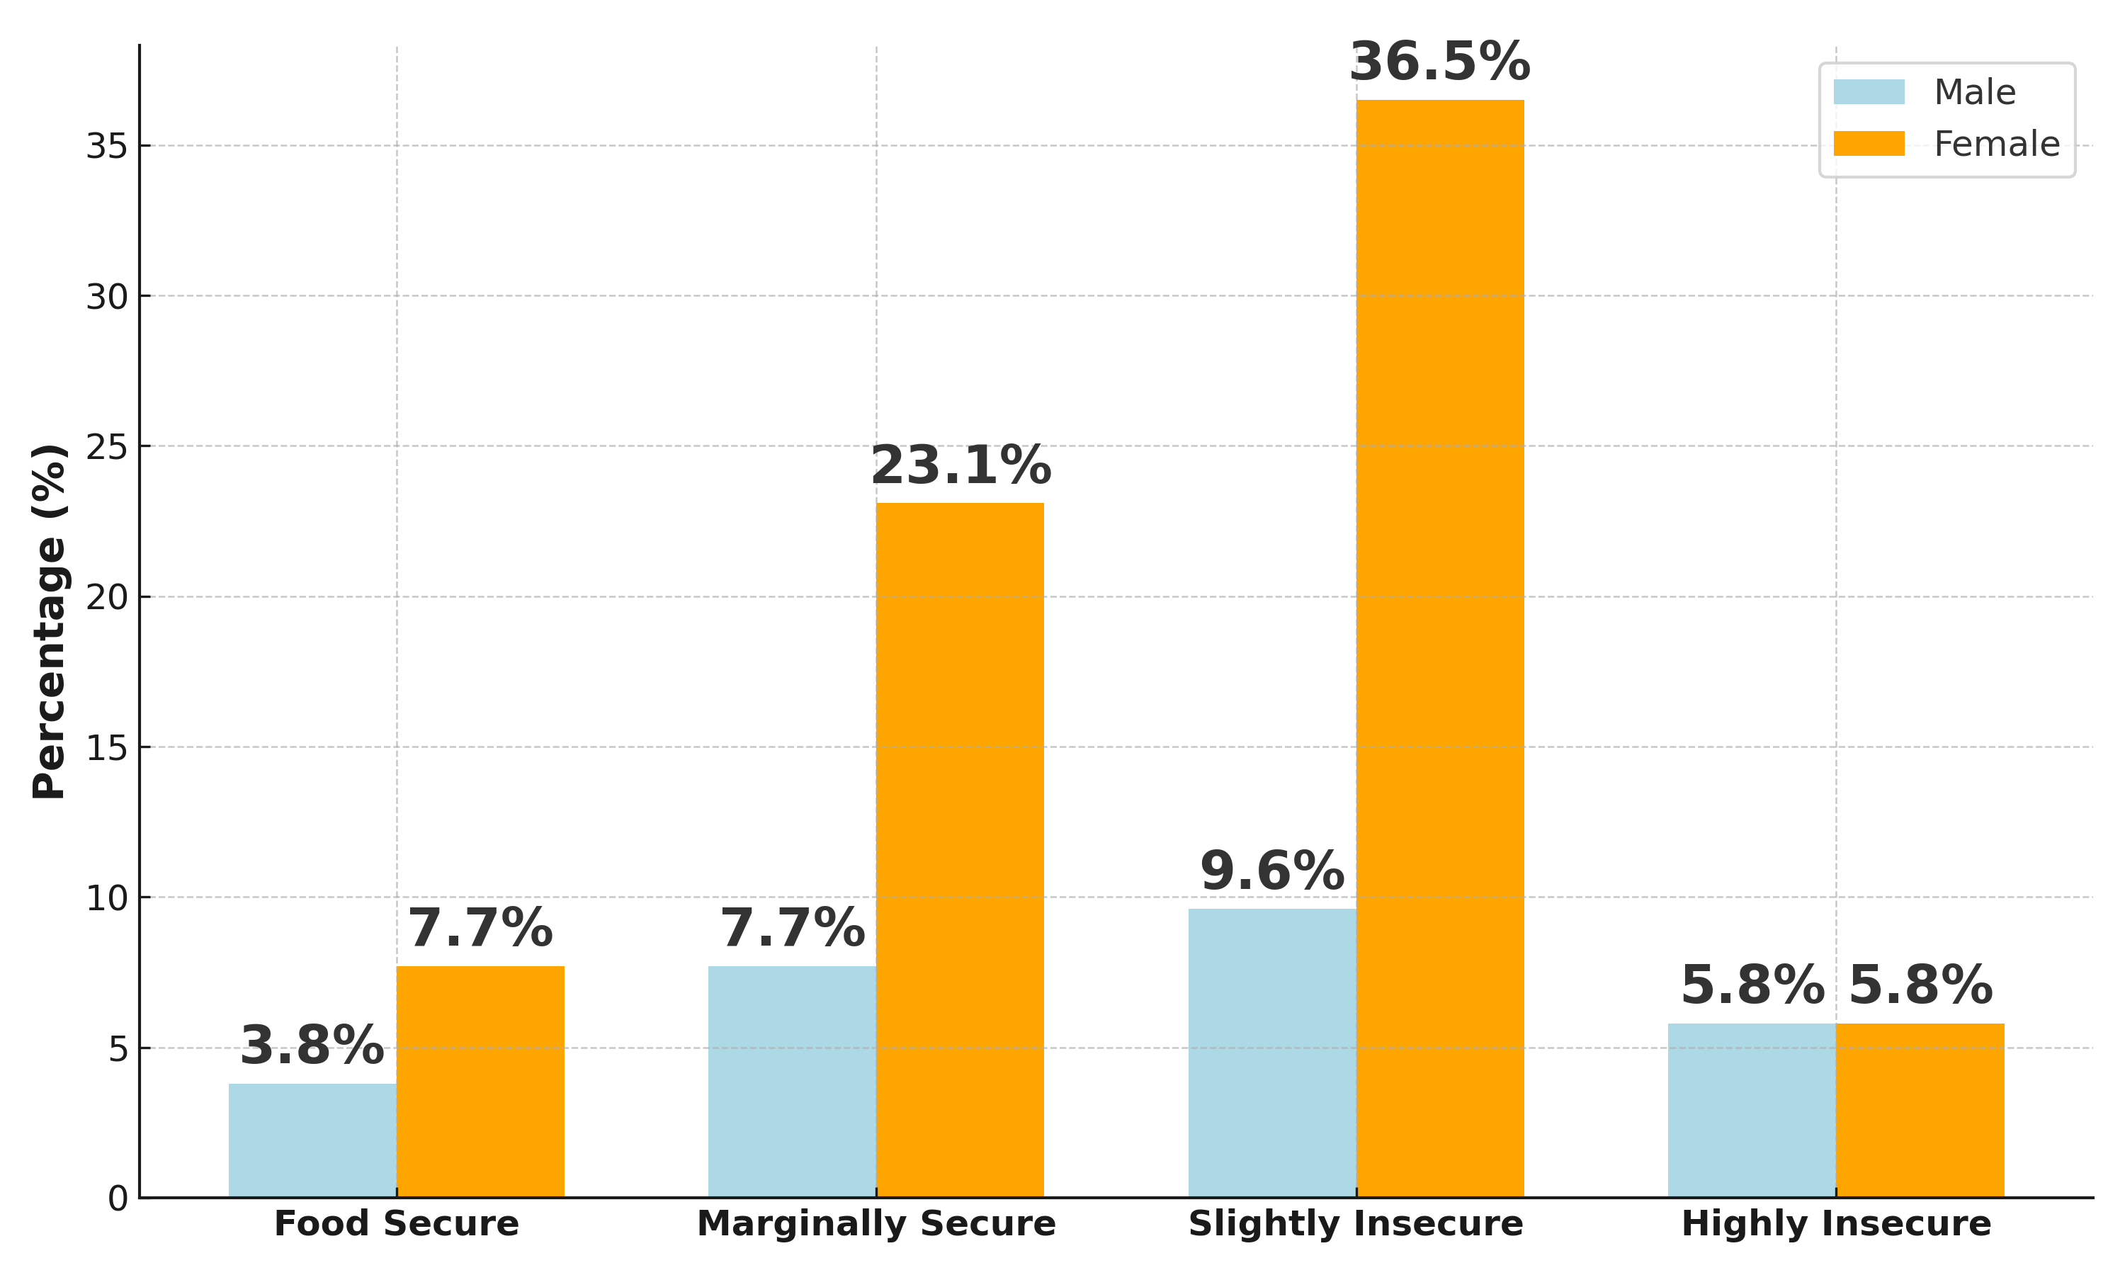
RELATIONSHIP BETWEEEN FOOD SECURITY, PSYCHOSOCIAL STRESS AND GLYCAEMIC STATUS IN INDIVIDUALS LIVING WITH TYPE 2 DIABETES ATTENDING AN OUTPATIENT CLINIC IN THE TAFO MUNICIPALITY, KUMASI
Cornelia Quainoo Donkor¹, Cassius Quaye¹ and Collins Afriyie Appiah*
¹Department of Biochemistry and Biotechnology, Kwame Nkrumah University of Science and Technology, Kumasi,
Ghana
*Corresponding author email: caappiah.cos@knust.edu.gh
3.8
INTRODUCTION
25.0
Type 2 diabetes (T2D) is a chronic disorder characterized by insulin resistance and impaired insulin production.
Globally, 589 million adults are living with diabetes, of which over 90% have Type 2 diabetes (IDF, 2025).
Food security and psychosocial stress could impact glycemic control in people with type 2 diabetes (FAO,2023)
28.8
34.6
36.5
32.7
61.5
38.5
38.5
Category
61.50
100
Desirable/ Optimal/Normal
AIMS &OBJECTIVES
Borderline High /Near Optimal
High
LDL
T. Chol
HDL
TG
AIM: To assess the relationship between food security, glycaemic status, lipid profile, and lifestyle factors among individuals living with type 2 diabetes (ILWT2D).
OBJECTIVES:
Assess dietary intake, food security status,
and psychosocial stress levels among ILWT2D.
2. To determine Blood glucose level (FBS, HbA1c) and
lipid profile (LDL, HDL, triglycerides, total cholesterol) among the ILWT2D.
3. To determine the relationship between food security, psychosocial stress, physical activity, glycaemic control and lipid profiles in the ILWT2D.
Lipid Profile Parameters
Figure 1.0 Dietary patterns across food groups
Figure 3.0 Lipid Profile of participants
Table 3.0 Associations between food security, psychosocial stress, physical activity, lipid profile, dietary patterns and glycemic status
Exposure Variable | Outcome Variable | r | p
Food security | HbA1c | -0.226 | 0.107
Psychosocial stress | HbA1c | +0.283 | 0.042*
Visceral Fat | HbA1c | +0.270 | 0.053
Food security | HDL cholesterol | -0.345 | 0.012*
Physical activity | LDL cholesterol | -0.303 | 0.029*
Visceral fat | FBS | +0.331 | 0.016*
Fruit-dominant diet | BMI | -0.330 | 0.017*
Starchy & high-fat diet | Triglycerides & VLDL | +0.302 | 0.029*
Figure 2.0 Food security status of participants
METHODOLOGY
Table 1.0 Psychosocial stress level of participants
Variable | Male n (%) | Female n (%) | Total n (%) | p- Value
PSQ index | 0.31 ± 0.07 | 0.36 ± 0.07 | 0.30 ± 0.06
Low stress | 6 (11.5%) | 29 (55.8%) | 35 (67.3%) | 0.01*
Moderate stress | 8 (15.4%) | 9 (17.3%) | 17 (32.7%)
Total | 14(26.9%) | 38(73.1%) | 52(100%)
A cross-sectional study was conducted from
January to July, 2025 among 52 ILWT2D aged
18 and above at the Tafo Government Hospital.
Body Weight, standing height and Waist
circumference were measured and BMI was
calculated.
FBS, HbA1c and lipid Profile tests were
performed. Data was entered into excel, analyzed
with SPSS.
CONCLUSION
Poor glycemic control was common in a large number
of participants.
There was a high rate of food insecurity among the participants.
Fruit-dominant patterns were protective against obesity, while starchy and high-fat dietary patterns were linked
to adverse lipid outcomes.
A considerable proportion of participants showed moderate psychosocial stress.
Psychosocial Stress and dietary patterns significantly influenced glycemic control.
Strategies to improve food insecurity, psychosocial stress, and dietary habits in ILWT2D could improve glycemic control and prevent progression to complications.
Table 2.0 Glycemic status of participants
Variables | Mean±SD | Male n (%) | Female n (%) | Total n (%) | p- Value
(HbA1c) | 7.04 ± 0.97 | 7.60 ± 1.27 | 6.84 ± 0.76 |  | 0.034*
Good Control |  | 4 (7.7%) | 27 (51.9%) | 31 (59.6%)
Poor Control |  | 10 (19.2%) | 11 (21.2%) | 21 (40.4%)
Total |  | 14 (26.9%) | 38 (73.1%) | 52 (100%)
Structured questionnaires were used to collect
information on: Food security status (USDA Food
security module), Dietary intake (FFQ), Physical
activity levels (IPAQ), Psychosocial stress levels
(PSQ).
REFERENCES
RESULTS
International Diabetes Federation. (2025). IDF Diabetes Atlas (11th ed.). International Diabetes Federation. https://diabetesatlas.org/resources/idf-diabetes-atlas-2025/
Food and Agriculture Organization of the United Nations, International Fund for Agricultural Development, United Nations International Children’s Emergency Fund, World Food Programme, & World Health Organization. (2023). The state of food security and nutrition in the world 2023. FAO. https://openknowledge.fao.org/items/445c9d27-b396-4126-96c9-50b335364d01
World Health Organization. (2023). The state of food security and nutrition in the world 2023. WHO. https://www.who.int/publications/m/item/the-state-of-food-security-and-nutrition-in-the-world-2023
The study included 52 participants, of whom 73% were female and 27% male.

