Slide 1

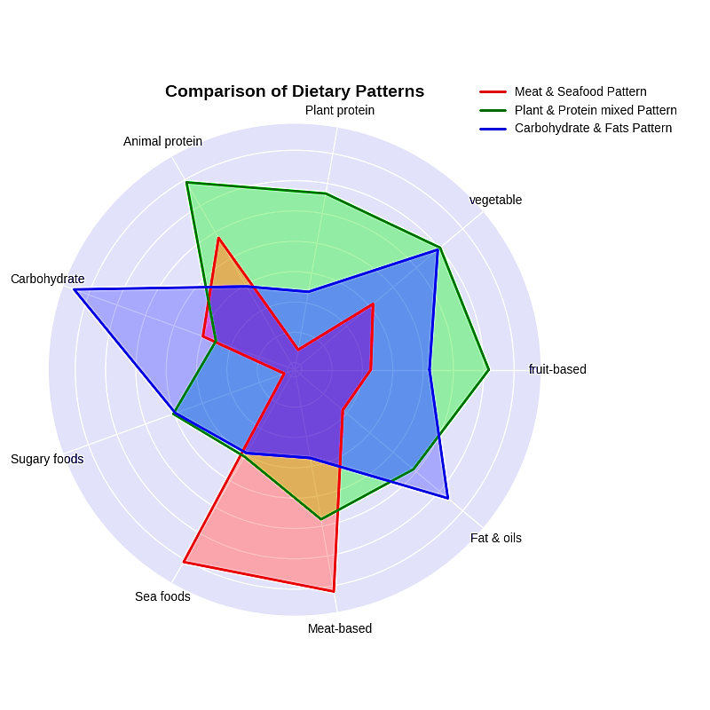
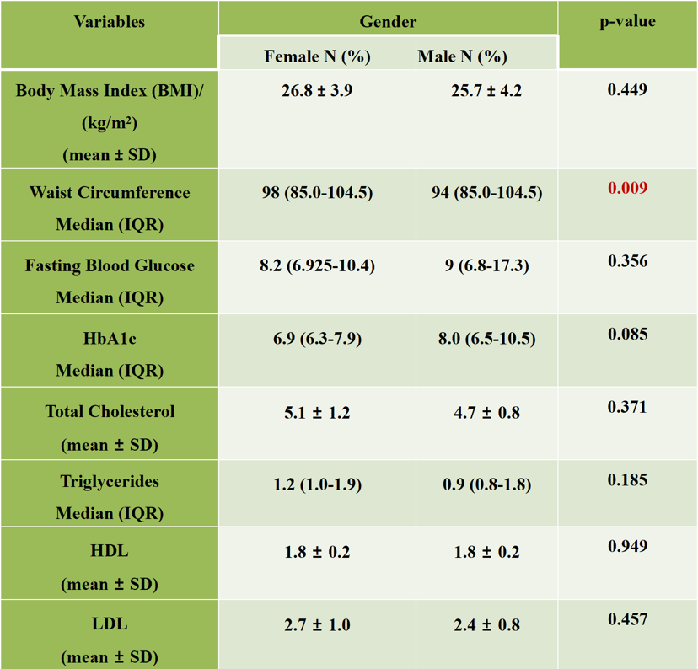
Food Security, Psychosocial Stress, and Glycemic Status of Individuals Living with Type 2 Diabetes Attending the Outpatient Clinic at Kumasi South Government Hospital, Asokwa Municipality, Ashanti Region.
Randy Kwarteng Ankrah¹, Pasmas Coffie¹, Rhoda Serwaah Yeboah¹, and Collins Afriyie Appiah ^{1,*}
¹ Department of Biochemistry and Biotechnology, Kwame Nkrumah University of Science and Technology, Kumasi, Ghana
*Corresponding author email: caappiah.cos@knust.edu.gh
Poster ID: 319
INTRODUCTION
RESULTS AND DISCUSSION
Table 1.0. Anthropometric and biochemical parameters
Type 2 Diabetes Mellitus (T2DM) characterized by insulin resistance and hyperglycemia, is often complicated by poor glycemic control and lipid abnormalities (Ong et al., 2023)
T2DM prevalence in the Ashanti region, ranges from 3.9% to 8.3% (Katey et al., 2022)
About 2.4 million (7.4%) Ghanaians are vulnerable to food insecurity (Ministry of Food and Agriculture, 2025)
Food insecurity and psychosocial stress could impact the glycemic control in T2DM (Sun et al., 2022)
AIM: To investigate the relationship between food security, psychosocial stress, and glycemic control of individuals living with type 2 diabetes (ILWT2D)
SPECIFIC OBJECTIVES:
Assess dietary intake of participants
Assess anthropometric data and biochemical parameters (BMI, waist circumference, HbA1c, lipid profile)
Assess food security, psychosocial stress, and physical activity
Relationship between food security, psychosocial stress, physical activity, and glycemic status of ILWT2D
Figure 1: Dietary patterns across food groups
Table 2.0. Correlation between psychosocial stress, food security, dietary patterns, lipid profile, and glycemic status
Variable | HbA1c r, (p) | TC r, (p) | TG r, (p) | HDL r, (p) | LDL r, (p) | VLDL r, (p) | CR r, (p)
Food Insecurity | 0.163, (0.259) | -0.114, (0.432) | -0.019, (0.893) | -0.110, (0.447) | -0.098, (0.496) | -0.019, (0.896) | -0.044, (0.763)
Psychosocial Stress | -0.048, (0.741) | -0.113, (0.435) | -0.154, (0.287) | 0.130, (0.369) | -0.118, (0.415) | -0.156, (0.297) | -0.201, (0.161)
Physical Activity | -0.211, (0.142) | -0.031, (0.832) | -0.154, (0.286) | 0.389, (0.005)** | -0.083, (0.565) | -0.155, (0.282) | -0.223, (0.119)
BMI | -0.077, (0.595) | 0.153, (0.290) | 0.175, (0.224) | 0.138, (0.339) | 0.099, (0.495) | -0.175, (0.225) | 0.092, (0.524)
Meat & Seafood Pattern | -0.115, (0.426) | 0.054, (0.711) | 0.147, (0.307) | -0.001, (0.994) | 0.025, (0.861) | 0.148, (0.306) | 0.037, (0.801)
Plant & Protein mixed | -0.216, (0.131) | -0.149, (0.302) | -0.146, (0.313) | 0.151, (0.294) | -0.165, (0.252) | -0.147, (0.310) | -0.248, (0.083)
Carbohydrate & Fats | -0.015, (0.916) | 0.198, (0.168) | 0.129, (0.373) | 0.148, (0.304) | 0.158, (0.273) | 0.129, (0.373) | 0.119, (0.410)
Figure 2: Food security status of participants
MATERIALS AND METHODS
STUDY DESIGN :
Cross-sectional study among 50 adults living with type 2 diabetes attending the outpatient clinic at Kumasi South Government Hospital, Ashanti Region.
MEASUREMENTS:
Anthropometry (weight, height, BMI, waist circumference)
Biochemical parameters (FBS, HbA1c, lipid panel)
CONCLUSION
A high prevalence of food insecurity was observed among the participants.
A high percentage of the participants experienced moderate to high psychosocial stress levels.
Nearly half of the participants had poor glycemic control.
No significant relationship were found between food insecurity, psychosocial stress, dietary patterns, and glycaemic status.
Strategic interventions combining dietary modification, psychosocial support and adequate food security are essential to improve health outcomes among these participants
DATA COLLECTION TOOLS:
USDA Adult Food Security Survey Module (AFSSM) → food security
Perceived Stress Questionnaire (PSQ) → psychosocial stress
International Physical Activity Questionnaire-Short Form (IPAQ-SF) → physical activity
Food Frequency Questionnaire → dietary intake assessment
Figure 3: Psychosocial stress status of participants
REFERENCES
ANALYSIS:
Data coded in Excel, analyzed with SPSS v26 using descriptive statistics, chi-square, and correlation tests
Katey, D., Addo, A. A., Abass, K., & Morgan, A. K. (2022). Prevalence study of type 2 diabetes mellitus in the Ashanti region of Ghana: a systematic review of risk factors. Journal of Endocrinology, Metabolism and Diabetes of South Africa, 27(3), 93–99. https://doi.org/10.1080/16089677.2022.2074121
Ong, K. L., Stafford, L. K., McLaughlin, S. A., Boyko, E. J., Vollset, S. E., Smith, A. E., Dalton, B. E., Duprey, J., Cruz, J. A., Hagins, H., Lindstedt, P. A., Aali, A., Abate, Y. H., Abate, M. D., Abbasian, M., Abbasi-Kangevari, Z., Abbasi-Kangevari, M., Abd ElHafeez, S., Abd-Rabu, R., … Vos, T. (2023). Global, regional, and national burden of diabetes from 1990 to 2021, with projections of prevalence to 2050: a systematic analysis for the Global Burden of Disease Study 2021. The Lancet, 402(10397), 203–234. https://doi.org/10.1016/S0140-6736(23)01301-6
Ministry of Food and Agriculture. (2025). Food insecurity and food security situation overview in Ghana
Figure 4: Glycemic status of participants

