Slide 1
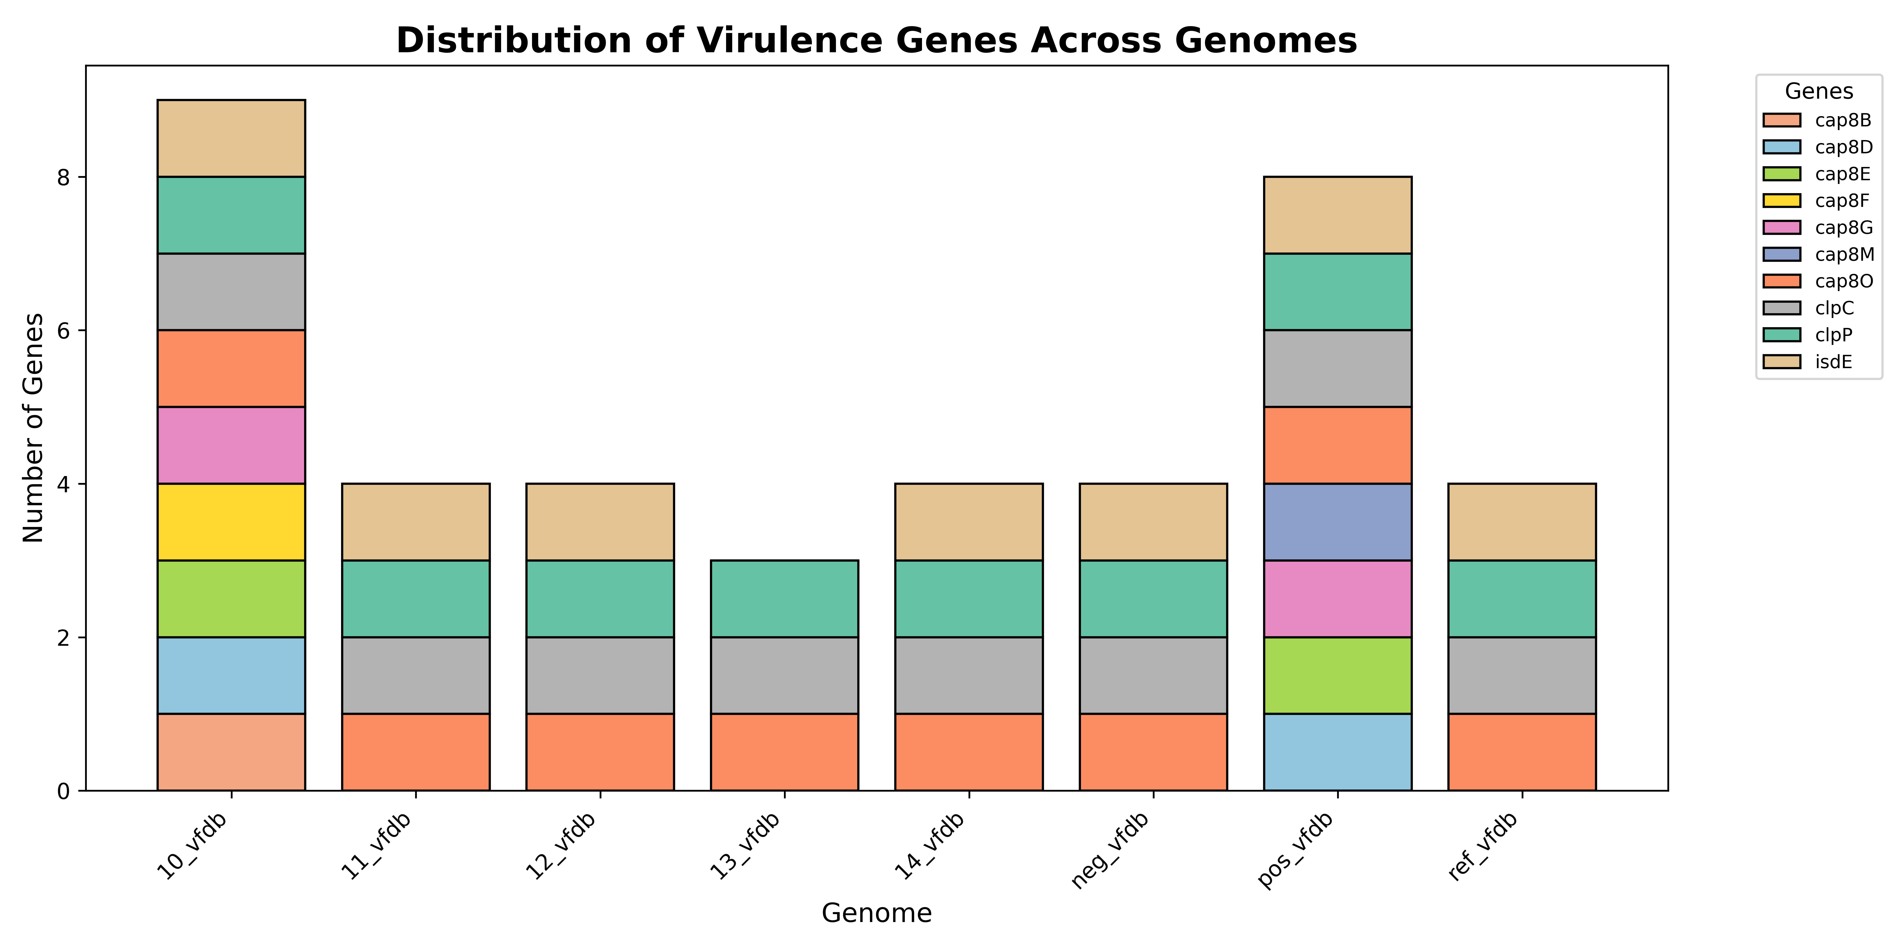
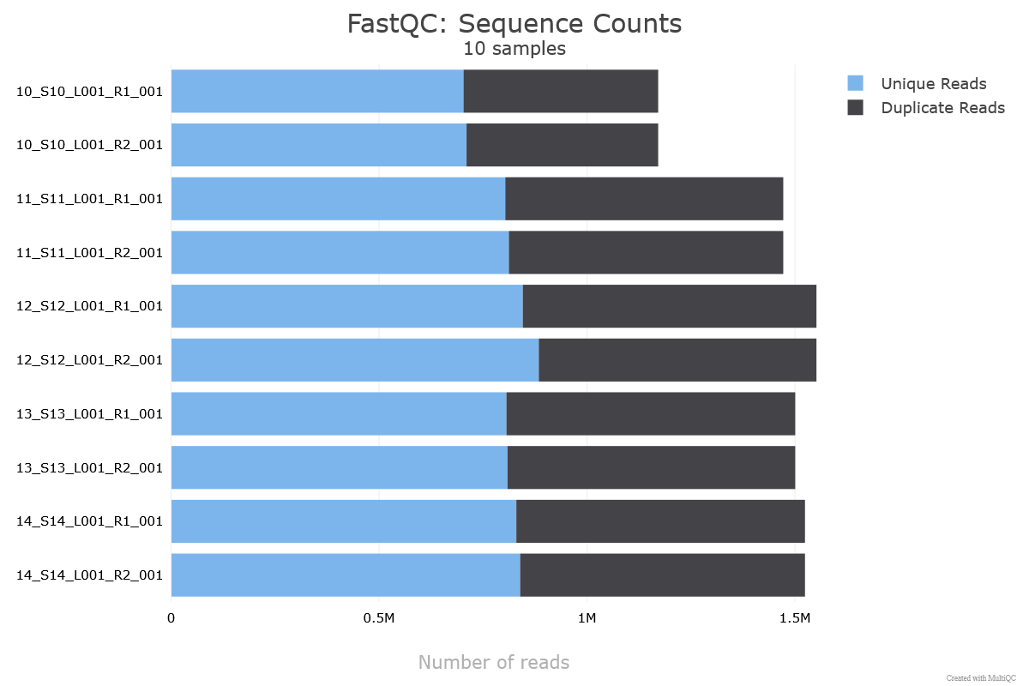
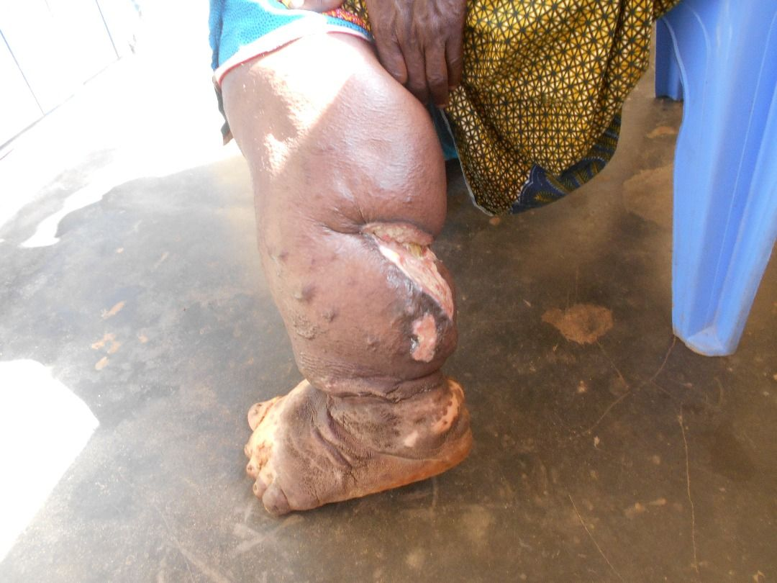
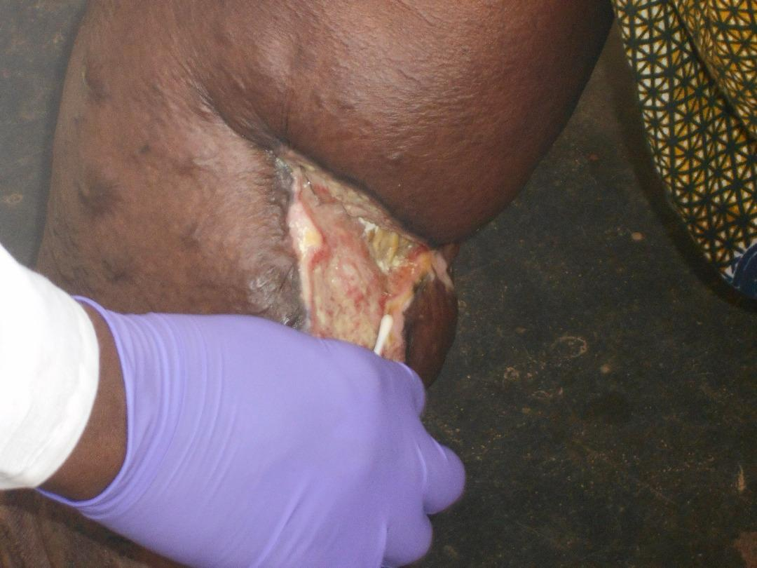
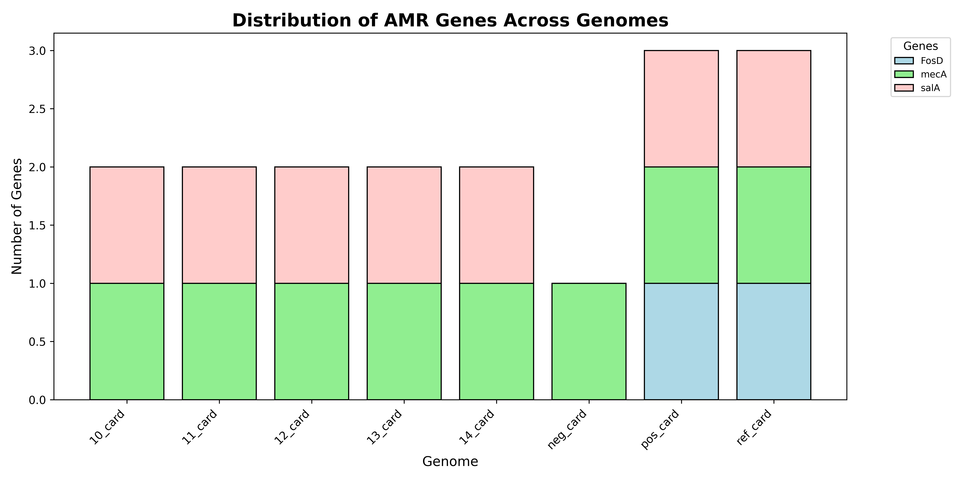
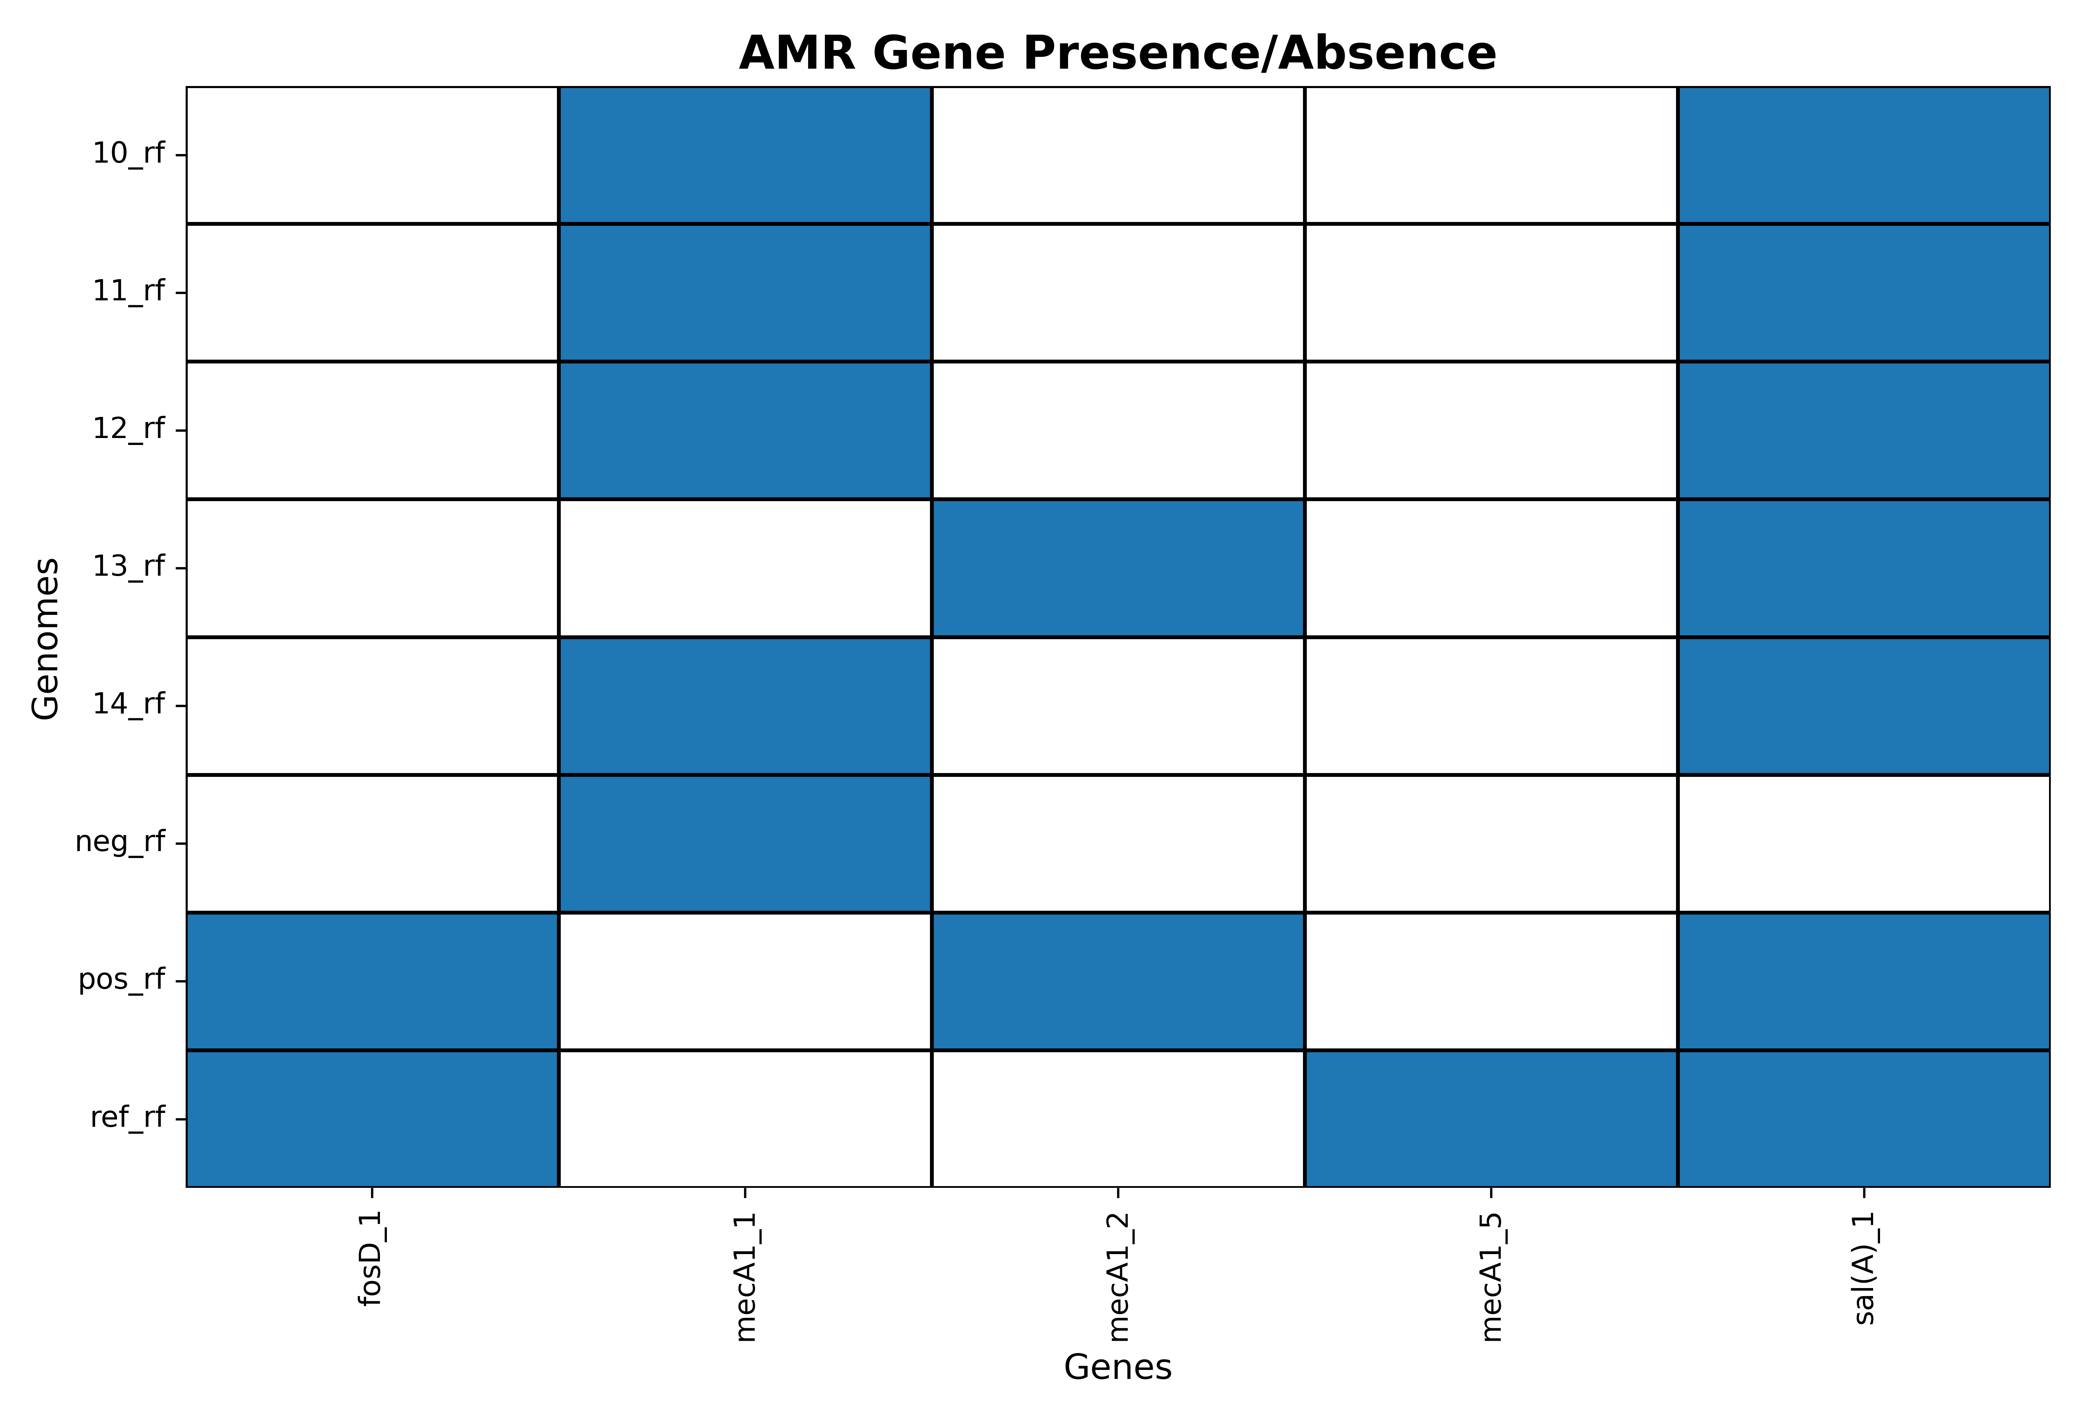

MOLECULAR CHARACTERIZATION OF Staphylococcus Sciuri ISOLATED FROM FILARIAL LYMPHOEDEMA WOUNDS IN SOUTHERN GHANA
Gyasi Kweku Foh
Department of Biochemistry and Biotechnology, Kwame Nkrumah University of Science and Technology (KNUST), Kumasi, Ghana
kwekugyasi66@gmail.com
INTRODUCTION
RESULTS AND DISCUSSION
Lymphatic filariasis, a neglected tropical disease caused by the parasites: Wuchereria bancrofti, Brugia malayi and Brugia timori, affects over 120 million people worldwide (Kwarteng et al., 2023).
Wounds develop on surface of lymphedema. Bacterial pathogens take advantage of these chronic wounds and contribute to further complications (Maheswary et al., 2021).
Staphylococcus sciuri has been implicated in these wounds. wounds. Molecular characterization techniques will enable the genetic analysis of this pathogen (Jha et al., 2017).
Fig3. duplication counts after sequencing
Measures | 10.fna | 11.fna | 12.fna | 13.fna | 14.fna
Duplication ratio | 1.001 | 1 | 1 | 0.999 | 1
NGA50 | 84265 | 42599 | 51586 | 64657 | 66749
Contigs | 14 | 23 | 21 | 19 | 20
Fig6. Virulence from VFDB
Table1. summary QUAST results
All S. sciuri isolates carried various virulence genes, reinforcing their pathogenic potential.
All S. sciuri isolates carried mecA gene found in MRSA.
B-lactam antibiotics should not be used in therapy but fosfomycin should be encouraged.
Fig1. Lymphedema With Open Wounds
Measures | 10.fna | 11.fna | 12.fna | 13.fna | 14.fna | Pos.fna | Neg.fna | Ref.fna
CDS | 2678 | 2738 | 2728 | 2514 | 2625 | 2774 | 2843 | 2720
Genes | 2749 | 2807 | 2799 | 2583 | 2696 | 2844 | 2912 | 2800
Unique genes | 119 | 138 | 152 | 183 | 83 | 250 | 232 | 241
CONCLUSION & RECOMMENDATION
Fig2. Lymphedema with Open Wounds
S.sciuri from LF-associated wounds carries several resistance (eg. mecA, salA) and virulence genes (eg. cap8B, clpC, isdE etc), highlighting their pathogenicity.
Future studies should expand resistance profiling from several clinical isolates and access environmental and antibiotic-use factors.
AIM AND OBJECTIVES
Table 2. summary annotation results
AIM
To characterize and study the whole genome sequence of S. sciuri from filarial lymphedema.
SPECIFIC OBJECTIVES
To isolate and identify S.sciuri from wound swabs of lymphedema patients.
To detect antibacterial resistance and virulence genes in S.sciuri.
ACKNOWLEDGEMENT
We are grateful to all members of the Kwarteng Lab for their guidance and support throughout this project.
REFERENCES
Jha, R., Gangwar, M., Chahar, D., Setty Balakrishnan, A., Negi, M. P. S., & Misra-Bhattacharya, S. (2017). Humans from Wuchereria bancrofti endemic area elicit substantial immune response to proteins of the filarial parasite Brugia malayi and its endosymbiont Wolbachia. Parasites & vectors, 10, 1-14
Kwarteng, A., Kenyon, K. H., Asiedu, S. O., Garcia, R., Kini, P., Osei-Poku, P., Kwarteng, E. S. and Amewu, E. K. A. (2023). Knowledge and perceptions of lymphatic filariasis patients in selected hotspot endemic communities in southern Ghana. PLOS Global Public Health, 3(10 October), 1–11. https://doi.org/10.1371/journal.pgph.0002476
Maheswary, T., Nurul, A. A., & Fauzi, M. B. (2021). The insights of microbes’ roles in wound healing: A comprehensive review. Pharmaceutics, 13(7), 981.
METHODS
Fig4. AMR from CARD
Data and sample collection
Bacteria culture and identification
DNA extraction and sequencing
Bioinformatic Analysis
Fig5. AMR from Resfinder

