Slide 1




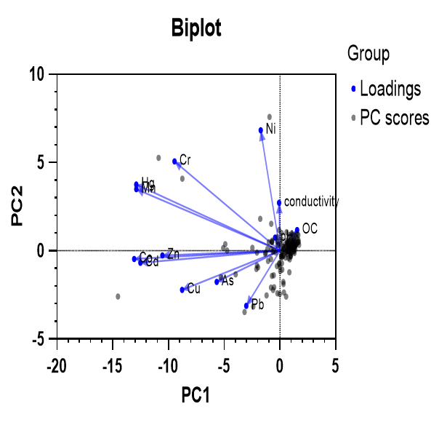
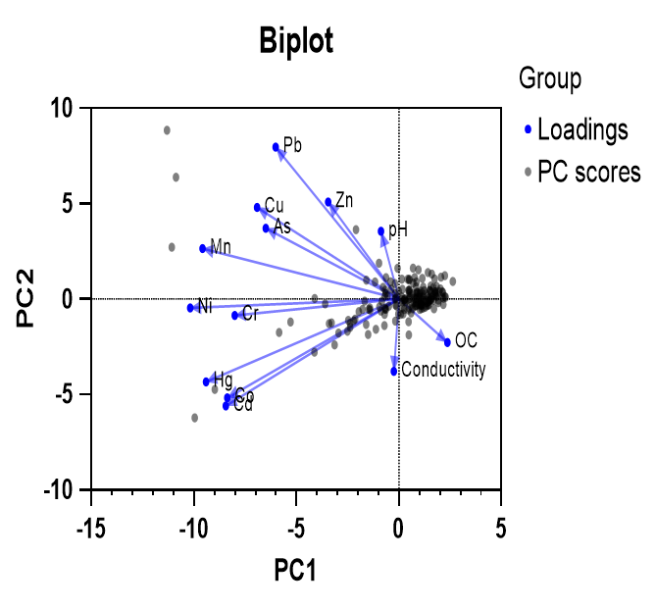
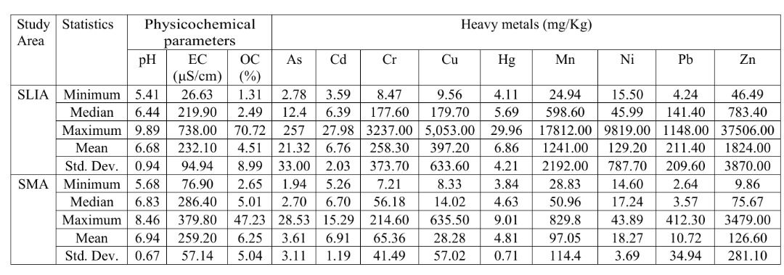
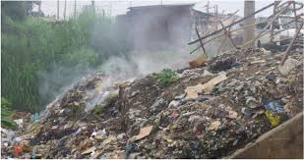
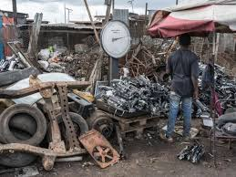
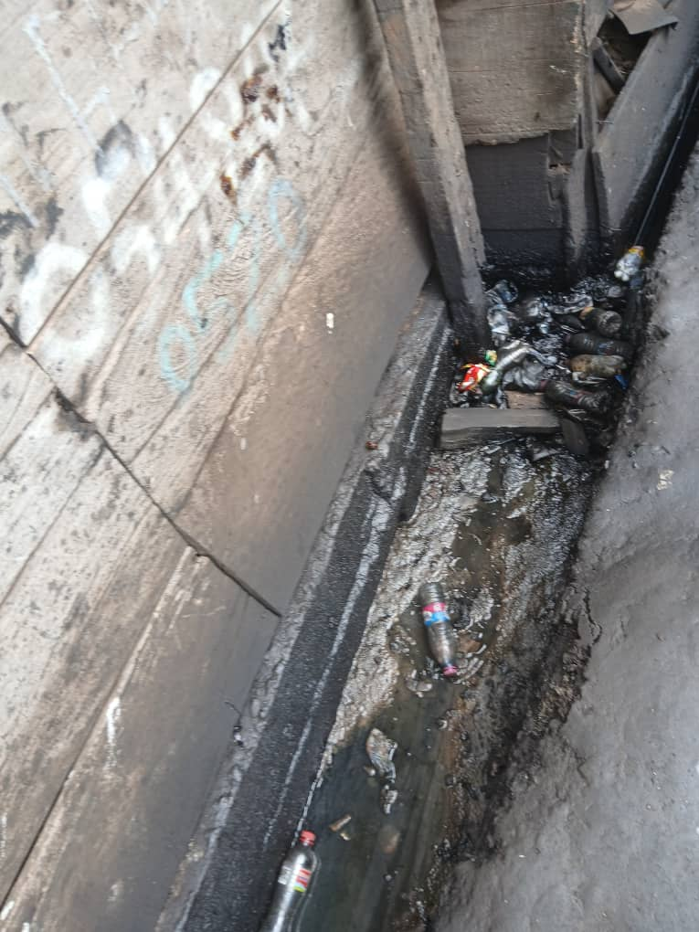
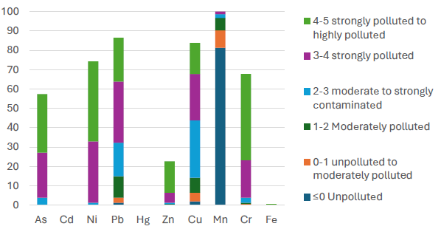
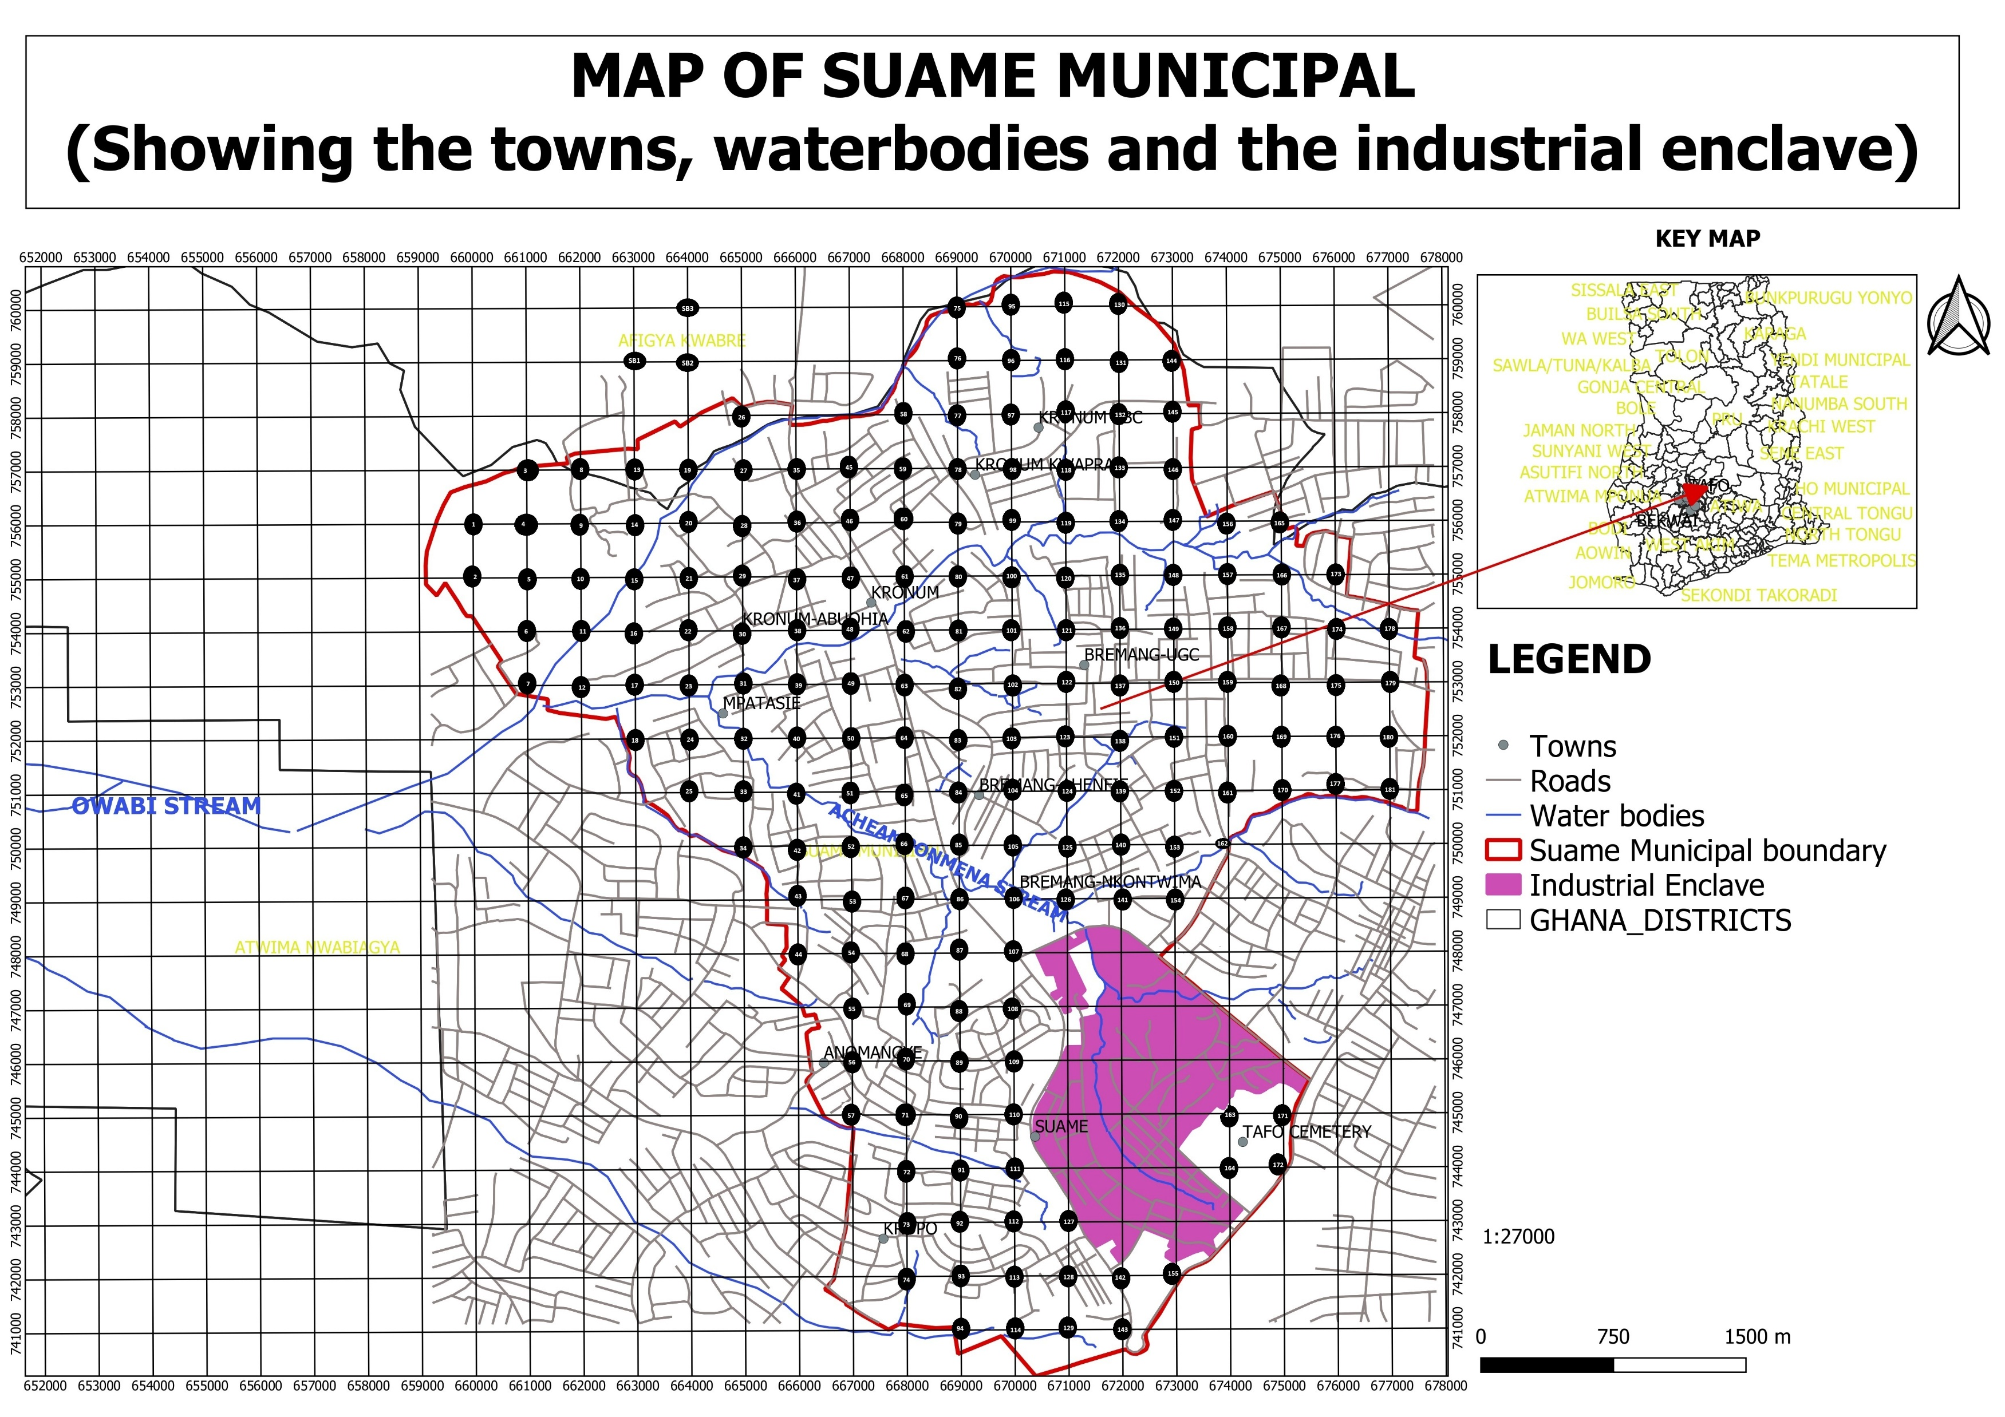
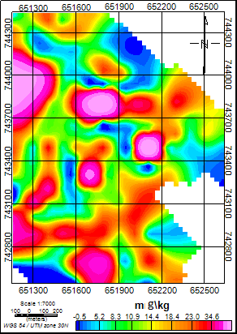
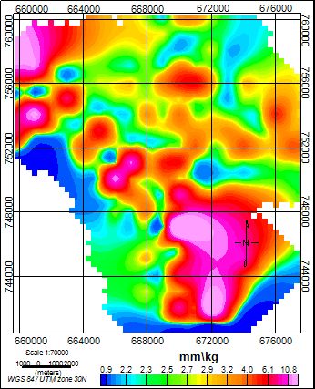
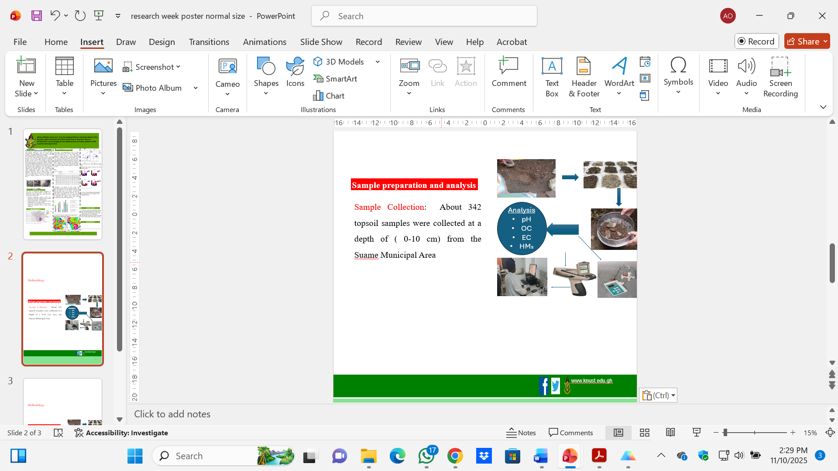

HEAVY METALS IN SURFACE SOILS IN THE SUAME MUNICIPAL AREA, KUMASI, GHANA: EXTENT OF POLLUTION AND ECOLOGICAL RISKS ASSESSMENT
Agnes Oppong^{1*}, Osei Akoto¹, Godfred Darko¹ and Matt Dodd²
¹Department of Chemistry, Kwame Nkrumah University of Science and Technology, Kumasi, Ghana
² School of Environment and Sustainability, Royal Roads University, Victoria, Canada
Corresponding author: oppongagnes20@gmail.com; +233246072821
INTRODUCTION
RESULTS AND DISCUSSIONS
RESULTS AND DISCUSSIONS
Urbanization and industrial growth bring development and economic growth (Sakketa, 2022), but can lead to significant environmental challenges, such as heavy metal pollution. The Suame Industrial Area (SLIA) is located in the Suame Municipal Area (SMA) of Ghana.
It is one of the largest industrial hubs in Africa, and it’s known for its economic impact and high residential growth.. Activities in the hub generate a significant amount of waste, which is poorly managed, leading to heavy metal pollution. According to Antwi (2022) and Ghana’s National Solid Waste Management Strategy (2020), only 30–40% of municipal waste is properly collected and disposed of. Over the years, these industrial activities have spread to other parts of the municipality. This overlapping of industrial and residential zones, with a lack of robust waste management systems, and limited public awareness about the risks of heavy metals, is a challenge. Long-term exposure to heavy metals can result in health effects in artisans, residents, and especially children (Cobbina et al., 2025).
From Table 1, pH ranged from ~5.4 to ~7, with some alkaline spots (~9.9 in SLIA). The mean pH values for both SLIA (6.7) and SMA (6.9) suggested limited acidity to rising alkalinity. Electrical conductivity (EC) mean values were 232.1 µS/cm in SLIA and 259.2 µS/cm in SMA. Although SMA recorded some high EC values, the highest EC value of 739.98 µS/cm was recorded in SLIA.
Organic carbon OC content was generally low to moderate in the entire municipality. SMA soils showed slightly higher mean OC, compared to SLIA.
Fig 6. PCA plots for SMA and SLIA
PCA indicated that metal pollution was from different sources. PC1 separated sites with high heavy metals (left) from those with high OC & EC (right).
Two metal groups:
• Pb–Zn–Cu–As–Mn (upper-left)
• Hg–Cd–Ni–Cr (lower-left)
Table 1. Descriptive statistics of heavy metals concentration (mg/kg) in soils at the study area
Fig 1: Activities in SLIA
Concentration of almost all the PTMs was significantly elevated in SLIA compared to SMA. The mean concentrations of all the metals except Cd for SLIA and SMA, and As for SMA, exceeded the CCME guideline for residential land use. Also, the mean metal concentration for Cu, Pb, and Zn exceeded Dutch Intervention values (VROM, 2000). Zn exhibited the highest mean and median concentrations for the entire municipality.
OBJECTIVES
The aim is to study the spatial distribution of potentially toxic metals (PTMs) in surface soils within the Suame Municipal Area and their associated ecological risks.
Principal Component Analysis (PCA) was employed to determine if heavy metal pollution sources were geogenic or anthropogenic.
Pollution Indices (PI) were employed to assess contamination levels of these metals.
Ecological risk assessment tools were used to identify the potential risks to some living organisms.
Fig 7. Bar chart of risk quotients for SMA and SLIA
Ecological risk assessment indicated that living organisms were at a higher risk at SLIA than at SMA
CONCLUSION
Generally, it was observed that pollutants have spread throughout almost the entire municipality. SLIA showed significantly higher pollution levels than SMA, indicating the spread of pollution from SLIA to the other parts of the municipal area.
METHODOLOGY
RECOMMENDATION
Fig 4. Bar chart of Igeo values for SLIA
The study recommends:
Frequent monitoring of metal levels in soil, air, and water in the area.
Industries should adopt cleaner technologies and proper waste disposal to reduce environmental contamination.
Authorities must separate residential areas from industrial zones to minimize human exposure to these pollutants.
PI values for the entire municipality ranged from unpolluted to extremely polluted
Fig 2. Map of study area showing SMA and SLIA study sites
REFERENCES
Antwi, B. Y., & Koranteng, J. (2022). Solid Waste Management in Ghana (Issue June 2020).
Cobbina, S. J., Edu, A. R., Bosso, E. E., Bampoe, E., & Gautam, S. (2025). Impact of industrial activities on soil quality in urban settings: a study of heavy metal concentrations in Lamashegu, Ghana. Discover Soil, 2(1). https://doi.org/10.1007/s44378-025-00098-5
Sakketa, T. G. (2022). Urbanisation and Rural Development in Developing Countries A Review of Pathways and Impacts.
Fig 3. Sample preparation and analysis
Fig 5. Distribution map of As in SMA and SLIA

