Slide 1
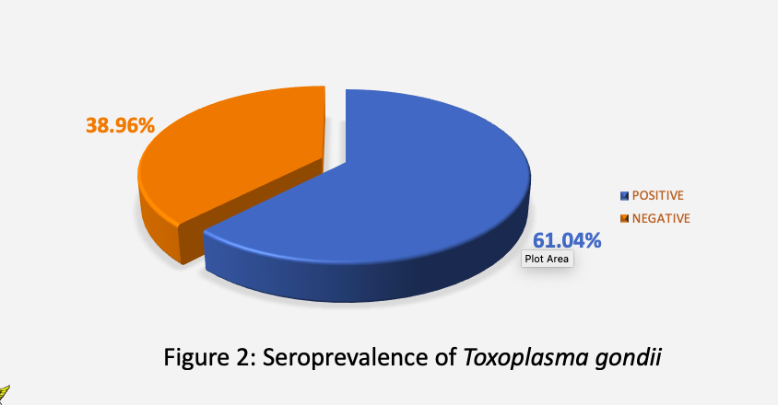
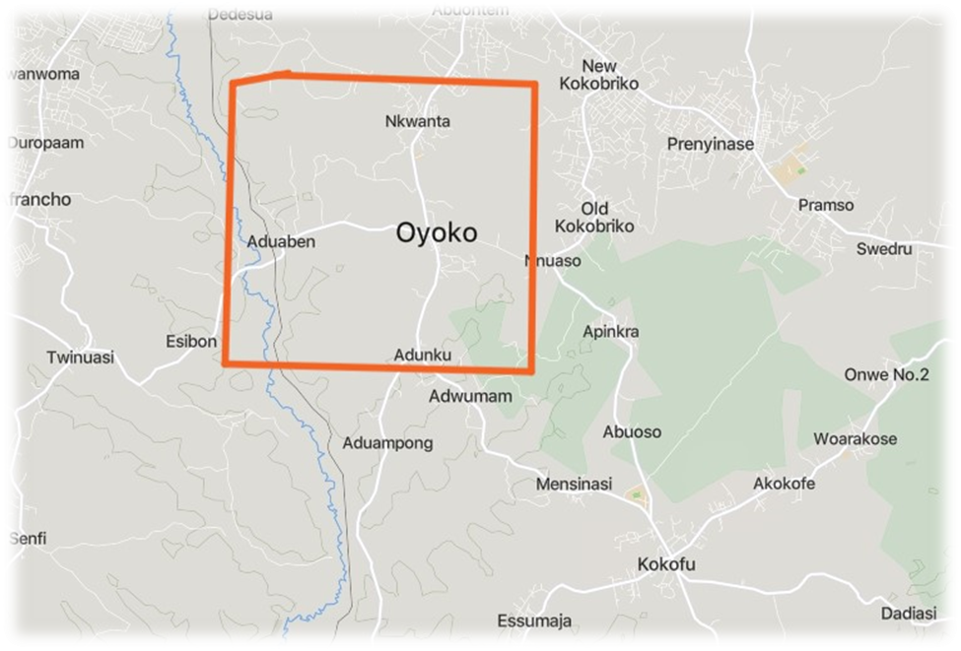

Seroepidemiology of Toxoplasma gondii Infection in Local Chickens (Gallus gallus domesticus) in the Bosomtwe District of the Ashanti Region, Ghana
Emmanuel Aduamah¹, Bernard Walter Lawson¹, John Aseidu Larbi¹.
Department of Theoretical and Applied Biology, Kwame Nkrumah University of Science and Technology
*Correspondence: aduamah85@gmail.com
INTRODUCTION
RESULTS
RESULTS
Toxoplasma gondii is an apicomplexan protozoan parasite that infects nearly all warm-blooded animals, including poultry and humans (Shapiro et al., 2019).
Transmission occurs via maternal-fetal transmission, ingestion of tissue cysts in raw or undercooked meat, ingestion of oocysts from contaminated food, water or soil (Mose et al., 2020).
Despite its global prevalence, epidemiological data on toxoplasmosis in poultry in the Sub-Saharan Africa region remain limited (Amissah-Reynolds, 2020)
Table 3. Housing conditions and its associated seropositivity in chickens
Variables | Total, N (%) | Test results, N (%) |  | P-value
 |  | Negative, N (%) | Positive, N (%)
Main purpose for rearing birds |  |  |  | 0.036
Egg production | 20 (5.6) | 12 (60) | 8 (40)
Hobby | 137 (38.1) | 49 (35.8) | 88 (64.2)
Meat production | 142 (39.4) | 58 (40.8) | 84 (59.2)
To sell | 61 (16.9) | 17 (27.9) | 44 (72.1)
Birds sleeping place |  |  |  | 0.081
In a coop/cage | 239 (66.4) | 99 (41.4) | 140 (58.6)
On trees | 121 (33.6) | 37 (30.6) | 84 (69.4)
Chicken house cleaning frequency |  |  |  | 0.296
Frequently | 196 (82) | 80 (40.8) | 116 (59.2)
Occasionally | 38 (15.9) | 18 (47.4) | 20 (52.6)
Rarely | 5 (2.1) | 1 (20) | 4 (80)
Disinfection frequency |  |  |  | 0.685
Frequently | 21 (8.8) | 9 (42.9) | 12 (57.1)
Occasionally | 44 (18.4) | 16 (36.4) | 28 (63.6)
Rarely | 174 (72.8) | 74 (42.5) | 100 (57.5)
Separate house for injured birds |  |  |  | 0.148
Yes | 44 (12.2) | 21 (47.7) | 23 (52.3)
No | 316 (87.8) | 115 (36.4) | 201 (63.6)
Table 1. Summary of ELISA results on seroprevalence of Toxoplasma gondii at various study sites
Towns | Total, N (%) | Test results, N (%) |  | P- Value | Odds ratio | Confidence Interval
 |  | Negative, N (%) | Positive, N (%)
ADUABEN | 87 (24.2) | 41 (47.1) | 46 (52.9) | 0.006 | 0.428 | 0.235 – 0.780
ADUNKU | 58 (16.1) | 5 (8.6) | 53 (91.4) | 0.007 | 4.045 | 1.470 – 11.125
BEDAASE | 52 (14.4) | 32 (61.5) | 20 (38.5) | < 0.001 | 0.238 | 0.118 – 0.482
NKWANTA | 58 (16.1) | 29 (50) | 29 (50) | 0.005 | 0.382 | 0.195 – 0.745
OYOKO | 105 (29.2) | 29 (27.6) | 76 (72.4) | REF | REF | REF
OBJECTIVES
MAIN OBJECTIVE
To determine the seroprevalence of Toxoplasma gondii infection and associated risk factors among local chickens in the Bosomtwe District of the Ashanti Region, Ghana
SPECIFIC OBJECTIVES
To determine the seroprevalence of Toxoplasma gondii infection in local chickens in the Bosomtwe District.
To identify risk factors associated with the prevalence of Toxoplasma gondii infection in local chicken populations in the selected communities.
To evaluate the level of awareness and knowledge of owners of chickens on the risk of Toxoplasma gondii infection in chicken meat.
Table 2. Risk factors associated with the prevalence of Toxoplasma gondii infection in local chicken populations.
Variables | Total, N (%) | Test results, N (%) |  | P-value
 |  | Negative, N (%) | Positive, N (%)
Presence of a cat at home No | 203 (56.4) | 80 (39.4) | 123 (60.6) | 0.541
Yes | 157 (43.6) | 56 (35.7) | 101 (64.3)
Cat roaming in the same area as chickens |  |  |  | 0.053
No | 12 (7.6) | 2 (16.7) | 10 (83.3)
Yes | 145 (92.4) | 54 (37.2) | 91 (62.8)
Access to areas where cats might have urinated/defaecated |  |  |  | 0.452
No | 4 (2.5) | 0 | 4 (100)
Yes | 153 (97.5) | 56 (36.6) | 97 (63.4)
Free-range chickens feeding on contaminated soil/vegetation |  |  |  | 0.898
No | 210 (58.3) | 80 (38.1) | 130 (61.9)
Yes | 150 (41.7) | 56 (37.3) | 94 (62.7)
METHODOLOGY
DATA COLLECTION
Questionnaire
SAMPLE COLLECTION
Blood samples
Centrifugation
Serum Extraction
Refrigeration
CONCLUSION
LABORATORY ANALYSIS
ELISA
DATA ANALYSIS
Descriptive test
Chi-square
High seroprevalence of Toxoplasma gondii among local chickens were observed with significant variations among communities. None of the environmental and management factors, except the purpose of chicken rearing, showed a statistically significant association with infection, even though some had weak and borderline associations
REFERENCES
Amissah-Reynolds, P. K. (2020). Toxoplasmosis in Humans and Animals in Ghana (1962–2020): A Review. International Journal of Tropical Disease & Health, 41(14), 20-31
Mose, J. M., Kagira, J. M., Kamau, D. M., Maina, N. W., Ngotho, M., & Karanja, S. M. (2020). A review on the present advances on studies of toxoplasmosis in eastern Africa. BioMed Research International, 2020(1), 7135268. https://doi.org/10.1155/2020/7135268
Shapiro, K., Bahia-oliveira, L., Dixon, B., Dumètre, A., Wit, L. A. De, Vanwormer, E., & Villena, I. (2019). Food and waterborne parasitology environmental transmission of Toxoplasma gondii: oocysts in water, soil and food. Food and Waterborne Parasitology, 15, e00049. https://doi.org/10.1016/j.fawpar.2019.e00049
Figure 1. Map of Study Sites
DEPARTMENT OF THEORETICAL AND APPLIED BIOLOGY

