Slide 1

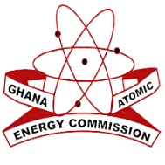

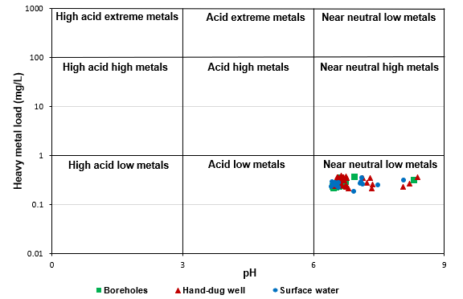
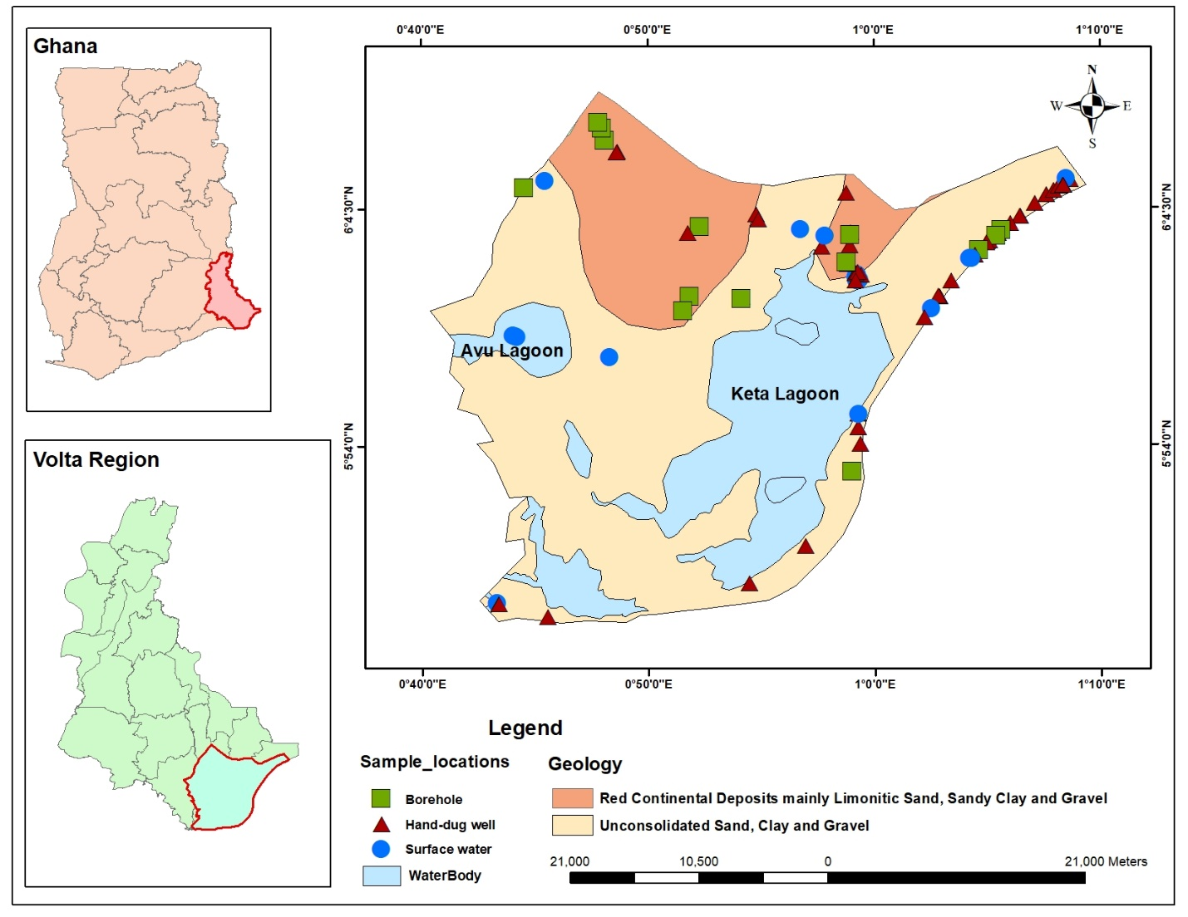
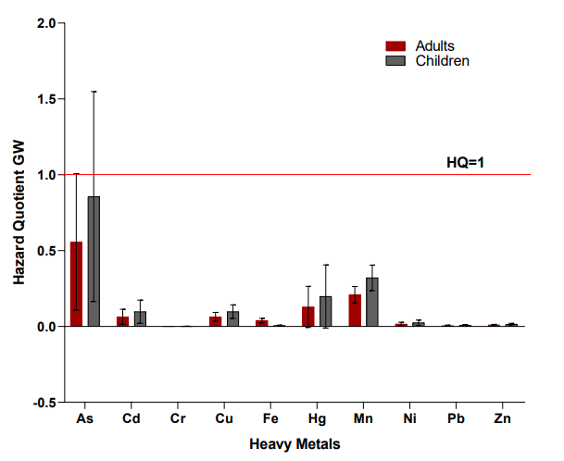
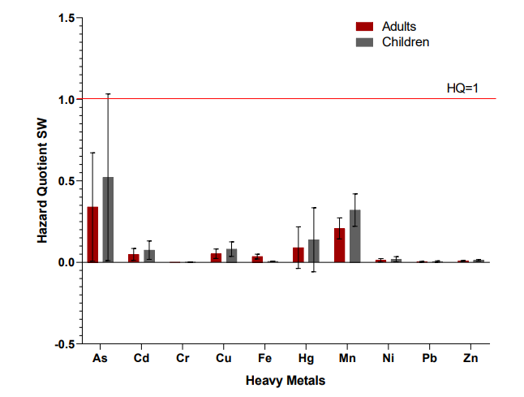
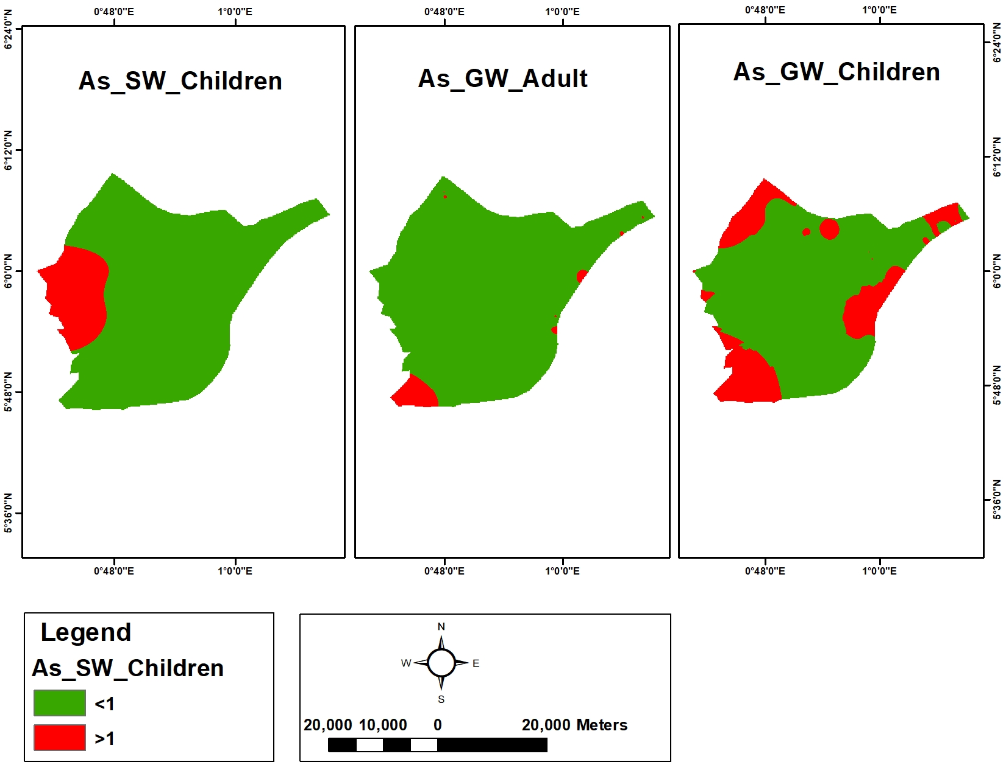
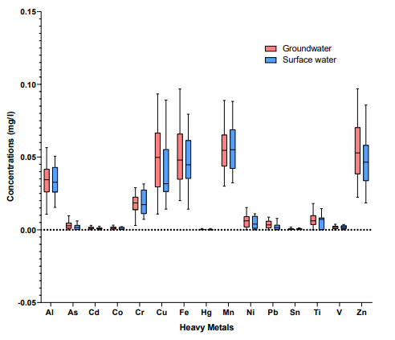
Effect of Rapid Urbanisation on Water Quality in the Keta Wetland: Insights from Heavy Metal Analysis
Abigail Adjei^{1*},Charles Gyamfi¹, Courage D, Egbi² ,Solomon Tawiah Ampafo^{1,3}
¹Regional Water and Environmental Sanitation Centre Kumasi (RWESCK), Department of Civil Engineering, Kwame Nkrumah University of Science and Technology, Kumasi, Ghana
²Water Resources Research Centre, National Nuclear Research Institute, Ghana Atomic Energy Commission, Box LG 80, Legon, Accra, Ghana
Kumasi Technical University, Kumasi, Ghana
1.0 INTRODUCTION
Heavy metal (HM) contamination in water bodies poses significant public health risks due to increasing human activities. The Keta Wetland Complex (KWC) Ramsar Site, an ecologically critical area, faces increasing anthropogenic pressures from urbanisation and industrialisation.
In addition, agricultural activities, salt mining operations, and proximity to the Gulf of Guinea expose the KWC to multiple contamination pathways, including coastal flooding runoff, along with industrial effluents, and sediment-bound HM.
Contributing to ensuring access to portable water and public health protection, this study assessed the levels, spatial distribution and sources of HMs in water resources of the wetland.
Figure 3. Classification of water sources based on the Ficklin-Caboi diagram
2.0 METHODS AND MATERIALS
The Ficklin-Caboi diagram displayed all water samples at the near-neutral low metals class, inferring low metallic concentration and immobility of metals in water sources.
Study Area
Potential Health Risk Assessment
The KWC encompasses all or parts of the Keta, South Tongu, Ketu, Anloga and the Akatsi districts in the Volta Region, totalling about 101,022.69 hectares (Figure 1).
It is the largest Ramsar site in Ghana and is renowned for safeguarding mangrove forests and migrating birds, as well as providing breeding grounds for sea turtles and other fish species.
The wetland receives seasonal inflow of seawater from the Gulf of Guinea and regular inflow from rivers, mainly from the Aka, Belikpa, Volta, and Tordzi.
Figure 1. The Keta Wetland Ramsar Site
Figure 4. HQ of Heavy metals concentrations for (a) GW and (b) SW
Sampling and Analytical Technique
Groundwater (GW) (n=61) and surface water (SW) (n=18) samples were analysed for 16 HMs – Al, As, Cu, Cd, Co, Cr, Cu, Fe, Hg, Mn, Ni, Pb, Sn, Ti, V, Zn, alongside physicochemical and major ions. Descriptive statistics was used to compute and compare HMs concentrations against the WHO drinking and irrigation water standards. The Ficklin-Caboi diagram was employed to classify water quality based on pH and total metal load.
For health risk evaluation, non-carcinogenic impact was assessed using Hazard Quotient (HQ) and Hazard Index (HI) for children and adults, while carcinogenic risk was evaluated through Lifetime Cancer Risk (LCR).
Spatial distribution analysis using ArcGIS 10.8 IDW interpolation identified contamination hotspots.
Also, Pearson correlation analysis determined relationships between physicochemical parameters, major ions, and heavy metals to identify natural and anthropogenic contamination sources.
Figure 5. Spatial distribution of Arsenic HQ
Arsenic exceeded the safe threshold for children and adults, particularly evident at Adina, Akatsi, Anyanui, Keta, and areas around the Avu lagoon.
3.0 RESULTS AND DISCUSSION
Figure 5. LCR Ratios for Ingestion of Groundwater and Surface Water in the Keta Wetland
The findings indicate that adults and children are at risk of carcinogenic health implications after long-term ingestion of drinking water sources.
HMs sources in the KWC included mineral weathering, agricultural runoff from fertiliser and manure application, effluents from sewage and human waste.
Figure 2. A box plot showing the concentrations of the investigated heavy metals for both sources
4.0 RECOMMENDATION AND CONCLUSION
The measured concentration of all HMs analysed were below the allowable threshold limits for drinking and irrigation, meaning, in terms of HMs concentrations, these water sources are safe for both uses.
It is therefore deduced that the continuous consumption of GW and SW in the KWC poses chronic effects on human health
The findings hence point to the need for management strategies to safeguard the quality of water sources in the KWC
Key References:Duku, E., Mattah, P.A.D. and Angnuureng, D.B. (2021). Assessment of land use/land cover change and morphometric parameters in the Keta Lagoon Complex Ramsar site, Ghana. Water, 13(18), p.2537.
Sharma, A., Grewal, A.S., Sharma, D. and Srivastav, A.L. (2023). Heavy metal contamination in water: consequences on human health and environment. In Metals in water, Elsevier, pp. 39-52.
KNUST Research Week and Scientific Conference November 10 – 14, 2025, Kumasi, Ghana

