Slide 1

Overview of the School

Slide 2


Joint Initiative of:
Department of Meteorology and Climate Science, FPCS, COS, KNUST
Clean Air Fund

Slide 3
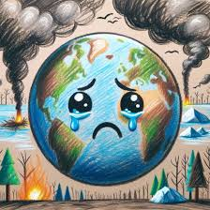
Why this School?
Air quality Statistics are daunting
Ambient and household air pollution are major causes of death and diseases globally
Over 91% of the global population breathes heavily polluted air
About 7 million premature deaths occurs each year due to indoor and outdoor air pollution
Capacity-building is key to addressing the issue
The goal of the School is to equip participants with relevant skills that help them contribute to improving Air Quality and championing its cause.

Slide 4





Fully-Funded
Financial support for all participants
Interdisciplinary
Cross-sector collaboration and learning
Project-Oriented
Hands-on practical applications
Theory & Practicals
Balanced learning approach
Community Engagement
Real-world impact and outreach

Slide 5
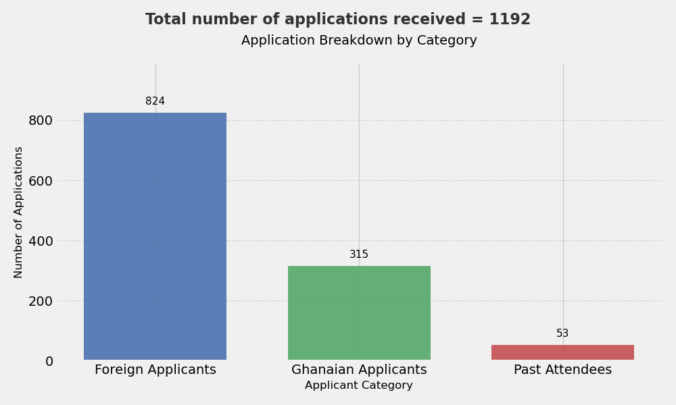
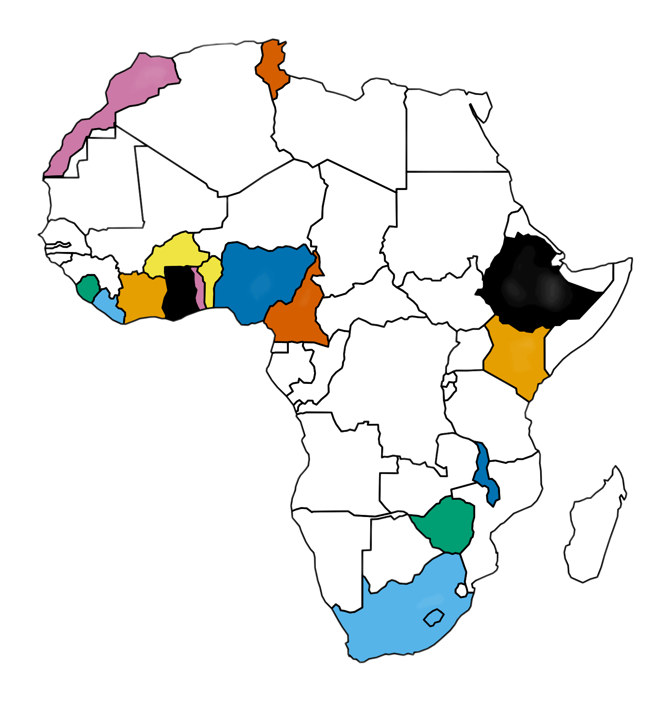
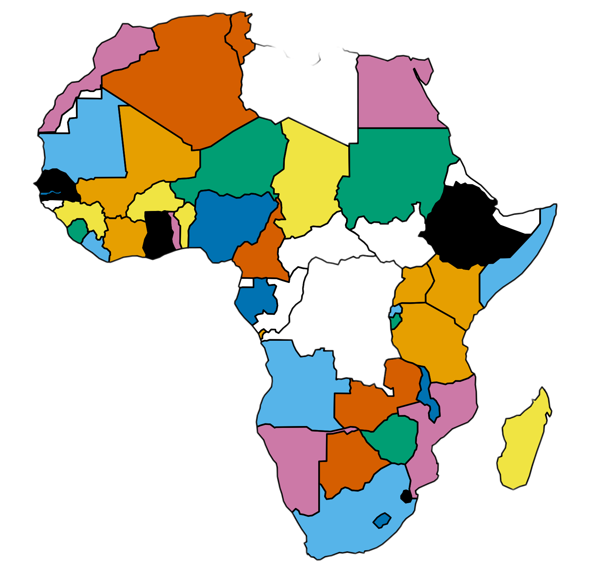
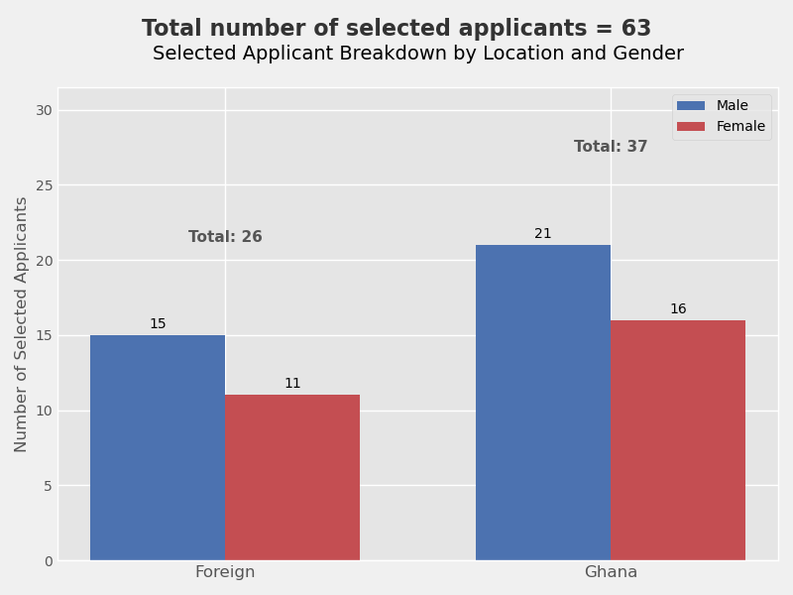
PARTICIPANT SELECTION
Participants Rep.
17 out of 47 countries

Slide 6

PARTICIPANT SECTOR SELECTION

Slide 7
<<< What To Expect >>>

Slide 8
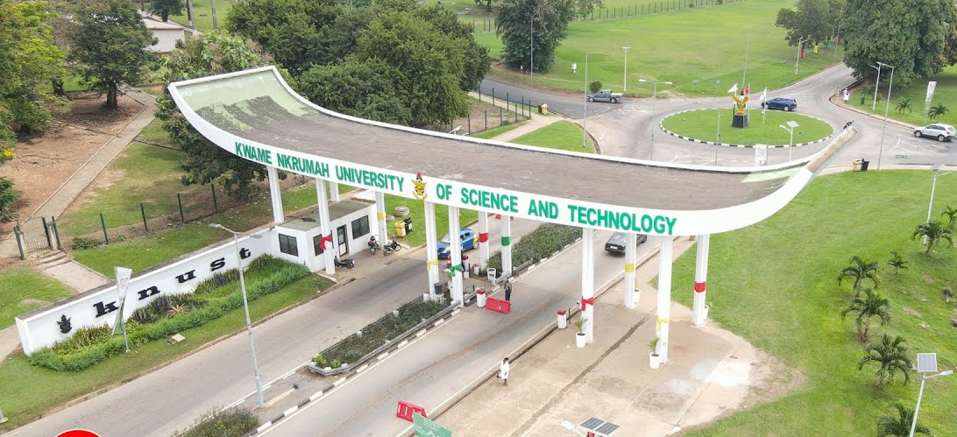
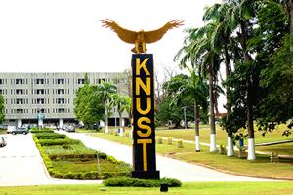
Important Dates
Arrival of Participants:
Sunday, 30th November 2025
Icebreaker Reception
Hand your travel tickets/receipts upon arrival at the earliest or within the first week of the School, to the Organizing Committee.
Monday 1st December 2025:
Opening Ceremony
Wednesday 10th December 2025:
Network Dinner
Departure:
Thursday, 11th December 2025

Slide 9
Week 1: Lecture, Practicals, Community Engagement
Day One (Monday, 1st December 2025): Opening Ceremony
Day Two (Tuesday, 2nd December 2025): Sources and Causes of Air Pollution
Day Three (Wednesday, 3rd December 2025): Health and Social Impacts of Air Pollution
Day Four (Thursday, 4th December 2025): Data Analysis and Interpretation
Day Five (Friday, 5th December 2025): Community Engagement
Conference and Lecture Materials to be hosted here: https://kems.knust.edu.gh/e/aqppss

Slide 10

WEEKEND BREAK
(6th & 7th December 2025)
Recreational Activity

Slide 11
Week 2: Air Quality Framework Fieldwork & Community Engagement
Day Eight (Monday, 8th December 2025): Fieldwork
Day Nine (Tuesday, 9th December 2025): School’s Outreach
Day Ten (Wednesday, 10th December 2025): Group Presentations
Departure (Thursday, 11th December 2025)

Slide 12
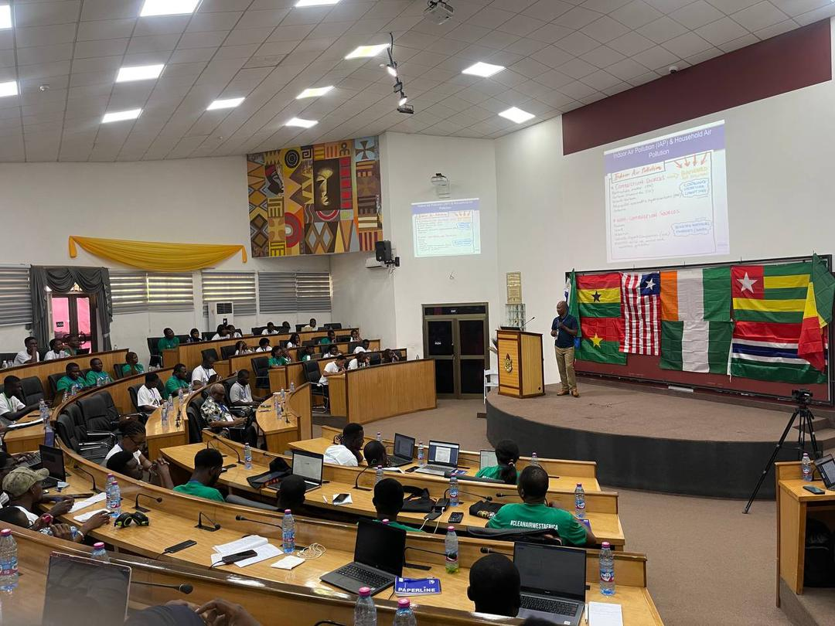
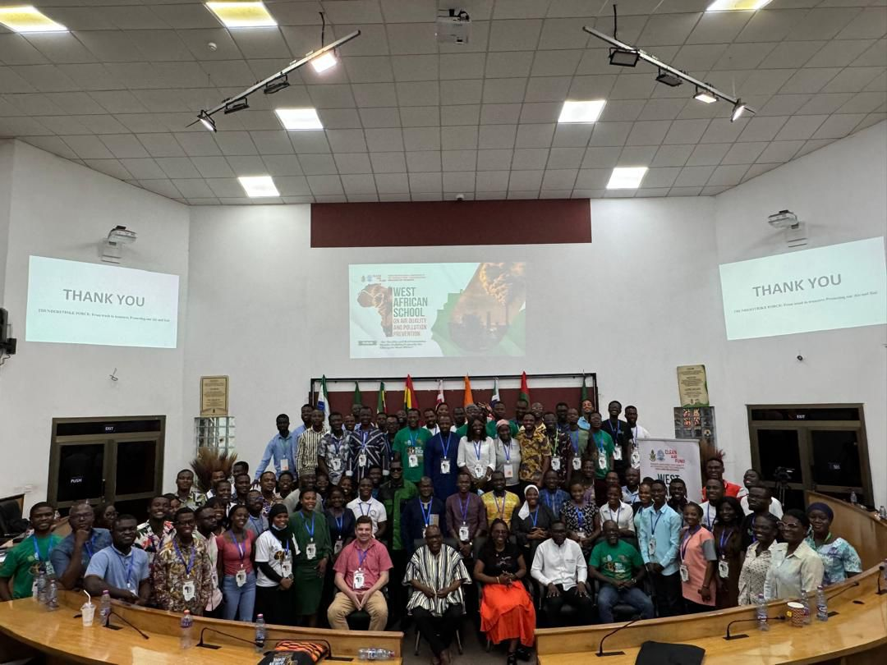
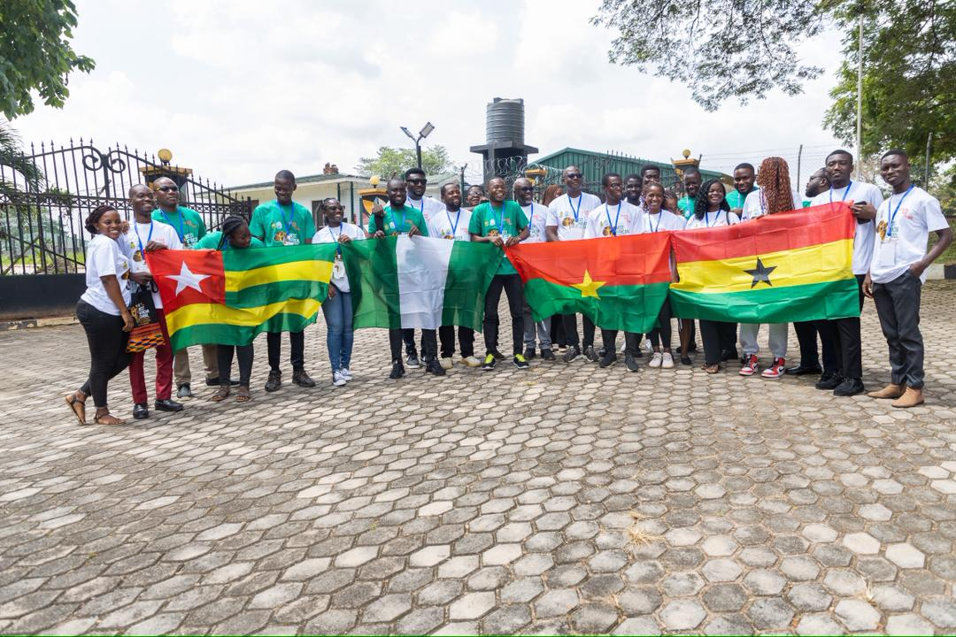
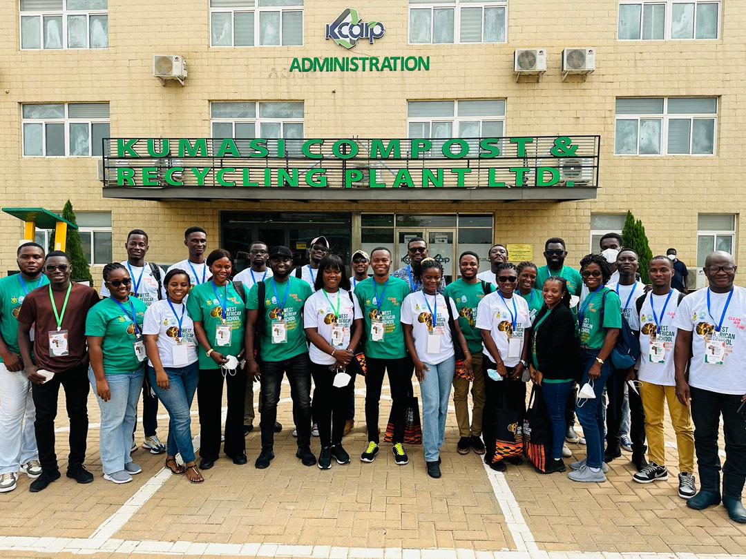
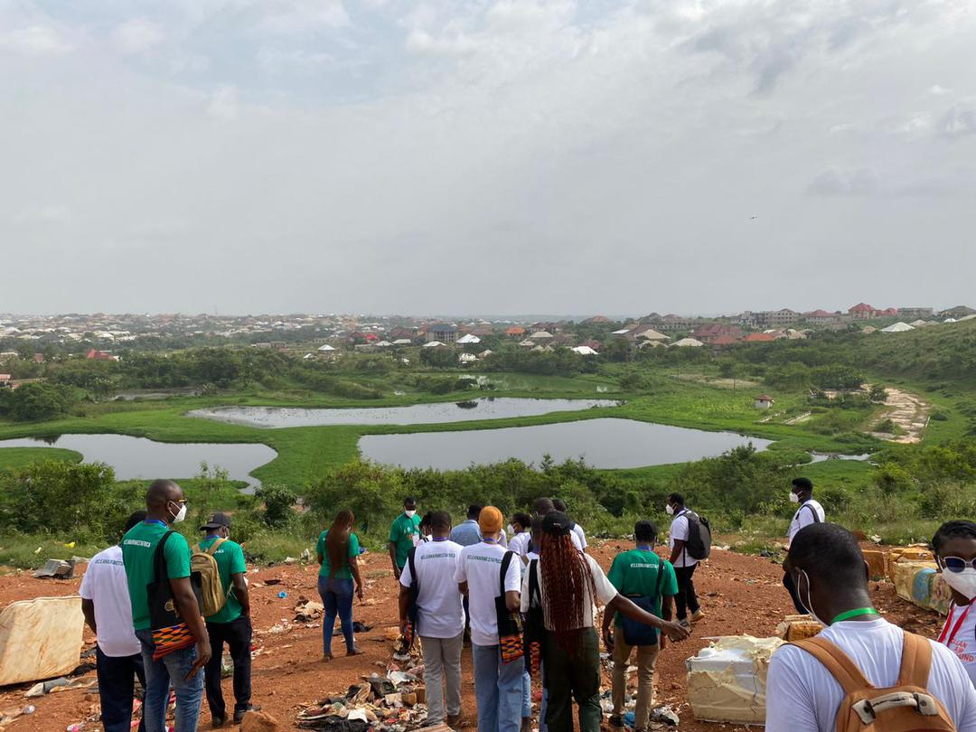
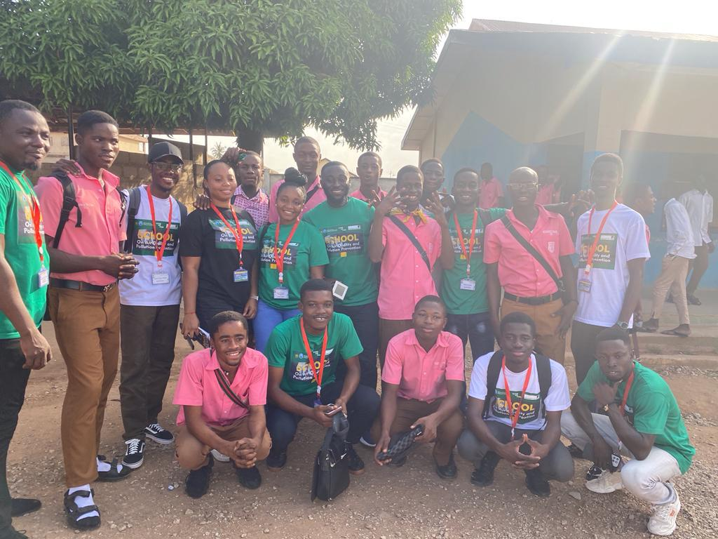
Images from Previous Schools

Slide 13
LOC Team
Prof. L. K. Amekudzi
Prof. Emmanuel Quansah: +233 24 8571016
Ms. Lydia Korley: +233 55 9540992
Dr. Edmund I. Yamba: +233 55 056353
Mr. Alex Tuffour Frempong: +233240063387
Ms. Mercy Mawunyo Apaw: +233552898404
Mr. Desmond Osei-Tutu: +233 543612149
Dr. Jeffrey N. A. Aryee: +233 24 8524226

Slide 14

AGENDA

