Slide 1
Evaluation of Cooking Fuel-Induced Air Pollution and Survey on Cooks' Awareness of Smoke Inhalation Risks in High School Kitchen
2025 African School on Air Quality and Pollution Prevention
@Impact Building. KNUST-Kumasi, Ghana
1st – 10th December, 2025
Professor Marian Asantewah Nkansah, FGA
Department of Chemistry
KNUST, Kumasi-Ghana

Slide 2
Outline
Introduction
Pollutants from cooking emissions
Some health effects of pollutants from cooking
Highlights of studies on environmental samples
Summary of findings of studies on environmental samples
Rationale and objectives of the survey on awareness
Study area and methodology
Major Findings
Recommendations and call to action

Slide 3
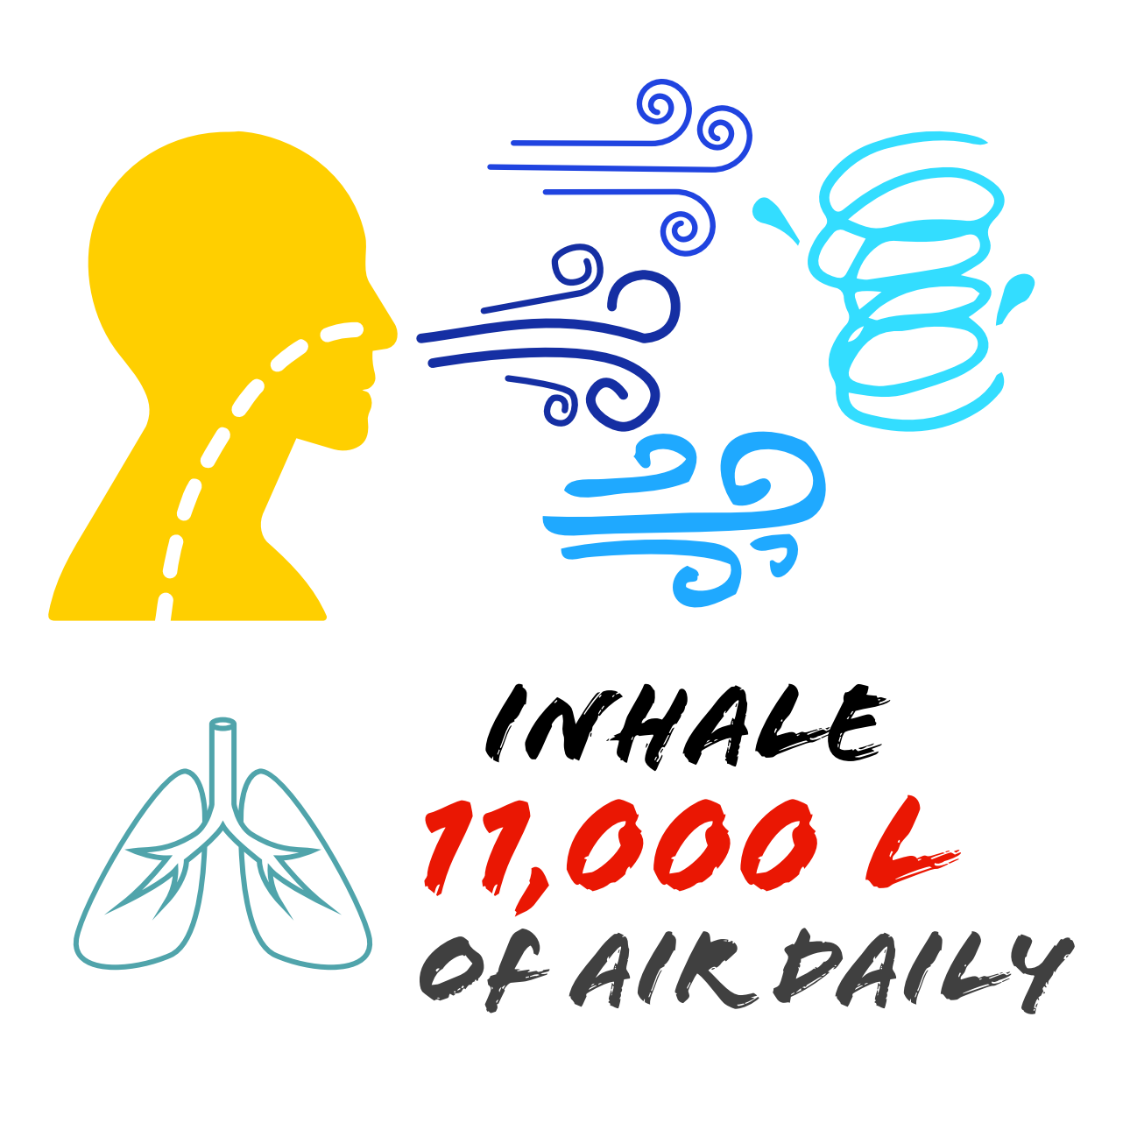
Introduction
Indoor air quality is key to health the average person spends about 90% of their time indoors [Klepeis et al., 2001]
Schools’ indoor environment have the potential for exposure to air pollutants due to activities such as waste treatment [Ababio et al., 2023]
Significant sources of indoor air pollution in school microenvironments are school kitchens [Ababio et al., 2024]
[Nazaroff 2018]

Slide 4
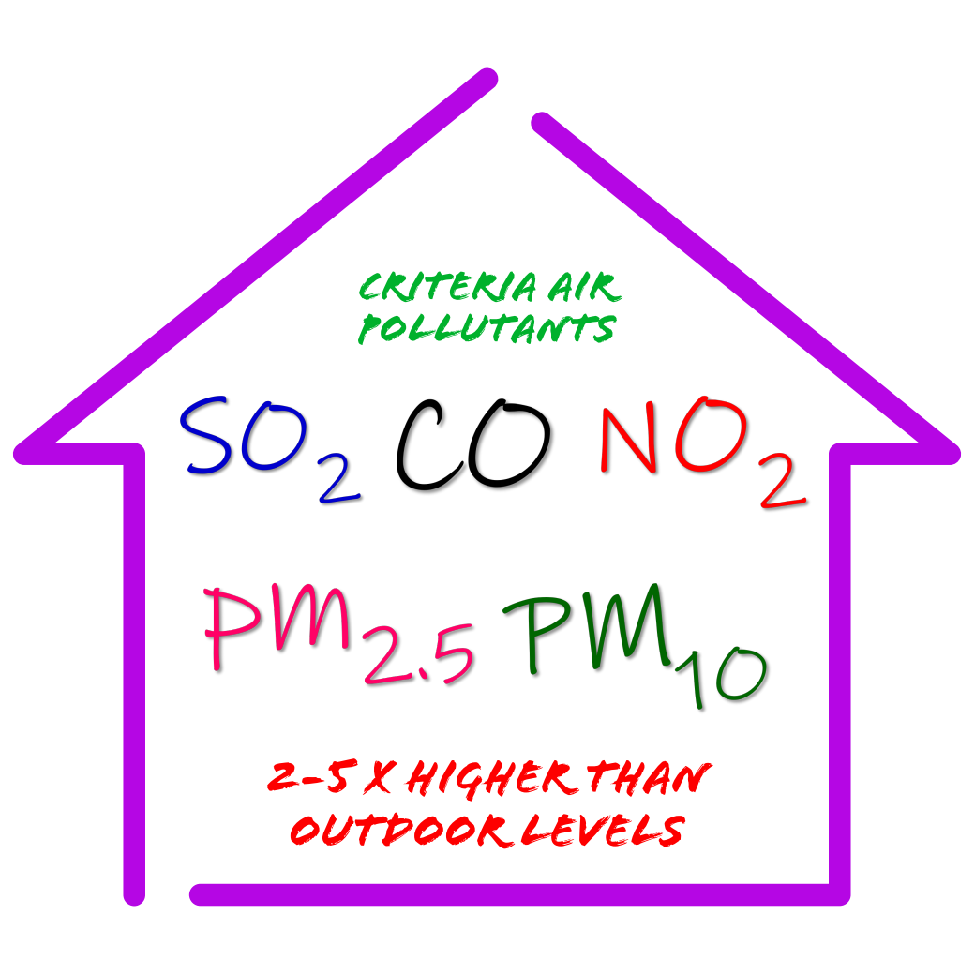
Pollutants from Cooking Emissions.
Air in the kitchen environment is typically polluted by emissions from either cooking fuel or from food due to cooking method.
The emissions contain criteria gaseous and particulate air pollutants.
[USEPA 2021]

Slide 5
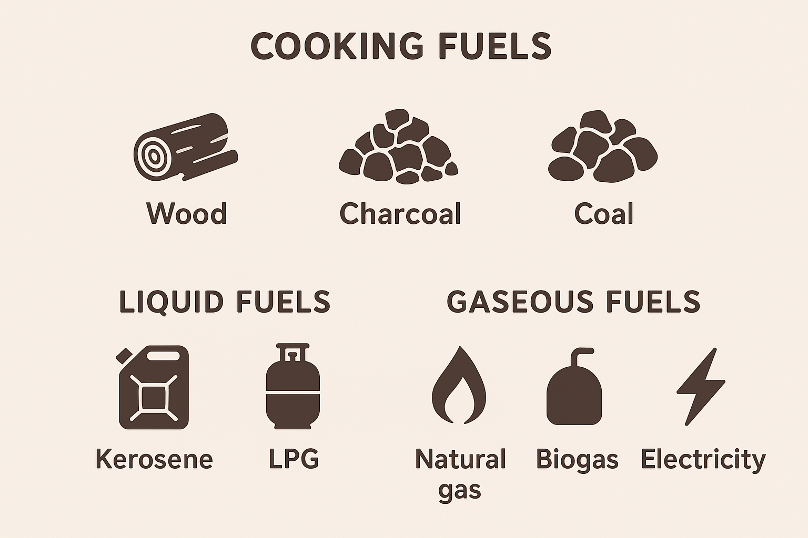
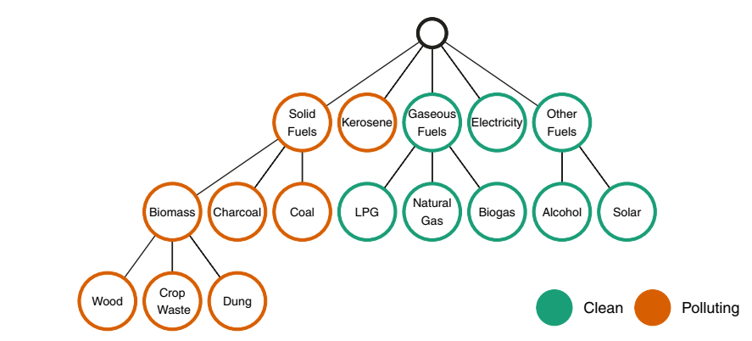
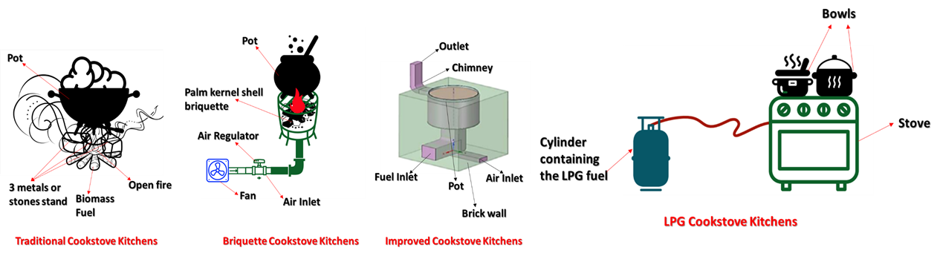
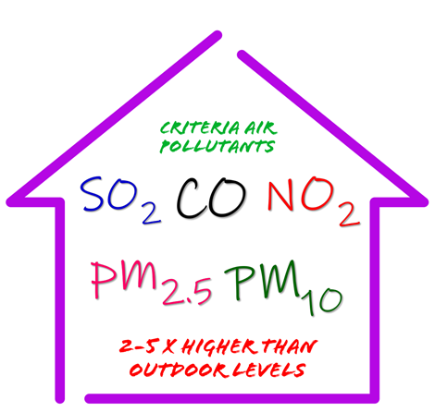
Pollutants from Cooking Emissions..
Cooking fuels are energy sources used to produce heat for cooking food.
They can be categorized primarily as solid, liquid, and gaseous fuels.
They have different impacts on health and the environment

Slide 6
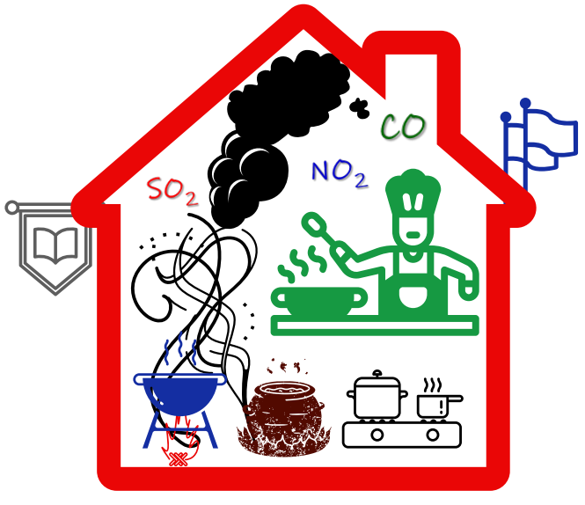
Pollutants from Cooking Emissions...
PM: is a heterogeneous mixture of microscopic or tiny solid particles and liquid droplets in the air
CO: a colourless, odourless, tasteless and toxic gas produced from incomplete fuel combustion
SO₂: a colourless, toxic gas with pungent irritating smell produced from fuel combustion
NO₂: a redish brown toxic gas with pungent smell producd from fuel combustion
Smoke: is a visible suspension of airborne particulates and gases pollutants, e.g. PM, CO, NO_{X}, volatile organic compounds & PAHs
Exposure to these are harmful to human health upon acute and chronic exposure [Gyaase et al., 2025]

Slide 7

Health Effects from Exposure to Emissions from Cooking Fuels

Slide 8
PM Health Effects
Acute (Short-term) Exposure Effects:
Exposure over hours to days triggers acute cardiovascular events like
heart attacks
irregular heartbeat
Strokes
Exacerbates respiratory conditions, including asthma attacks and chronic obstructive pulmonary disease (COPD)
Leads to increased hospital admissions and emergency visits
Chronic (Long-term) Exposure Effects:
Long-term exposure spanning months to years to PM (especially PM_{2.5}) is linked to premature death, mainly from
cardiovascular diseases
lung cancer
chronic respiratory illnesses

Slide 9

Health Effects of SO₂ and NO₂
Acute (Short-term) Exposure Effects:
Irritation of the respiratory tract, causing symptoms such as
coughing
wheezing
chest tightness
shortness of breath [CARB, 2022]
Chronic (Long-term) Exposure Effects:
Increased risk and development of chronic respiratory diseases such as
asthma
chronic obstructive pulmonary disease (COPD)
Reduced lung function and lung growth in children

Slide 10

Health Effects of CO
Acute Health Effects of CO:
Headache, dizziness, nausea, confusion, unconsciousness, and death (in severe cases).
Chronic (Long-term) Exposure Effects:
Increased risk of chronic digestive diseases
hepatic fibrosis/cirrhosis
nonalcoholic fatty liver disease (NAFLD)
Neuropsychological effects such as chronic headaches, lethargy, nausea, and cognitive impairments [Yang et al., 2022].

Slide 11
Highlights of studies on environmental samples
1. In-kitchen particulate matter emissions in high schools in the Kumasi metropolis, Ghana: Levels and the health risk assessment (EPAM-7500 MONITOR)
2. Modelled particulate matter respiratory deposition for cooks’ occupational exposure in solid-fueled high school kitchens (MPPD)
3. Gaseous air quality and health risk assessment of high school kitchens in the Kumasi Metropolis (Aeroqual S500 Monitor)

Slide 12
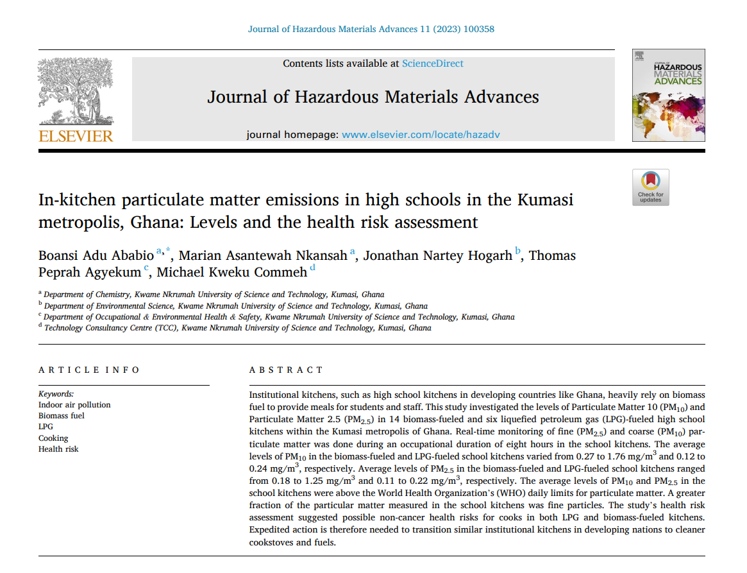

Slide 13
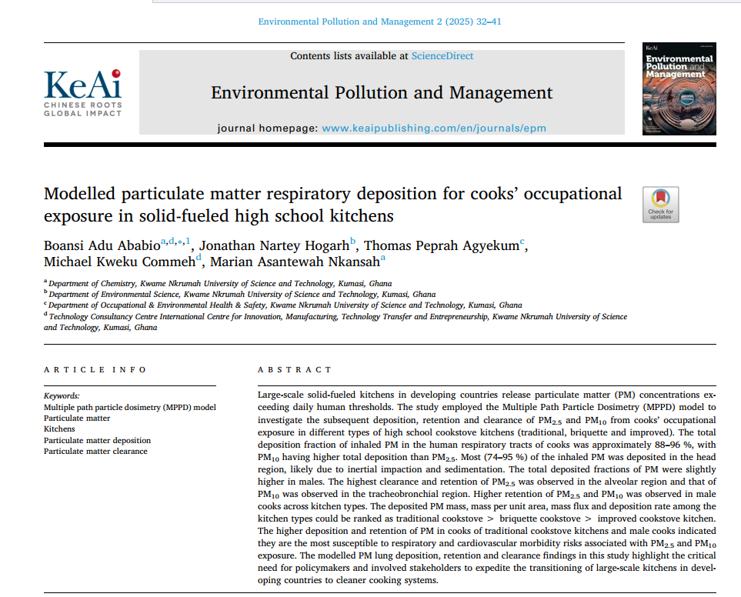

Slide 14
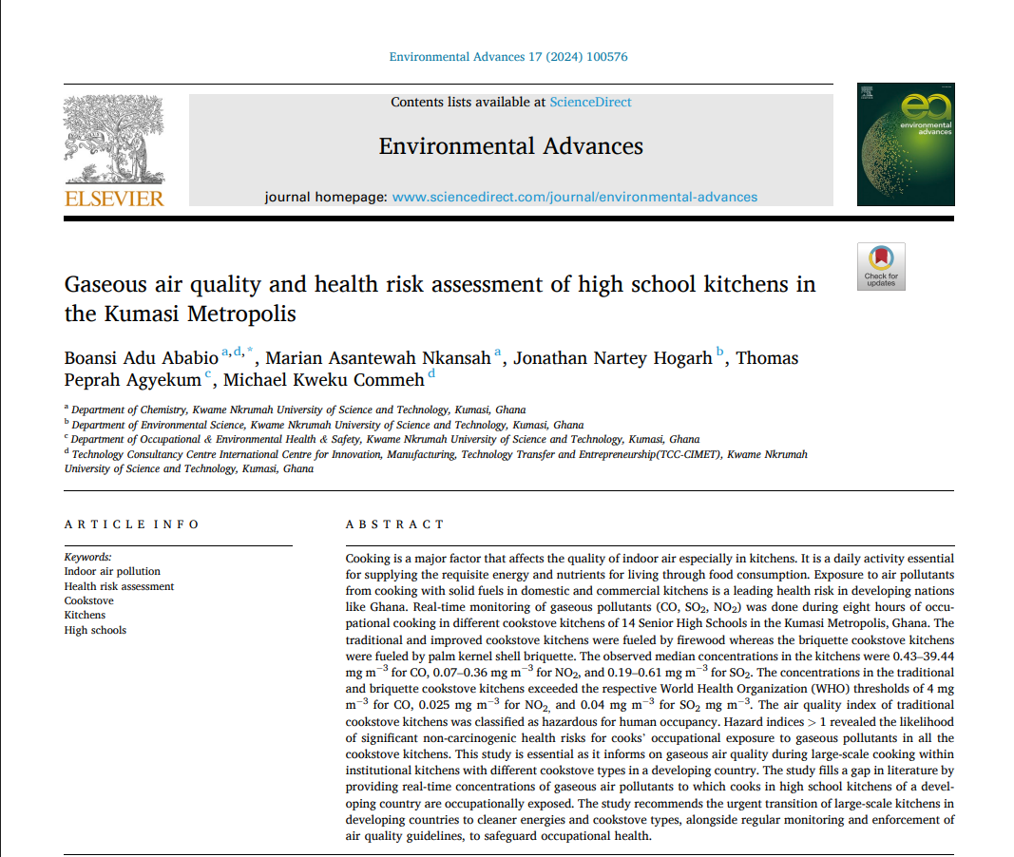

Slide 15
Summary of findings of studies on environmental samples
The study provides evidence that cleaner fuels (LPG) and improved stoves significantly reduce air pollutants (CO, NO_{2,}SO₂) the risks ranked: Traditional > Briquette > Improved > LPG.
And Health risk assessment (HI>1) suggests possible non-cancer health risks for both gaseous and solid-fueled kitchens.
Air Quality Index ranged from unhealthy to hazardous
High school cooks face significant exposure to indoor pollutants from kitchen smoke.

Slide 16


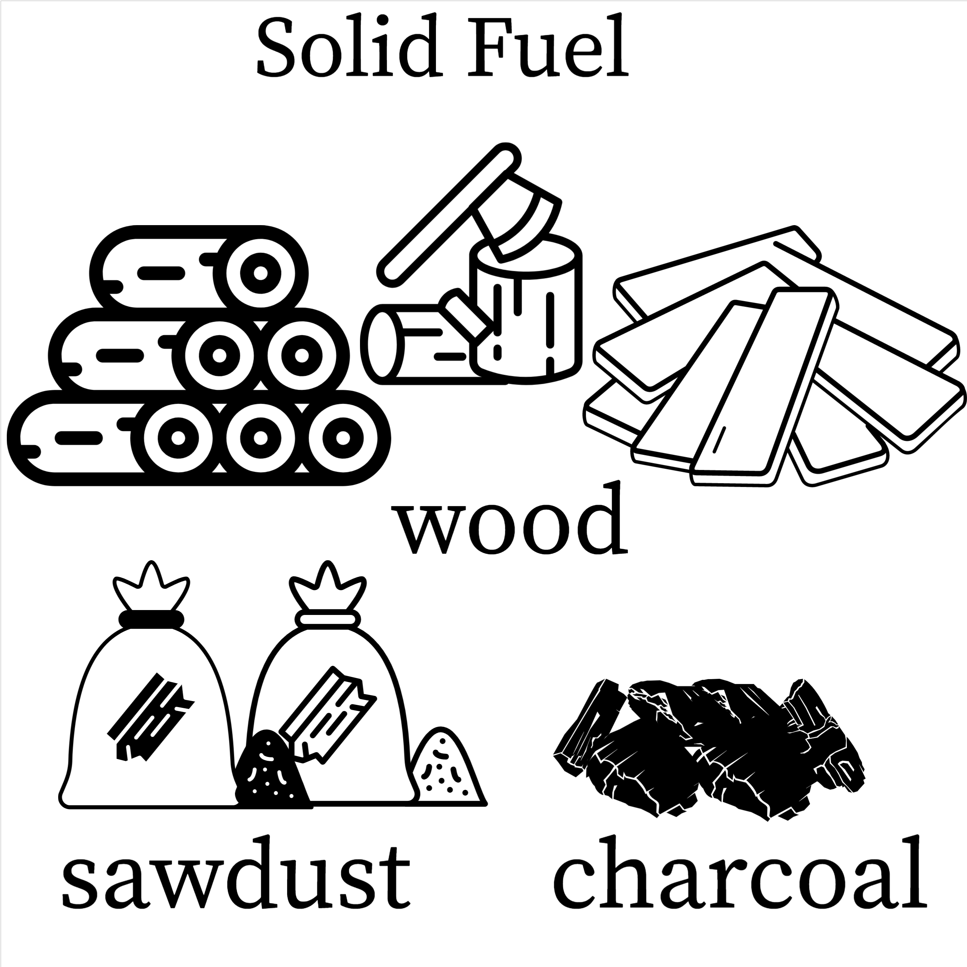
Rationale and objectives of the survey on awareness
In Ghana, most high school kitchens rely heavily on solid fuels for large scale cooking
Knowledge, perception, awareness of cooks on health effects related to indoor air pollution and smoke inhalation remain unknown
Cooks‘ exposure to biomass smoke highlights the need to assess their understanding, health impact and inform policy to reduce risk

Slide 17
Objectives
Assess the knowledge and awareness among cooks regarding the health risks
Explore the perceptions and attitudes of cooks towards occupational indoor air pollution and its health implications
Evaluate potential health impact associated with the kitchen environment

Slide 18
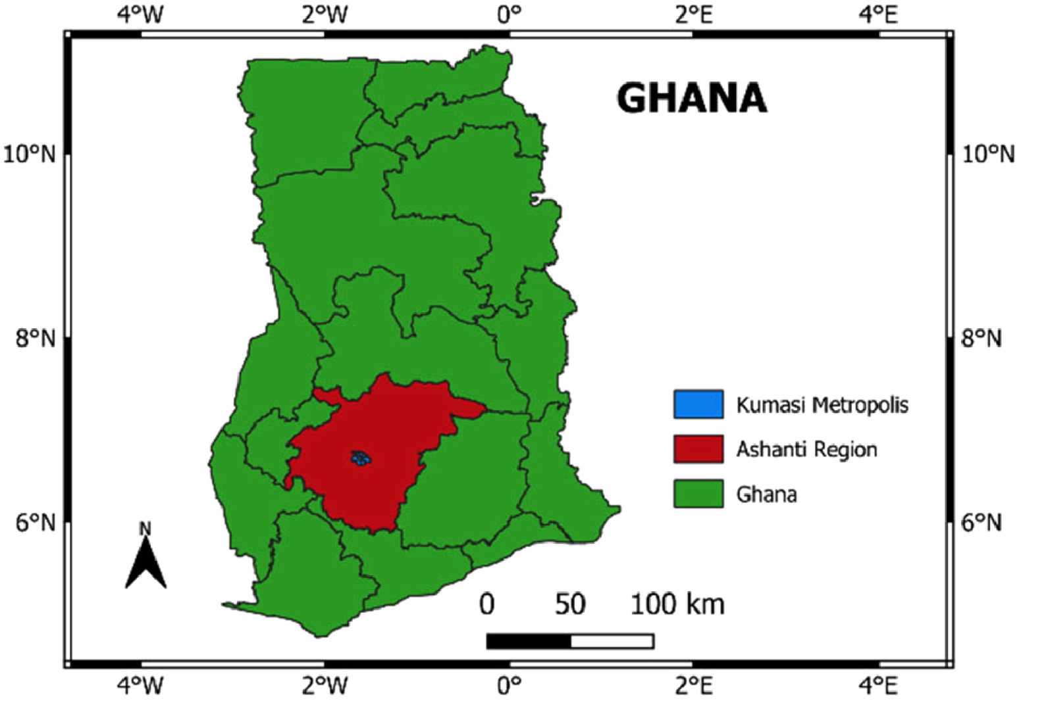
Study Area
Figure 1: Map of Ghana showing the Study Area and the Location of Selected Institutions

Slide 19
Methodology
Study Design: Cross-sectional survey conducted in high school kitchens in Kumasi Metropolis, Ghana.
Study Area: 14 senior high schools within Kumasi Metropolis, selected purposively based on reliance on biomass fuel for cooking.
Sample Size & Sampling:
Targeted 308 cooks, 22 per school kitchen
Achieved 293 respondents (95.1% response rate)
Participants: Non-smoking cooks with no major chronic respiratory conditions before employment, working in solid-fueled kitchens

Slide 20
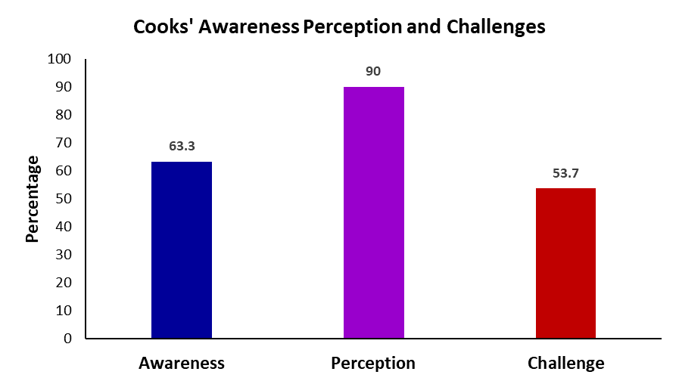
Major Findings.
Awareness: A majority of cooks (63.3%) had heard of indoor air pollution and thought their kitchens released air pollutants
Perception: The majority (90%) of cooks rated their perception of IAP levels as high
Challenges: 53.7% of cooks were not aware that smoke from cooking could cause indoor air pollution.

Slide 21
Major Findings..
Health Impact: A high prevalence of acute respiratory and eye symptoms was reported among cooks
79.9% had dry and sore throat
70.6% eye irritation
72.4% cough
71.7% shortness of breath
73.4% difficulty breathing
Many others experienced headache, nasal blockages, and runny noses

Slide 22
Major Findings...
* Some chronic health conditions were reported: 19.1% had hypertension and 9.9% asthma linked to long-term exposure to biomass smoke
* Most cooks complained about the hot, smoky, and sometimes stuffy air in kitchens, reflecting poor ventilation and continuous biomass fuel use
* Nearly all cooks suffered post-work fatigue, aching joints, and over half had difficulty sleeping, reflecting the heavy physical workload

Slide 23
Major Findings….
Significant associations between demographics and health outcomes
Female cooks were more numerous but male cooks showed higher susceptibility to eye redness
Younger cooks were more prone to hypertension
The longer employed had more breathing difficulties and recognized kitchens as pollution sources

Slide 24
Major Findings..…
Despite awareness, <50% understood that smoke directly causes indoor air pollution
This indicate gaps in knowledge and need for education, advocacy & policy
(interventions)

Slide 25
Recommendations and call to action
A comprehensive national/regional policy specifically targeting large-scale, institutional cooking facilities like high school kitchens.
National and regional indoor air quality guidelines for AU states
Regional campaign to transition to cleaner cooking fuels (e.g. LPG, electricity, solar, improved cookstoves) to minimize harmful emissions and significantly reduce indoor air pollution.
Educate, Monitor, Advocate, Maintain, Integrate

Slide 26
Selected References
Klepeis, N., Nelson, W., Ott, W., Robinson, J., Tsang, A., Switzer, P., Behar, J.V.; Hern, S.C, Engelmann, W. (2001). The National Human Activity Pattern Survey (NHAPS): A Resource for Assessing Exposure to Environmental Pollutants. Journal of Exposure Science and Environmental Epidemiology;11, p. 231-252.
Ababio, B.A., Nkansah, M.A., Hogarh, J.N., Agyekum, T.P. and Commeh, M.K., 2023. In-kitchen particulate matter emissions in high schools in the Kumasi metropolis, Ghana: Levels and the health risk assessment. Journal of Hazardous Materials Advances, 11, p.100358.
Ababio, B.A., Nkansah, M.A., Hogarh, J.N., Agyekum, T.P. and Commeh, M.K., 2024. Gaseous air quality and health risk assessment of high school kitchens in the Kumasi Metropolis. Environmental Advances, 17, p.100576.
Nazaroff, W. W. (2018). The Air Around Us. Indoor Air, 28 (1), p.1
USEPA, U. S. (2021). Indoor Air Quality. Retrieved from United States Environmental Protection Agency: https://www.epa.gov/report-environment/indoor-air-quality (accessed 15.09.2022)
Gyaase, S., Nyame, S., Klipstein-Grobusch, K., Asante, K.P. and Downward, G.S., 2025. Climate, Air Quality and Their Contribution to Cardiovascular Disease Morbidity and Mortality in Low-and Middle-Income Countries: A Systematic Review and Meta-Analysis. Global Heart, 20(1), p.35.
Pajot, A., Yapo, M., Coulibaly, S., Doumbia, M., Gnamien, S., Kouao, K., Ahoua, S., Adjoua Dje, S., Liousse, C., Moh, R. and Orne-Gliemann, J., 2025. Air pollution exposure, respiratory consequences, and perceptions among urban African children living in poor conditions–A case study in Abidjan, Côte d’Ivoire. PLOS Global Public Health, 5(4), p.e0003703.
Seow, W.J., Downward, G.S., Wei, H., Rothman, N., Reiss, B., Xu, J., Bassig, B.A., Li, J., He, J., Hosgood, H.D. and Wu, G., 2016. Indoor concentrations of nitrogen dioxide and sulfur dioxide from burning solid fuels for cooking and heating in Yunnan Province, China. Indoor air, 26(5), pp.776-783.

Slide 27





Research Team
Dr. Thomas
Peprah
Agyekum³
Boansi
Adu Ababio¹
Professor
Jonathan
Nartey Hogarh²
Ing. Michael
Kweku Commeh⁴
Department of Chemistry, KNUST, Kumasi, Ghana
Department of Environmental Science, KNUST, Kumasi, Ghana
Department of Occupational & Environmental Health & Safety, KNUST, Kumasi, Ghana
Technology Consultancy Centre International Centre for Innovation, Manufacturing, Technology Transfer and Entrepreneurship, KNUST, Kumasi, Ghana
27

Slide 28
THANK YOU

