Slide 1




Interpretation of Air Quality Indices and Reporting
Victoria Owusu-Tawiah
Kigali Collaborative Research Centre

Slide 2







PRESENTATION OUTLINE
Introduction
AQI and Its Relevance
Key Pollutants
AQI calculation, Categories and Color Coding
Health Implications
Importance of AQI Interpretation
Conclusion

Slide 3
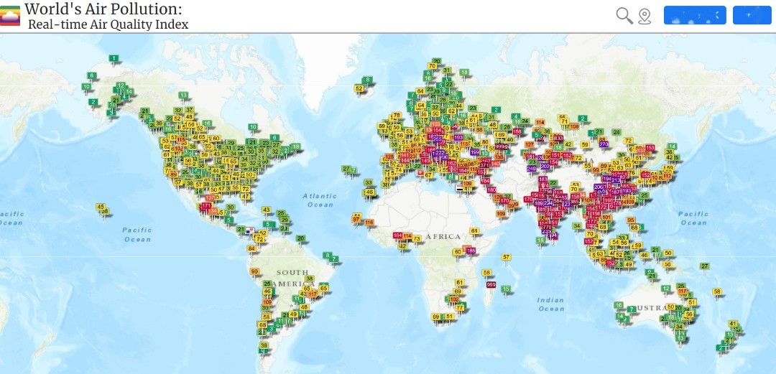
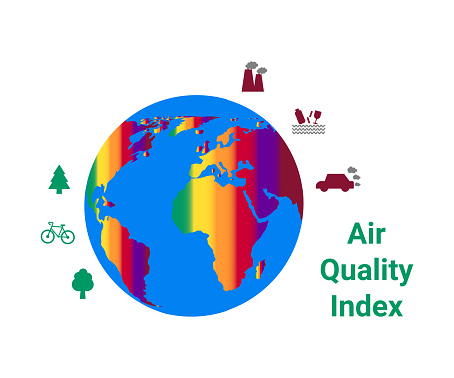
INTRODUCTION
Air quality affects health, environment, and policy decisions.
The Air Quality Index (AQI) is a standardized tool used worldwide.
Notes:
The Global Air Quality Forecasting and Information System (GAFIS) project, a new initiative by the WMO Global Atmospheric Watch (GAW) program is aimed at providing globally harmonized air quality forecasts tailored to the needs of end users.
The World Health Organization (WHO) attributes millions of premature deaths annually to exposure to ambient PM2.5

Slide 4



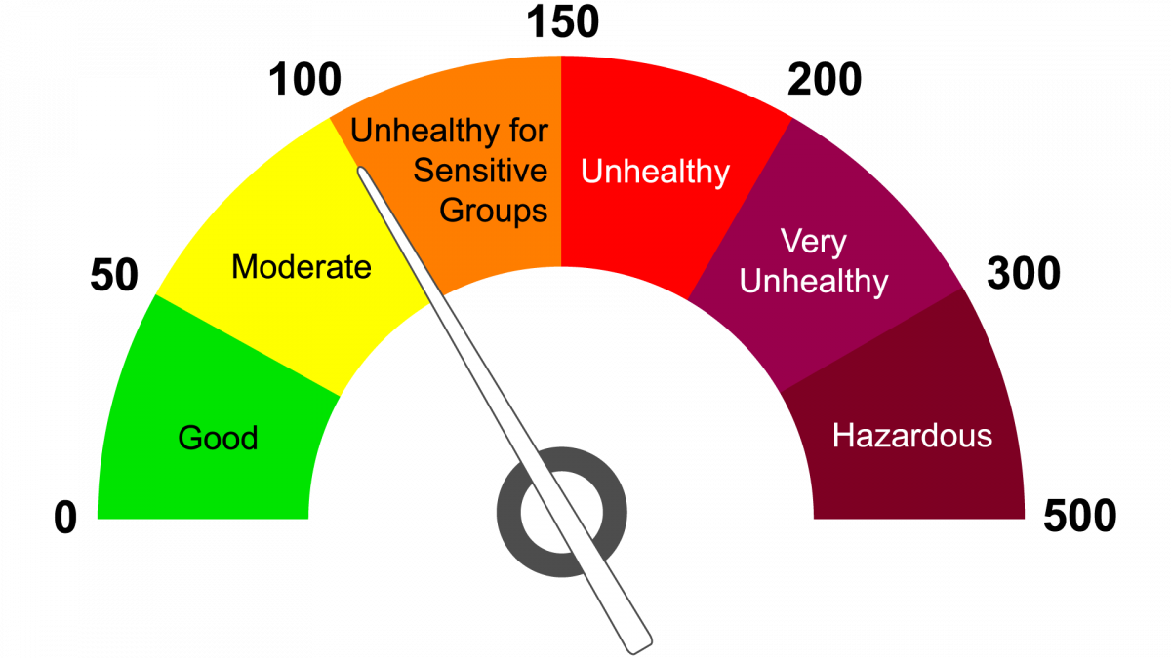




WHAT IS AQI?
A numerical scale that communicates how clean or polluted the air is.
Ranges typically from 0–500.
Higher value = greater health risk.

Slide 5





PURPOSE OF AQI
Guides government health advisories.
Enables consistent reporting across regions.
Simplifies scientific air-quality measurements.
Helps the public make decisions about outdoor activities

Slide 6

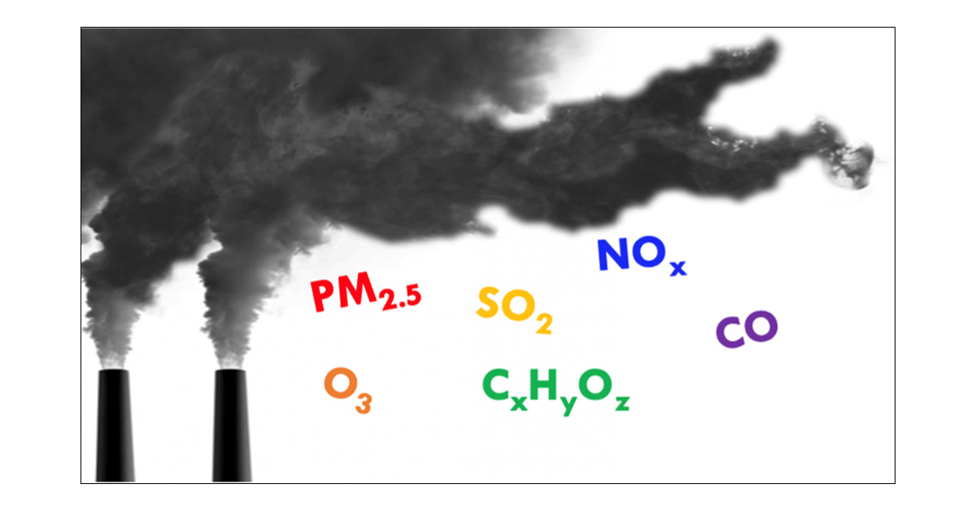
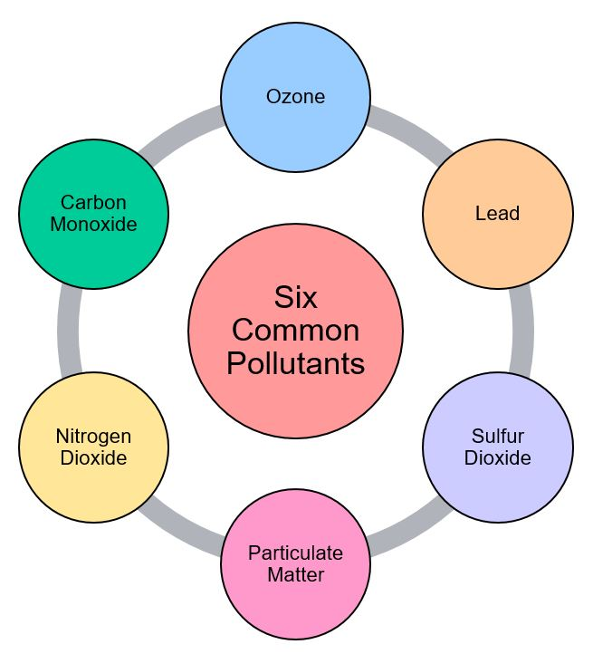

KEY POLLUTANTS USED IN AQI
Particulate Matter (PM2.5 & PM10)
Ozone (O₃)
Nitrogen Dioxide (NO₂)
Sulfur Dioxide (SO₂)
Carbon Monoxide (CO)

Slide 7
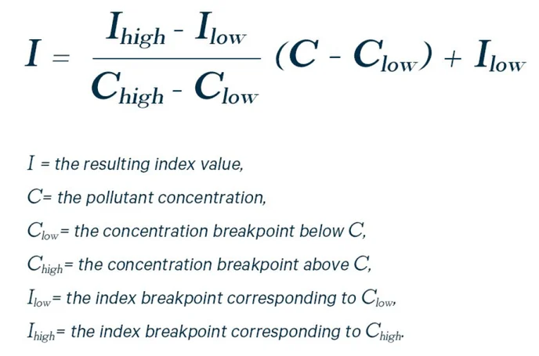
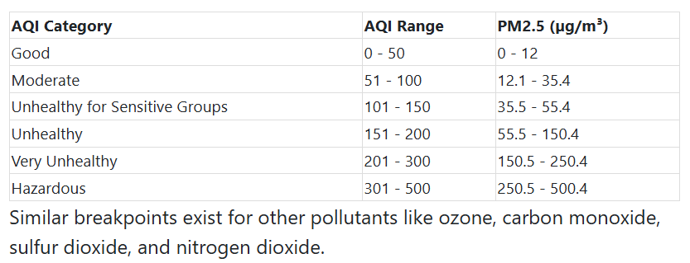
HOW AQI IS CALCULATED
Let’s calculate the AQI for PM_{2.5} when its measured concentration is 40 µg/m³.
From the AQI table, 40 µg/m³ falls in the "Unhealthy for Sensitive Groups" category (35.5 - 55.4 µg/m³), with an AQI range of 101 - 150.
Using the formula:
AQI = [(150 - 101) / (55.4 - 35.5)] * (40 - 35.5) + 101
AQI = [(49) / (19.9)] * (4.5) + 101
AQI ≈ 112
So, the AQI for PM2.5 at 40 µg/m³ is approximately 112, meaning the air quality is "Unhealthy for Sensitive Groups

Slide 8
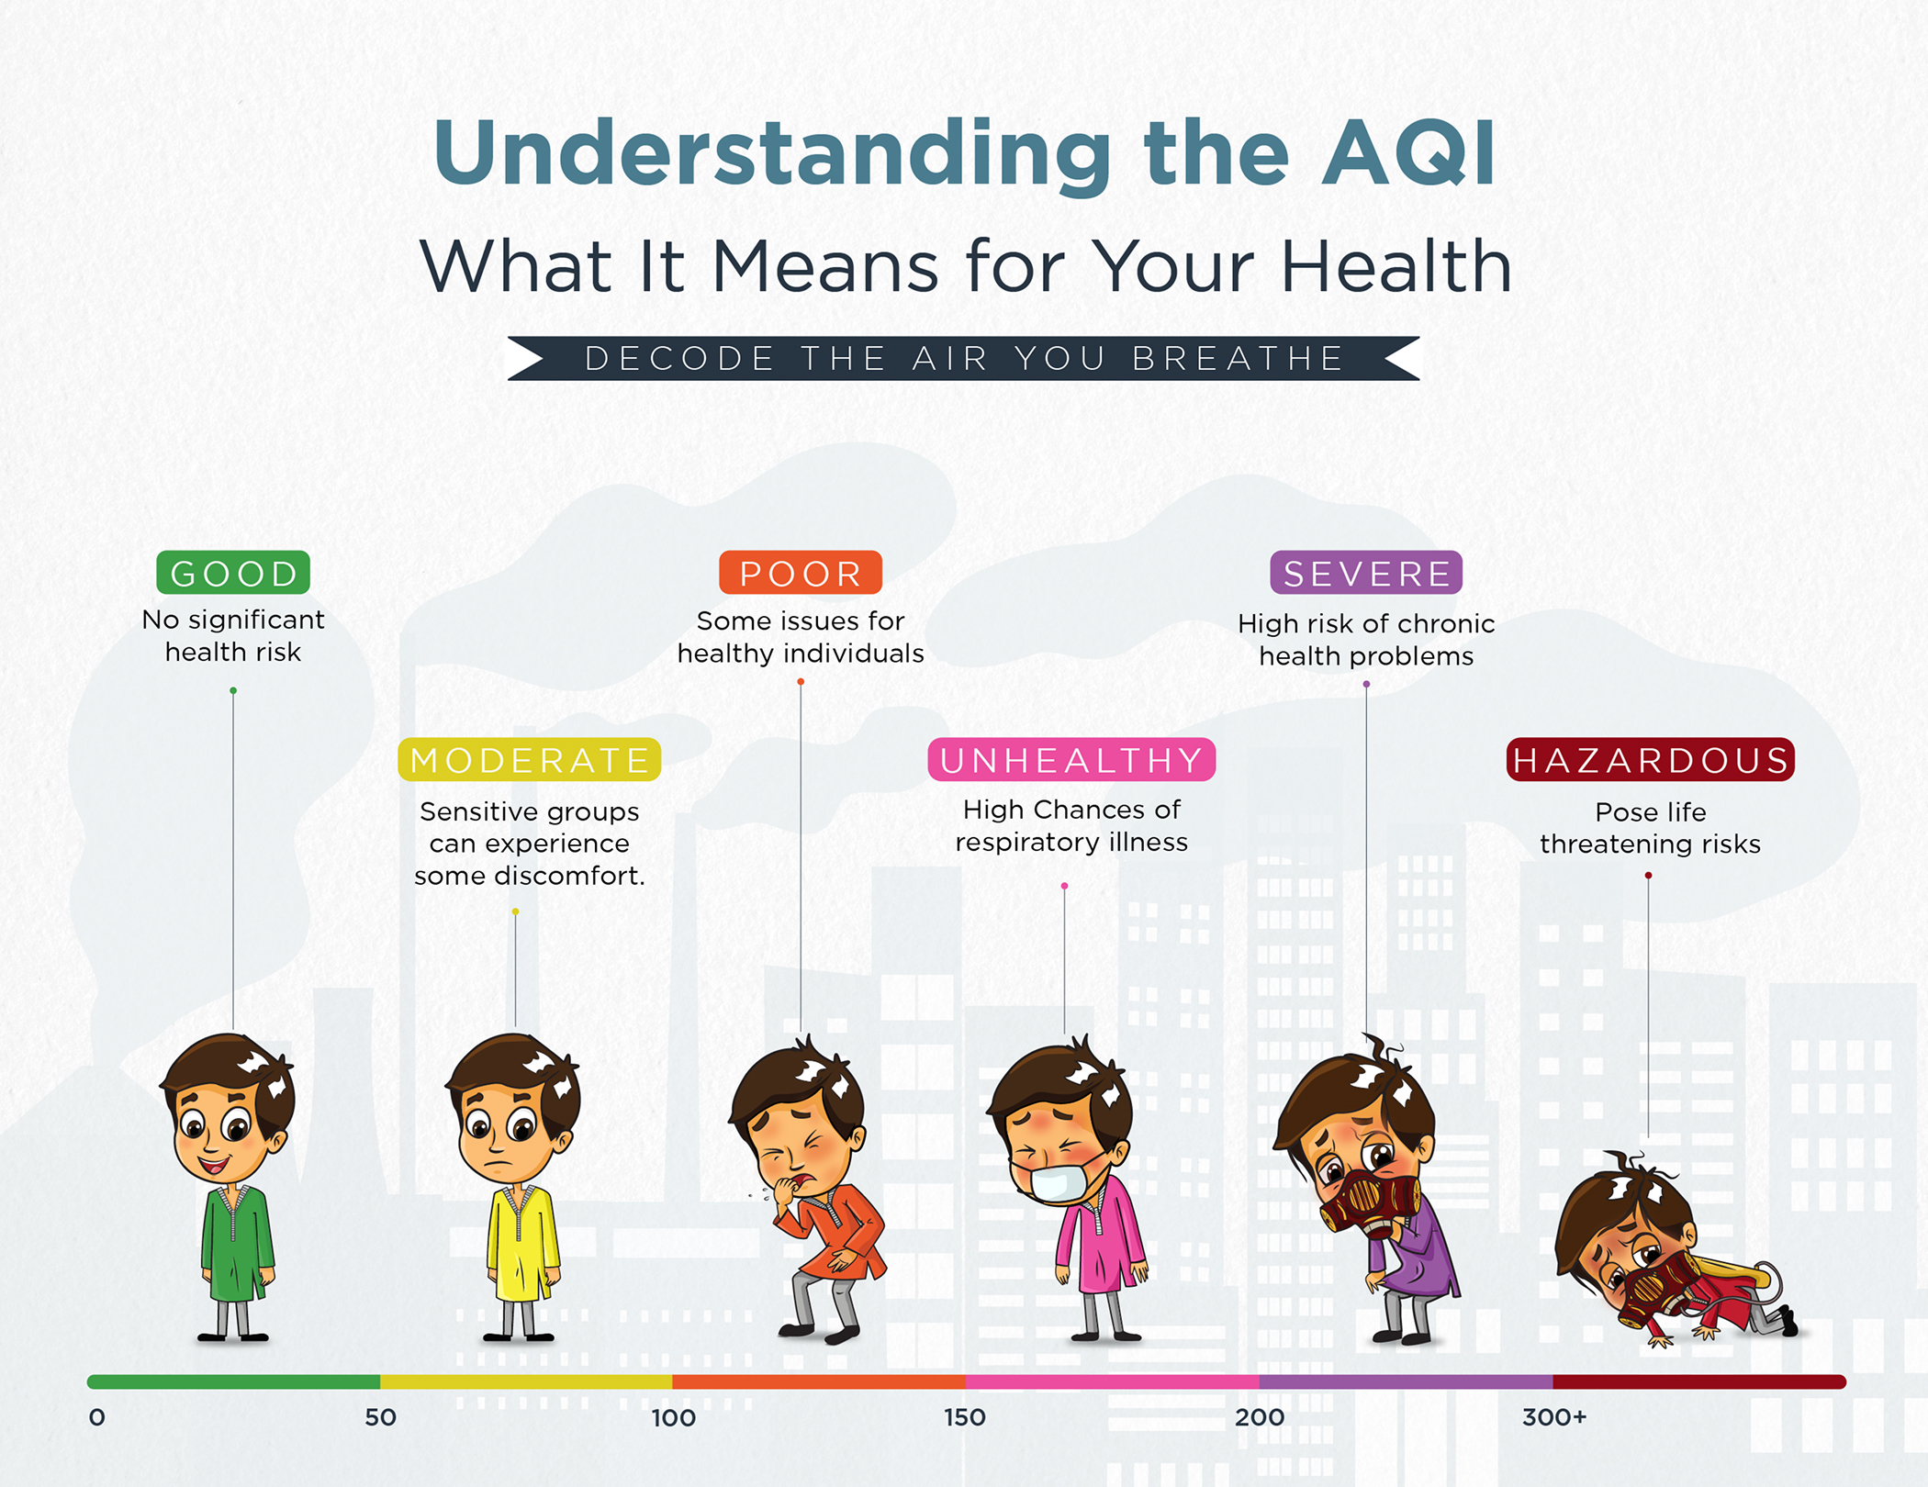
COLOR-CODING SYSTEM AND HEALTH IMPLICATIONS
Green Yellow Red Pink Purple Maroon
Image Source: Metro Manila Air Quality Index (AQI)

Slide 9



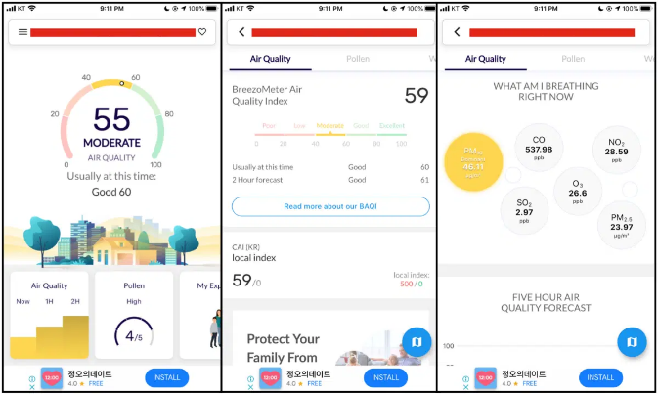
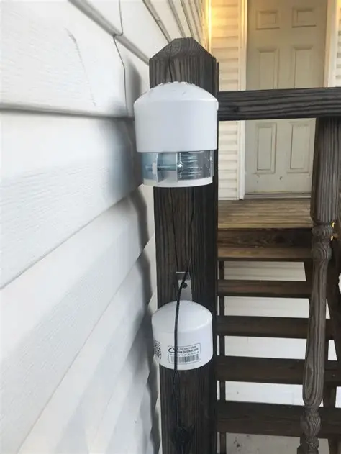
TOOLS FOR MONITORING AQI
Ground-based sensors (EPA, national agencies)
Satellite data (e.g., Sentinel-5P, MODIS)
Real-time dashboards and mobile apps.
Low-cost community sensors.

Slide 10

REPORTING STANDARDS
Must Include:
Location
Timestamp
Pollutant Concentration
AQI Category + Health Message
Daily or hourly reporting depending on region

Slide 11

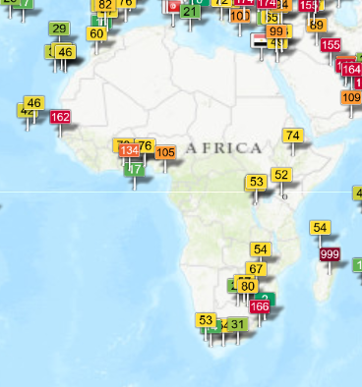



CHALLENGES IN AQI REPORTING
Low data coverage in some regions
Public misunderstanding of technical terms
Sensor Calibration and accuracy issues
Variability in standards across countries

Slide 12



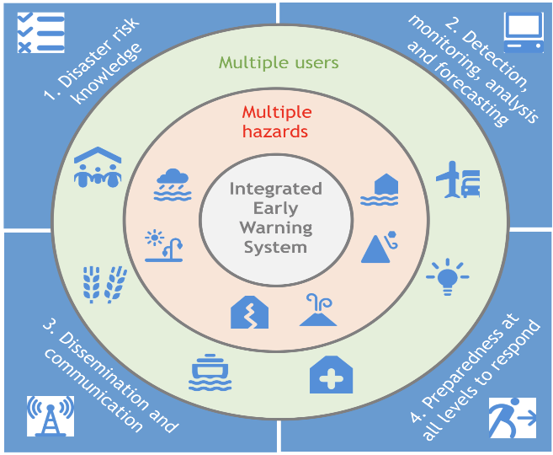

IMPORTANCE OF AQI REPORTING
Supports public health protection
Helps city planners and policymakers
Builds environmental awareness
Essential for early-warning systems

Slide 13

CONCLUSION
AQI is a powerful tool that converts complex air-quality measurements into simple, actionable information
Effective interpretation and reporting help safeguard health and guide community decisions.
Accurate communication = stronger environmental risk management.

Slide 14
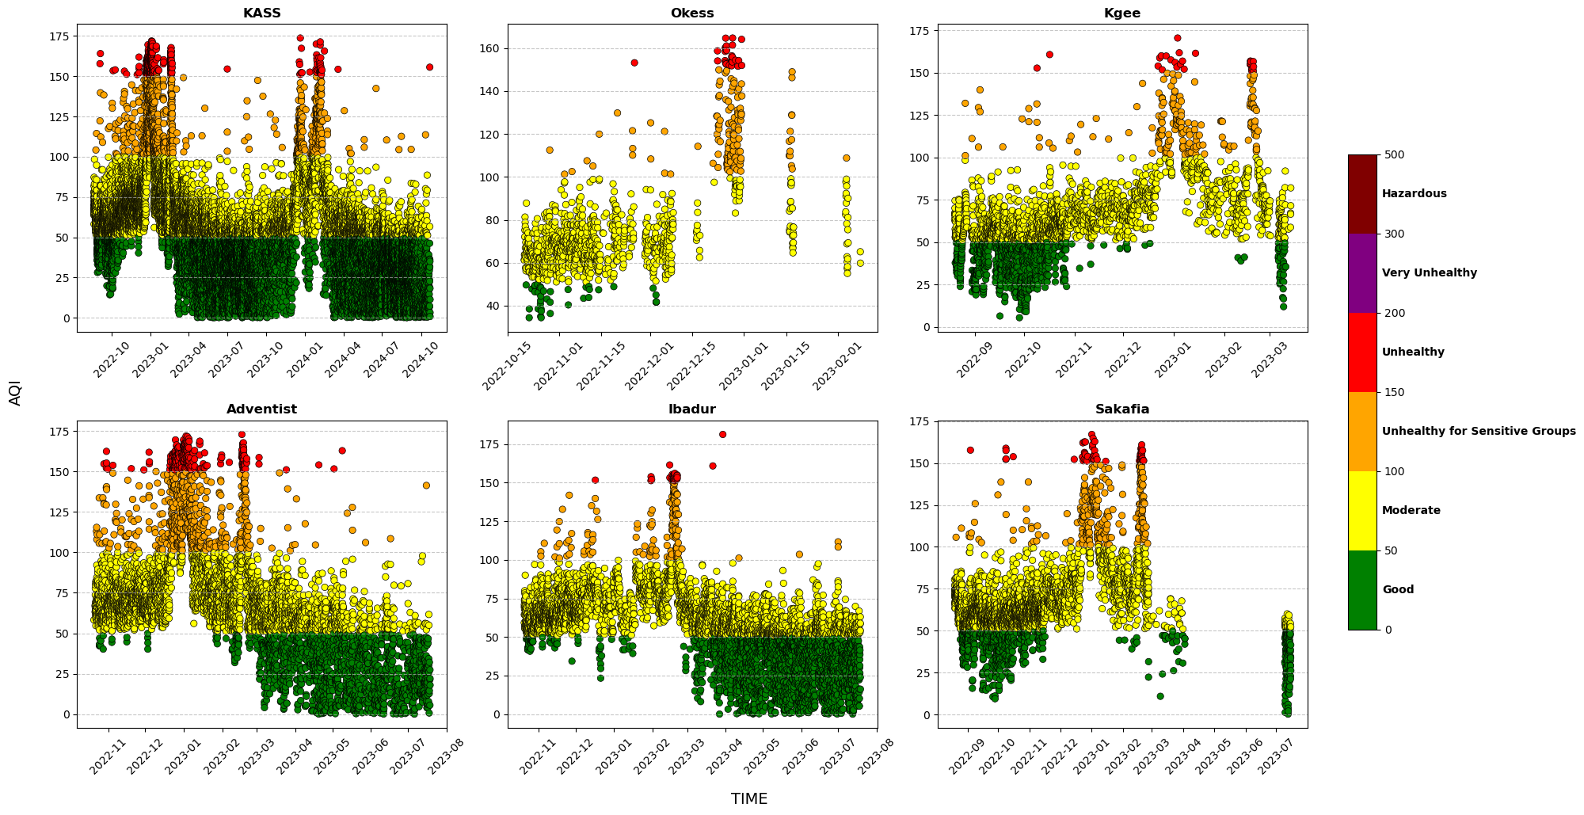
Assessment of PM₂.₅ exposure risk levels Using AQI

Slide 15
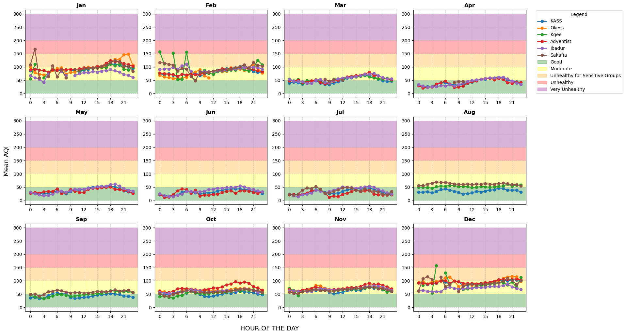
Diurnal Variations of AQI across the six schools

Slide 16
THANK YOU
Victoria Owusu Tawiah
vikowusu@gmail.com

