Slide 1

Data and Tools for Understanding
Air Quality Information
Dr Sarath Guttikunda
December 3rd, 2025
African School on Air Quality and Pollution Prevention
KNUST, Ghana

Slide 2






APnA City Program
City airshed landscape, geography, and meteorology
Baseline inventory of total & gridded emissions
Modelled pollution totals & source contributions
Knowledge sharing

Slide 3
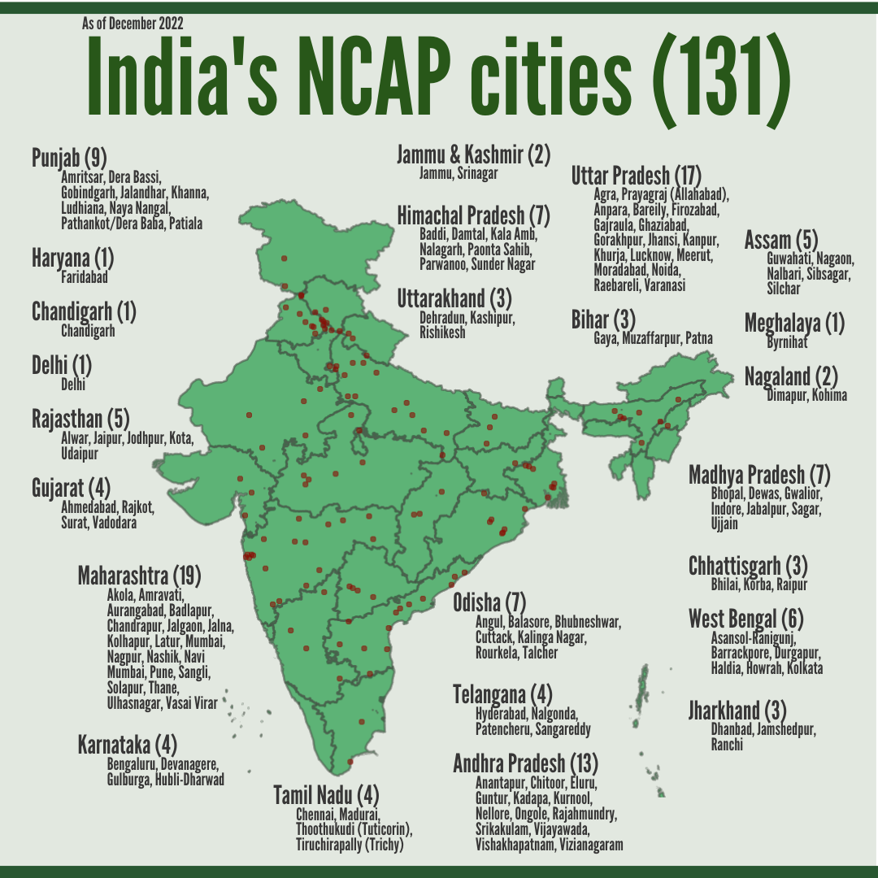
APnA City Program
Other cities
(Africa) Addis Ababa, Kampala, Nairobi, Accra, (Eastern Europe and Central Asia) Tashkent, Bishkek, Skopje, Sarajevo, Belgrade, (Asia) Bangkok, Hanoi, Dhaka, Kathmandu, and Jakarta

Slide 4
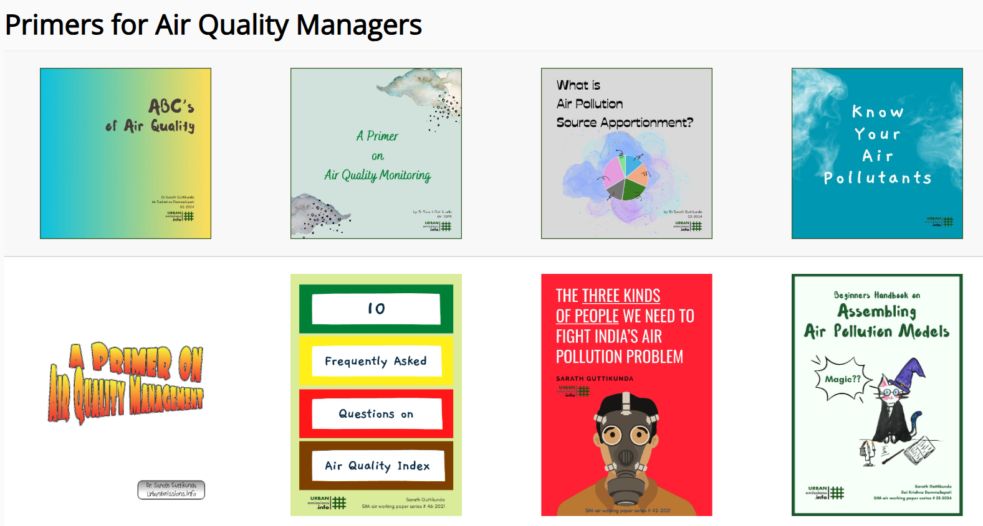

Slide 5
History Lessons Using Data

Slide 6
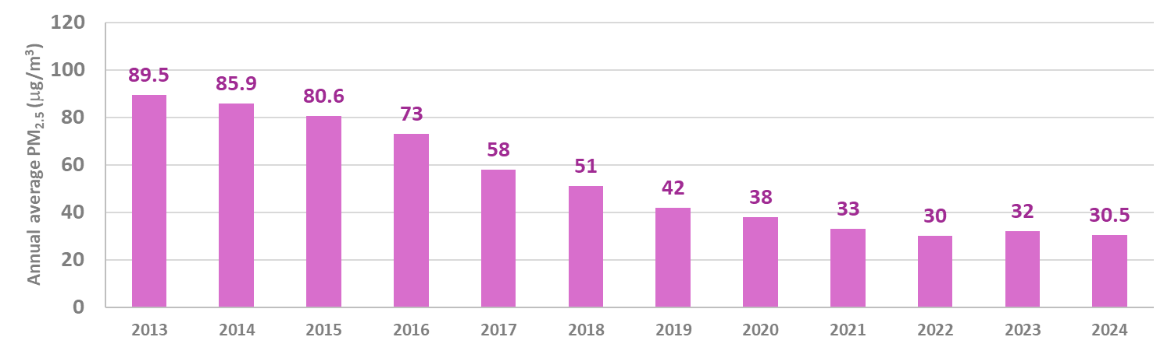
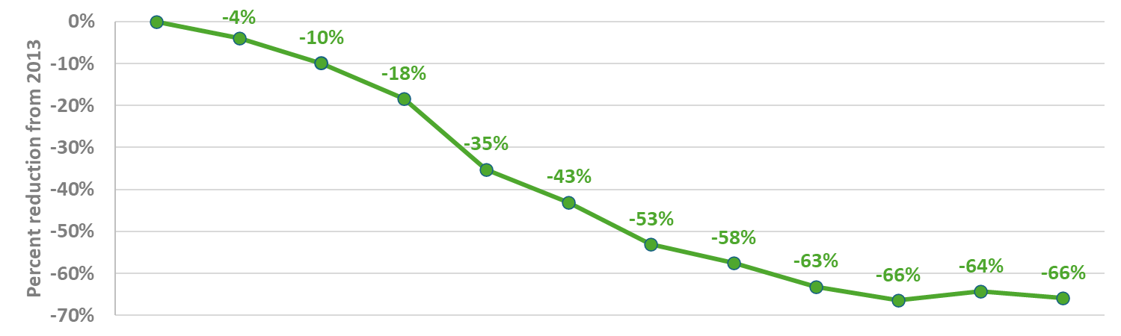

PM_{2.5} concentration trends in Beijing 2013 to 2024
Sustained improvements take 10-15 years of long-term planning and implementation
Trials and planning started with the Beijing Olympics in 2008
Increase in public transport, walking and cycling infrastructure and promotion for its usage; low-emission fuel consumption; waste management; improvement and enforcement of industrial emission standards; and public awareness
Source: Beijing Municipal Ecology & Environment Bureau via https://www.chinadaily.com.cn/a/202301/05/WS63b60eb3a31057c47eba7bba.html

Slide 7

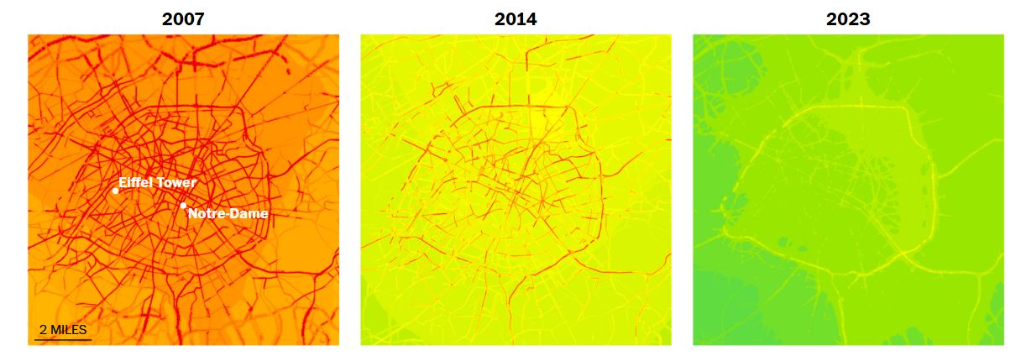

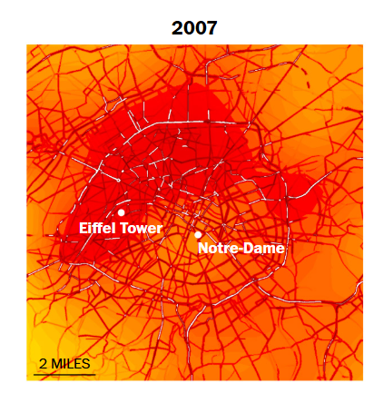
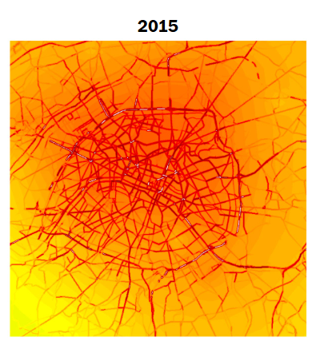
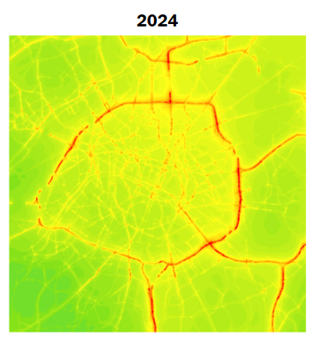
Air quality trends in Paris 2007 to 2024
PM_{2.5} dropped 55%
… 15 years and counting, Paris has undergone a major physical transformation…
Added 1000 km of bike lanes, with plans for 1400 km
Added 300 hectares of green spaces
Eliminating 60,000 parking spaces
SUV’s pay more for parking –
€18 vs €6 per hour for smaller cars
All public transport is offered free on forecasted bad air days
NO₂ dropped 50%
Data Source: AirParif via https://www.washingtonpost.com/climate-solutions/2025/04/12/air-pollution-paris-health-cars/

Slide 8
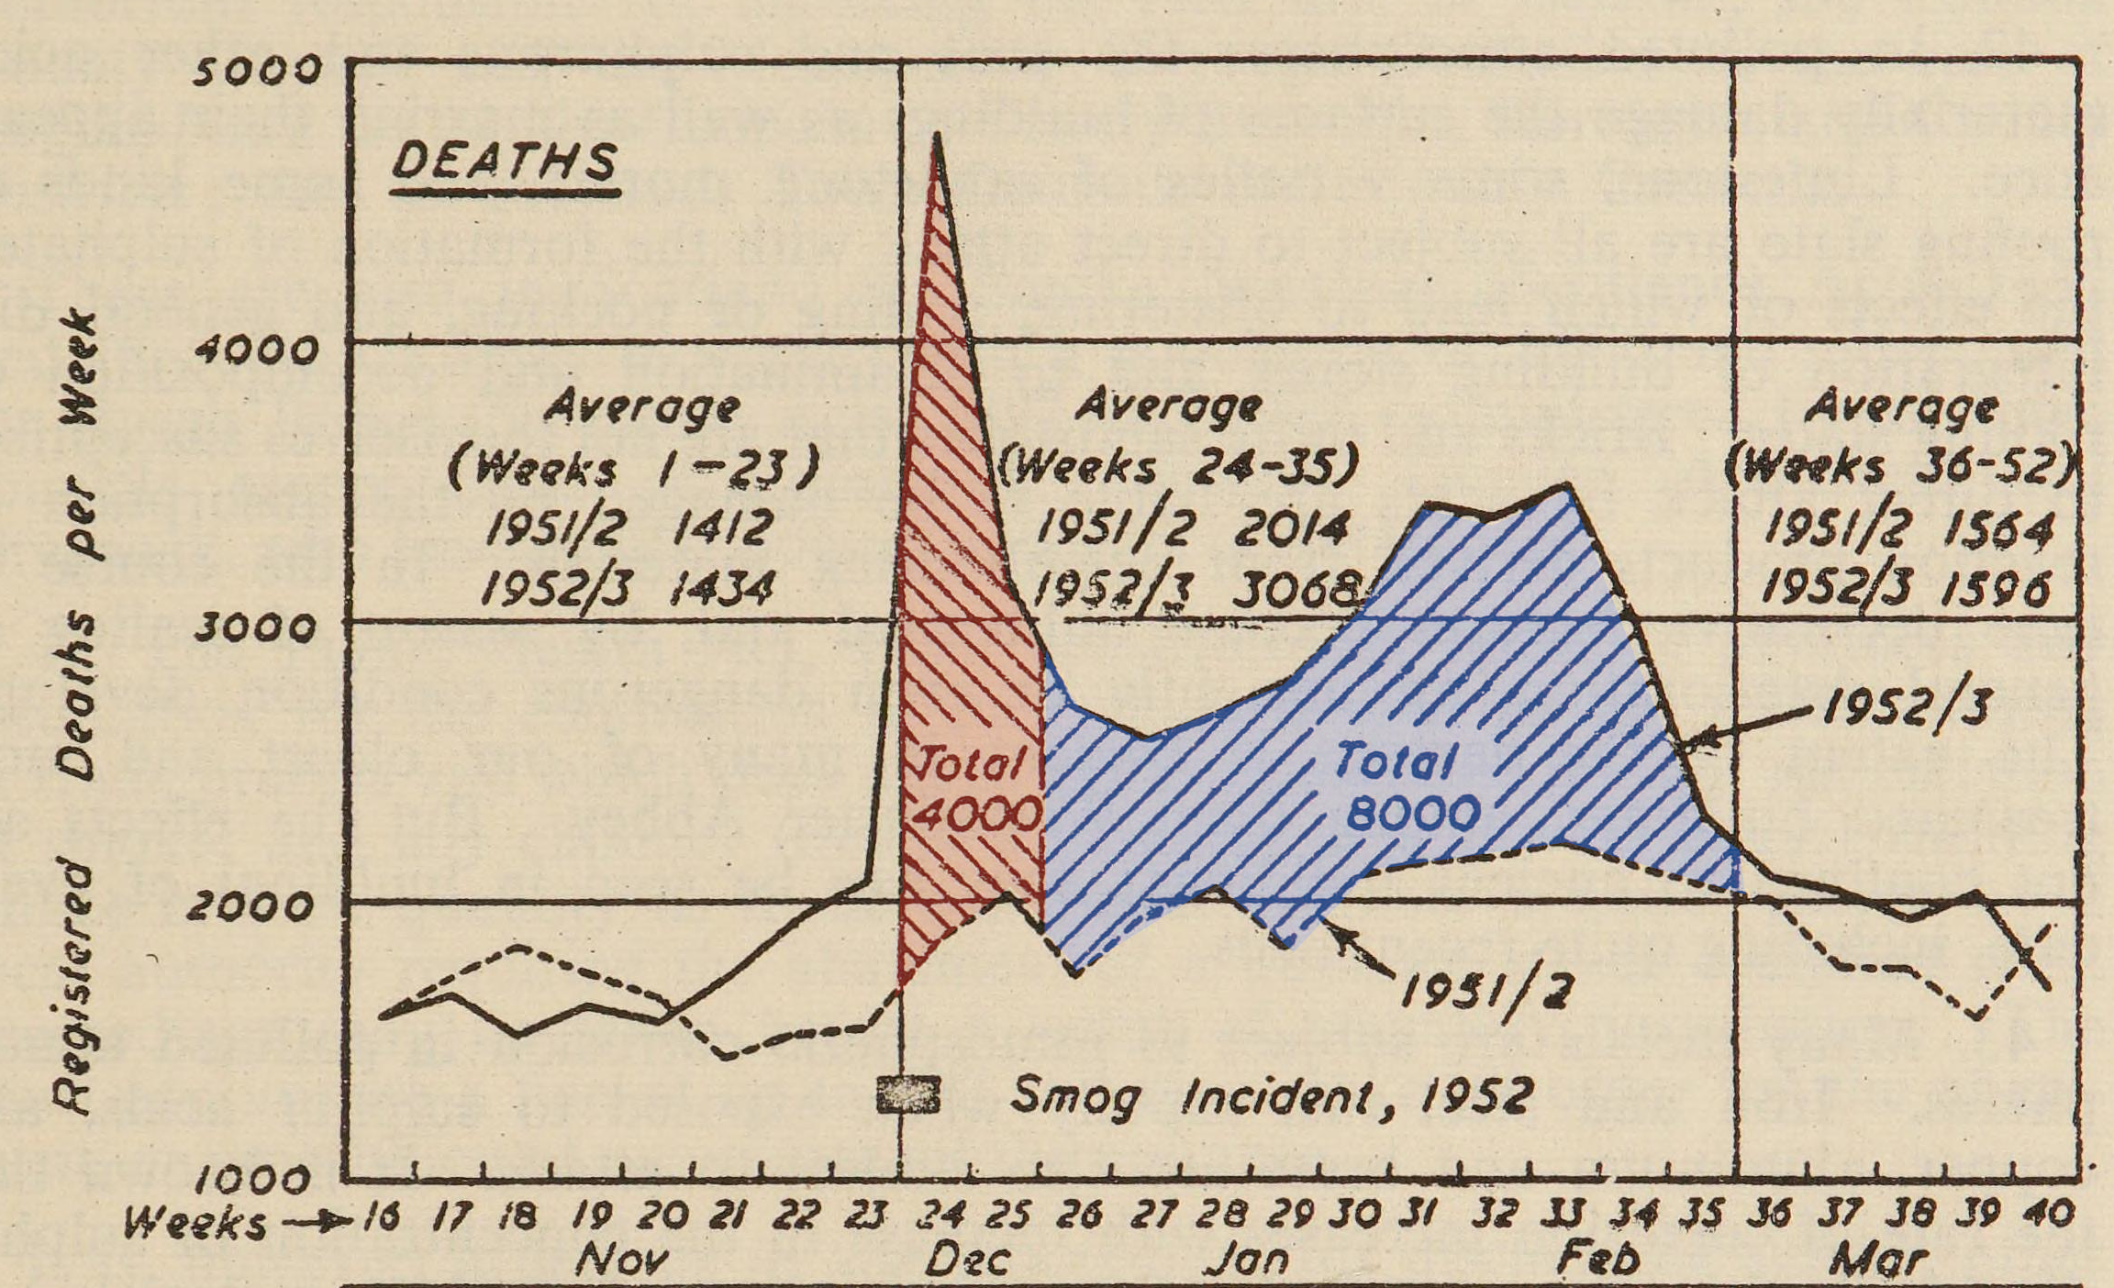
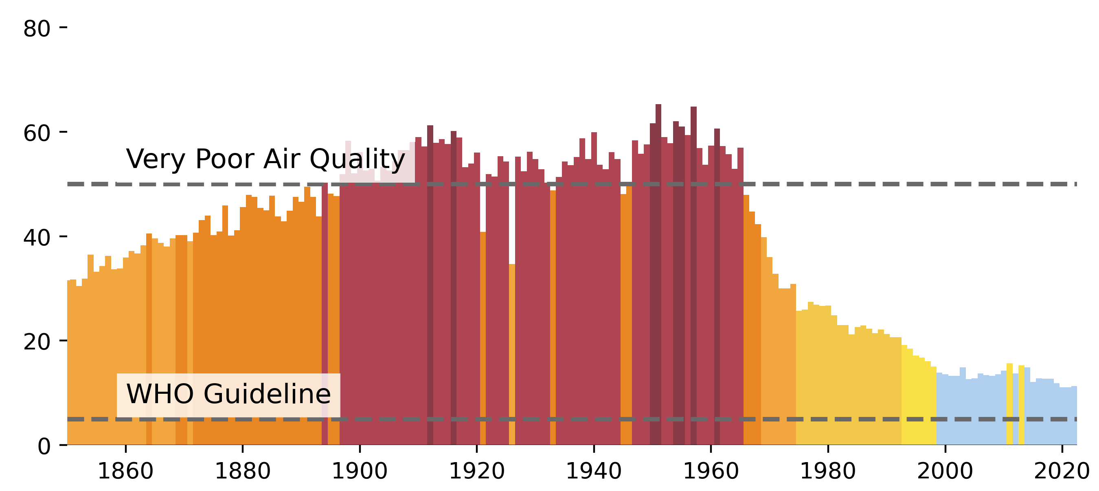
Air quality trends in London 1950 to 2024
Gradual transition from coal to gas and electricity to support residential and industrial energy demand
Market mechanisms for urban mobility management in the 2000s
12,000 deaths recorded during the “Great Smog” of 1952
First published in 1953
PM_{2.5} Concentrations (μg/m³)
75% drop from the episode
Data Source: https://airqualitystripes.info/stripes/?continent=Europe&country=United%20Kingdom&city=London&plot=bar

Slide 9
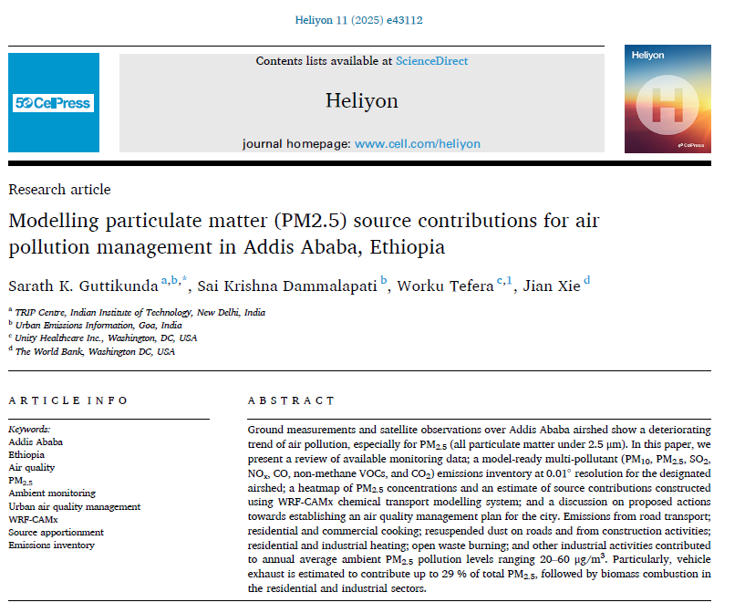
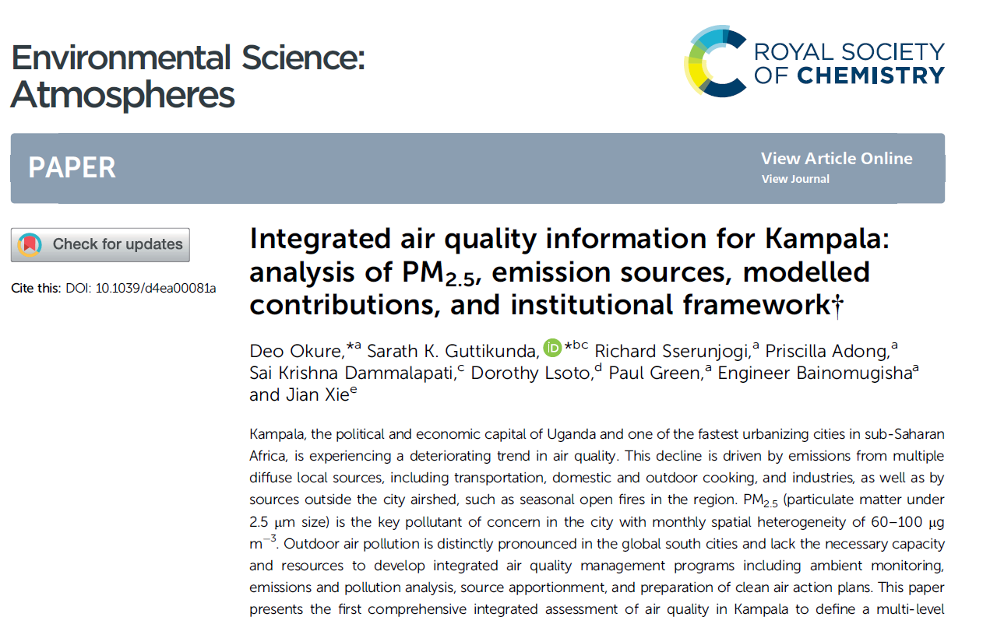
APnA City Program

Slide 10
Air Quality Information Tools

Slide 11
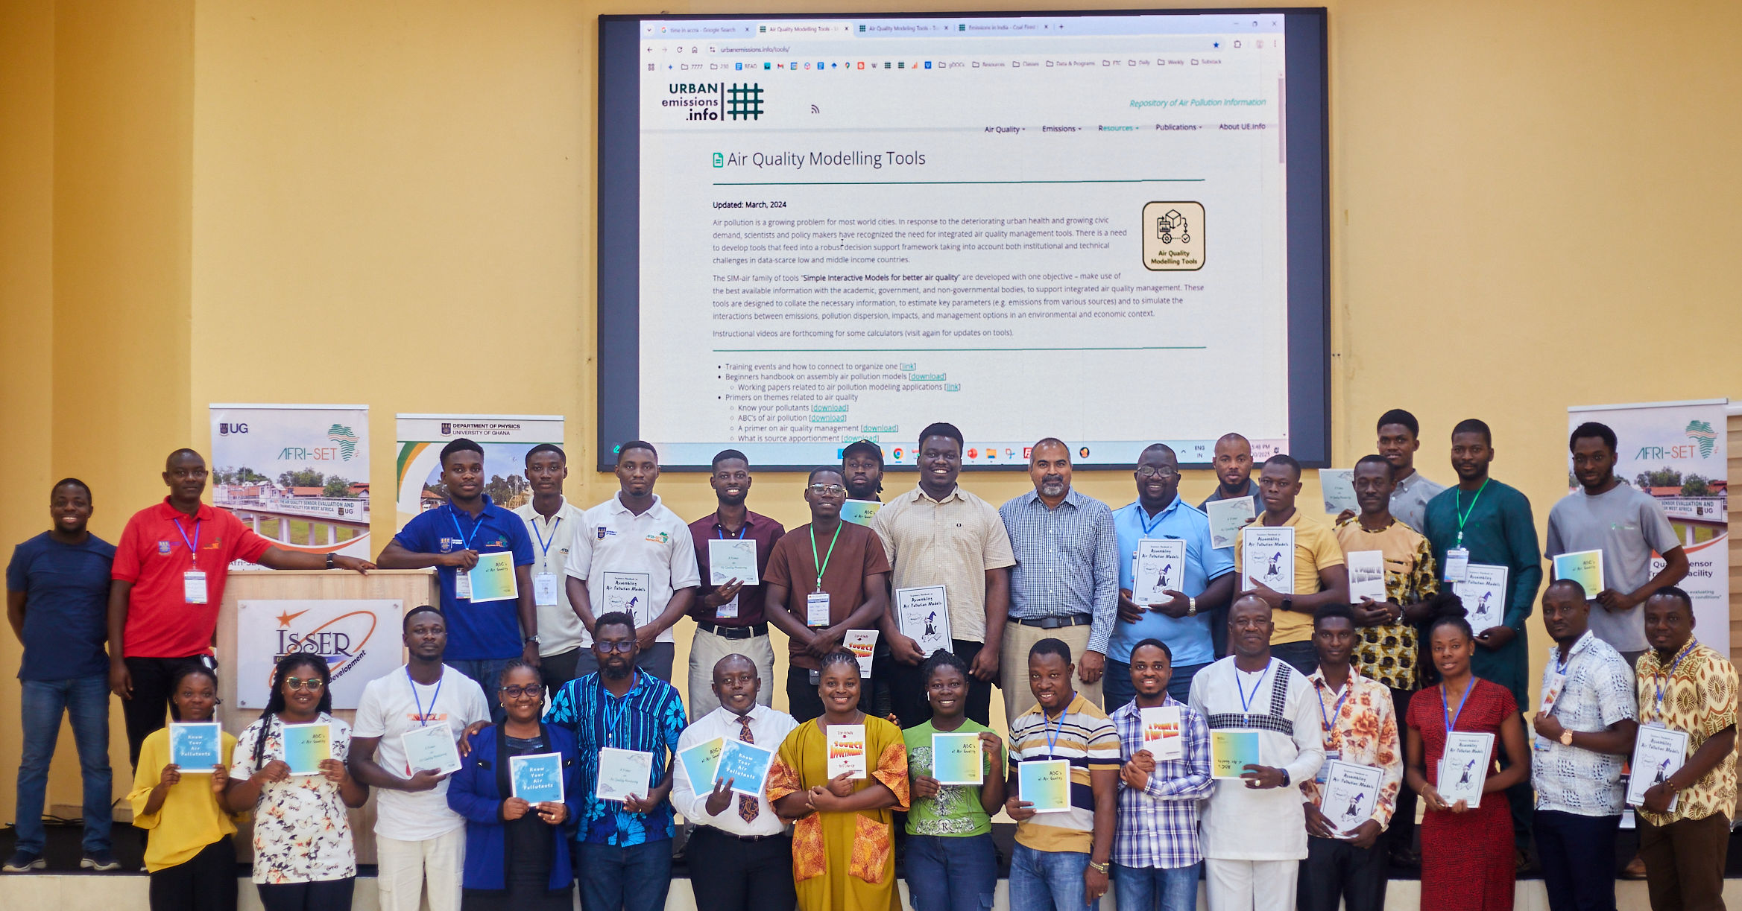

Air Quality Information Awareness Course
https://urbanemissions.info/tools

Slide 12
How to use Monitoring Data for Policy
https://urbanemissions.info/tools

Slide 13
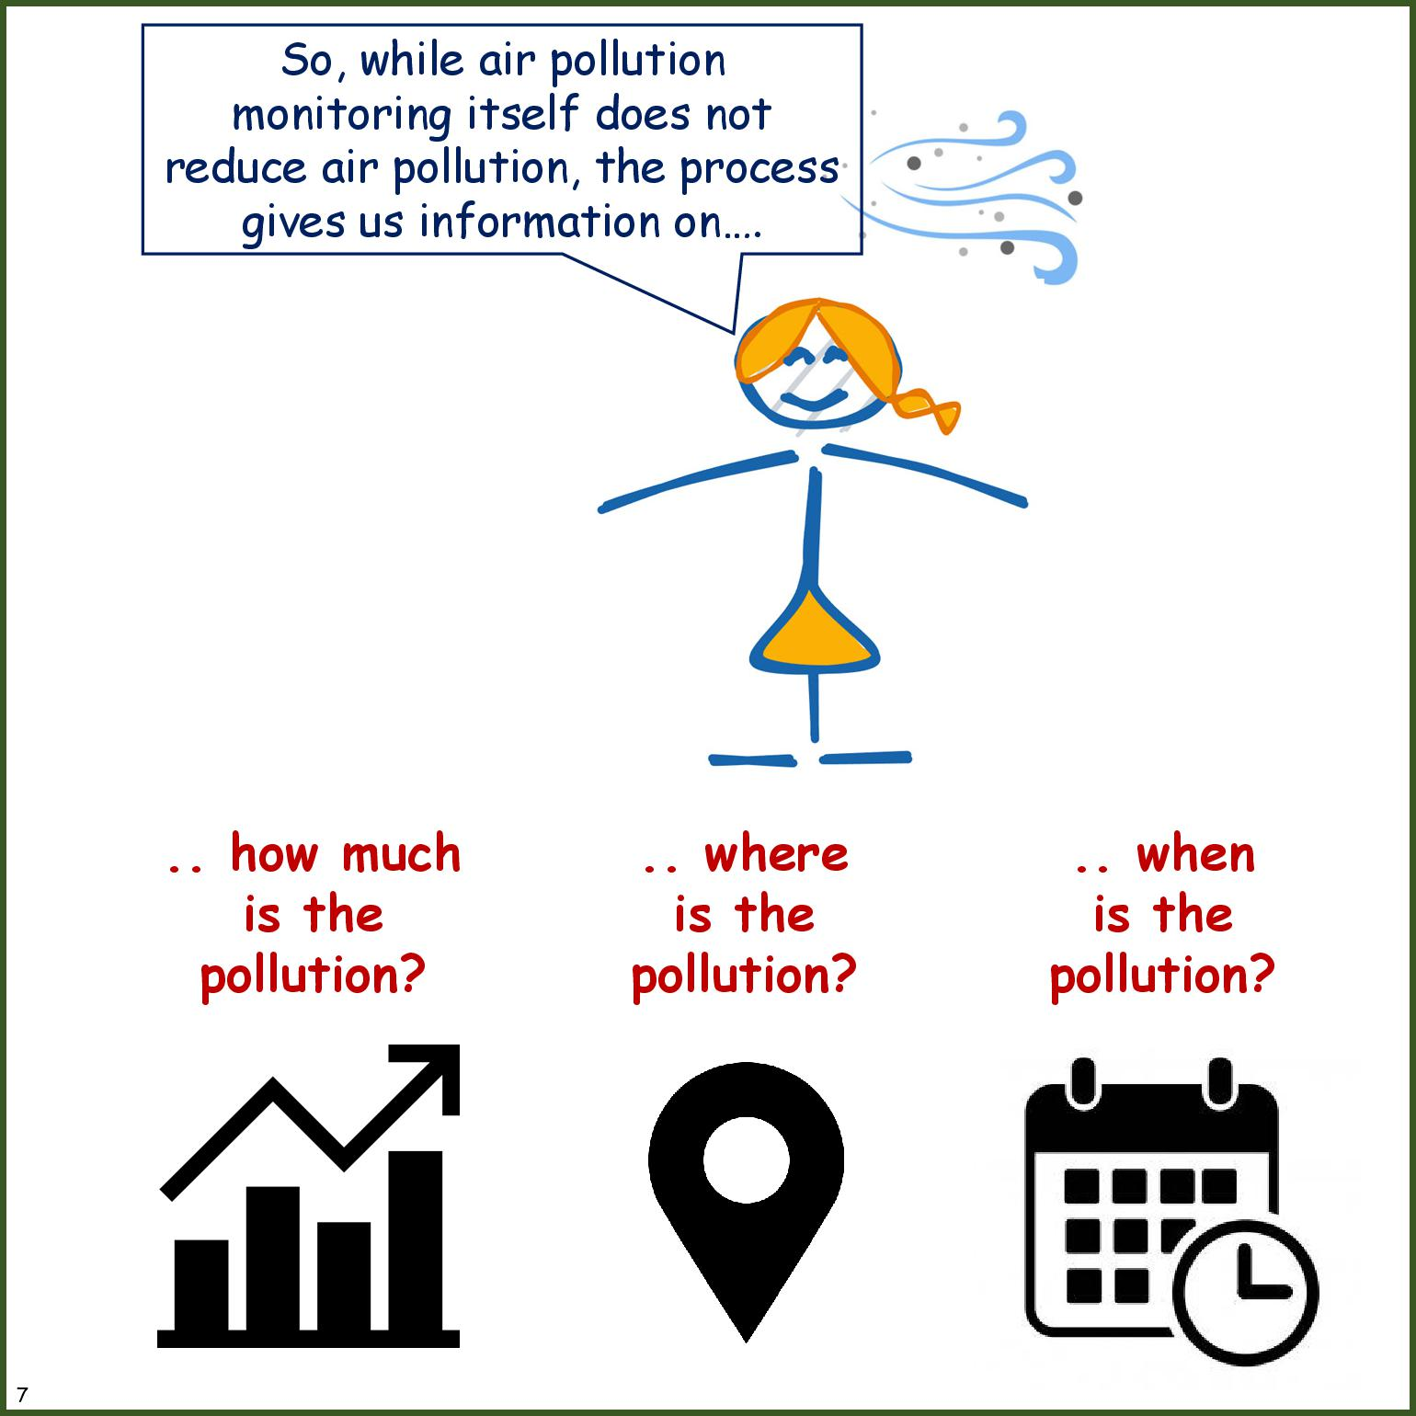
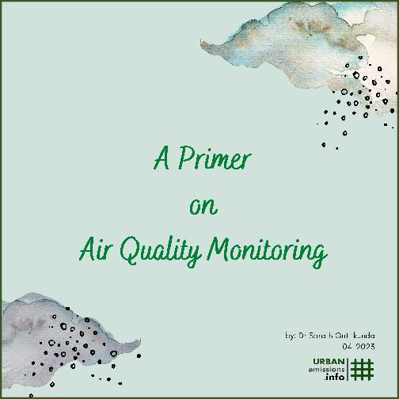
https://urbanemissions.info/publications/primer-on-air-pollution-monitoring/

Slide 14
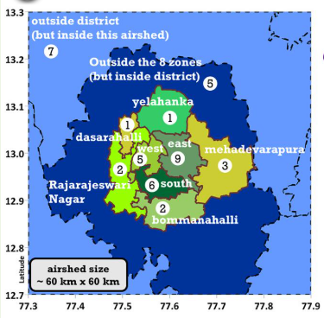
Air Quality Scenario Players
https://urbanemissions.info/publications/primer-on-air-pollution-monitoring/

Slide 15
Building a Timeline for AQ Management

Slide 16
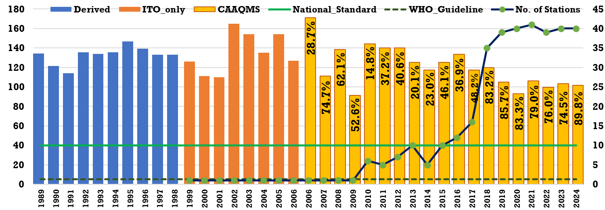
Summary of Annual Average Ambient Monitoring PM2.5 Data - 1989 to 2024
% value = % 15-minute data points available in that year
PM_{2.5} Concentrations (μg/m³)
Number of continuous stations
Detailed paper is published @ https://www.mdpi.com/2071-1050/15/5/4209
Open access to this data @ https://www.urbanemissions.info

Slide 17



Reconstructed PM_{2.5} Source Apportionment Results
This infographic is distributed under creative commons attribution and non-commercial license. @urbanemissions @urbanemissions.info

Slide 18
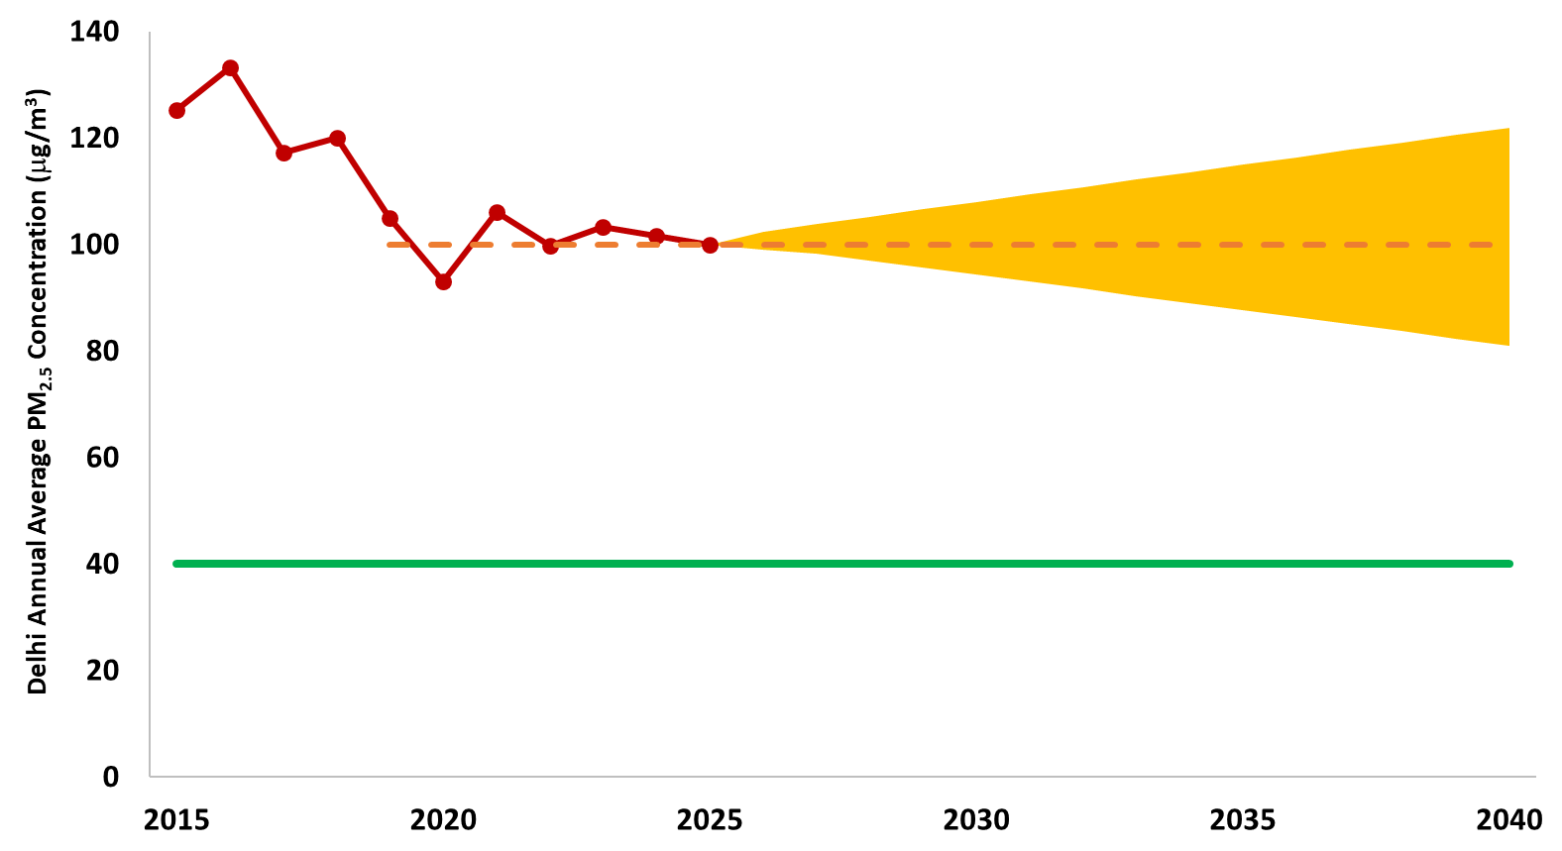
Business-as-usual scenario
Avoided exposure burden
0%
Business as usual projection band
Cumulative exposure burden
100%
National annual ambient standard
Cost of delay

Slide 19
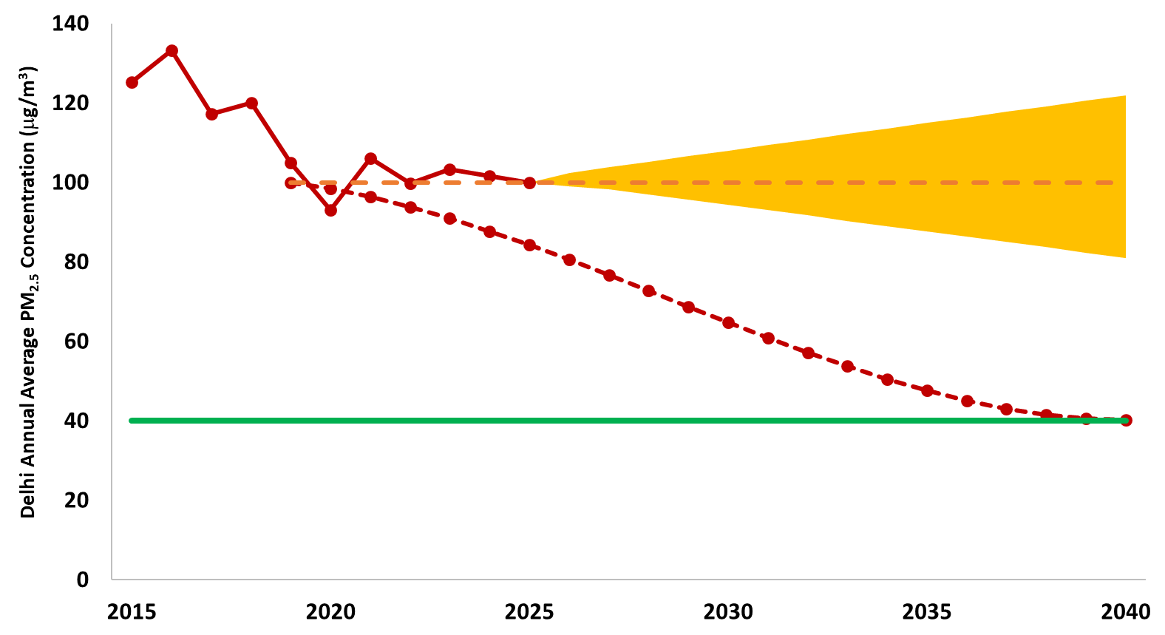
If implementation started in 2019 and sustained to reach 40
Business as usual projection band
Avoided exposure burden
32%
Cumulative exposure burden
68%
National annual ambient standard
Cost of delay

Slide 20
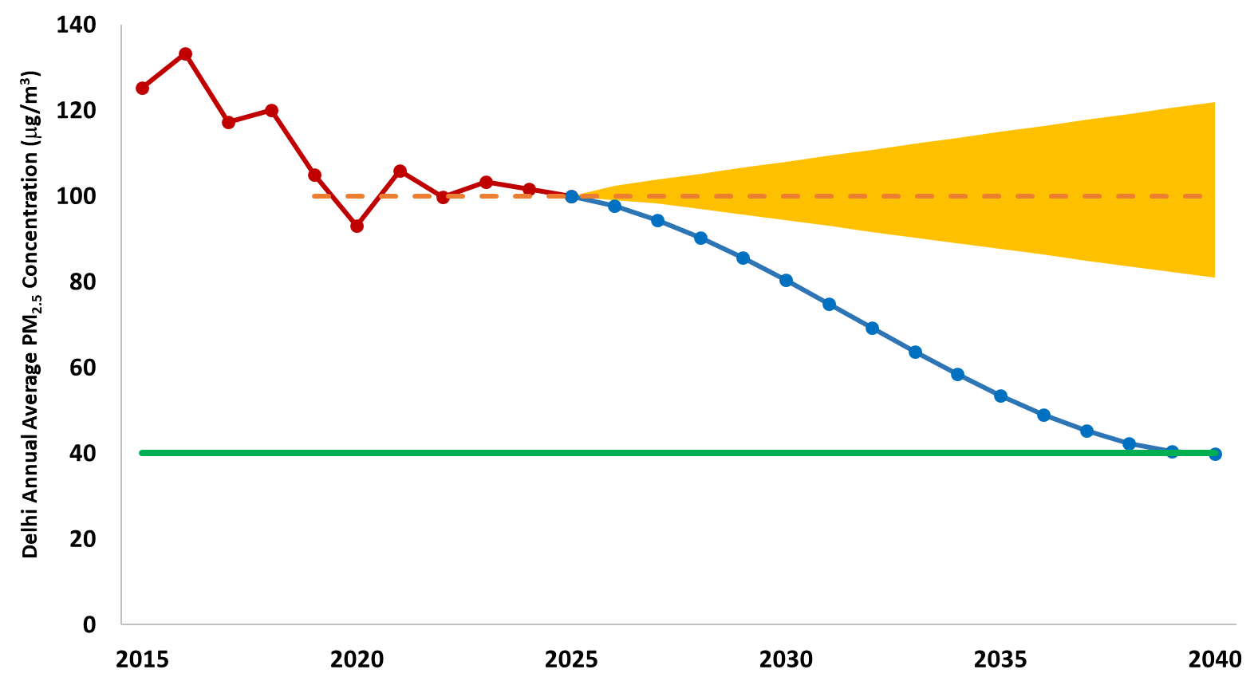
If implementation started in 2026 and sustained to reach 40
Business as usual projection band
Avoided exposure burden
24%
Cumulative exposure burden
76%
National annual ambient standard
Cost of delay

Slide 21
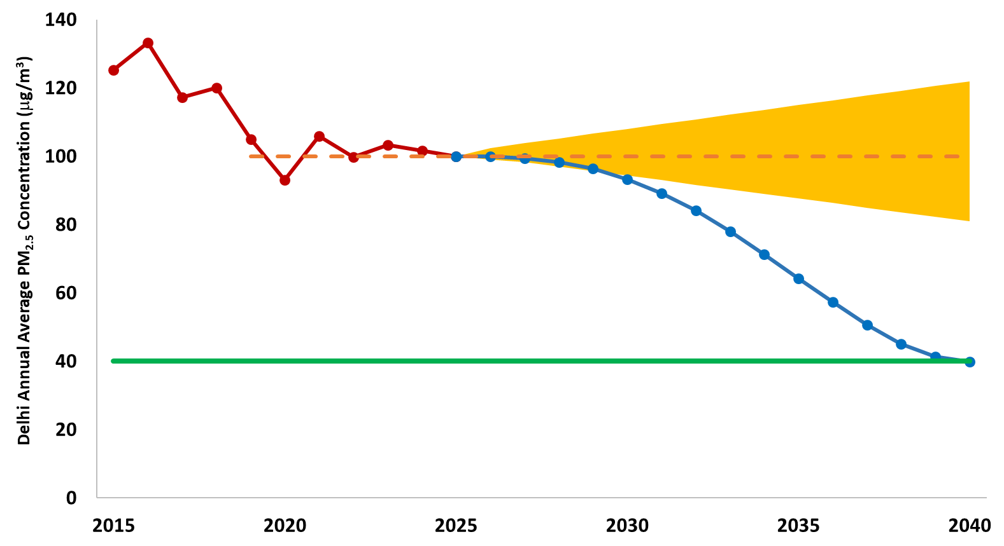
If implementation started slow in 2026 and sustained to reach 40
Business as usual projection band
Avoided exposure burden
18%
Cumulative exposure burden
82%
National annual ambient standard
Cost of delay

Slide 22
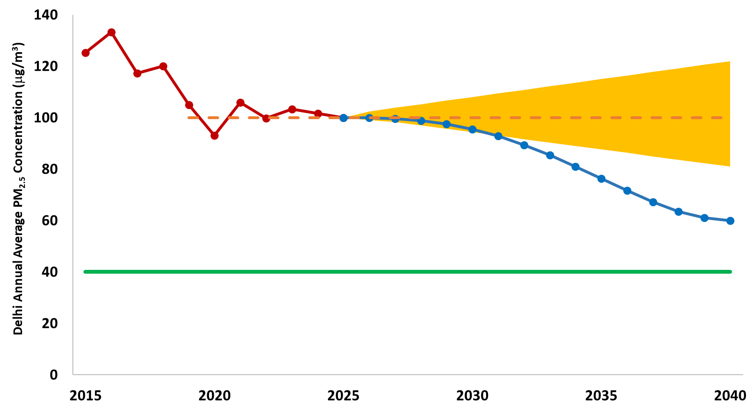
If implementation started slow in 2026 and reached only 60
Business as usual projection band
Avoided exposure burden
12%
Cumulative exposure burden
88%
National annual ambient standard
Cost of delay and inaction

Slide 23
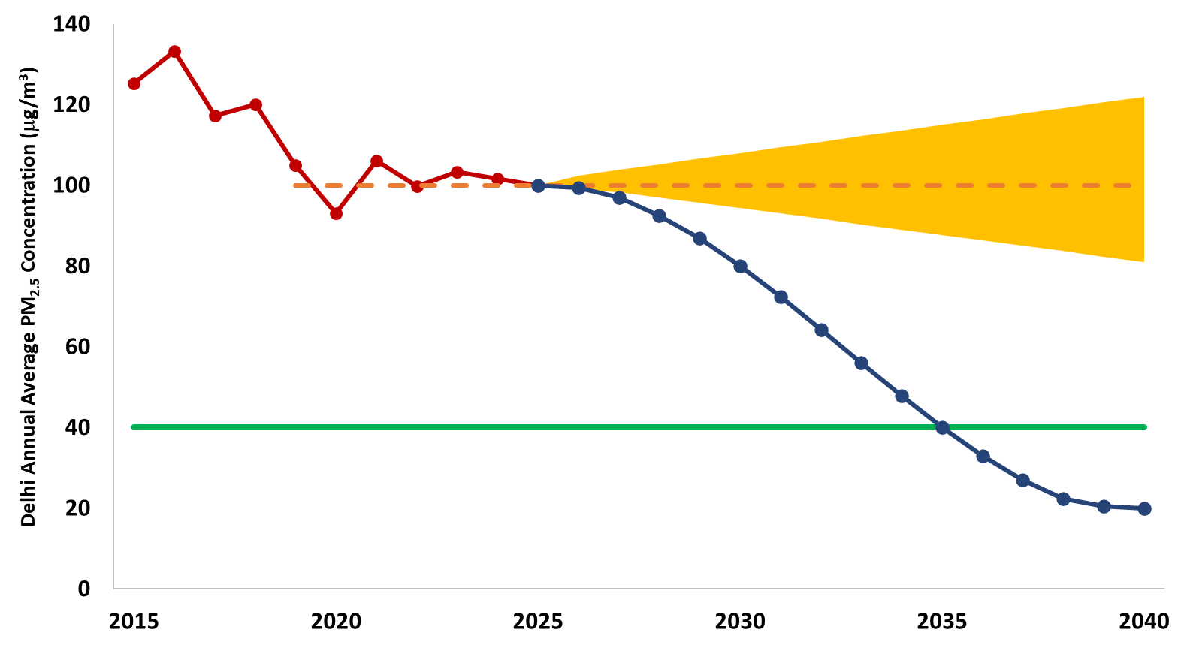
If implementation started in 2026, sustained to reach 40 in 2035 and more in 2040
Business as usual projection band
Avoided exposure burden
29%
Cumulative exposure burden
71%
National annual ambient standard
Benefits of acting now and more

Slide 24
Demonstration of the tool
Download the file here -- https://urbanemissions.info/whats-polluting-delhis-air

