Slide 1




Turning Air Quality Data into Policy Solutions for Africa: A Practical Demonstration via Policy Simualtion
Victoria Owusu-Tawiah
Kigali Collaborative Research Centre

Slide 2



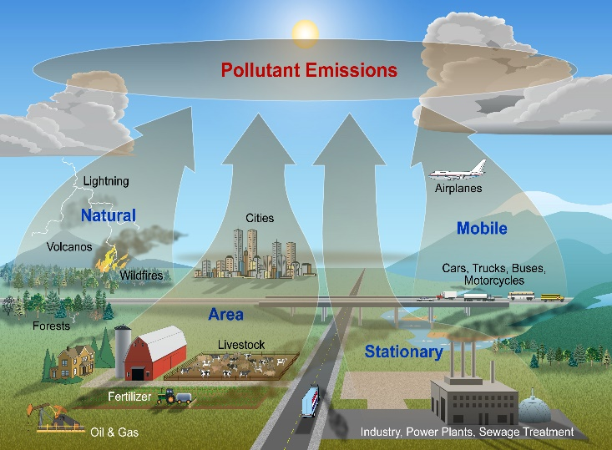

WHAT TO DO
1
2
General perception of air pollution in your country
Identify an air pollution problem in your country
3
4
5
Describe the cause(s) of that pollution problem
Provide solutions and simulate how the situation will look in the next 5 years

Slide 3
THANK YOU
Victoria Owusu Tawiah
vikowusu@gmail.com

