Slide 1


Health Effects of Air Pollution
December 3, 2025
African School on Air Quality and Pollution Prevention in Ghana

Slide 2

If you are not feeling sick, air pollution is not causing harm.
Is this true?

Slide 3
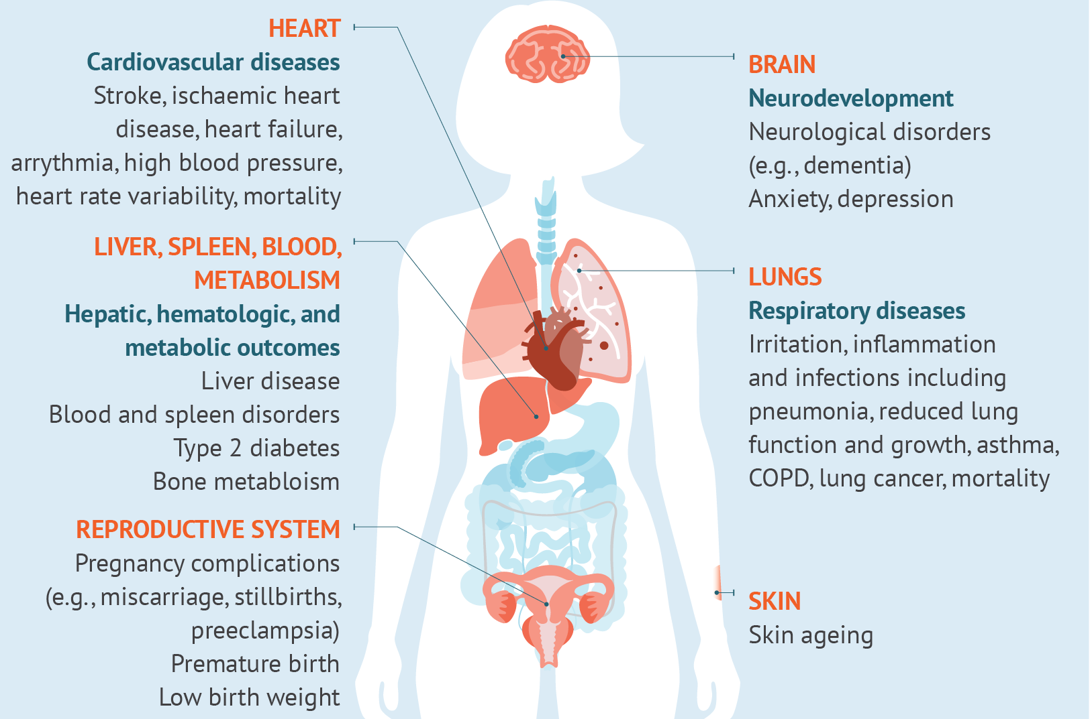
Air pollution harms almost all organ systems.
State of Global Air 2025

Slide 4
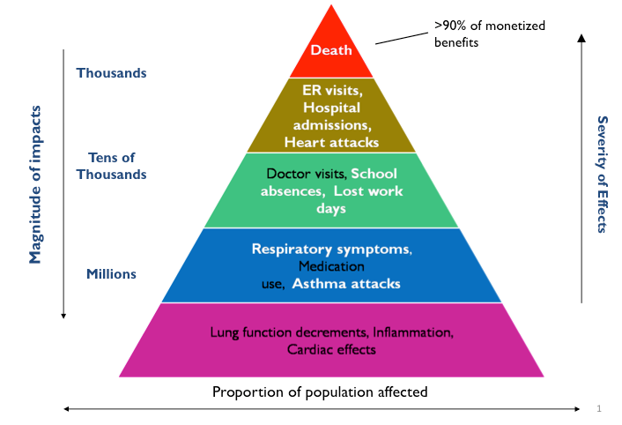
Short- and long-term effects
US EPA

Slide 5
. 2011 Mar:120 Suppl 1:S8-2
Types of studies used to establish health effects of air pollution
Epidemiology
Studies involving populations, either looking at short-term exposures or long-term exposures
Cross-sectional (at any point in time, what is the rate/prevalence of a health outcome), time-series (changes in health outcomes as pollutant levels change) and cohort studies (association between long-term or chronic exposures)
Clinical Studies
Clinical studies typically involve controlled experiments of human volunteers in exposure chambers. However, sample sizes are often small. E.g., observing changes in lung function or asthma symptoms in subjects exposed to varying levels of ozone over set periods of time.
Toxicology
Animal toxicological studies typically involve controlled experiments of animals in chambers exposed to specified doses/concentrations of pollutants.
Such studies help us understand the biological mechanism of for the effect.
Stanek et al. 2011. Air pollution toxicology--a brief review of the role of the science in shaping the current understanding of air pollution health risks. Toxicol Sci, 120.

Slide 6
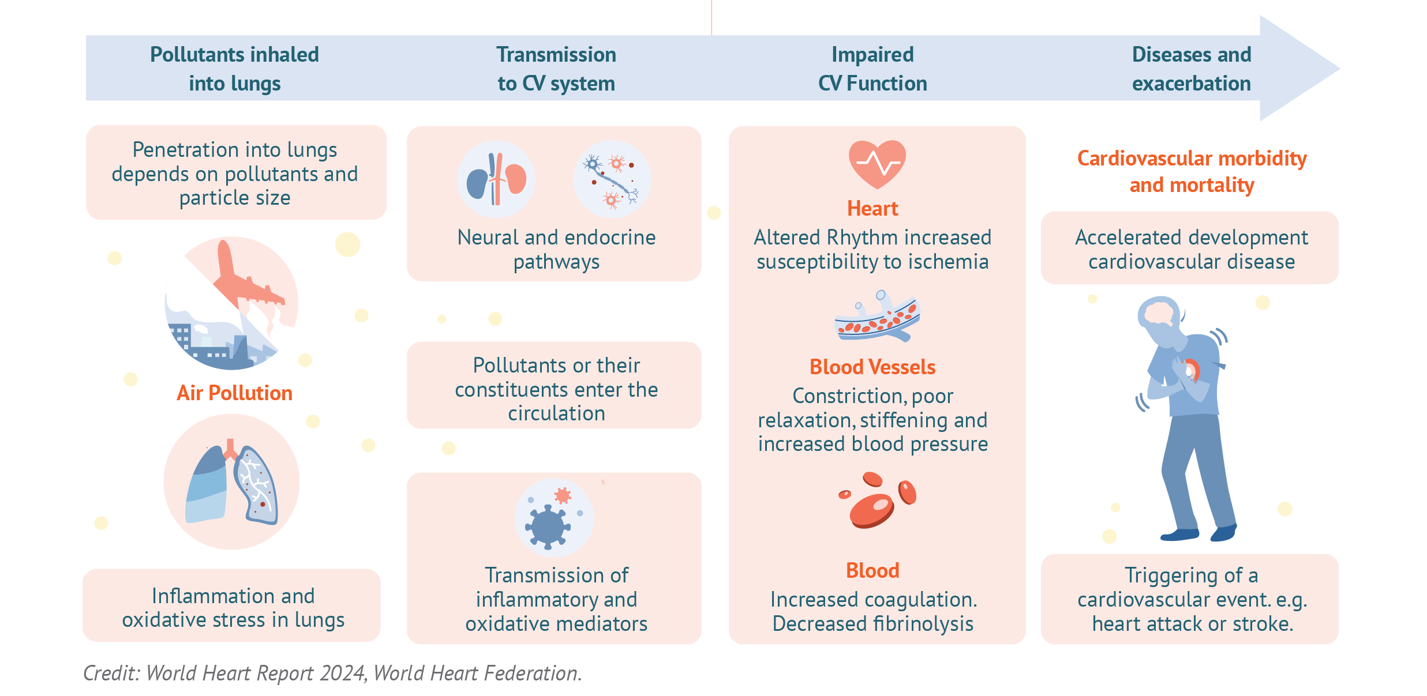
How does air pollution contribute to cardiovascular (heart) health effects?
State of Global Air 2025

Slide 7
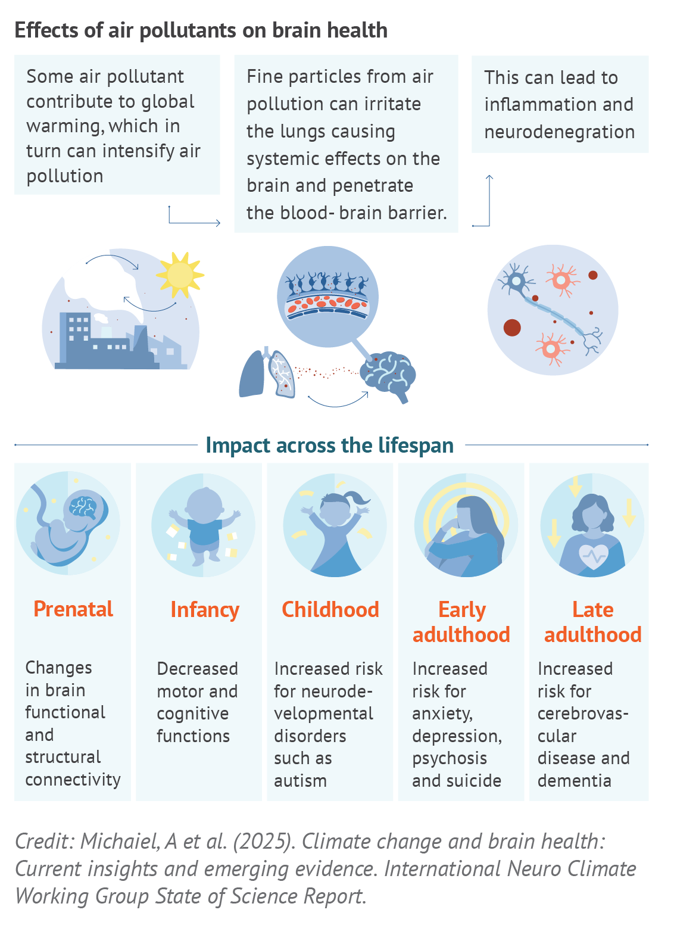
Air Pollution and Brain Health
“People who breathe polluted air experience changes within the brain regions that control emotions, and as a result, they may be more likely to develop anxiety and depression than those who breathe cleaner air.” Zundel et al. NeuroToxicology 2022; 93
“There is emerging evidence of associations between poor air quality, both indoors and outdoors, and poor mental health more generally, as well as specific mental disorders. Furthermore, pre-existing long-term conditions appear to deteriorate, requiring more healthcare.”
Bhui et al. BJPsych Open 2023; 9(4): e120
“A systematic assessment of the literature that suggests exposure to particulate matter <2.5 microns in diameter (PM_{2.5}) is associated with increased risk of dementia”
Wilker et al. BMJ 2023; 381:e071620
State of Global Air 2025

Slide 8
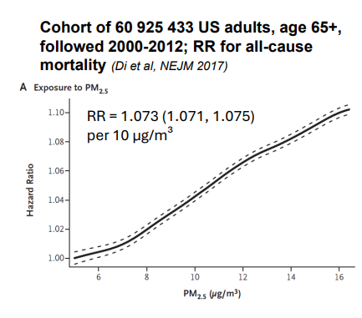
Concentration- Response (C-R) Functions
Also referred to as exposure-response function, and describes the relationship between a pollutant and an adverse effect on health (mortality, morbidity)
E.g., stunting, mortality (death), asthma exacerbation etc.
Very important for health impact assessments and burden of disease estimates attributed to air pollution (more on this tomorrow)
Di et al., NEJM 2017

Slide 9
Why is fine particulate matter, or PM_{2.5} considered to be the key pollutant driving health effects?
Is this true?

Slide 10
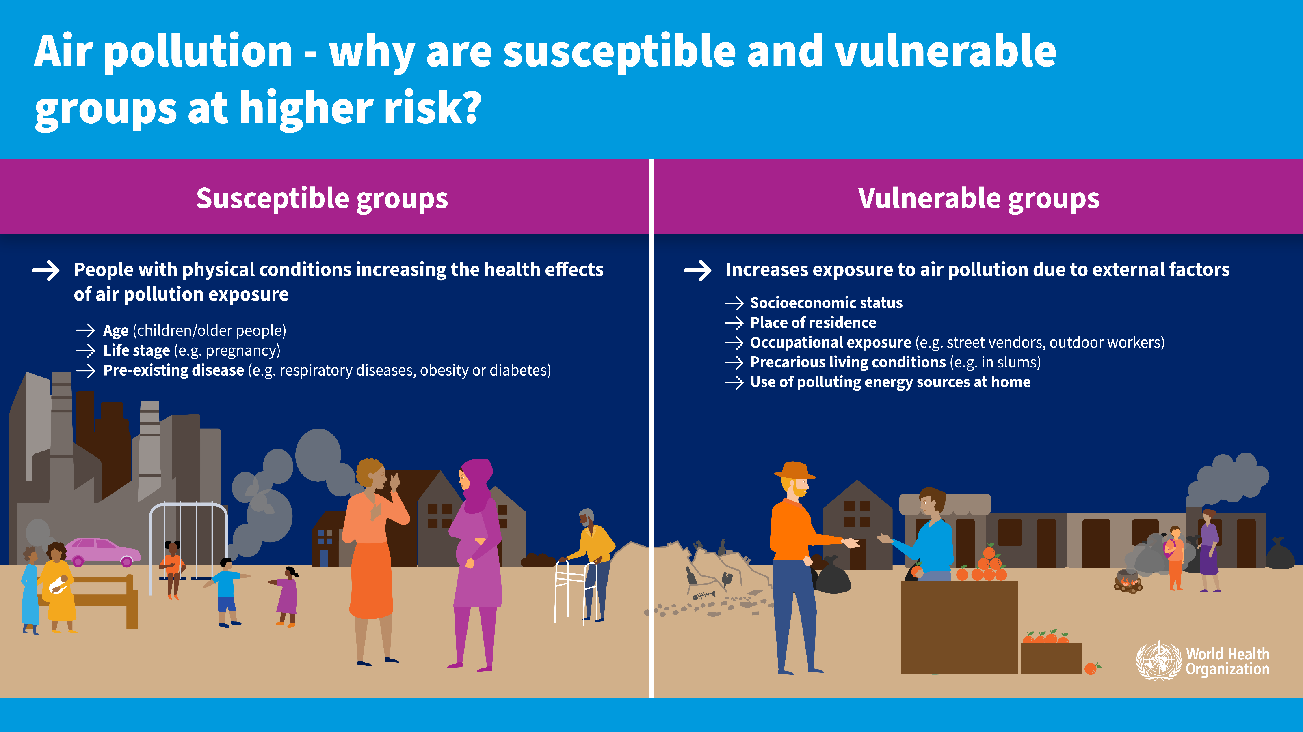
Susceptible vs vulnerable groups
WHO, 2025

Slide 11




Impacts of air pollution on children
Infants
Children under 5
Children & adolescents
Children & adolescents
Premature birth
Lung development
Asthma
Other effects
Exposure during pregnancy cause preterm birth, low birth weight etc.
Babies born too early or too small can get other diseases
Inhale more air per kilogram of body weight compared to adults
Exposure to air pollution during the critical developmental period can result in poor lung growth and reduced lung function
Exposure to air pollution has been associated with asthma exacerbation as well as development of new asthma cases among children.
Respiratory infections, impaired cognitive development, altered growth (e.g., stunting), ear infections etc.

Slide 12



Case Study
Do children living in more polluted environments experience poorer health outcomes?
Kampala- 177.5 µg/m³
Jinja- 96.3 µg/m³
Buwenge- 31.4 µg/m³
“Children in study sites with high ambient (outdoor) air pollution had lower lung function than those in sites with low ambient air pollution.”
Source: Kirenga et al., 2018, https://doi.org/10.3390/ijerph15122653

Slide 13

The case of Ella Roberta
“Air pollution was a significant contributory factor to both the induction and exacerbations of her asthma. During the course of her illness between 2010 and 2013 she was exposed to levels of nitrogen dioxide (NO₂) and particulate matter in excess of World Health Organisation Guidelines. The principal source of her exposure was traffic emissions. During this period there was a recognised failure to reduce the level of NO₂ to within the limits set by EU and domestic law which possibly contributed to her death. Ella's mother was not given information about the health risks of air pollution and its potential to exacerbate asthma. If she had been given this information she would have taken steps which might have prevented Ella's death.”
Clean air for all | The Ella Roberta Foundation

Slide 14
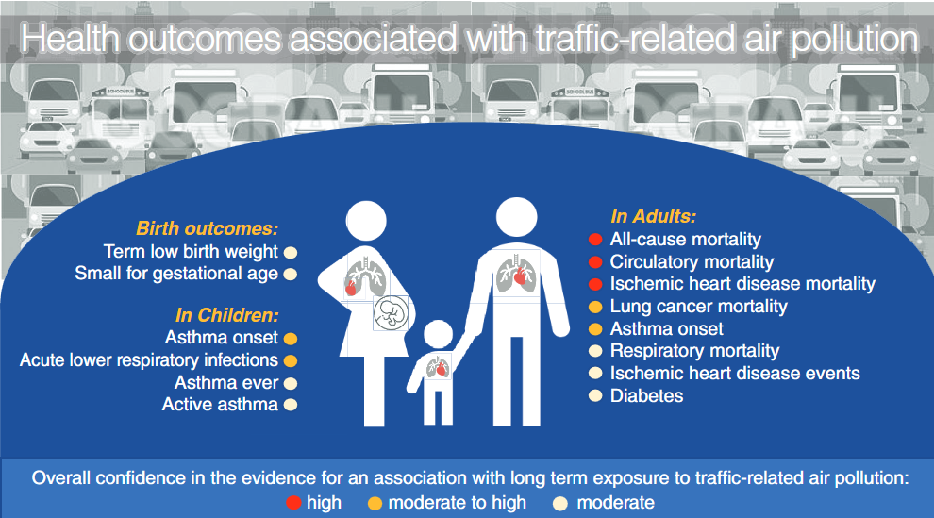
Health effects of traffic-related air pollution
Street vending during pregnancy >> risk of low birth weight (Ghana)¹
Severe asthma associated with exposure to air pollution (South Africa)²
PM_{2.5} exposure among street traders increases the occurrence of respiratory and cardiovascular symptoms [coughing, irregular heartbeat, sharp chest pain headaches etc.] (Ghana)³
HEI 2022. Systematic Review and Meta-analysis of Selected Health Effects of Long-Term Exposure to Traffic-Related Air Pollution
¹https://www.sciencedirect.com/science/article/abs/pii/S1438463913001041
²https://bmjopenrespres.bmj.com/content/10/1/e001498
⁴https://www.nature.com/articles/s41370-021-00357-x

Slide 15
Exposure to air pollution/smoke from wood or coal use for cooking is not harmful for health.
Is this true?

Slide 16
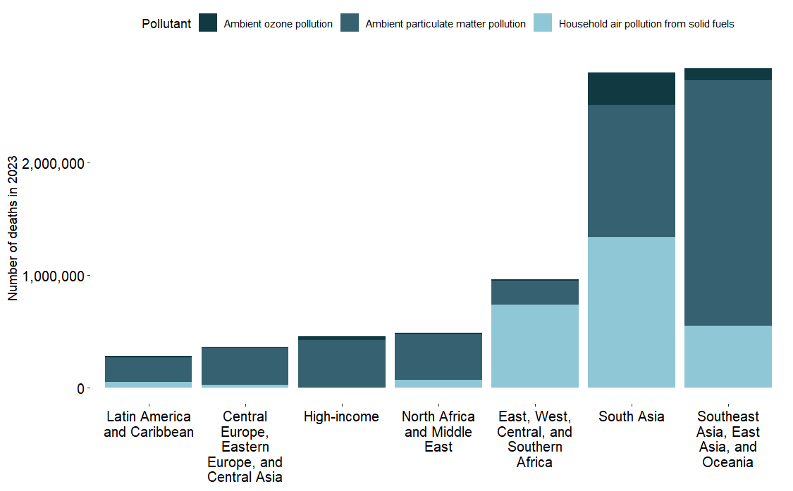
Significant disparities in exposure and health impacts across regions
5 -10x
higher death rates in LMICs
2.6 million
South Asia
1.2 million
African Union

Slide 17
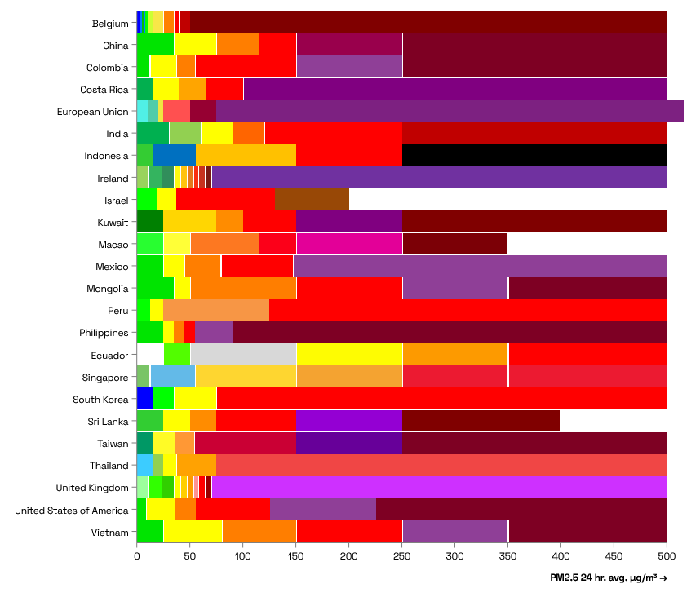
Air Quality Index (AQI)
A unitless value, often accompanied by a color and categorical label, summarizing the concentration of a single pollutant or multiple pollutants on a standardized scale Often used for public communication, AQI values are typically reported hourly or daily
OpenAQ AQI Hub

Slide 18
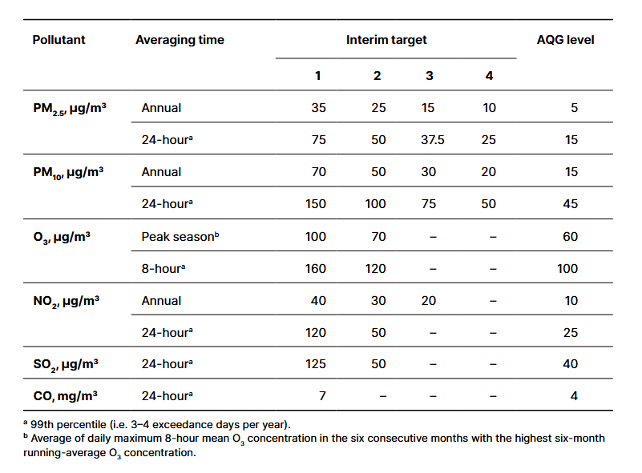
WHO Air Quality Guidelines
Guideline and interim targets; exceedance of the air quality guideline levels is associated with important risks to public health
Pollutants include PM_{2.5}, PM₁₀, ozone, nitrogen dioxide, sulfur dioxide and carbon monoxide
An evidence-informed tool that they can use to inform legislation and policy; not legally binding standards
WHO, 2021

Slide 19
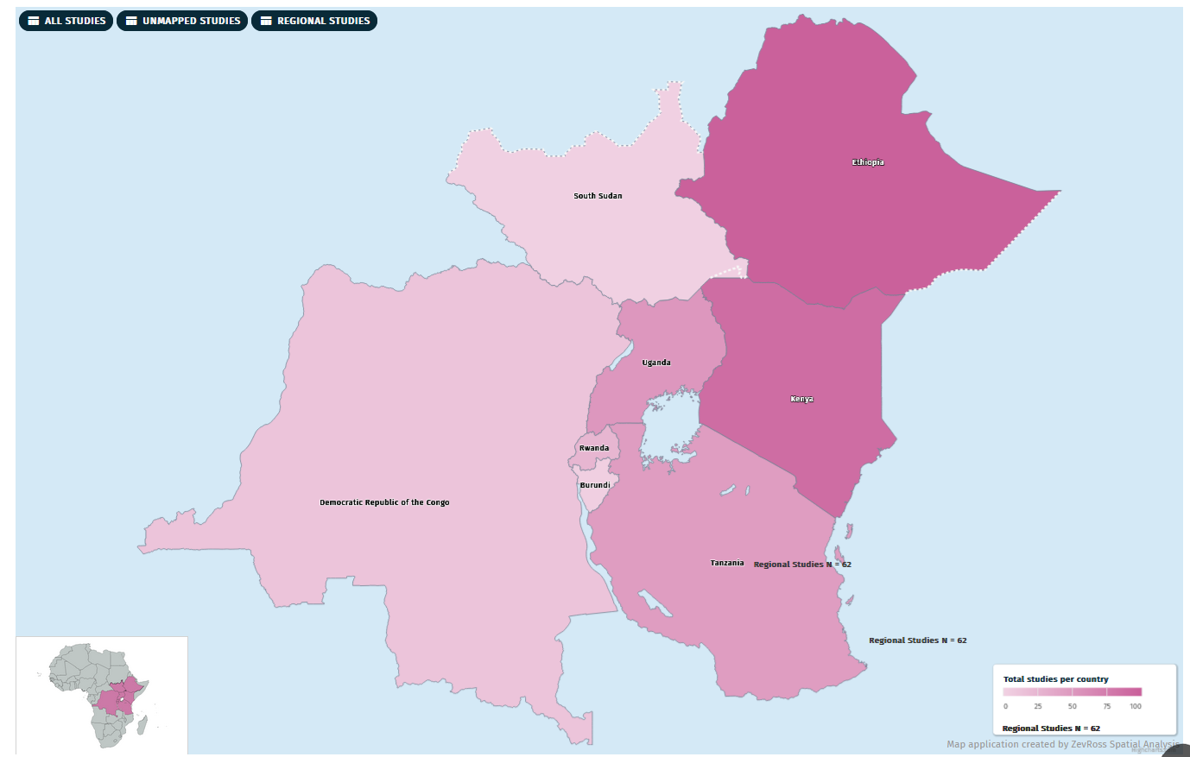
LinDA-HEWA
Literature Database for Air Pollution and Health Work in East Africa (LiNDA HEWA)
132 epidemiological studies
106 exposure assessment studies
86 air quality monitoring and modeling studies
31 review, editorial and commentary articles
20 health impact assessments
3 toxicological studies
https://www.healtheffects.org/global/interactive-database/east-africa

Slide 20
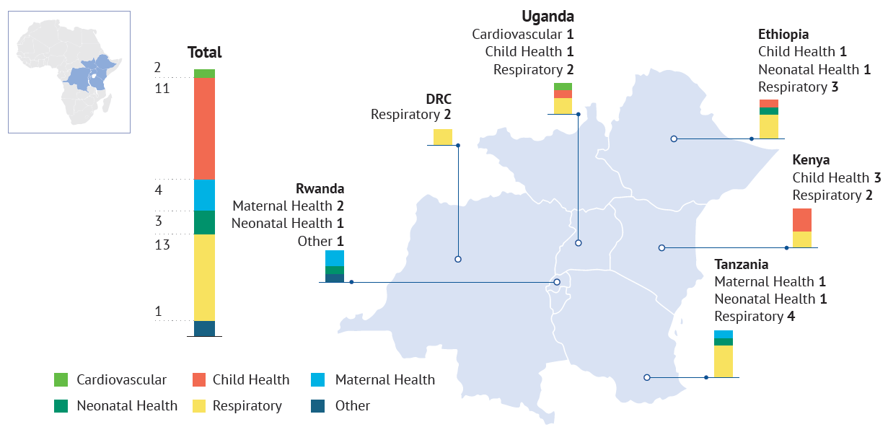
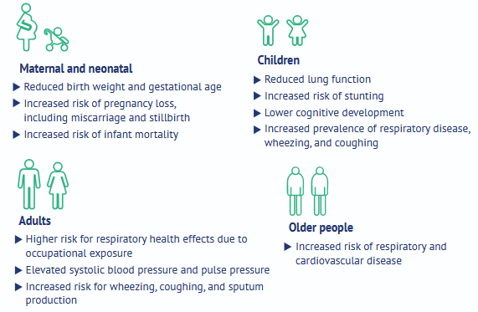
What types of health evidence has been generated in East Africa?
A range of health outcomes have been studied in East Africa, including children and adult health.
There are a number of multi-country studies, and some focused on individual countries. Many use available administrative or hospital data.
https://www.healtheffects.org/announcements/new-scoping-review-report-available-health-effects-air-pollution-east-africa

Slide 21
Methodology for estimating the burden of disease
Exposure Level Risks Age | Sex | Year | Location
Effect Size Risk-outcome Age | Sex
Optimal Level Risk Exposure Global
~11 x 11 km resolution (also 1 x 1 km) , annual average PM_{2.5}, ozone, NO₂
Ground measurements from stations around the world
PM_{2.5} - Stroke, ischemic heart disease, lower respiratory infections, COPD, lung cancer, *cataracts- household air pollution
Diabetes (2017), maternal and neonatal disorders (2019), dementia (2023)
Ozone- COPD
NO₂- childhood asthma (2021)
Uniform distribution bounded by the minimum and 5th percentile of exposure distributions from low-level studies (2.4-5.9 µg/m³ ) (midpoint ~4 µg/m³ )

Slide 22


Food for thought
How best can we use the available evidence to inform policy and communities and fill remaining data gaps?
Email ppant@healtheffects.org

Slide 23
What data do we need to estimate burden of disease?
Estimates of the exposure or exposure distribution for the population
Based on ground monitoring and atmospheric models for air pollution
An exposure-response relationship to estimate the risks of exposure
Based on global/local epidemiological data
Population demographics
From national census data
Population mortality (morbidity) statistics
From national vital statistics and other sources for morbidity

Slide 24
What data do we need to estimate burden of disease?
Estimates of the exposure or exposure distribution for the population
Based on ground monitoring and atmospheric models for air pollution
An exposure-response relationship to estimate the risks of exposure
Based on global/local epidemiological data
Population demographics
From national census data
Population mortality (morbidity) statistics
From national vital statistics and other sources for morbidity
Republic of Uganda National Population and Housing Census 2024; Kampala Cancer Registry
Ghana Demographic and Health Survey 2022
Cameroun Enquête par Grappes à Indicateurs Multiples (MICS5) 2014
Kenya National Inpatient Morbidity and Mortality Statistics
INDEPTH Network Consolidated HDSS data from 29 Sub-Saharan African Sites 1990-2018

