Slide 1
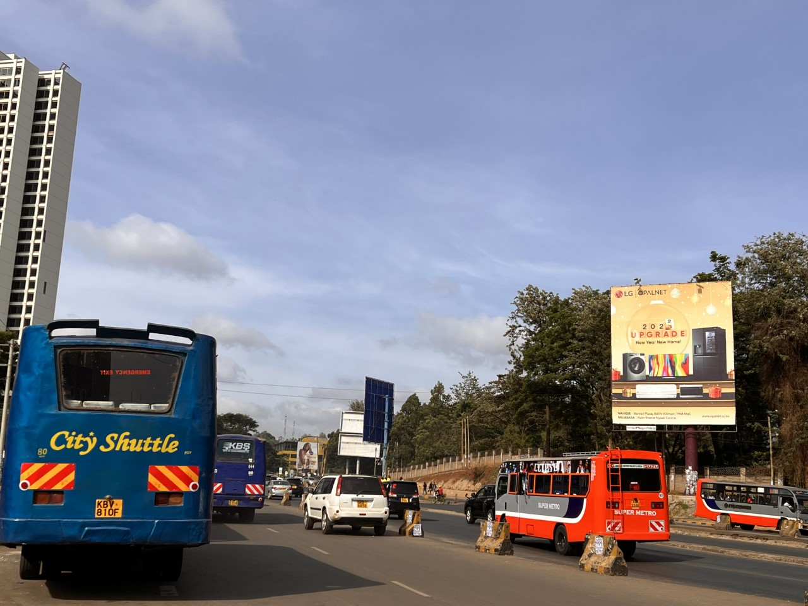

Health Impact Assessment
Pallavi Pant, PhD
Health Effects Institute
December 4, 2025
African School on Air Quality and Pollution Prevention in Ghana

Slide 2
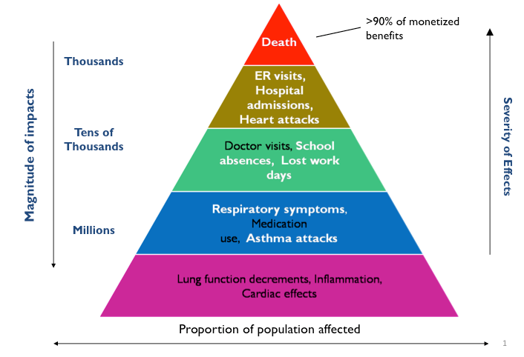
Short- and long-term effects
US EPA

Slide 3
Why do we need health risk assessment (HRA)?
What does it tell us?
Quantitative estimates of the burden of air pollution on population health
Estimates of the impacts of selected policies affecting air pollution on health
Basis for economic assessment of air pollution health burden and its changes due to policies
Essential arguments supporting clean air policy
What does it require?
Relevant data on population exposure and its expected changes due to policy under study
Reliable concentration-response functions (based on epidemiology studies)
Data on relevant health indicators for the target population
Expertise in HRA implementation
Slide courtesy of Michal Krzyzanowski

Slide 4
What questions can a health risk assessment answer?
Burden
What is the size of the problem currently?
How much inflated are current mortality rates?
How much potential life years are we losing?
Example: GBD/State of Global Air
Impact
If we apply policy A or B, what will be the (expected) change in health impacts (lived saved/burden reduced)?
What will be the pattern of mortality rate change?
What will be the pattern of changes in total life years?
Slide courtesy of Michal Krzyzanowski

Slide 5
Inputs needed
Exposure Level Age | Sex | Year | Location
Effect Size Risk-outcome Age | Sex
Optimal Level (Counterfactual) Risk Exposure Global
Air pollutant concentration/exposure
The uncertainty intervals give the reader a sense of the range (upper and lower bounds) within which the impacts are likely to fall.
Essentially, this is the ‘known unknown’
Concentration-response function (C-R), relative risk (RR)
Size of population, incidence rates for health outcomes (e.g., mortality rate)

Slide 6
What are we estimating?
Population Attributable Fraction (PAF): Fraction of health effects attributed to the exposure
Population Attributable Risk (PAR): Incidence attributed to the exposure (to air pollution)
Number of cases (N): Number of attributable cases

Slide 7
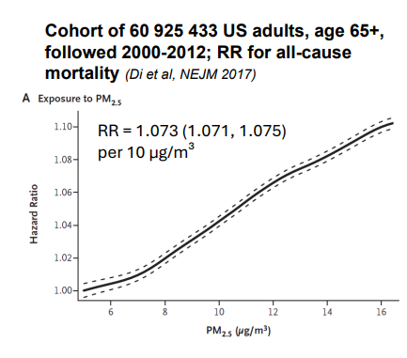
Concentration- Response (C-R) Functions
Also referred to as exposure-response function, and describes the relationship between a pollutant and an adverse effect on health (mortality, morbidity)
Relative risk (or RR) describes the likelihood of an adverse health outcome (e.g., mortality (death), asthma exacerbation, heart attack etc.) in a population exposed to higher level of air pollution compared to a population with lower levels of exposure.
Relative Risk looks at population risks, not risks for a particular person
Di et al., NEJM 2017

Slide 8
Counterfactual
Assumed for a world that does not exist, but theoretically could
Lowest observed exposure level or exposure level expected (assumed) after planned intervention or policy scenario
Could be:
Zero (0)
WHO AQ Guideline or Interim Target
National Air Quality Standard
For GBD/State of Global Air, the counterfactual value is
(2.4-5.9 µg/m³ ) (midpoint ~4 µg/m³ )

Slide 9
What assumptions are we making?
Generalizability across populations,
Considering effects of long-term exposures,
Equitoxicity across pollution sources
but baseline health status can vary
but not short-term exposures
Clean air for all | The Ella Roberta Foundation

Slide 10
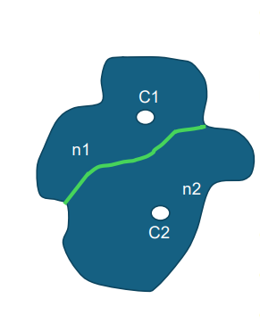
Population Weighted Mean Concentration/Exposure
C1 - concentration in location 1 (31 µg/m³)
C2 – concentration in location 2 (22 µg/m³)
n1 – population in district 1 (120, 000)
n2 – population in district 2 (60, 000)
N=n1+n2 – total population of the city (180, 000)
C – population-weighted city mean concentration: (C1*n1 + C2*n2)/N
C = (31*120000 + 22*60000)/180000 = 28 µg/m³
(mean of C1 and C2 = 26.5 µg/m³)
Clean air for all | The Ella Roberta Foundation

Slide 11
Let’s calculate
Annual mean PM_{2.5} exposure in Lagos in 2024 (C), is 51 µg/m³
The plan is to reduce it to counterfactual (C0) of WHO IT1, 35 µg/m³ (i.e., by 16 µg/m³)
CRF for all-cause mortality based on Chen & Hoek 2020, RR= 1.08 per 10 µg/m³,
i.e., 1.131 per 16 µg/m³
PAF = (1.131 – 1)/1.131 = 0.116 (11.6% of total mortality can be attributed to the
exposure > 35 µg/m³ in Lagos)
What if C0 was 25 µg/m³ (WHO IT2)?
RR per 26 µg/m³=1.222
PAF = (1.222 – 1)/1.222 = 0.182
18.2% of total mortality can be attributed to the exposure > 25 µg/m³ in Lagos)

Slide 12
Let’s calculate
Annual mean PM_{2.5} exposure in Lagos in 2024 (C), is 51 µg/m³
The plan is to reduce it to counterfactual (C0) of WHO IT1, 35 µg/m³ (i.e., by 16 µg/m³)
CRF for all-cause mortality based on Chen & Hoek 2020, RR= 1.08 per 10 µg/m³,
i.e., 1.131 per 16 µg/m³
PAF = (1.131 – 1)/1.131 = 0.116 (11.6% of total mortality can be attributed to the
exposure > 35 µg/m³ in Lagos)
All-cause mortality in ages 30+ is I=1400 per 100 000 people
Population attributable risk (PAR) = I*PAF 1400 * 0.116= 162.4 per 100 000 people (mortality attributable to the exposure > 35 µg/m³)
Total population: 1.4 million
55% in age 30+
NEx=1 400 000*0.55= 770 000 in age 30+
Number of attributable cases = NEx * PAR= (770 000/ 100 000) * 162.4 = 1250 deaths / year attributable to exposure > 35 µg/m³

Slide 13
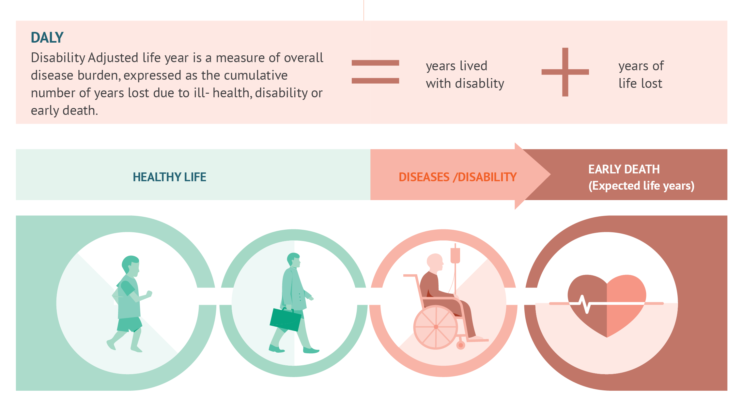
What do we mean by the burden of disease?
DALY – a single measure to quantify the burden of disease, injuries and risk factors;
based on years of life lost from premature death and years of life lived in disability (less than full health);
Introduced by Murray & Lopez in World Development Report 1993 prepared by WHO & HSPH for the World Bank; several modifications of the methodology since 1993

Slide 14
Methodology for estimating the burden of disease
Exposure Level Risks Age | Sex | Year | Location
Effect Size Risk-outcome Age | Sex
Optimal Level Risk Exposure Global
~11 x 11 km resolution (also 1 x 1 km) , annual average PM_{2.5}, ozone, NO₂
Ground measurements from stations around the world
PM_{2.5} - Stroke, ischemic heart disease, lower respiratory infections, COPD, lung cancer, *cataracts- household air pollution
Diabetes (2017), maternal and neonatal disorders (2019), dementia (2023)
Ozone- COPD
NO₂- childhood asthma (2021)
Uniform distribution bounded by the minimum and 5th percentile of exposure distributions from low-level studies (2.4-5.9 µg/m³ ) (midpoint ~4 µg/m³ )

Slide 15
What data do we need to estimate burden of disease?
Estimates of the exposure or exposure distribution for the population
Based on ground monitoring and atmospheric models for air pollution;
growing (but) limited data from Africa
An exposure-response relationship to estimate the risks of exposure
Based on global/local epidemiological data; studies available from countries across a range of exposures
Population demographics
From national census data
Population mortality (morbidity) statistics
From national vital statistics and other sources for morbidity

Slide 16
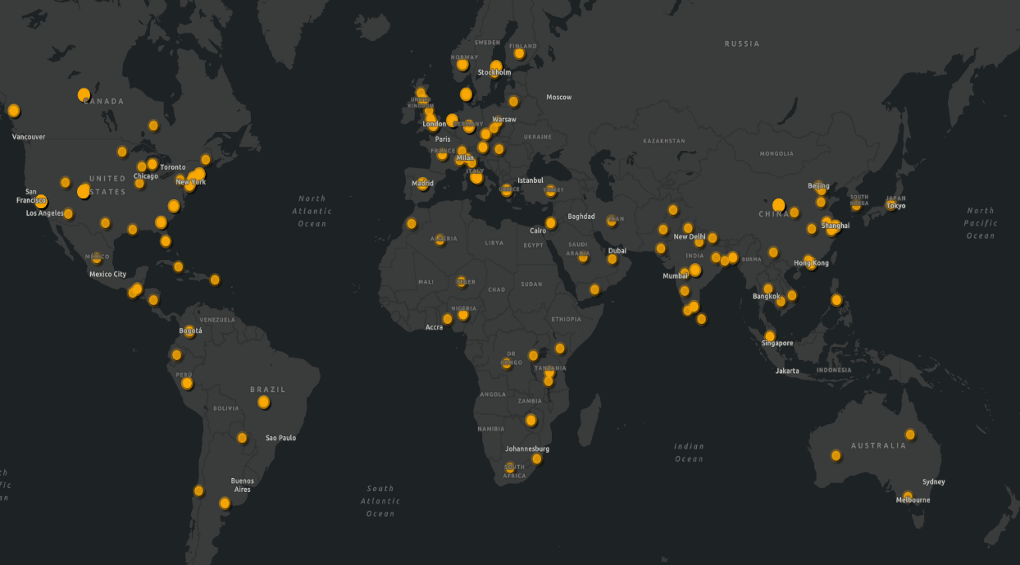
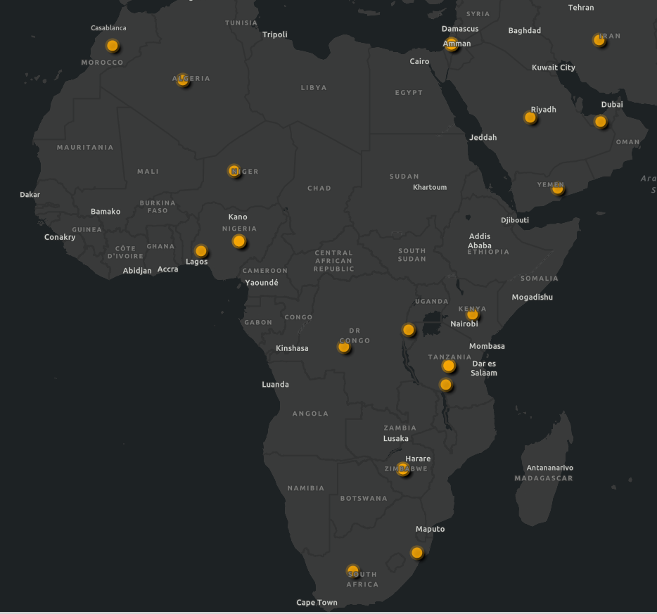
The risk estimates are derived from a variety of studies conducted around the world to create burden and exposure values, including work in Africa.

Slide 17
What data do we need to estimate burden of disease?
Estimates of the exposure or exposure distribution for the population
Based on ground monitoring and atmospheric models for air pollution
An exposure-response relationship to estimate the risks of exposure
Based on global/local epidemiological data
Population demographics
From national census data
Population mortality (morbidity) statistics
From national vital statistics and other sources for morbidity
Republic of Uganda National Population and Housing Census 2024; Kampala Cancer Registry
Ghana Demographic and Health Survey 2022
Cameroun Enquête par Grappes à Indicateurs Multiples (MICS5) 2014
Kenya National Inpatient Morbidity and Mortality Statistics
INDEPTH Network Consolidated HDSS data from 29 Sub-Saharan African Sites 1990-2018

Slide 18

The burden impacts estimates produced through such analyses are likely to be an underestimate.
Why might that be?
We are only considering health outcomes for which there is robust evidence, and CRF are available.

Slide 19
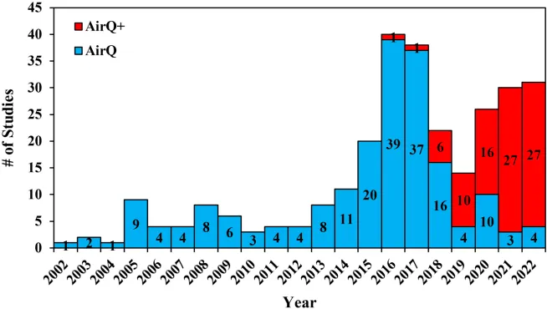
AirQ+
A user-friendly software to estimate the magnitude of the most important and best recognized effects of air pollution in a given population
Designed for public health or environmental specialists with minimum knowledge of atmospheric modelling, statistical methods, epidemiology or GIS
Used for more than 15 years in countries around the world
Can also be used for supporting educational and training activities related to environment and health
WHO AirQ+
Amini et al. 2023 Two Decades of Air Pollution Health Risk Assessment: Insights From the Use of WHO’s AirQ and AirQ+ Tools.
Manuals: https://www.who.int/europe/tools-and-toolkits/airq---software-tool-for-health-risk-assessment-of-air-pollution

Slide 20
If you are making a data/policy ask, what might that be?
Improved health surveillance
Better (or electronic) health data, including cause of death data
Better, locally representative air quality data

Slide 21
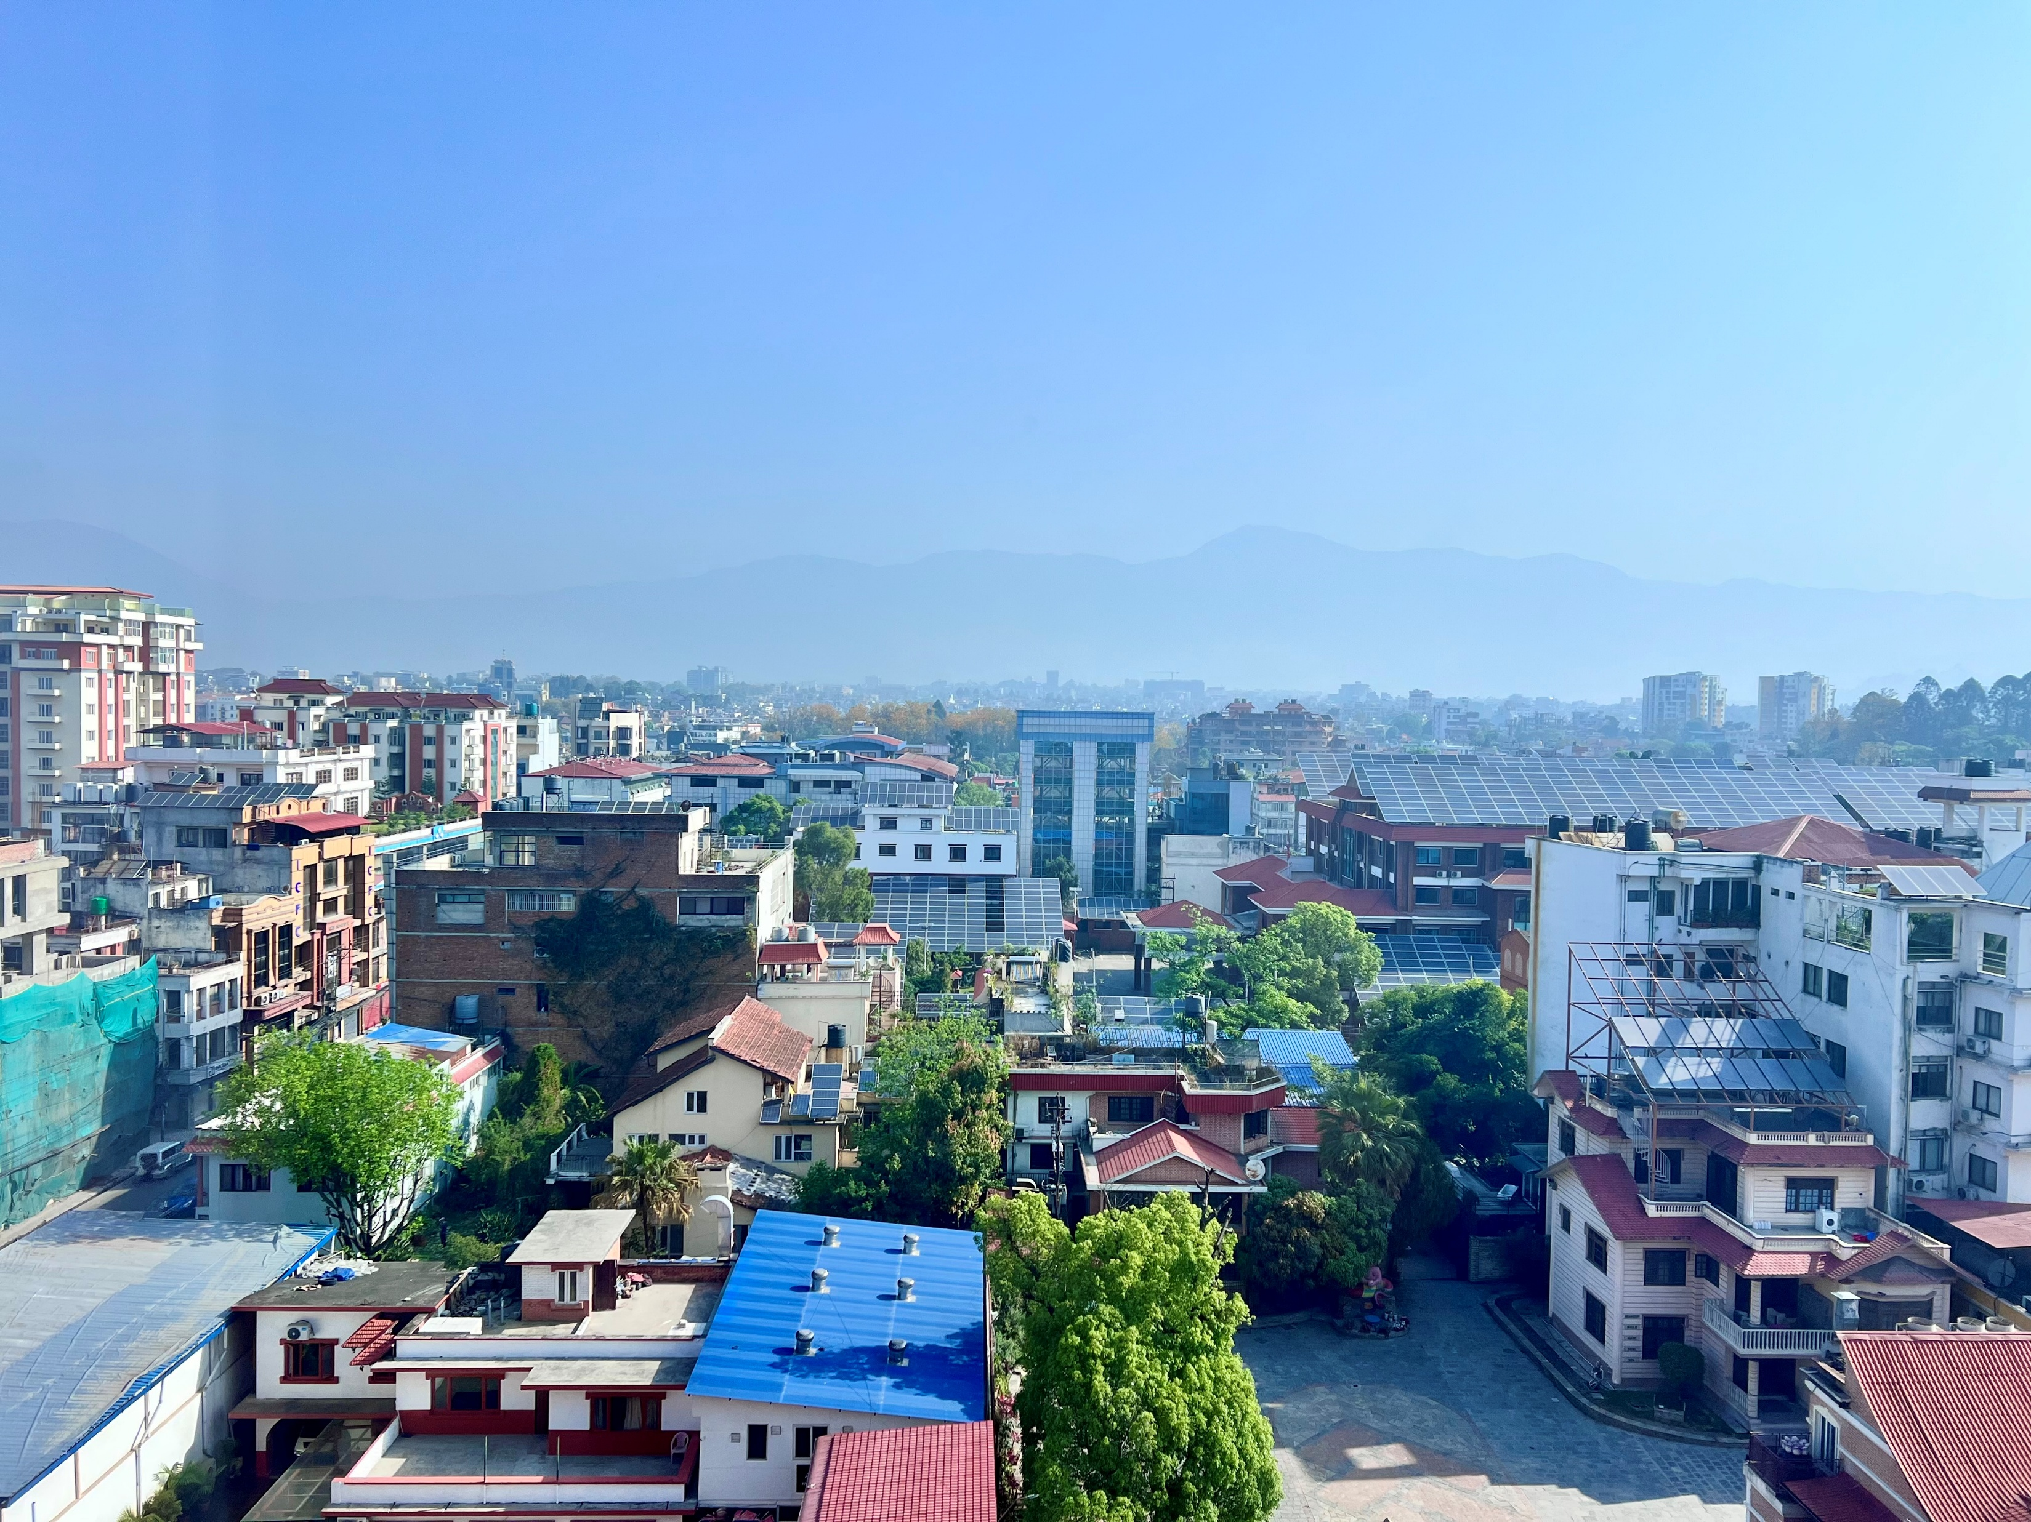

Food for thought
How best can we use the available evidence to inform policy and communities and fill remaining data gaps?
Email ppant@healtheffects.org

