Slide 1
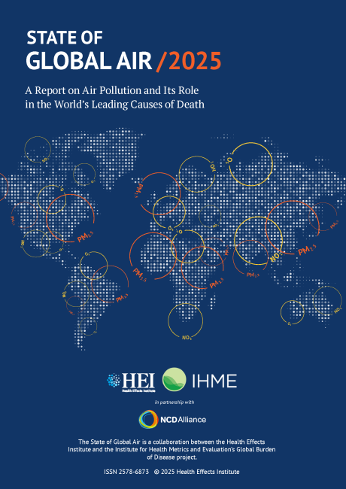

Global Trends in Air Quality and Health Impacts
December 4, 2025 | African School on Air Quality and Pollution Prevention in Ghana

Slide 2
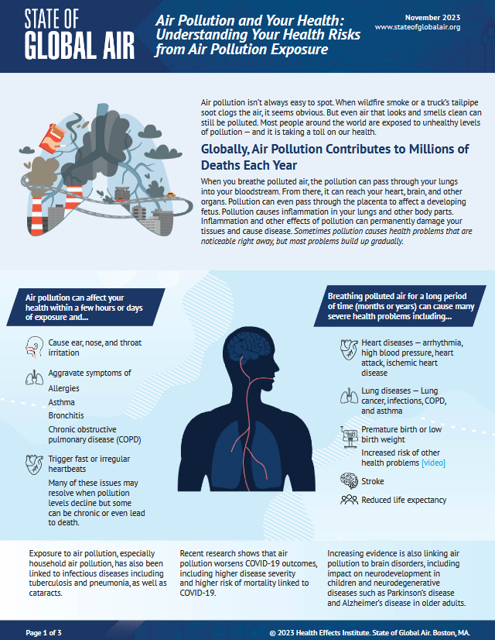
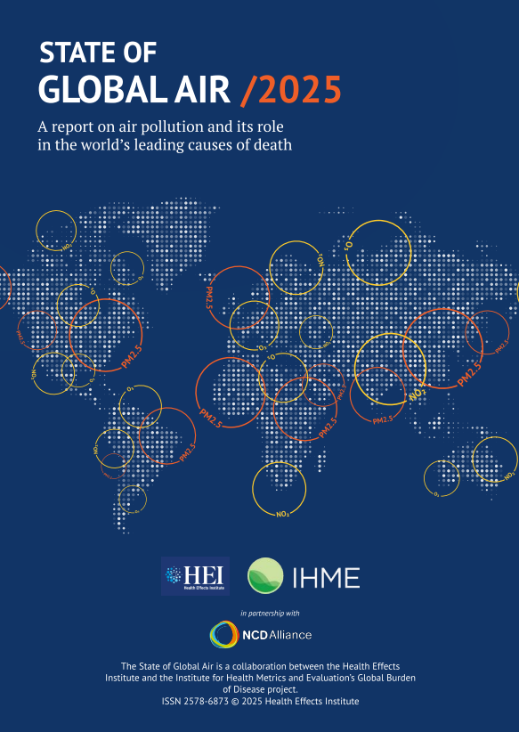
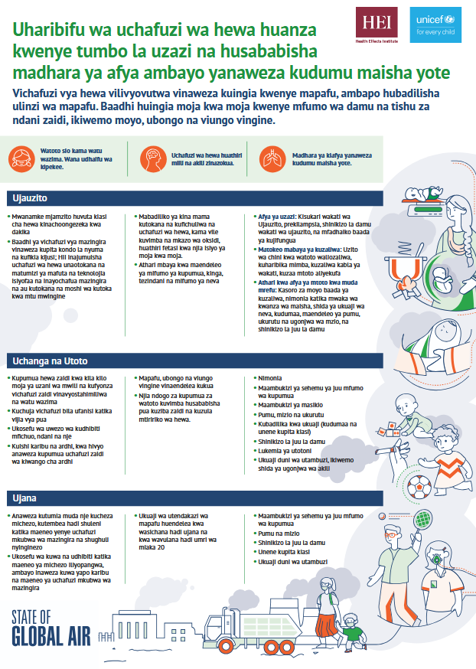
About the State of Global Air Initiative
Track and communicate long-term trends in air quality levels and health impacts for cities and countries around the world.
A collaboration between the Health Effects Institute (HEI) and Institute for Health Metrics and Evaluation (IHME).
Best available global estimates, allow a starting point for understanding scale of the health impacts of air pollution, can spur national/local data collection and action.
https://www.stateofglobalair.org/

Slide 3
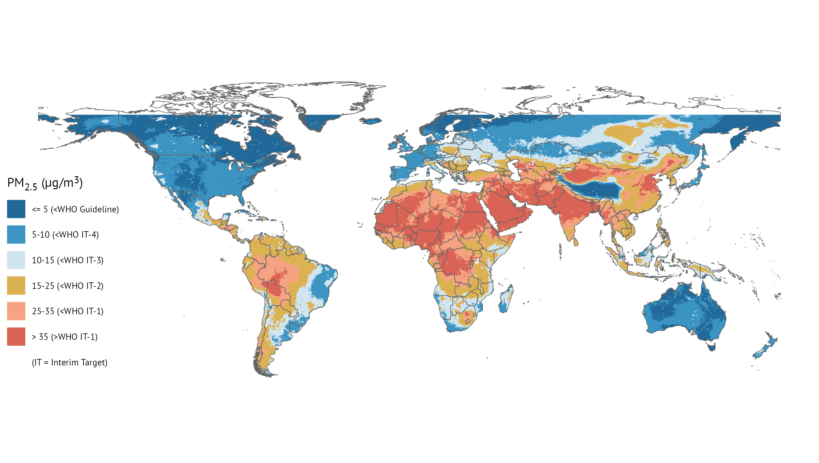
Nigeria
93%
Liberia
0%
Uganda
39%
South Africa
29%
36% of the world’s population is exposed to PM_{2.5} above the least stringent WHO Interim Target of 35 µg/m³.
18 countries in Africa experienced annual PM_{2.5} levels higher than the least stringent WHO Interim Target in 2023. Many countries do not yet have national air quality standards.

Slide 4
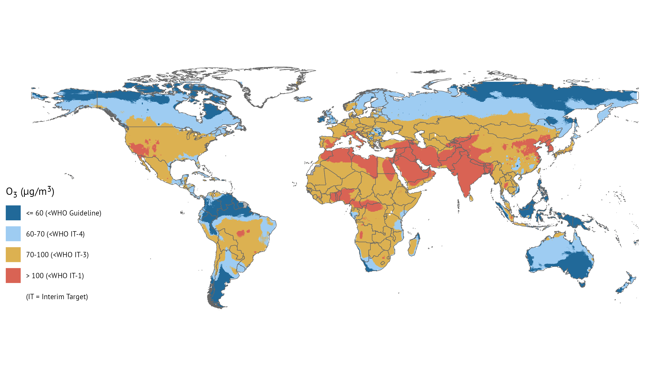
42% of the world’s population live in areas where the 8-hour average ozone levels exceed the least stringent interim target of 100 µg/m³.

Slide 5
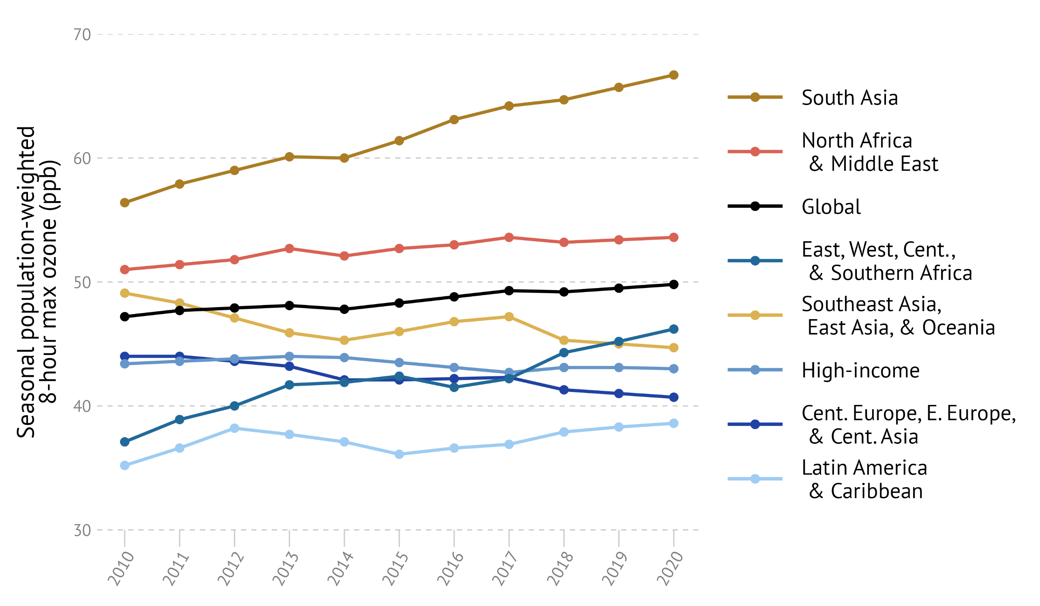
Exposure to ozone is increasing, especially in Asia and Africa
Rate of increase is high in South Asia, and East, West, Central and Southern Africa
Exposure to ozone linked to COPD, a chronic respiratory disease
~50% of the global mortality due to ozone exposures is in India (!)

Slide 6
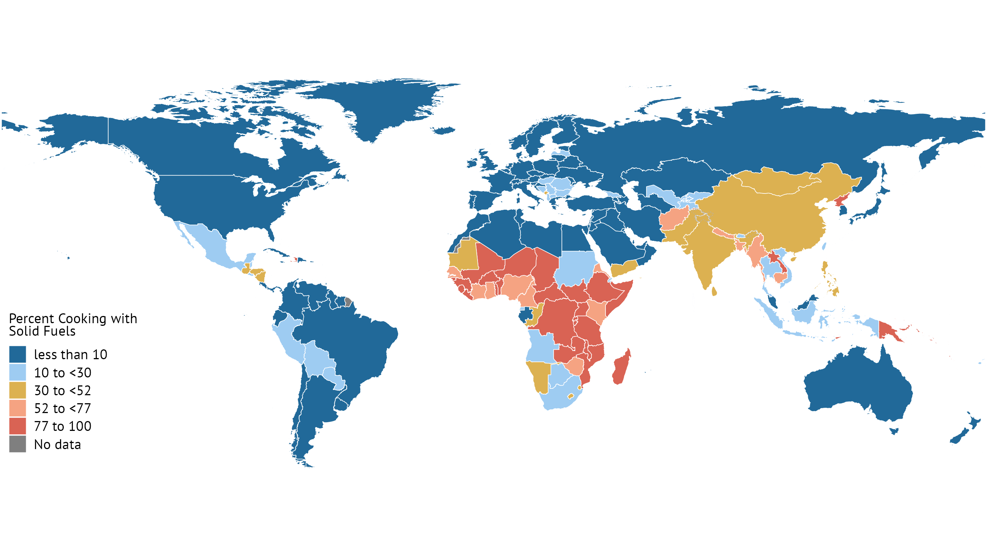
Nigeria
67%
Central African Republic
99%
Ghana
73%
Cameroon
71%
Kenya
76%
In 24 countries in Africa, over 90% of the population uses solid fuels for cooking.

Slide 7
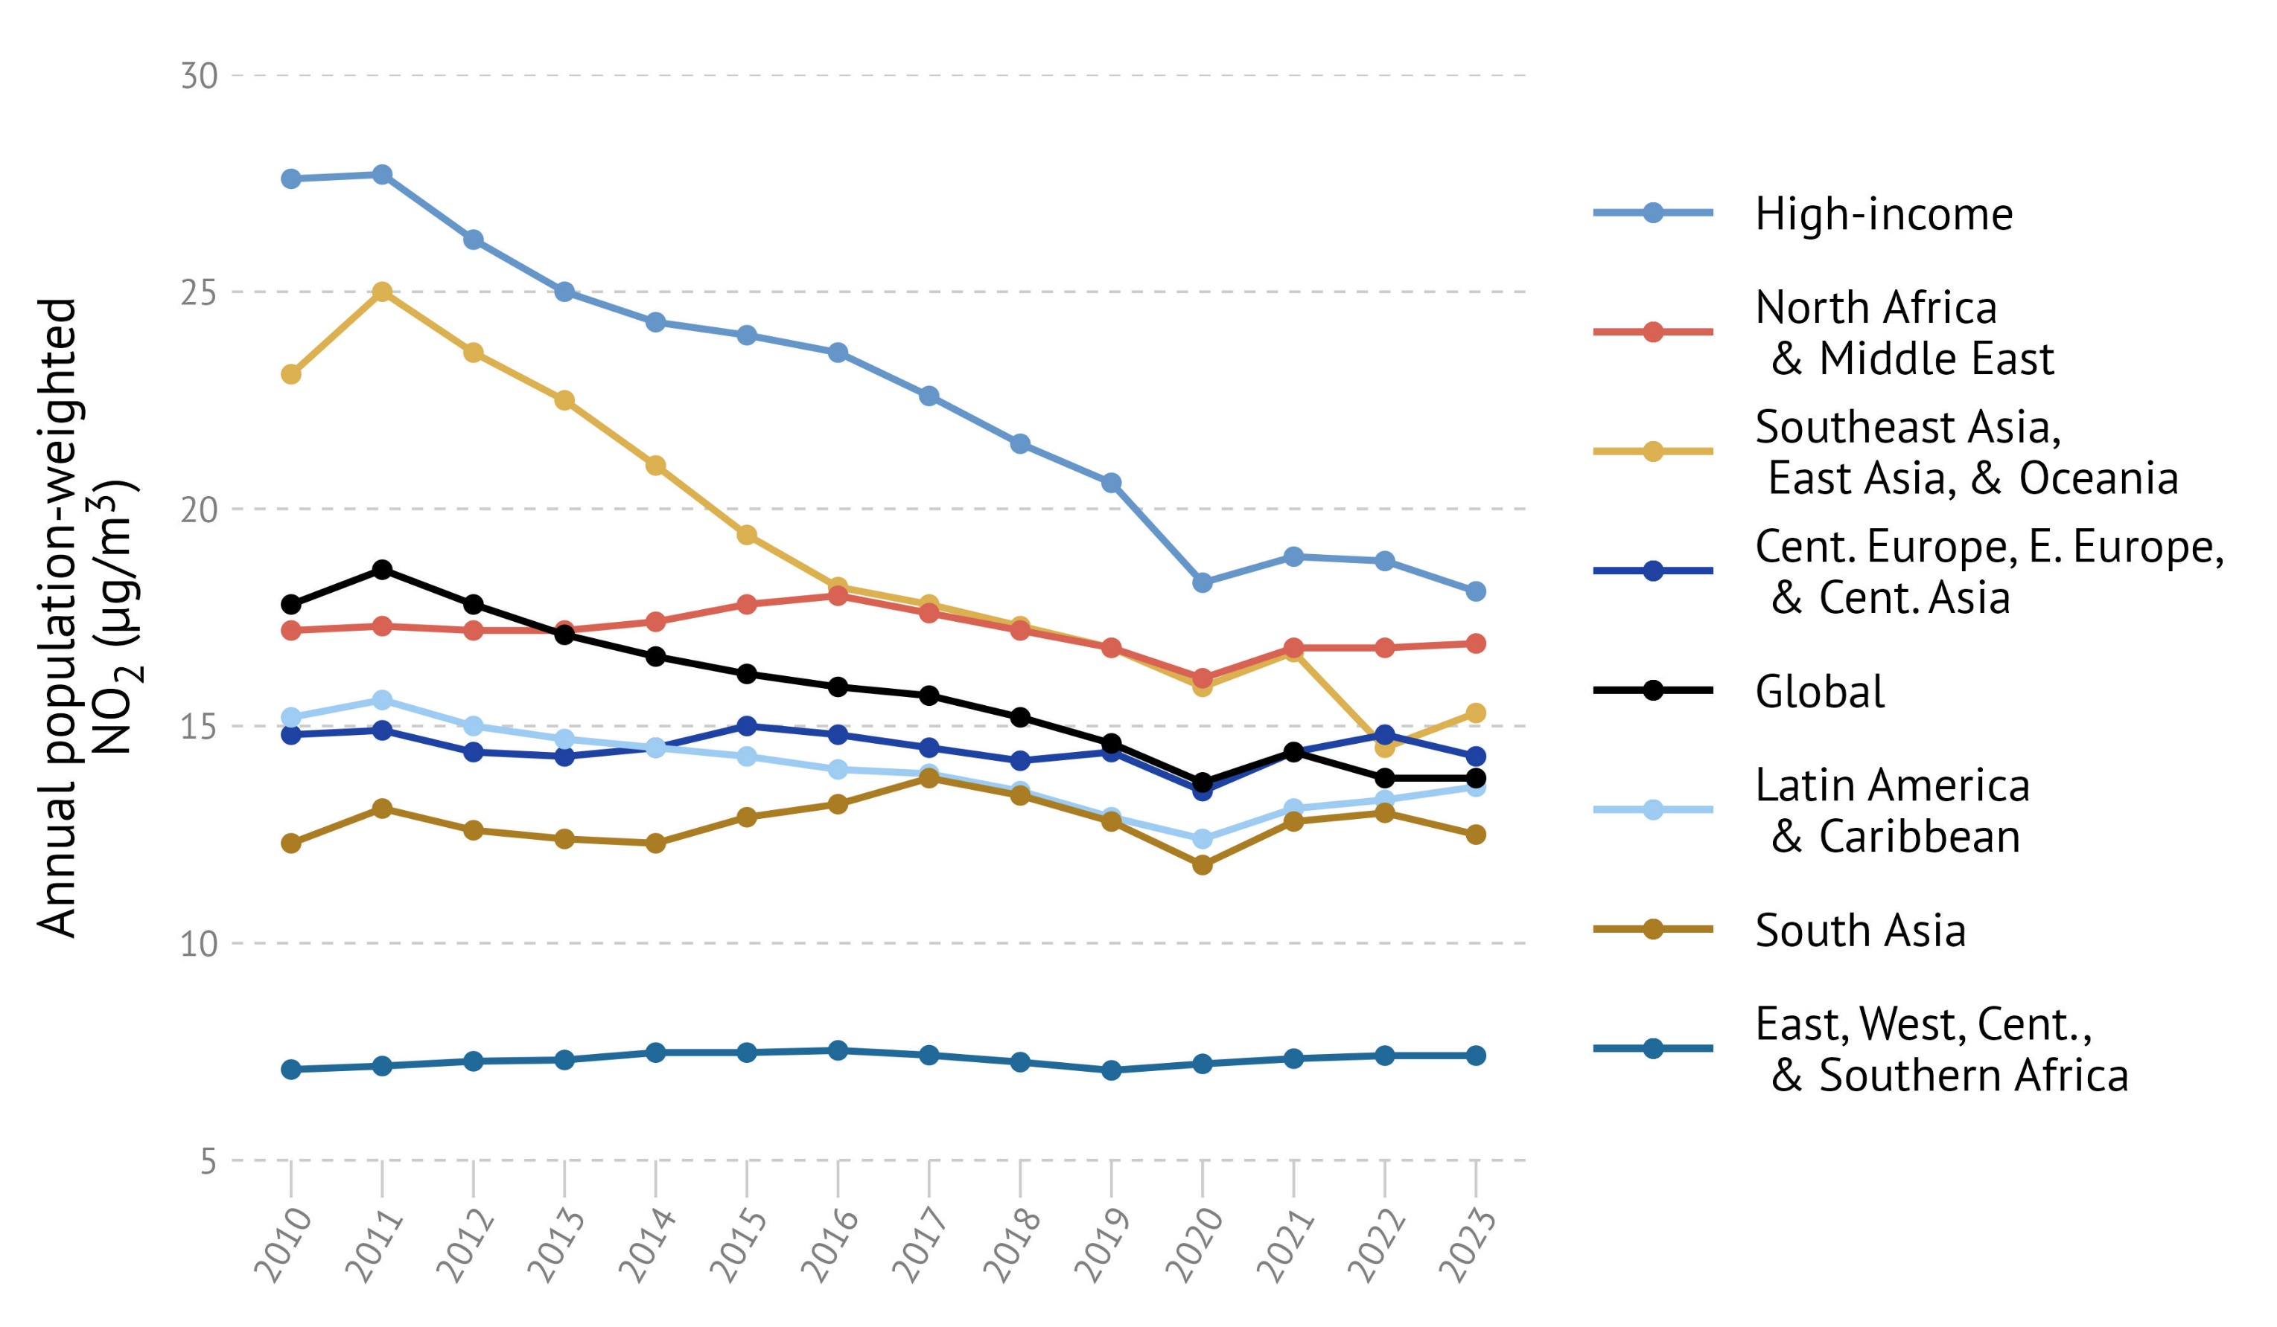
Trends for NO₂ vary significantly across countries
Tightening of fuel standards and vehicle emissions regulations
Control technologies for tailpipe emissions, e.g., selective catalytic reduction (SCR), exhaust gas recirculation (EGR), diesel particulate filter (DPF)
Emissions controls at power plants, industries etc.

Slide 8
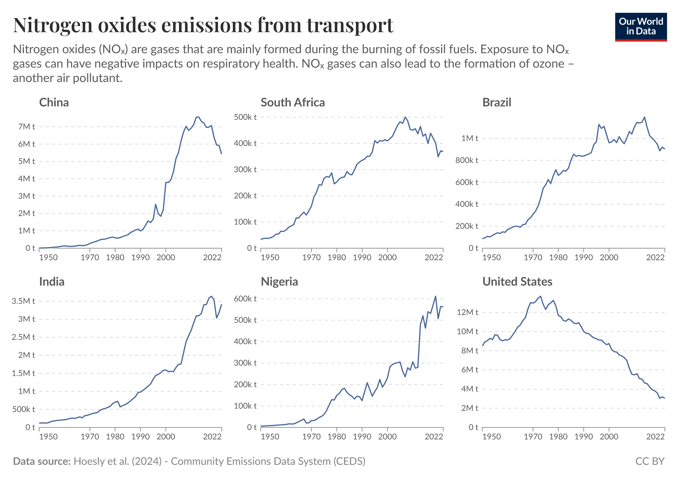
Trends for emissions of nitrogen oxides from transport also vary
https://ourworldindata.org/cleanest-air-lessons

Slide 9
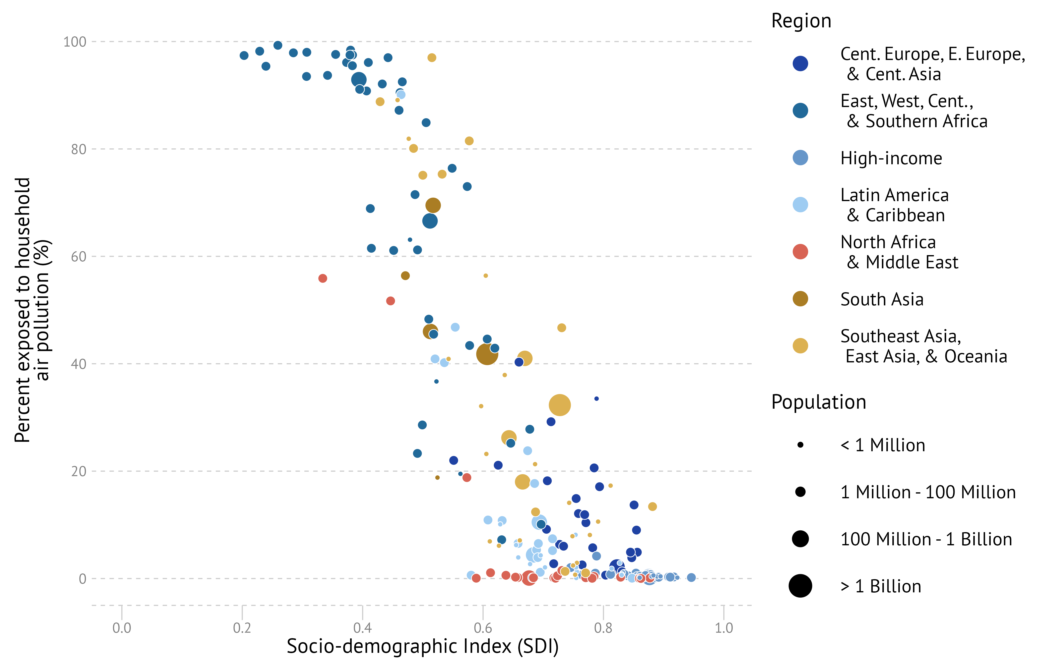
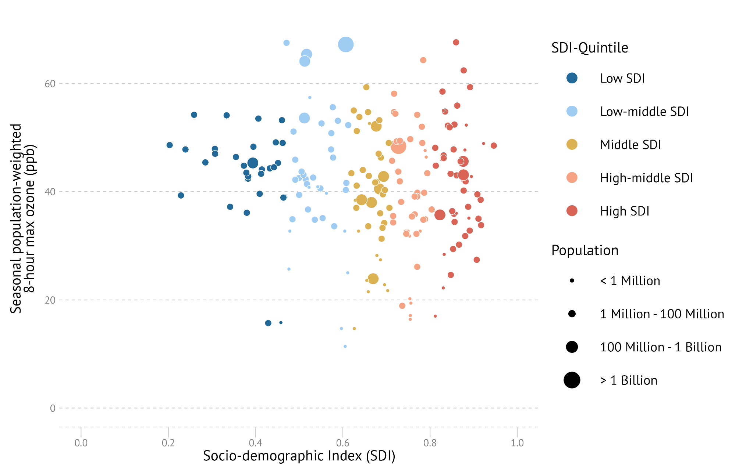
Exposure patterns across pollutants can vary too

Slide 10
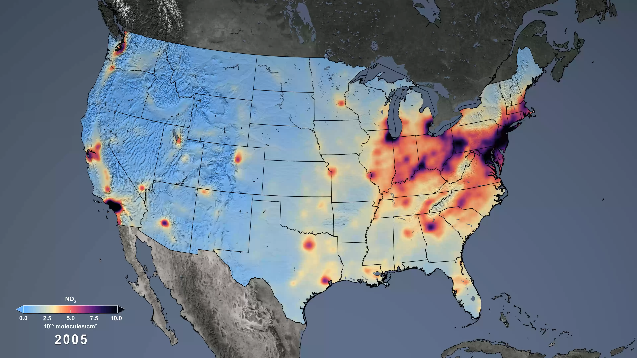
Changes in NO₂ between 2005-2022 in the US
https://svs.gsfc.nasa.gov/5070/

Slide 11
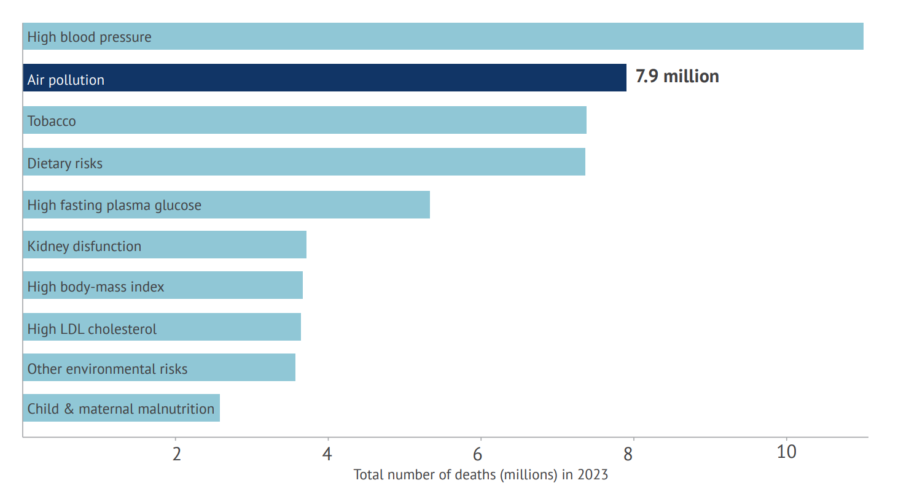
The big picture: air pollution’s toll in 2023
7.9 million
global deaths in 2023
1 in 8
deaths linked to exposure to air pollution
86% of air pollution deaths
attributable to noncommunicable diseases
3-5x
Higher disease burden in LMICs compared to
high-income countries
90% of air pollution deaths
in low- and middle-income countries
https://www.stateofglobalair.org/

Slide 12
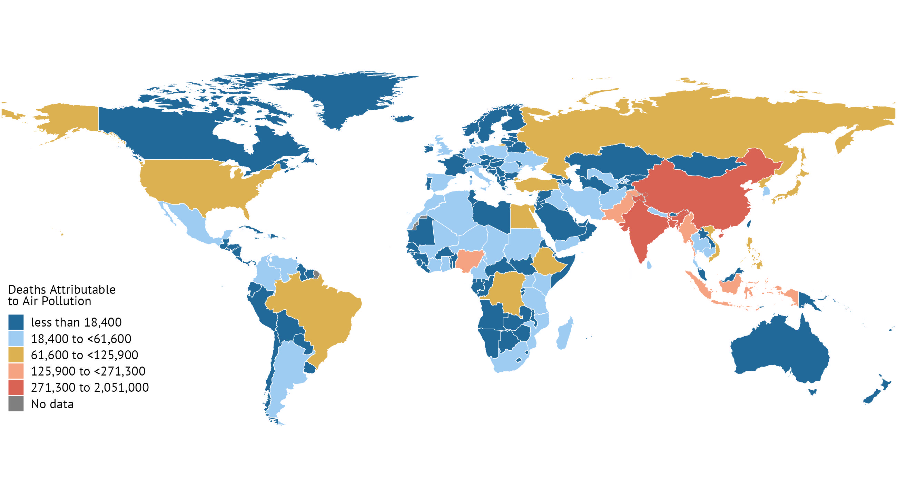
33% of the global deaths were in South Asia; higher number of deaths in more populated countries.

Slide 13
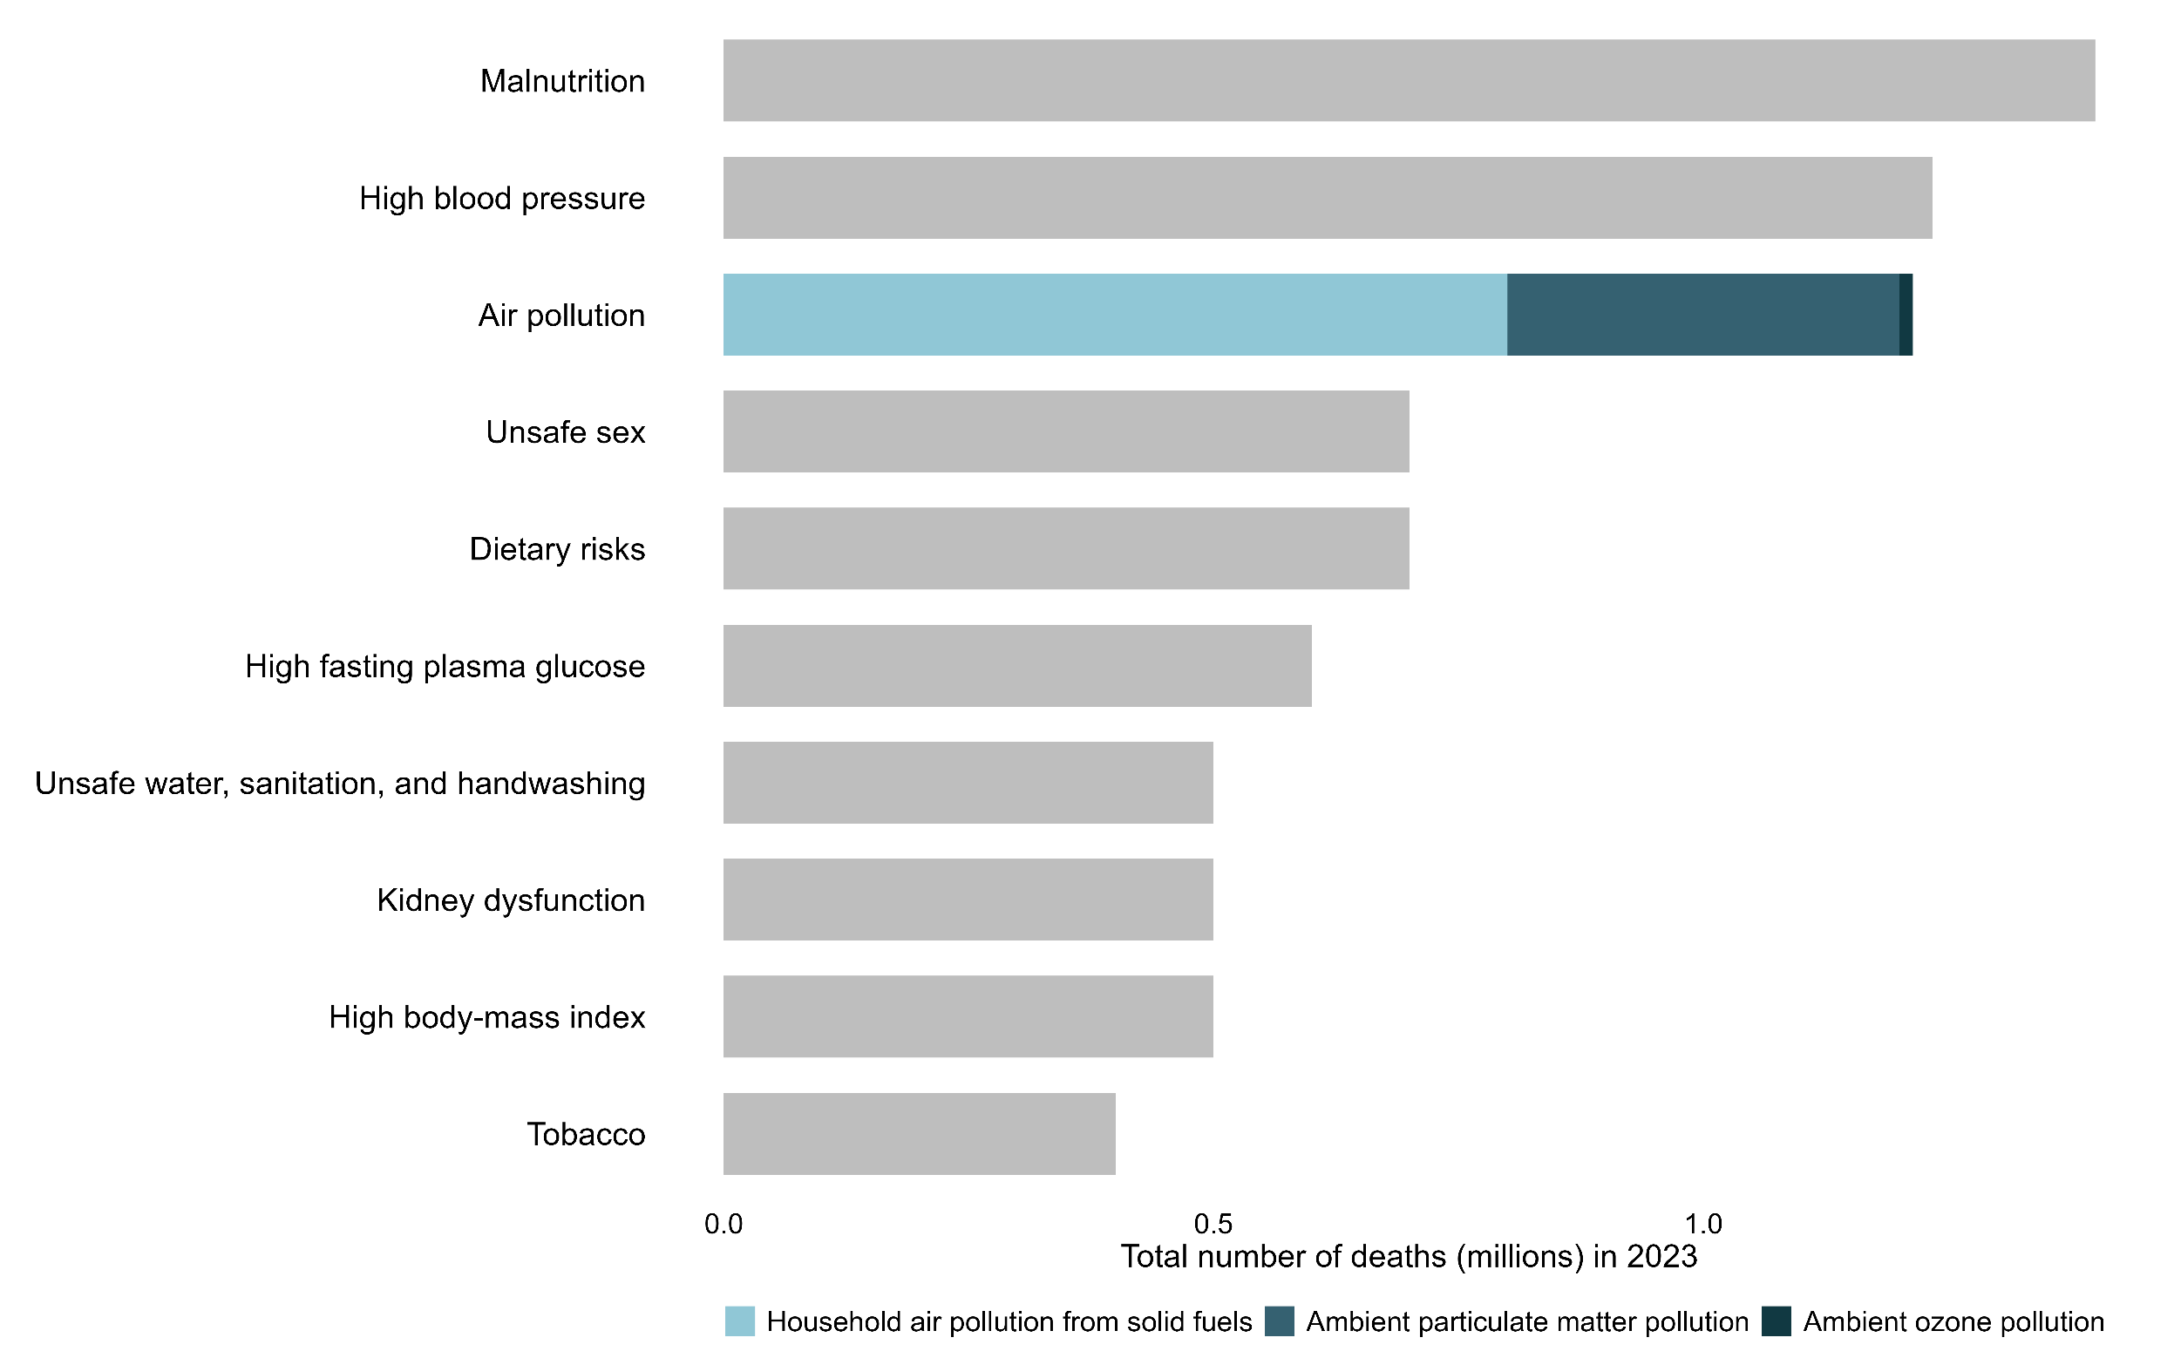
Air pollution is the 3rd leading risk factor for death in the African Union
1.2 million
deaths in 2023
591,000
deaths in adults over 60 years old
65% of air pollution deaths
attributable to household air pollution exposure
480,000+ deaths
due to cardiovascular disease linked to air pollution
Highest number of deaths seen in
  Nigeria 206,000
  Egypt 113,000
  DRC 90,000
Notes:
972,000
East, West, Central, & Southern Africa

Slide 14
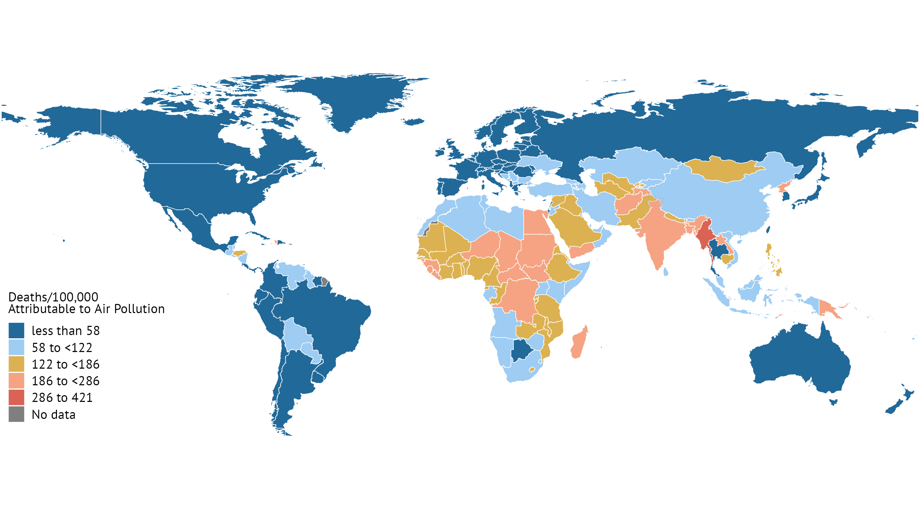
The African Union experiences a death rate nearly 9 times higher than the high-income region (145 deaths/100,000 people compared to 17 deaths/100,000 people).

Slide 15
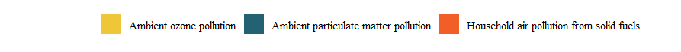
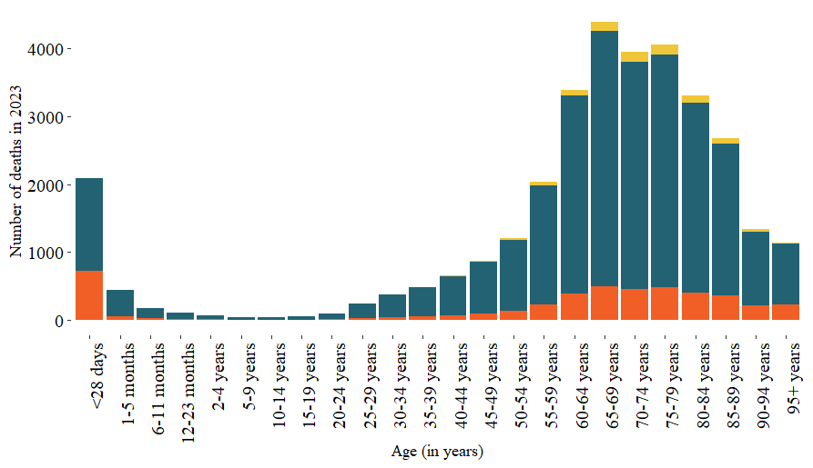
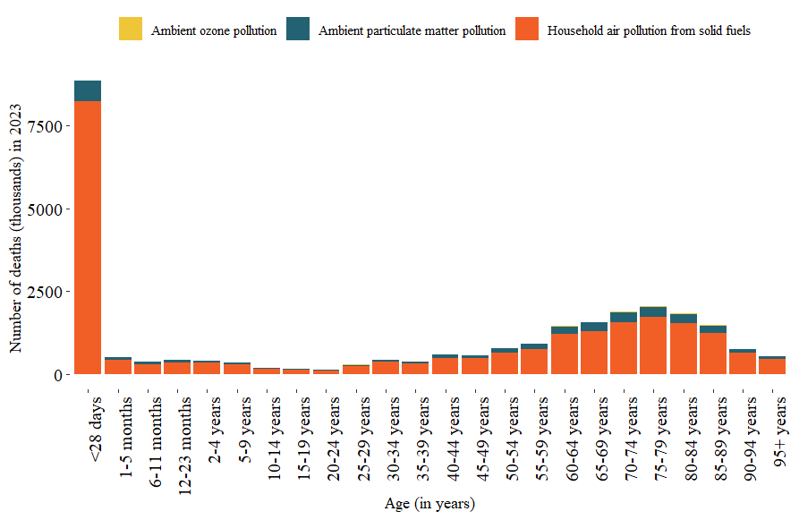
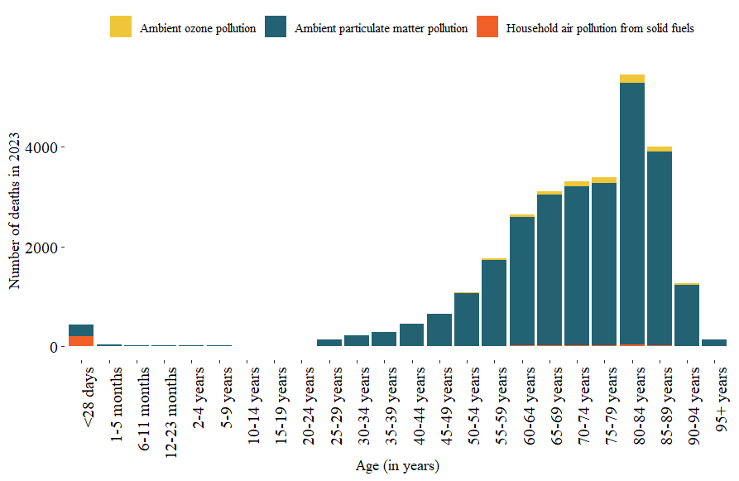
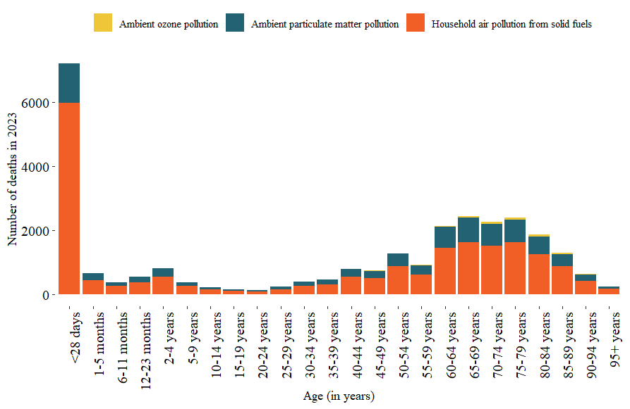
South Africa
Uganda
Morocco
Cameroon

Slide 16

In East, West, Central, & Southern Africa:
2nd
Leading risk factor for deaths in children under 5
32 million
healthy years of life lost due to air pollution
29% of deaths
in newborns within the first month of life
362,000 deaths
in children under 5 years of age

Slide 17
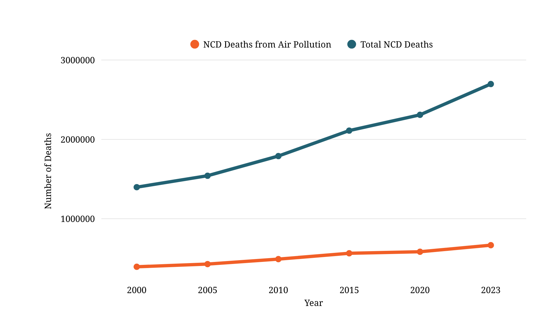
Air pollution is among the leading risk factors for NCDs
1 out 7 air pollution attributable deaths in the African Union were due to noncommunicable diseases
1 in 2 chronic obstructive pulmonary disease (COPD) deaths
1 in 3 ischemic heart disease deaths
1 in 3 stroke deaths
1 in 4 lung cancer deaths
1 in 5 type II diabetes deaths
Increased by nearly 1.3 million deaths since 2000, a 93% increase
Increased by nearly 272 thousand deaths since 2000, a 69% increase

Slide 18
Air pollution has a significant contribution to the NCD burden
 | Dementia | COPD | Type II Diabetes | Ischemic Heart Disease | Stroke | Lung Cancer
Egypt | 39 | 43 | 20 | 31 | 28 | 25
Ghana | 40 | 66 | 20 | 39 | 39 | 33
DRC | 42 | 75 | 20 | 43 | 42 | 40
South Africa | 41 | 72 | 20 | 42 | 41 | 37
Kenya | 40 | 69 | 19 | 40 | 39 | 34
Uganda | 42 | 74 | 20 | 42 | 42 | 39
Cameroon | 41 | 72 | 20 | 42 | 41 | 37
Nigeria | 40 | 69 | 19 | 40 | 39 | 35

Slide 19
Key messages
Air pollution impacts most organ systems; 2nd leading risk factor for deaths worldwide in 2023.
7.9 million global deaths, more than 60% due to exposure to ambient PM_{2.5} ; 1.2 million deaths in the African Union, 65% due to exposure to household air pollution
9 out of 10 air pollution deaths are due to NCDs
Best available estimates on impacts of air pollution on human health
Need to strengthen health data (mortality and morbidity) in LMICs, expand air quality monitoring, especially for pollutants such as ozone
Largest health impacts are observed in LMICs, and among children and older adults.
Opportunity to advance clean air interventions to improve public health and well-being

Slide 20
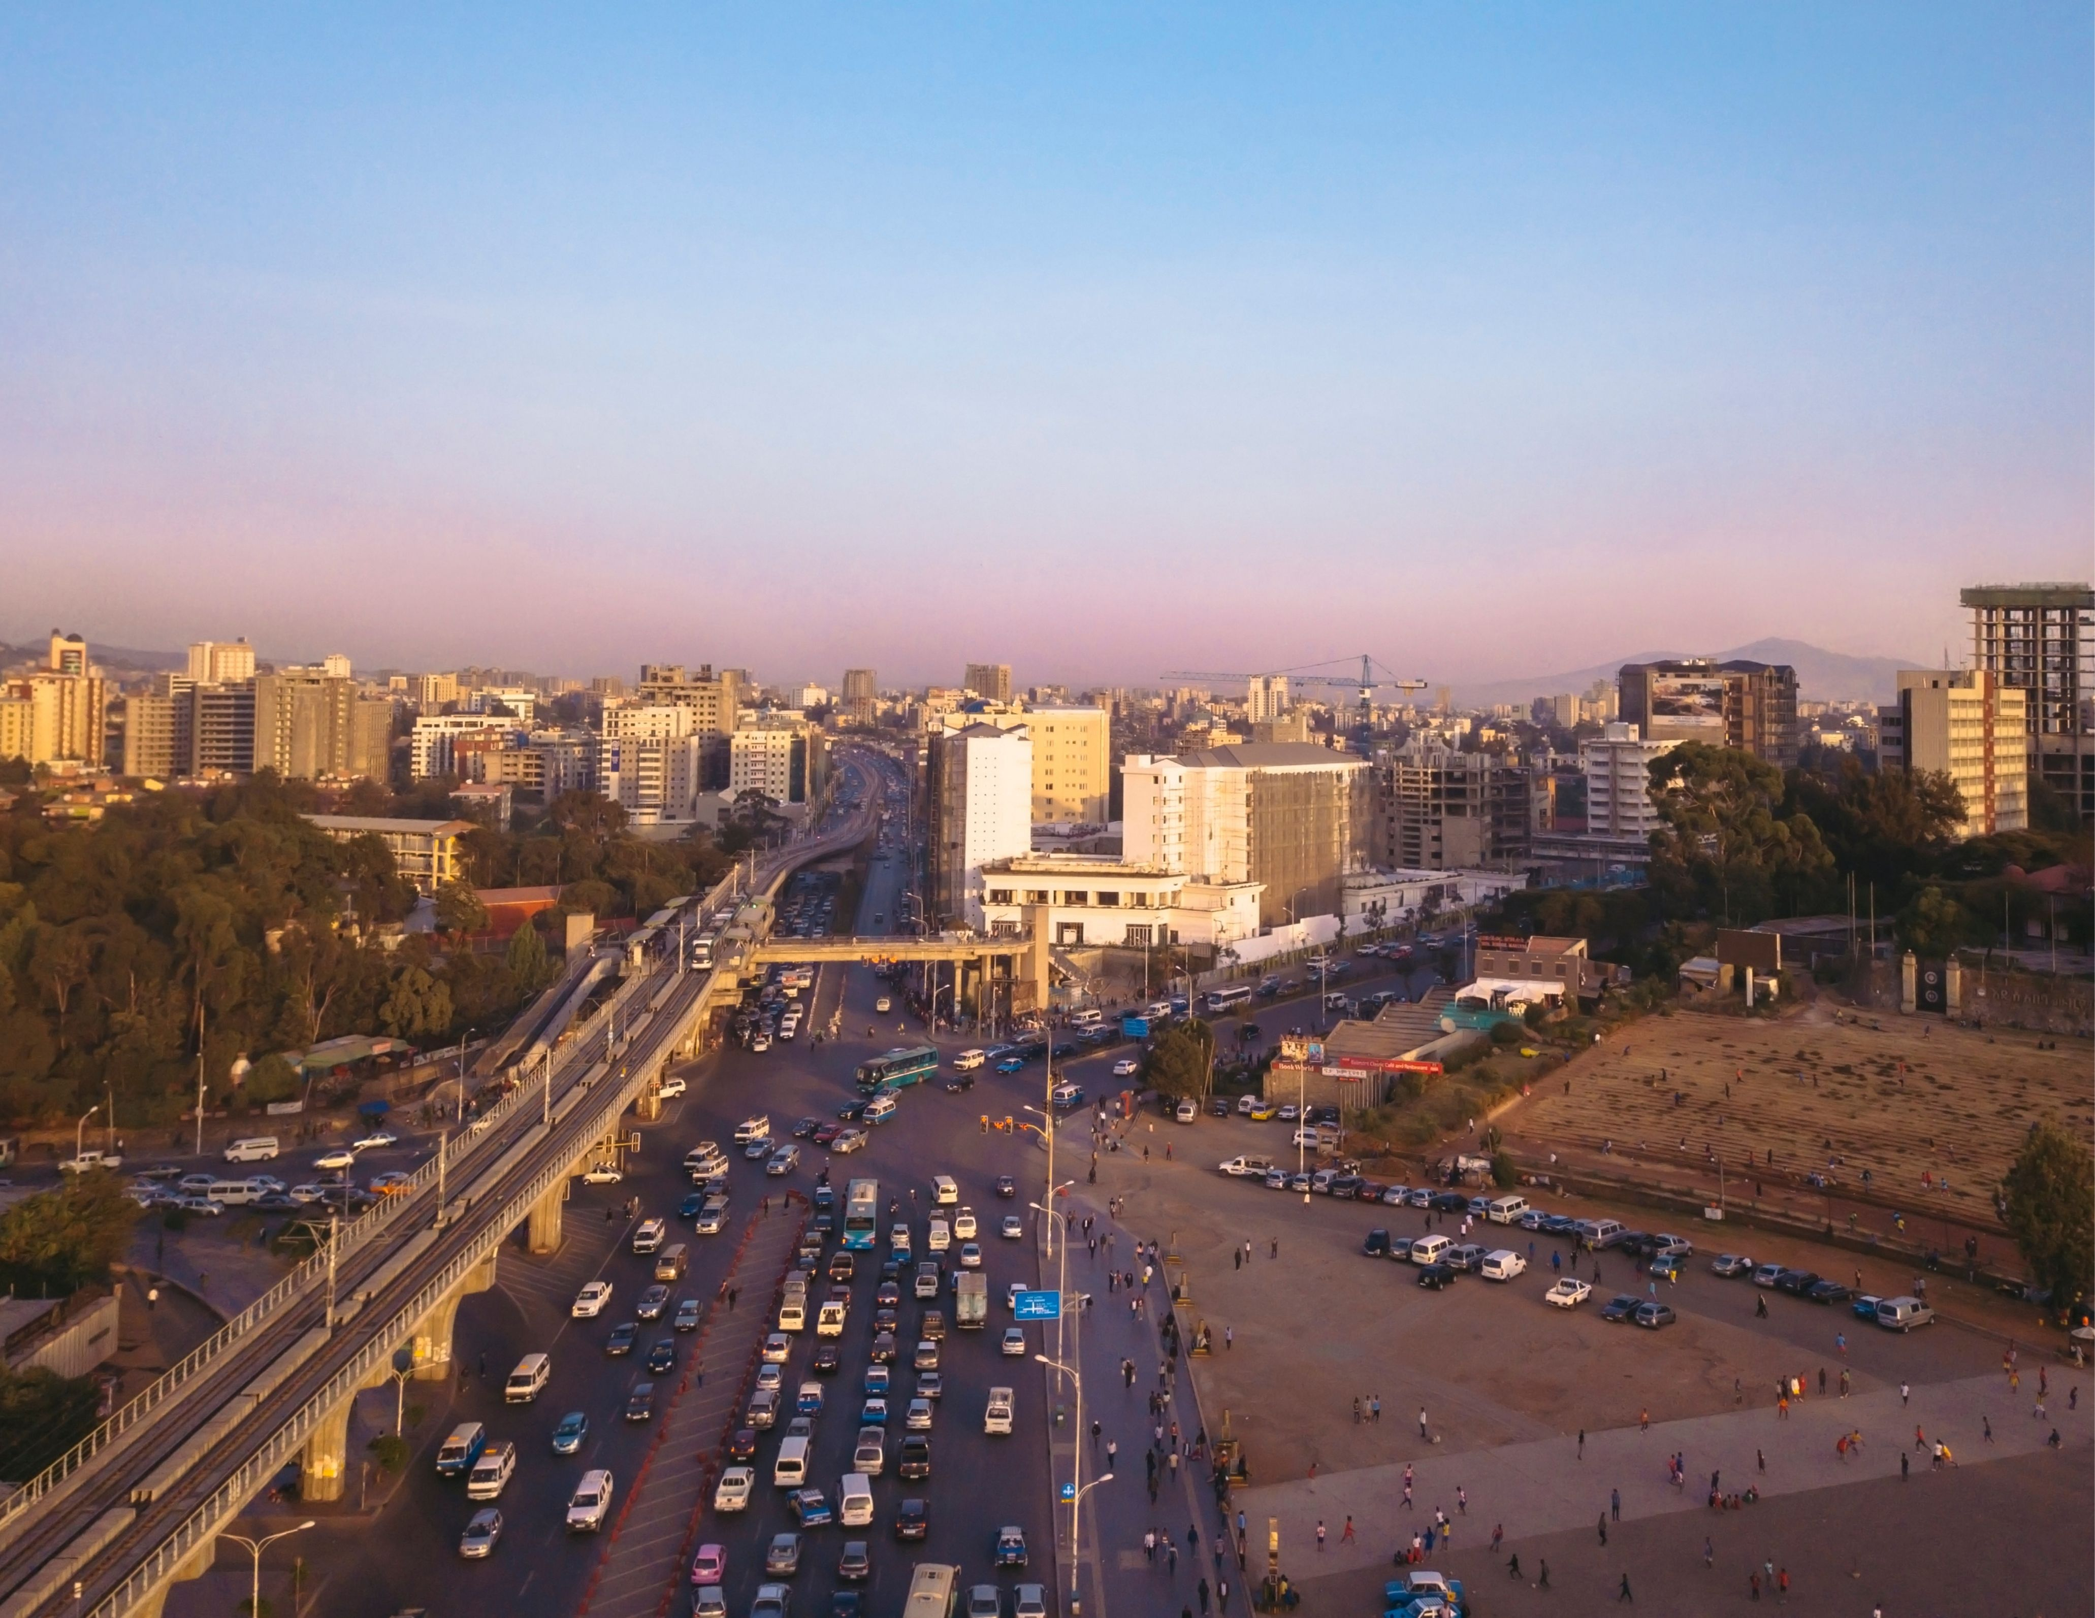
Actions taken to improve air quality — especially in key sectors, including energy, transport, and residential fuel use — can bring health benefits (e.g., fewer hospitalizations, improved birth outcomes, and a reduced number of cancer and dementia cases) while producing healthcare savings and improving quality of life.

Slide 21
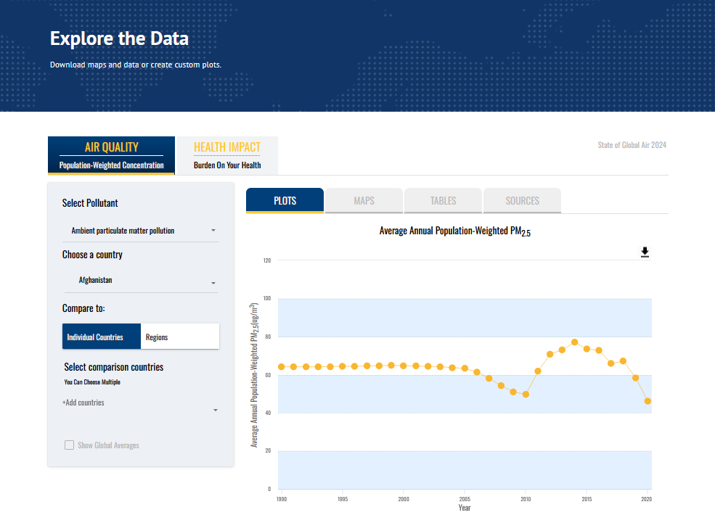
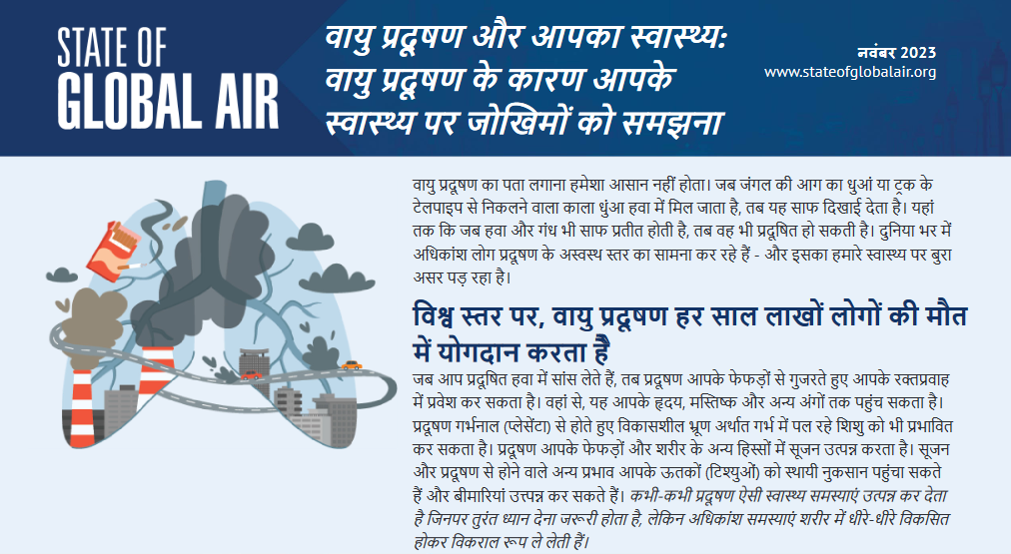

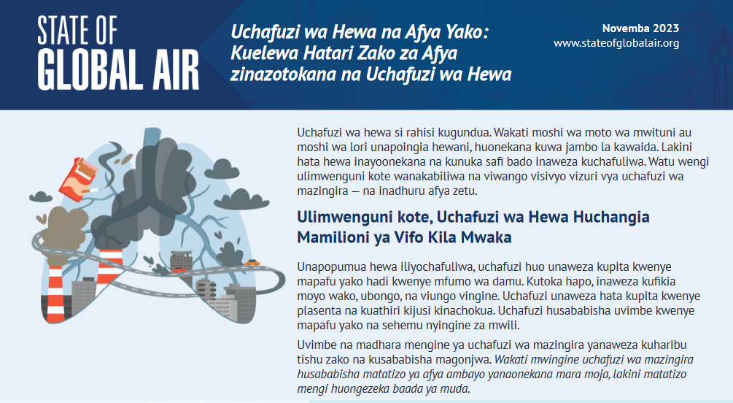
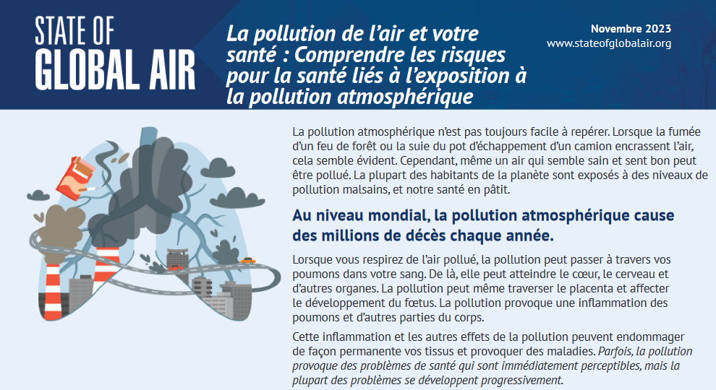
SoGA data and resources
Exposure
  PM_{2.5}, Ozone, Household Air Pollution, Nitrogen dioxide
Health impacts
  Mortality (deaths)
  Disability adjusted life years (DALYs) – healthy life years lost
  Age-standardized death and DALY rates
  Cause-specific % contributions
Data for 1990 to 2023
Factsheets and infographics
Interactive figures
Downloadable data & figures
Resources in English, Français, Kiswahili, Español, हिन्दी

Slide 22


Stay connected!
X @HEISoGA
Youtube @HEISoGA
LinkedIn @State of Global Air
Bluesky @heisoga.bsky.social
Email ppant@healtheffects.org
Website www.stateofglobalair.org

