Slide 1
Kenyatta University westervelt Aerosol Group Nairobi
NBOCHEM
Air Quality Ambient (LCS) Low Cost Sensors Parts and Basic accessories
Design ,Evaluation and Assembly .

Slide 2
(LCS)low cost sensors
References/Station Monitors
Low-Cost Sensors (LCS) are affordable, portable, and ideal for public awareness, community monitoring, and preliminary research.
Reference Monitors are expensive, extremely accurate, and officially used by governments and regulatory bodies for legally accepted air quality data.

Slide 3
(LCS)low cost sensors
References/Station Monitors
Feature | Low-Cost Sensors (LCS) | Reference Monitors
Cost | Very cheap ($10–$300) | Very expensive ($10,000–$100,000+)
Accuracy | Moderate to low | Very high and scientifically accurate
Calibration | Needs frequent calibration | Factory-calibrated and highly stable
Purpose | Community monitoring, awareness, research support | Regulatory monitoring and legal compliance
Maintenance | Low | High, requires trained experts
Power Use | Low | High
Portability | Small, portable | Large, fixed stations
Data Acceptance | Not legally accepted | Legally accepted for air quality standards

Slide 4
AQ Air Quality (LCS) Communication modules.
SIMCOMProvides cellular connectivity (GPRS, LTE) for IoT devices. Manufacturer of modules (e.g., SIM800, A7670) that use SIM cards to connect devices to the internet.
ESP Low-cost microcontrollers with integrated Wi-Fi and Bluetooth. Manufacturer (Espressif Systems) of popular chips (ESP32, ESP8266) used as the main processor for managing IoT projects and communications.

Slide 5
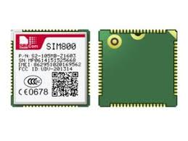
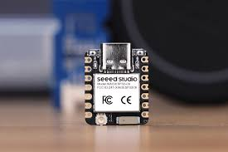
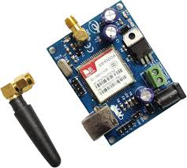
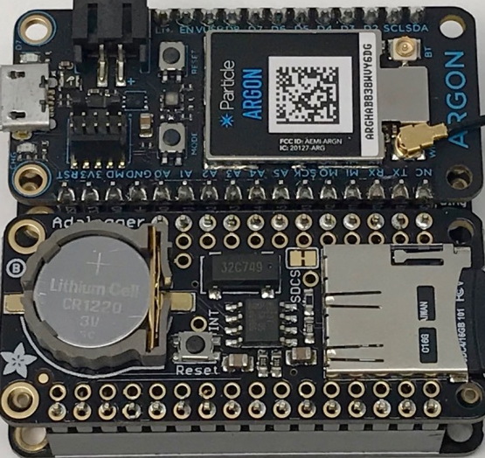
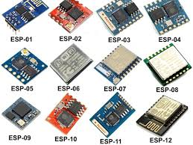
AQ Air Quality (LCS) Communication modules.
ESP Modules
Simcom Modules

Slide 6
(AQ)Factors of Data/files Storage
Key factors to consider.
Date daily logger 30days a month
Months –January to December a year-@folder
Time of data recorded 24hrs concentration.
File type –CSV Files in Fat32- universal storage of data
Storage – USB stick /SD Cards

Slide 7
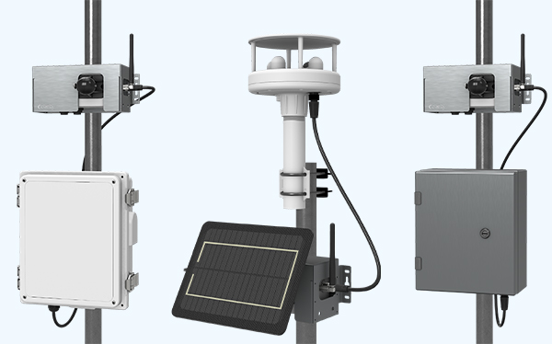
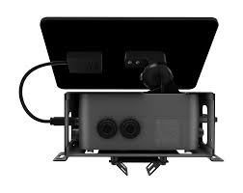
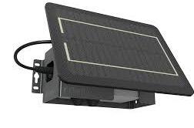
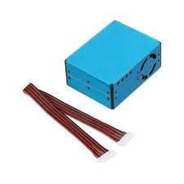
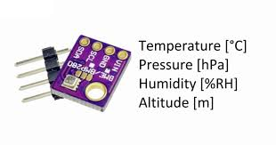
Clarity Node
PMS5003 single Plantower BME280 ESP Board/Cloud Electromechanical Sensors

Slide 8
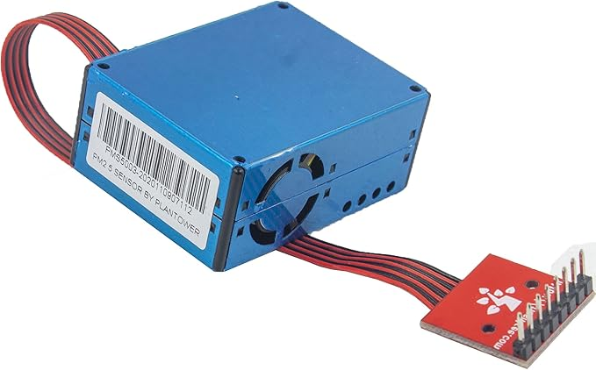
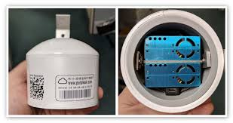
Purple Air
PMS5003 Plantower (2) two Pieces BME280 ESP Board/Cloud

Slide 9
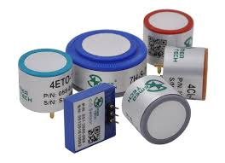
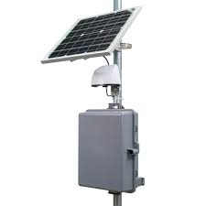
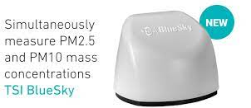
TSI Blue-sky
PMS5003 Single Plantower PCB Board with BME280 ESP Board/Cloud .Electro-Chemical gas sensors

Slide 10
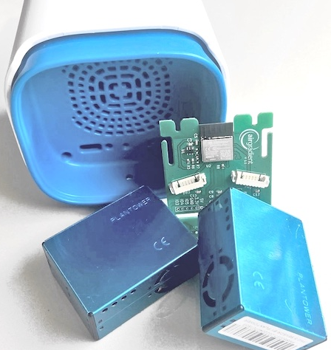
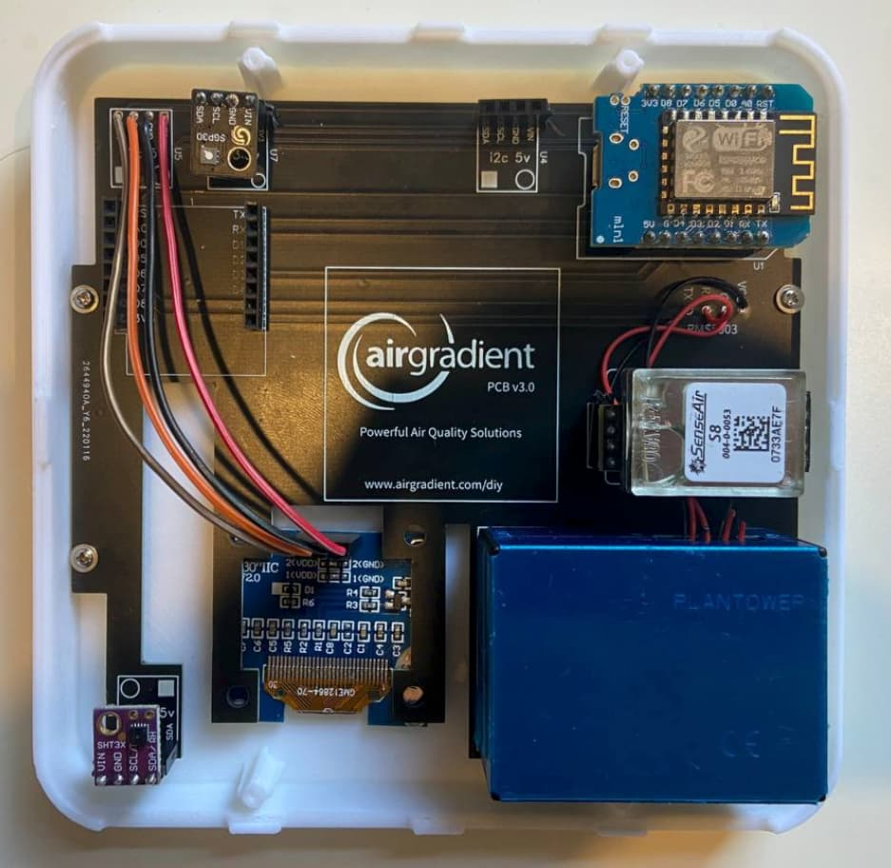
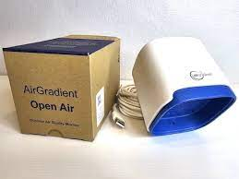
AirGradient
PMS5003 Plantower (2) two Pieces PCB Board with BME280 ESP Board/Cloud

Slide 11
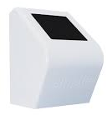
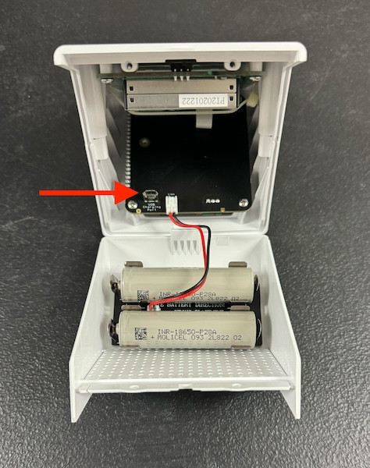
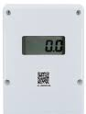
Airnote
PMS5003 Single Plantower PCB Board with BME280 ESP Board/Cloud
Air Particulate Matter (PM1, PM2.5 and PM10)
Temperature
Humidity
Barometric Pressure

Slide 12
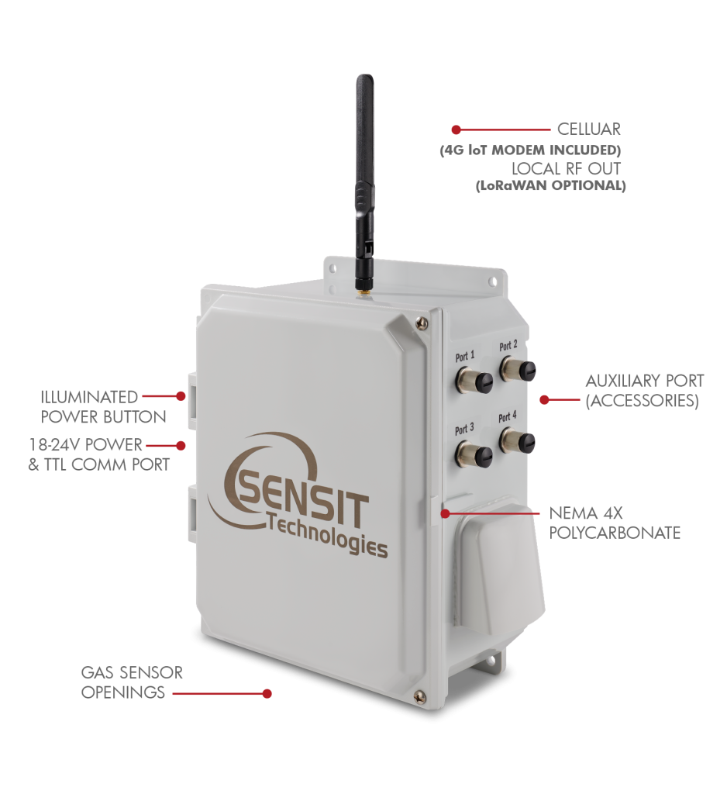
Sensit Ramp
PMS5003 Plantower (2) two Pieces PCB Board with BME280 ESP Board/Cloud .Electromechanical gas sensors.
Standard Sensors
Carbon Monoxide – CO
Carbon Dioxide – CO2
Nitric Oxide – NO
Nitrogen Oxide – NO2
Ozone – O3
Sulfur Dioxide – SO2
Particulate Matter – PM1, PM2.5, PM10
Hydrogen Sulfide – H2S
Ammonia – NH3
Volatile Organic Compounds – VOCs

Slide 13
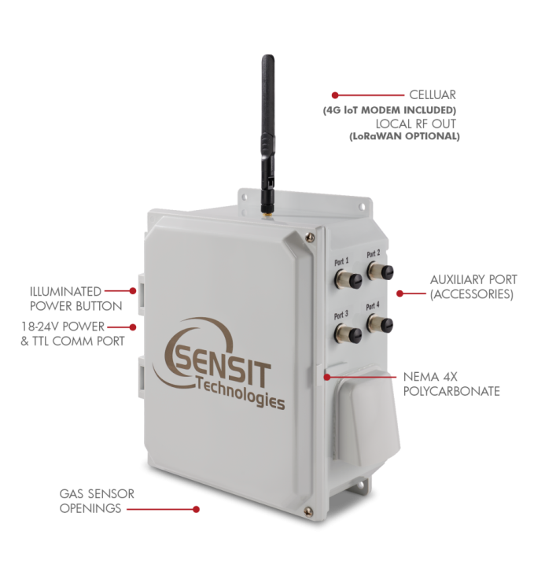
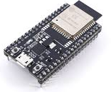
Sensit Ramp

Slide 14
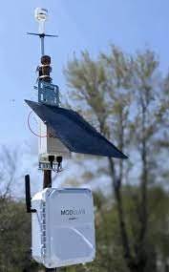
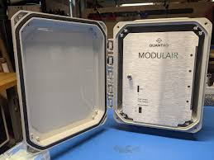
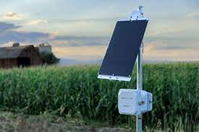
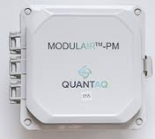
QuantAQ
Modulair & Modulair-PM

Slide 15
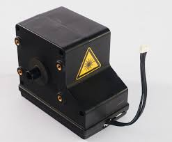
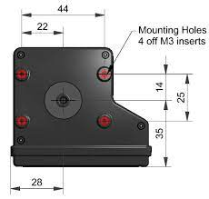
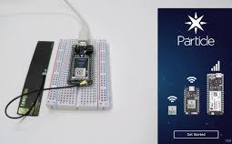
QuantAQ
Modulair & Modulair-PM
Modulair
Fully equipped with machine-learning powered CO, NO, NO₂ and O₃ sensors.
Obtain PM₁, PM_{2.5}, and PM₁₀ estimates as well as number concentrations for particles between 0.35 µm and 40 µm.
Modulair-PM
Obtain PM₁, PM_{2.5}, and PM₁₀ estimates as well as number concentrations for particles between 0.35 µm and 40 µm.

Slide 16
Conclusion .
Key factors developing (LCS)Low Cost Sensor
Sensor Selection & Calibration: Choose accurate sensors; calibrate regularly, especially for specific environments.
Environmental Effects: Mitigate temperature, humidity, and sensor aging impacts with calibration and maintenance.
Data Quality & Reliability: Use validation algorithms to filter out noise and ensure reliable data.
Data Communication & Storage: Enable data transmission (e.g., Wi-Fi, cellular) or local logging for remote access.
Power Management: Use solar or battery backups for off-grid operation, and optimize power usage.
System Integration & Scalability: Design modular systems for easy upgrades and seamless integration with monitoring platforms.
User Accessibility: Ensure ease of use and involve communities for greater data coverage and awareness.
Cost-Effectiveness: Use affordable components and design for low maintenance to support widespread deployment.
These factors support effective, sustainable, and scalable LCS solutions for air quality monitoring across various environments.

