Slide 1
Building a Low Cost Sensor (LCS) AirQuality Data Logger
Project Overview
Creating an Air Quality Data Logger using the PMS5003 sensor to measure PM1.0, PM2.5, in µg/m³ including a BME280 Temp Sensor using Arduino Mega 2560 Rev3 board. The data will be stored on an SD card with timestamps provided by an RTC module. Below is the code for the project, as well as design notes and a breadboard setup guide.

Slide 2
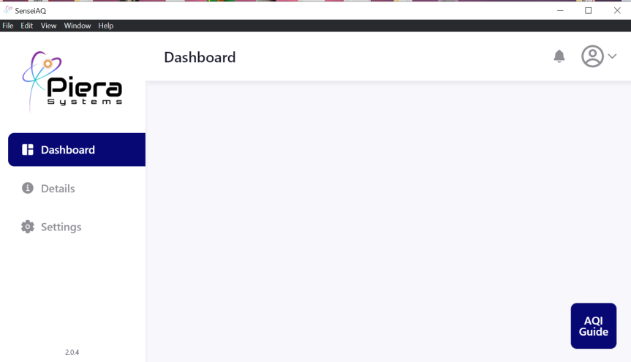
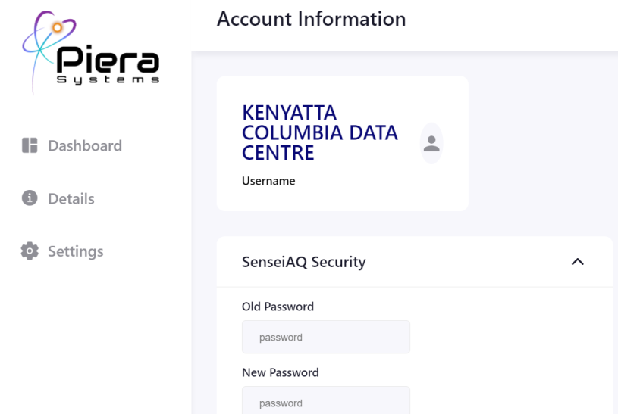
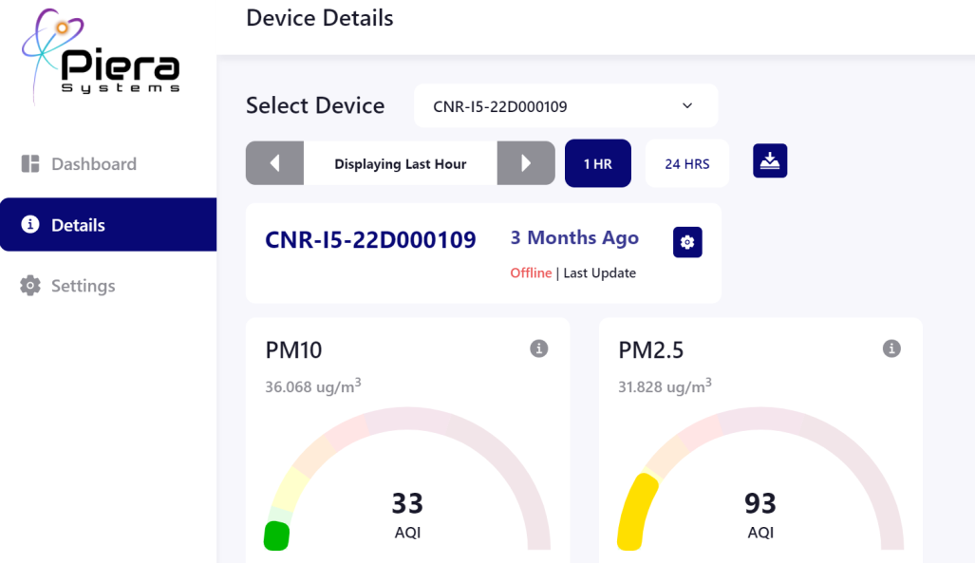
Sensei AQ Software. Piera Sensor.

Slide 3
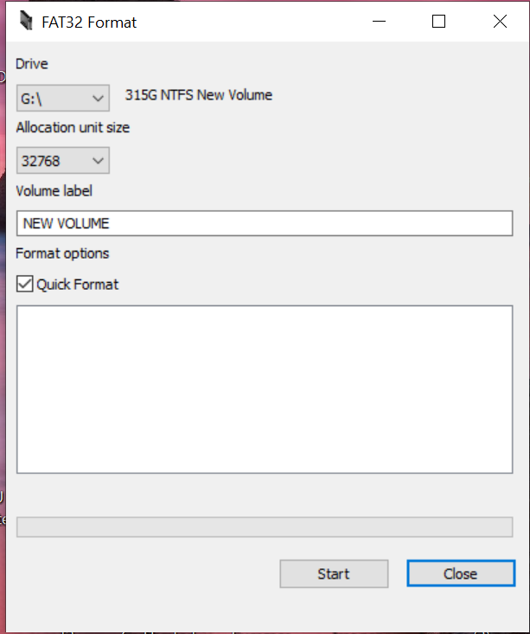
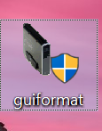
Format SD Card . Open the Guiformat –The next window will open file to format

Slide 4
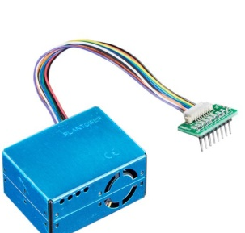
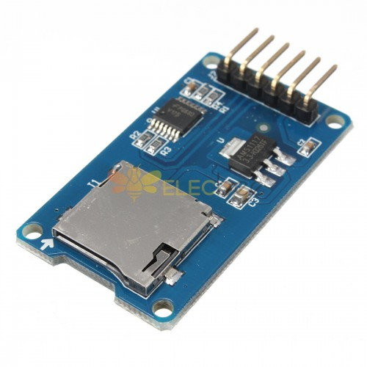
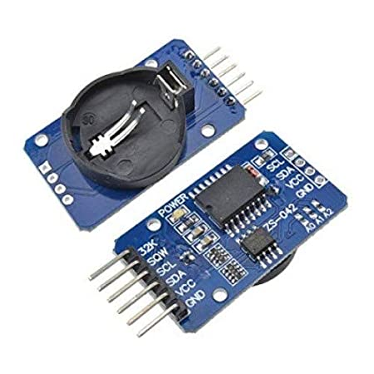
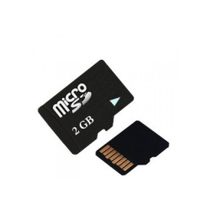
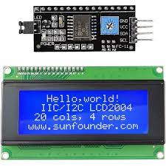
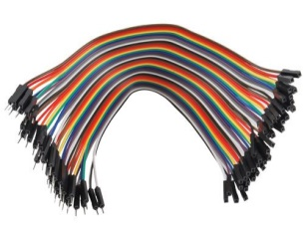
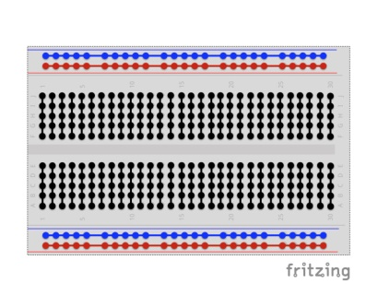
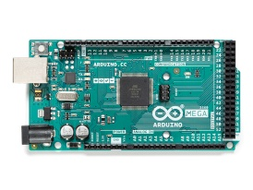
Arduino Parts and Modules

Slide 5
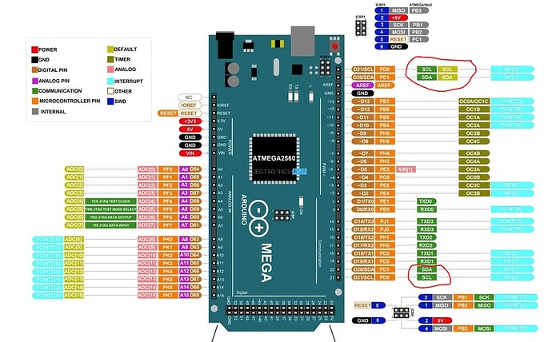
Arduino Mega Rev3

Slide 6
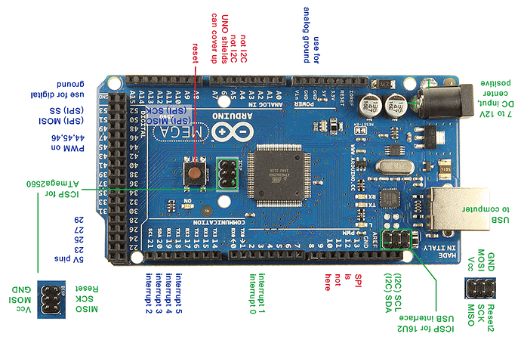
Arduino Mega Rev3 PINOUT

Slide 7
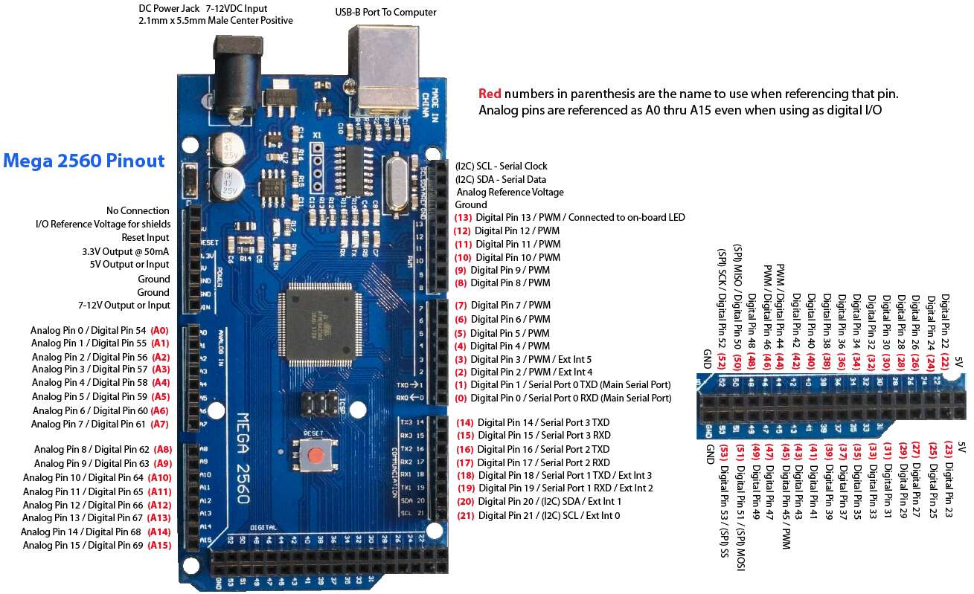
Arduino Mega Rev3 Pinout Circuit Flow

Slide 8
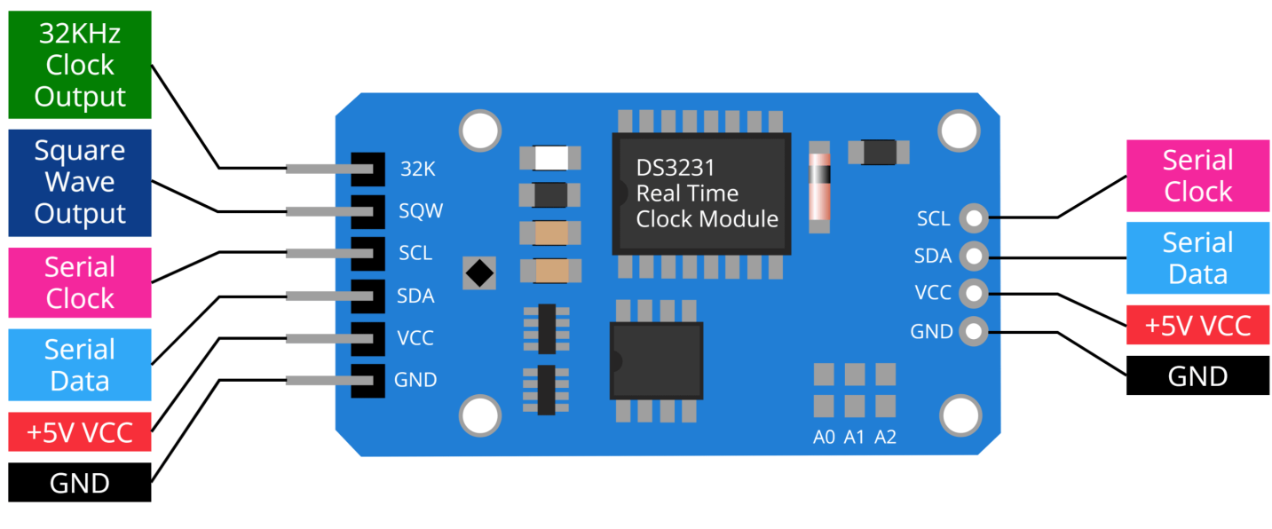
Circuit Pinout for (RTC)connection to Arduino Board
(RTC) Module Arduino Board
VCC 5V on Arduino
GND GND on Arduino
SDA A4 on Arduino
SCL A5 on Arduino

Slide 9
Interfacing DS1302 Real Time Clock(RTC) Module with Arduino Board
he real-time clock/calendar provides seconds, minutes, hours, day, date, month, and year information. The end of the month date is automatically adjusted for months with fewer than 31 days, including corrections for leap year. The clock operates in either the 24-hour or 12-hour format with an AM/PM indicator.

Slide 10
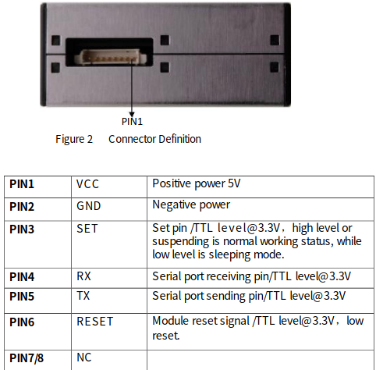
PMS5003 Plantower

Slide 11
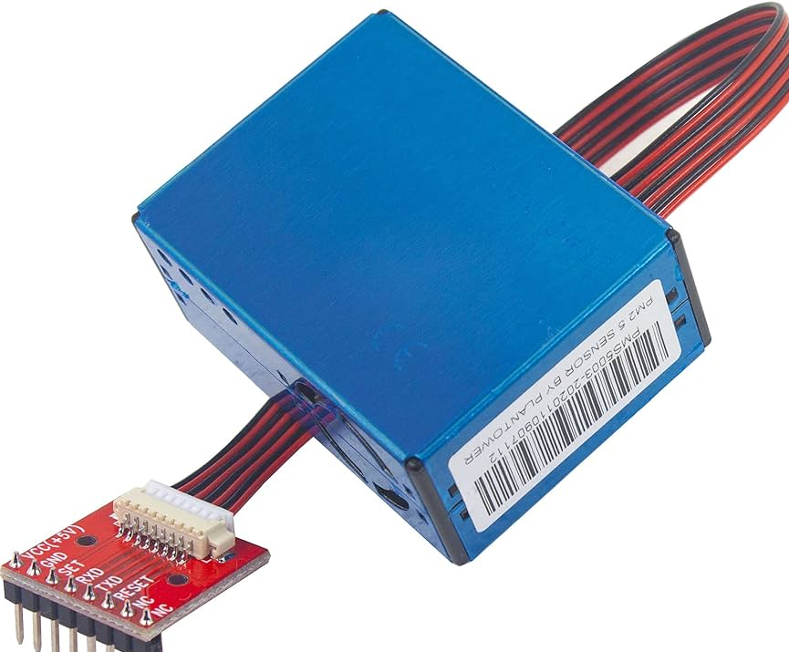
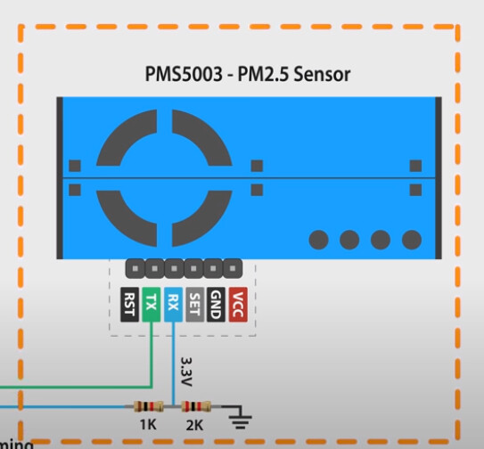
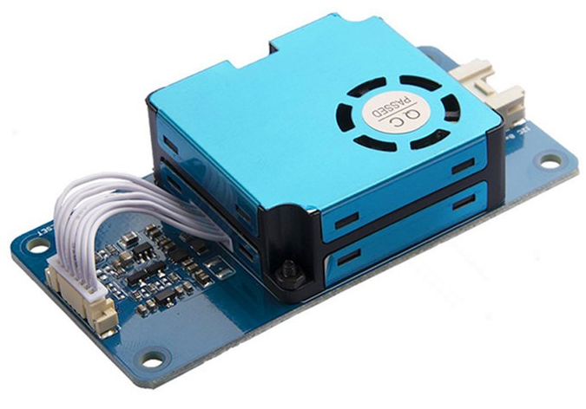
Interfacing PMS5003 PM2.5 Air Quality Sensor with Arduino Board.

Slide 12
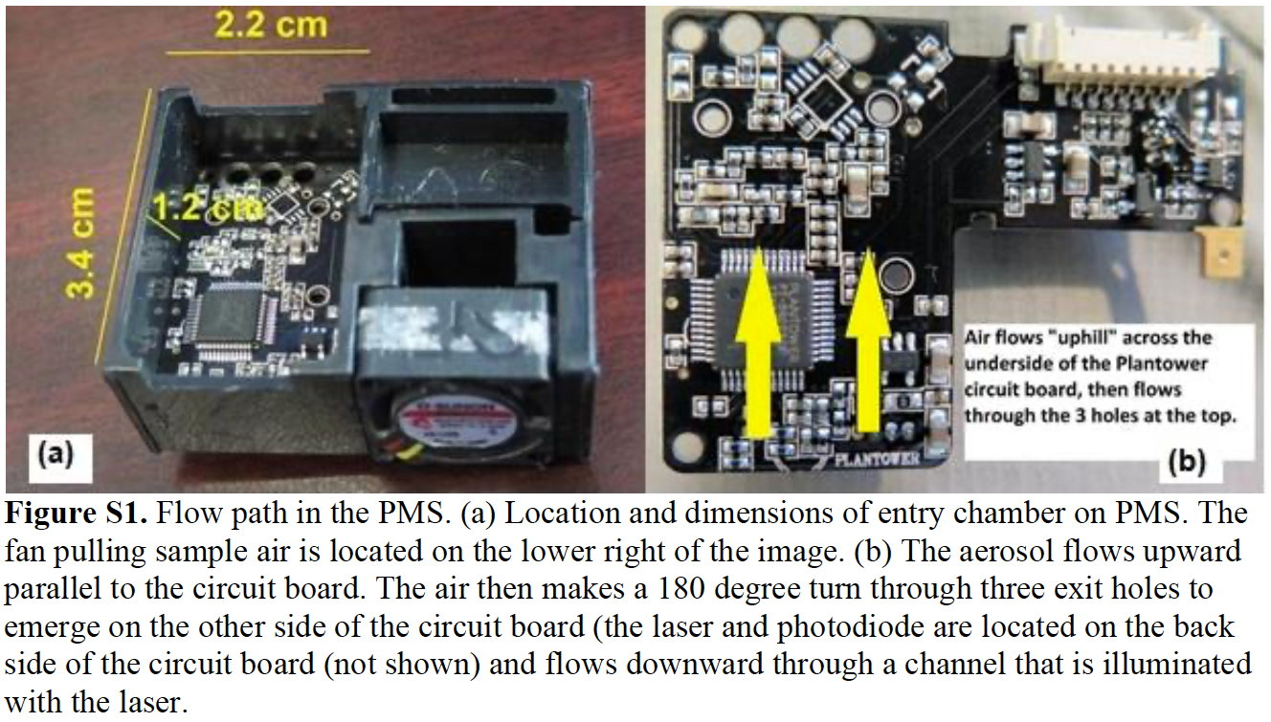
PMS5003 Plantower, Circulation of air

Slide 13
Interfacing Micro SD Card Module with Arduino
VCC pin provides power to the module and should be connected to the Arduino’s 5V pin.
GND is a ground pin.
MISO (Master In Slave Out) is the SPI output from the microSD card module.
MOSI (Master Out Slave In) is the SPI input to the microSD card module.
SCK (Serial Clock) pin accepts clock pulses from the master (an Arduino in our case) to synchronize data transmission.
CS (Chip Select) pin is a control pin that is used to select one (or a set) of slave devices on the SPI bus.

Slide 14
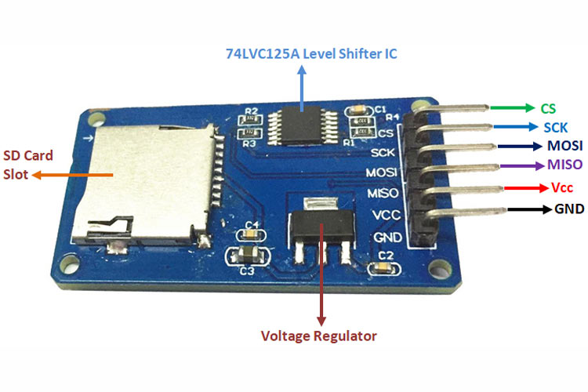

Slide 15
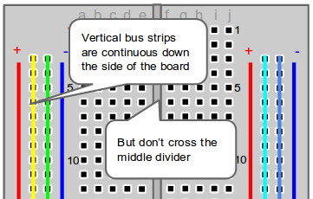
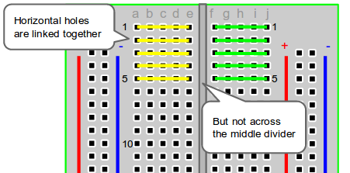
Parts of a Breadboard
Breadboards are composed of three (3) parts:
Horizontal Rows (yellow and green lines)
Vertical Columns
Power (red) /Ground (blue) Rails
The middle divider separates both sides. So if wire power and ground to one side of the breadboard, you will also need to power/ground the other side.

Slide 16
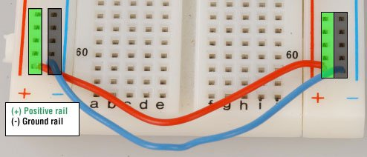
Configure Your Power Source
Next, let’s configure the power source. There are two sets of power rails that run along the edges of the breadboard. Rails are marked black/blue for ground (-) and red for power (+).
Each rail is independent of another, so you will have to connect the left positive rail to the right positive rail and the left negative rail to the right negative rail to supply power to both sides of the breadboard.
Here’s a visual of how to configure power to the breadboard:

Slide 17
Project Overview
This air quality data logger captures particulate matter (PM1.0, PM2.5, PM10) readings from the PMS5003 sensor and environmental data (temperature and humidity) from the BME280 sensor. The data is logged onto an SD card with timestamps provided by the DS3231 RTC module. The 20x4 I2C LCD display shows real-time readings for easy monitoring. This setup is designed for consistent data logging and real-time environmental monitoring. The system updates every two seconds, providing a live display and regular data logging for air quality tracking.
Components Required
Arduino Mega 2560 Rev3
PMS5003 Air Quality Sensor
SD Card Module
RTC (Real-Time Clock) Module (e.g., DS3231)
Breadboard and Jumper Wires
Power Supply
Arduino Code

Slide 18
SD Card Module:
CS on SD Card Module → Pin 10 on Arduino Mega
SCK on SD Card Module → Pin 52 on Arduino Mega
MOSI on SD Card Module → Pin 51 on Arduino Mega
MISO on SD Card Module → Pin 50 on Arduino Mega
VCC on SD Card Module → 5V on Arduino Mega
GND on SD Card Module → GND on Arduino Mega
LCD Display (I2C, 20x4):
SDA on LCD → SDA (Pin 20) on Arduino Mega
SCL on LCD → SCL (Pin 21) on Arduino Mega
GND on LCD → GND on Arduino Mega
VCC on LCD → 5V on Arduino Mega

Slide 19
Connect the RTC VCC pin to 5V on the Arduino.
Connect the GND pin to GND on the Arduino
.Connection VCC Pin to 5V on the Arduino Board.
Connect the SDA pin to SDA on the Arduino (pin 20).
Connect the SCL pin to SCL on the Arduino (pin 21).
BME280 Sensor (connected via I2C):
SDA on BME280 → SDA (Pin 20) on Arduino Mega
SCL on BME280 → SCL (Pin 21) on Arduino Mega
GND on BME280 → GND on Arduino Mega
VCC on BME280 → 3V or 5V on Arduino Mega, depending on the sensor's

Slide 20
For the project involving the PMS5003 sensor, SD card module, and RTC module on an Arduino Mega 2560, you will need the following libraries. These libraries are widely recommended and commonly used for their respective modules
https://support.arduino.cc/hc/en-us/articles/360019833020-Download-and-install-Arduino-IDE
Adafruit Sensor Library: General sensor library required by other specific sensor libraries.
Installation: Go to Sketch > Include Library > Manage Libraries, search for "Adafruit Unified Sensor", and install it.
Adafruit PMS5003 Library: For interfacing with the PMS5003 sensor.
Installation: This library can be installed manually from Adafruit's GitHub repository.
GitHub Repository: Adafruit PM25 AQI Library

Slide 21
RTClib: For using the RTC module (DS3231).
Installation: Go to Sketch > Include Library > Manage Libraries, search for "RTClib", and install it.
GitHub Repository: RTClib by Adafruit
SD Library: For using the SD card module.
Installation: This library comes pre-installed with the Arduino IDE. You can find it under Sketch > Include Library > SD.
Installation Steps
Open Arduino IDE.
Go to Sketch > Include Library > Manage Libraries.
Search and install the required libraries:
For Adafruit Unified Sensor: Search for "Adafruit Unified Sensor" and install.
For RTClib: Search for "RTClib" and install.
Manually Install Adafruit PMS5003 Library:
Download the ZIP: From the Adafruit PM25 AQI Library.
Install from ZIP: Go to Sketch > Include Library > Add .ZIP Library, and select the downloaded ZIP file.
These libraries will help you efficiently manage the sensors and modules for your Air Quality Data Logger project

Slide 22
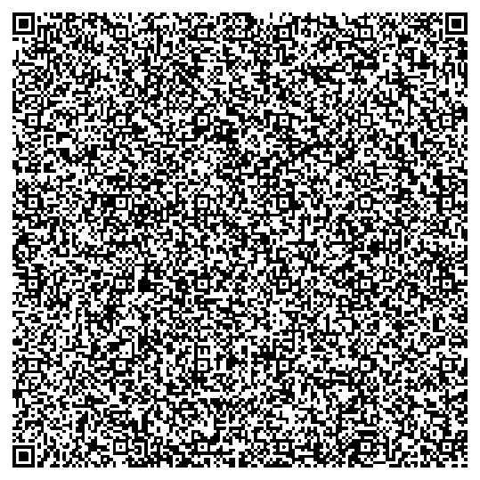
QR Code to upload using (IDE) downloads this code and upload using IDE

Slide 23
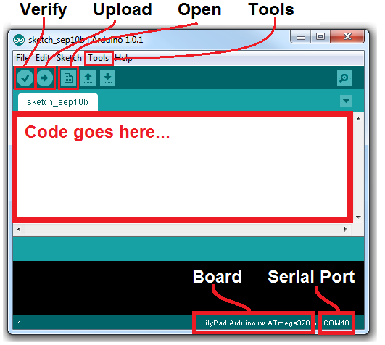
Uploading an Arduino Sketch
Install Arduino
You'll need to have Arduino installed from this point forward. You can grab the most recent version of the software from Arduino's downloads page. Check out our Arduino installation guide (Windows, Mac, or Linux) for help installing the IDE. :

Slide 24
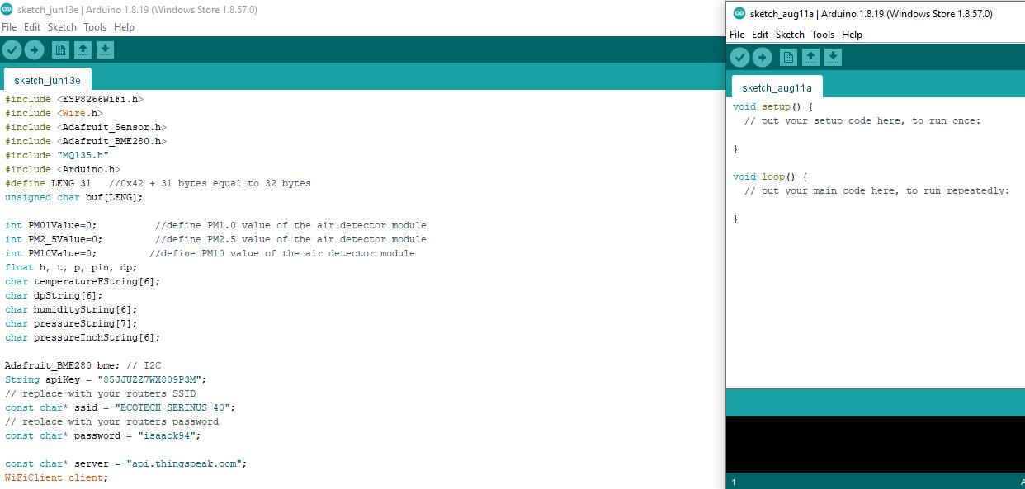

Slide 25
I shall provide code for all interfacing components in the slides .
Thank you for your time
I look forward for everyone developing their own Air Quality Sensor to improve air Quality in your communities and our working zones/Areas .
Thank you for your time…

